Slide 1
Урок английского языка 9 класс Let the music begin….
Учитель английского языка
Расторгуева Дарья Юрьевна
МБОУ «Средняя школа № 10»
Г. Петропавловск-Камчатский

Slide 2
You should put the letters into correct order.
S,L,E,E,T,N,U,S
L,A,A,U,N,N
T,I,N,N,S,E,T,M,R,U
D,I,N,G,R,E,C,O,R
M,U,B,L,A
D,O,L,I,
C,I,T,R,O,M,N,A
T,H,R,H,Y,M
Z,J,Z,A
R,O,C,N,D,U,C,T,O

Slide 3
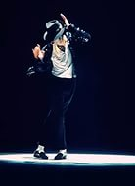
Check up your work
TUNELESS
ANNUAL
INSTRUMENT
RECORDING
ALBOM
IDOL
ROMANTIC

Slide 4
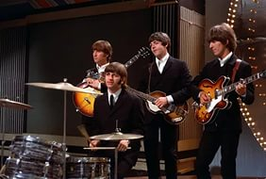
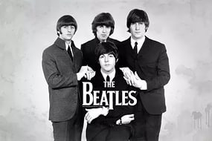
Sing the song
In the town where I was born Lived a man who sailed to sea And he told us of his life In the land of submarines So we sailed up to the sun Till we found the sea of green And we lived beneath the waves In our yellow submarine We all live in a yellow submarine Yellow submarine, yellow submarine We all live in a yellow submarine Yellow submarine, yellow submarine And our friends are all aboard Many more of them live next door And the band begins to play We all live in a yellow submarine Yellow submarine, yellow submarine We all live in a yellow submarine Yellow submarine, yellow submarine As we live a life of ease Everyone of us has all we need Sky of blue and sea of green In our yellow submarine We all live in a yellow submarine Yellow submarine, yellow submarine We all live in a yellow submarine Yellow submarine, yellow submarine We all live in a yellow submarine Yellow submarine, yellow submarine We all live in a yellow submarine Yellow submarine, yellow submarine

Slide 5
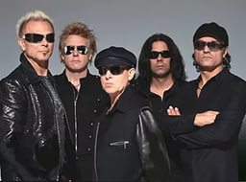
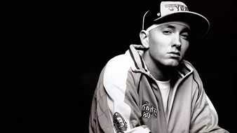
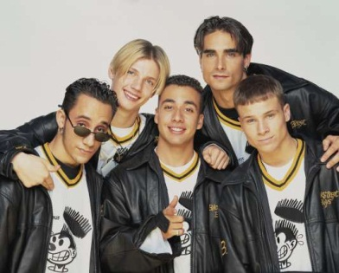
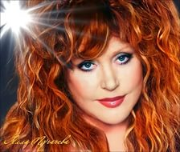
You should match the name with each picture.
Alla Pugacheva a g f
The Spice Girls
Fall out Boy b c h
Britney Spears
The Beatles
Backstreet Boys
Eminem d
Scorpions i
Valeria j
Jenifer Lopez
Michel Jackson e k

Slide 6
Keys
1 –e
6 - i
2 – g 7 - c
3-k 8 - b
4- f 9 - h
5- d 10 - a

Slide 7
Pair work
You are talking about different kind of music. Make up a dialogue using vocabulary.

