Slide 1
Why do people travel?

Slide 2
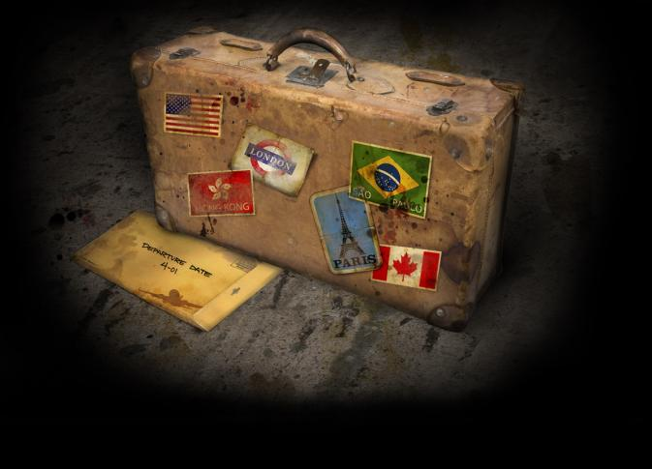
He who returns from a journey is not the same as he who left.

Slide 3
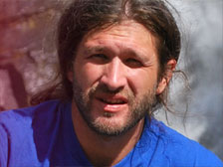
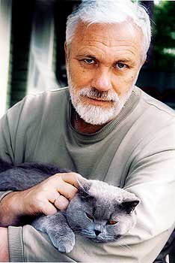
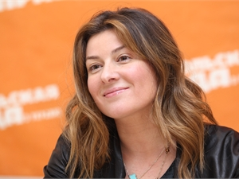
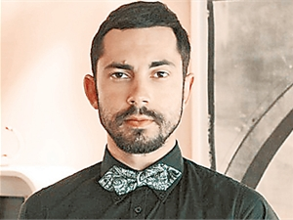
Job

Slide 4
STUDENTS’ EXCHANGE

Slide 5
religion beliefs

Slide 6
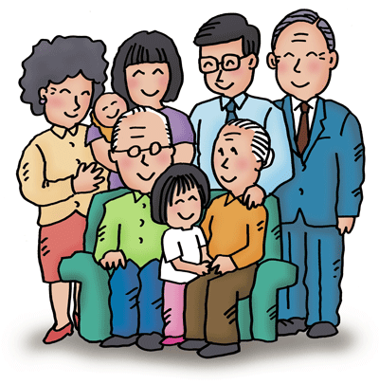
relatives

Slide 8
Highlighted verbs
Collapse(d)
Slip(ped)
Weigh(ed)
Plead(ed)
Hand(ed)
Well(ed)
Рухнуть, развалиться Соскользнуть, Подсунуть Весить Умолять, просить Передавать, вручать Наворачиваться

Slide 9
Cinquain .5 line poem
1st line - 1 word (a noun)
2nd line - 2 adjectives that describe line 1
3rd line – 3 verbs related to line 1
4th line - 4 words that describe line 1
5th line – 1 word (a noun). Synonym to line 1.

Slide 10
Example of cinquain
Travelling
Interesting exiting
Swim sleep eat
Travelling is very good
Sea

Slide 11
Self assessment card
I can… | guess the topic of the lesson | Speak on the topic “Why do people travel?” | make up goals of the lesson | understand the text | make a cinquain and summarize
Easy
Ok
Need help

Slide 12
Thank you for your work!

