Slide 1
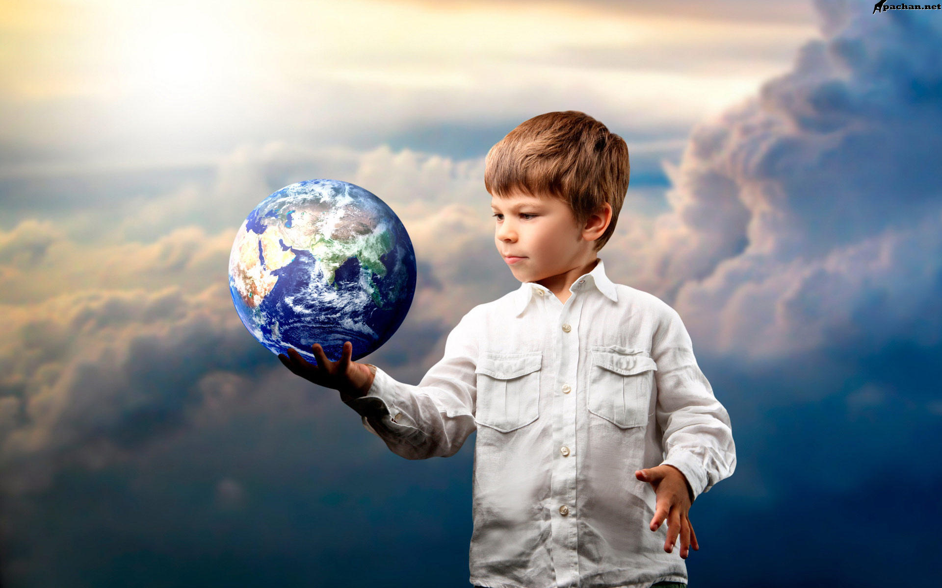
done by Kamagaeva ulyana vladimirovna
English Lesson

Slide 2
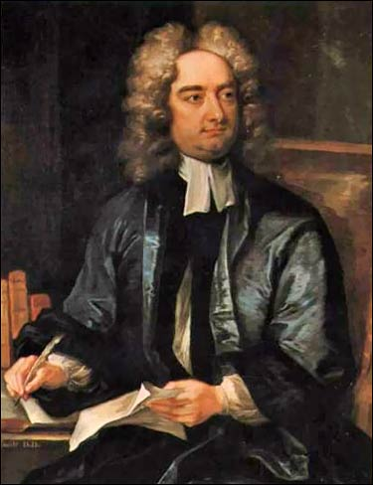

Slide 3
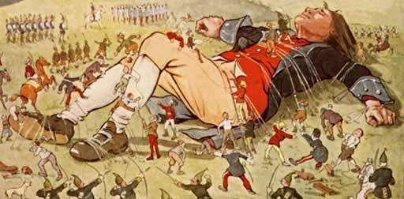
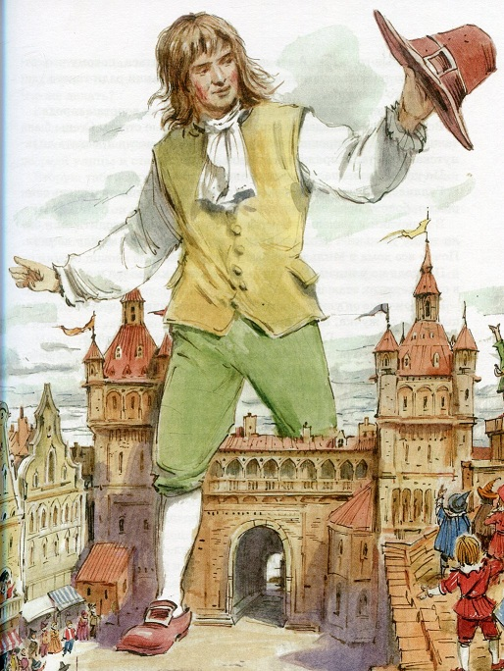
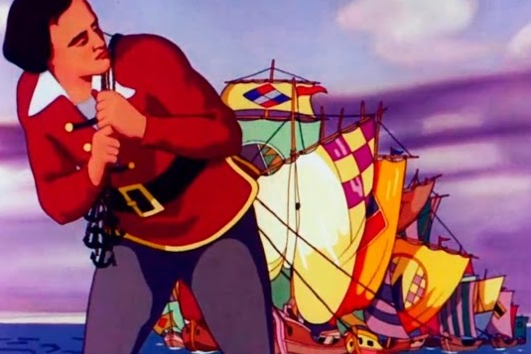

Slide 4
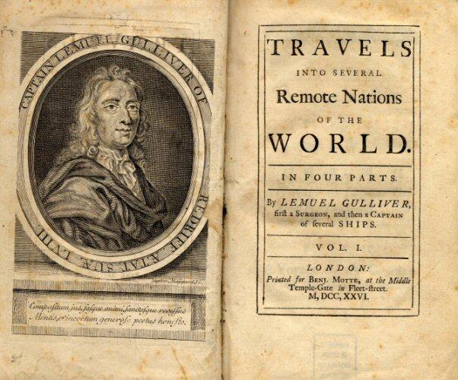
Jonathan swift 30 November 1667 – 19 October 1745
Travels into Several Remote Nations of the World, in Four Parts. By Lemuel Gulliver, First a Surgeon, and then a Captain of several Ships

Slide 5
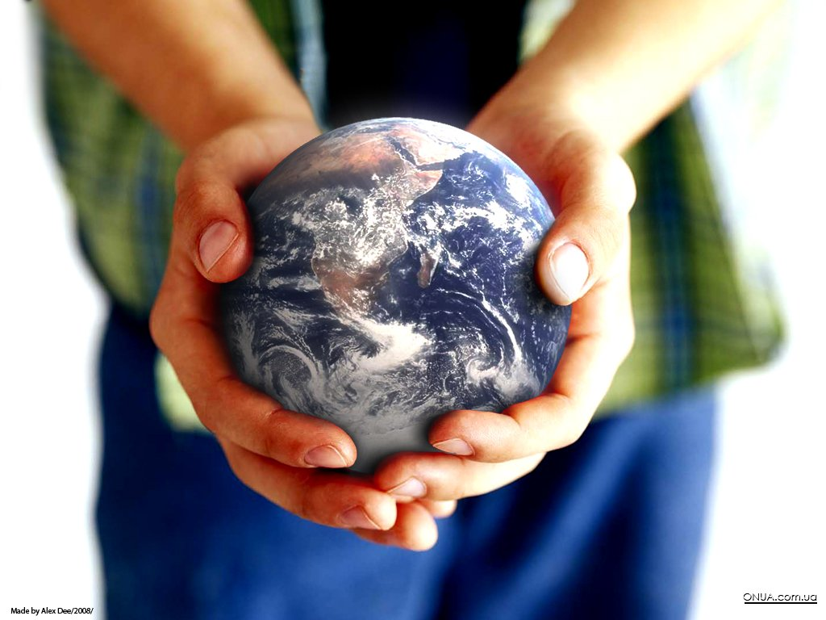
Reading gulliver’s travels
aim: you’ll be able to speak what you should do to save our world

Slide 6
Phonetic exercise
A creature A human being Envious Greedy To get along with each other To understand each other To receive information To tell lies Successful | to say things that are not true wishing that you had what someone else has wanting a lot more food, money, etc, that you need to know the meaning of something that someone says a man, a woman, a child to support an idea or to agree with someone’s opinion any large or small thing that can move To get something that someone has given or sent to you Having the effect or result you intended

Slide 7
Checking homework
Gulliver’s master didn’t know 3 things:
what meant telling lies;
why people fought;
the meaning of the word “soldier”

Slide 8
Task 1
Card 1 1. We use language in this country in order to … 2. We fight for many reasons … a) fight wars and tell lies? b) understand each other and give and receive information. c) sometimes because the enemy isn’t strong enough, sometimes because the neighbors want the things we have.
Card 2 3. His orders are to kill as many people as he can though … 4. With guns and bullets and gunpowder we can … a) destroy a thousand ships, a hundred cities, and twenty thousand men. b) than making war or making money. c) they never hurt him.
Card 3 5. Why do we humans so often … 6. Peace and truth began to seem more important … a) destroy a thousand ships, a hundred cities, and twenty thousand men. b) than making war or making money. c) fight wars and tell lies?

Slide 9
Case-study
CASE 1 Why was there no word which means “telling lies” in the fairytale country? Can people live without telling lies? Do you often lie? Is it bad to tell lies?
CASE 2 Were there any wars in the fairytale country? Is it possible to avoid (избегать) wars in our world? Why? Why do people start wars?
CASE 3 Would you like to live on the island with Houys? Why? Would you like our world to become similar to theirs?

Slide 10
What can people do to save the world
People should:
1)
2)
3)
4)
5)
People should not:
1)
2)
3)
4)
5)

Slide 11
What you would do to improve the world
To improve the world I would:
1)
2)
3)
4)
5)

Slide 12
reflection
Answer the questions:
What have you learnt today?
Was the lesson interesting to you?
What mark can you give to yourself?

Slide 13
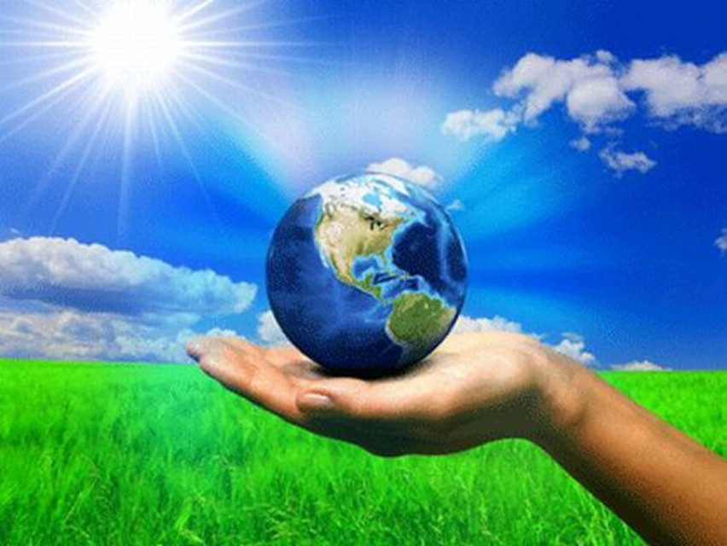

Slide 14
hometask
p.51 ex.36
Make a mini-project “A Perfect World”. Express your opinion using the words and phrases from the lesson. Write down your proposals how to make the world better. Represent your project to the group.

Slide 15
resources
https://en.wikipedia.org/wiki/Jonathan_Swift
https://ru.wikipedia.org/wiki/Путешествия_Гулливера#/media/File:Gullivers_travels.jpg
http://img1.liveinternet.ru/images/attach/c/7/125/53/125053169_svift.jpg
https://yandex.ru/images/search?text=картинки

