Slide 1
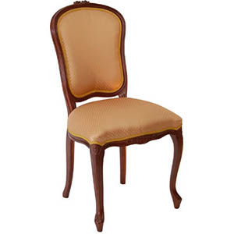

Slide 2
a chair

Slide 3
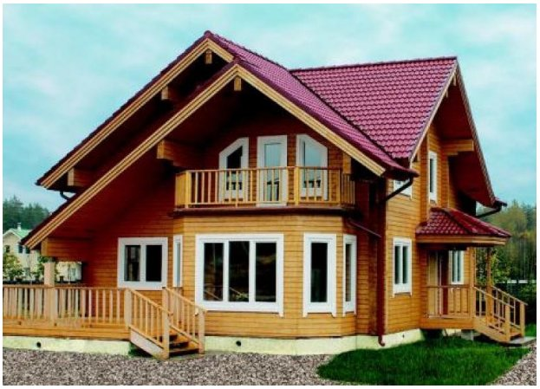

Slide 4
a house

Slide 5
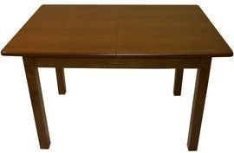

Slide 6
a table

Slide 7
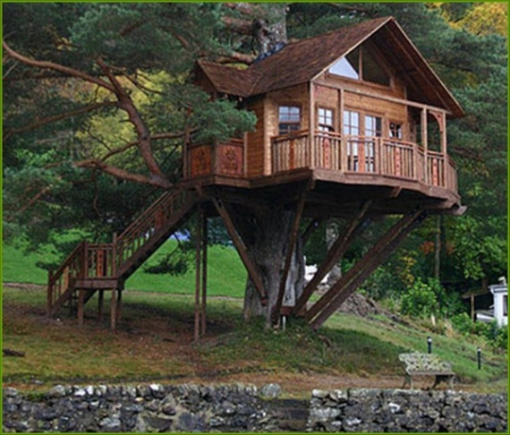

Slide 8
a tree house

Slide 9
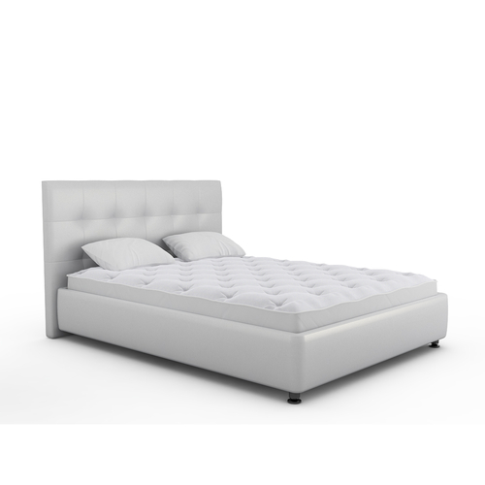

Slide 10
a bed

Slide 11
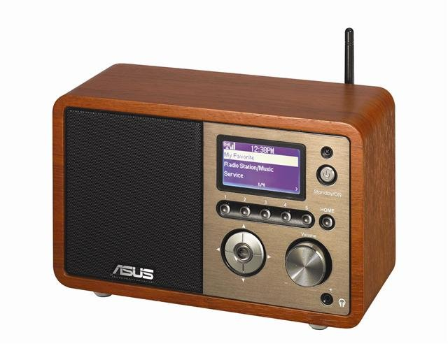

Slide 12
a radio

