Slide 1
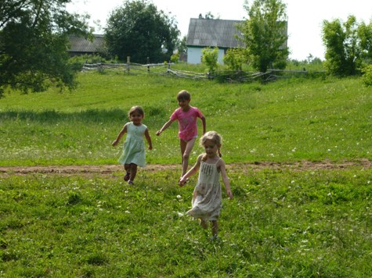
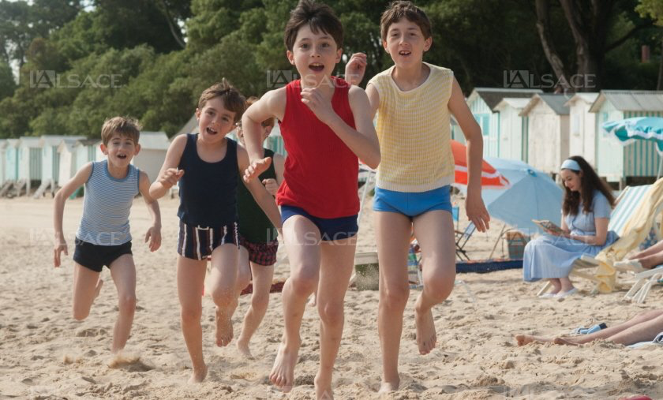
HOLIDAYS ARE OVER

Slide 2
Summer brings us nice warm sun
For swimming, fishing, and lots of fun;
For finding seashells in the sand;
For sunbathing to get a tan;
To do all these things and more
At the beach and at the seashore.

Slide 3
ran
swam
went
met
read
was
saw
watched
visited
played

Slide 4
Dictation
Last summer was very nice. Tom went to his country house near London.
He went there with his parents. He did a lot: ran, swam in the river and helped about the house.

