Slide 1


Slide 2
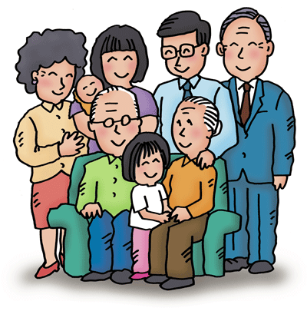
My family!

Slide 3
Our Aims:
to revise vocabulary on Family;
to train the verb can;
to train skills of oral speech and reading comprehension;
to train your memory, attention.

Slide 4
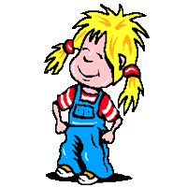
This Is My Family
This is the father, kind and true.
This is the mother who cares for you.
This is the brother so big and tall.
This is the sister who plays with her ball.
Repeat after me.

Slide 6
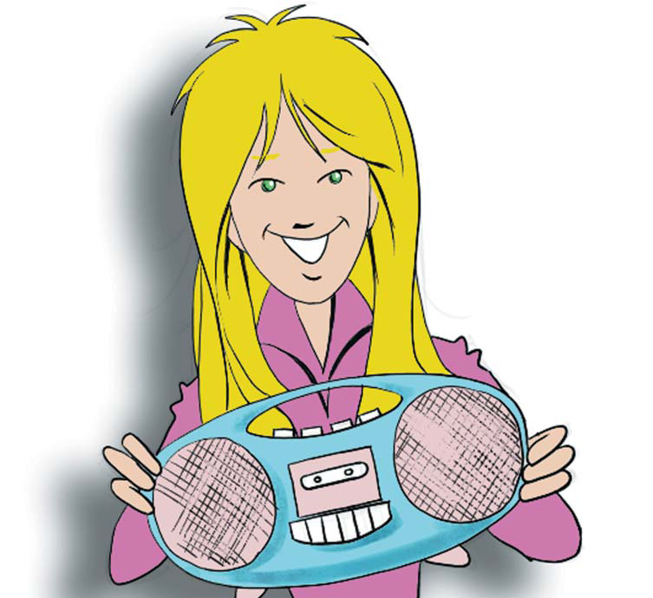

Slide 8
mother = mummy
father = daddy
grandmother = grandma
grandfather = grandpa

Slide 9
Find the synonymes.
1. mother | a) daddy
2. grandmother | b) mummy
3. grandfather | c) grandma
4. father | d) grandpa

Slide 10
Can обозначает возможность, способность, умение делать что-либо. Глагол can не изменяется по лицам и числам и за ним всегда следует смысловой глагол без частицы to.
I can dance. I can jump.
I can not (can’t) swim.
Can you run? – Yes, I can./ No, I can’t.

Slide 11


Slide 12


Slide 13


