Slide 1
Учитель: Фомичёва Т.В.
«Удивительные создания»

Slide 2
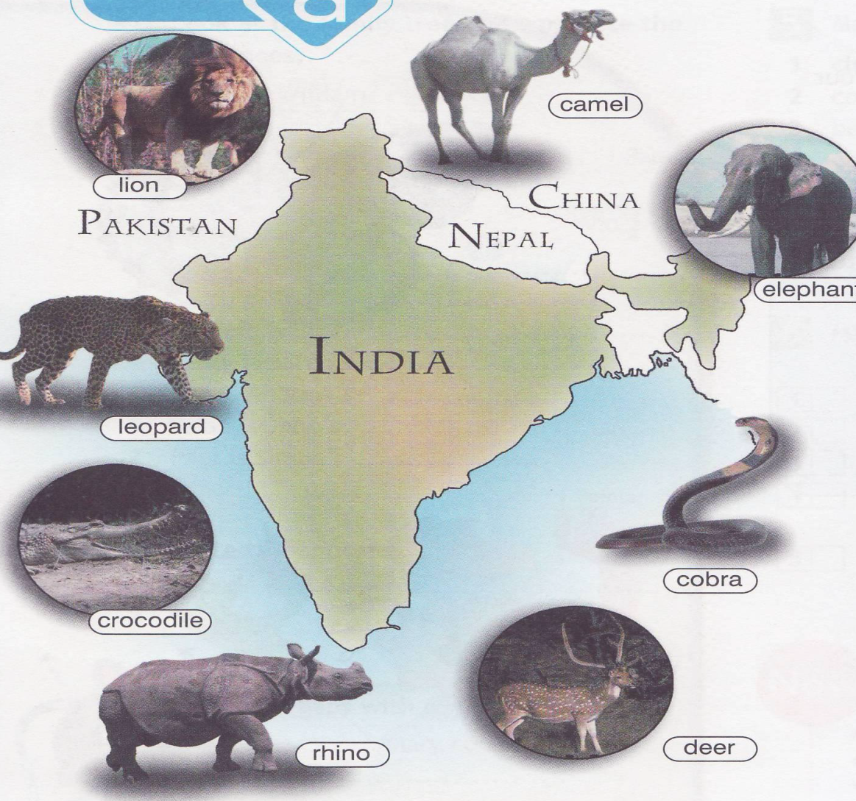
Which country can you see?
Which continent is it in: Asia or Africa? What countries are next to it?
India
In Asia
Pakistan, Nepal, China.

Slide 3
What will we speak at the lesson about?
About wild animals;
About where the animals live;
About what the animals like to eat.

Slide 4
New Words (новые слова):
Animal;
Carry;
Use;
Cobra;
Deer;
Leopard;
Rhino;
Dangerous.

Slide 5
Let’s have a rest!
Head and shoulders, knees and toes, knees and toes,
Head and shoulders, knees and toes, knees and toes,
And eyes, and ears, and mouth, and nose,
Head and shoulders, knees and toes, knees and toes.

Slide 6
PRESENT Simple (affirmative)
I read we read
You read you read
He/she/it reads they read
Verb –ss/-sh/-ch/-x/-o + -es;
The verb ending –y -i + -es;

Slide 7
Thank you for attention!

