Slide 1
СТЕПЕНИ СРАВНЕНИЯ ПРИЛАГАТЕЛЬНЫХ
Unit 2, Lessons 1,2,3,4.
Учебник для 4 класса
Автор В.П.Кузовлев.
Kirov
School №37
S.V.Prozorova

Slide 2
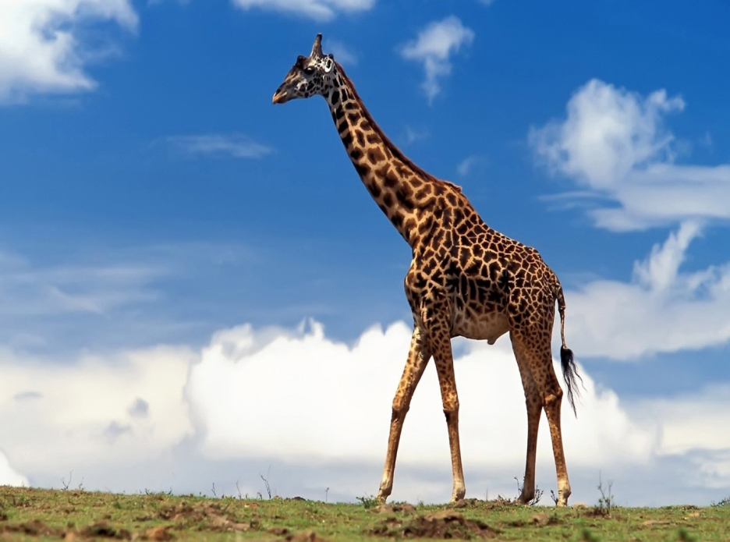
The giraffe is tall
The giraffe is big

Slide 3
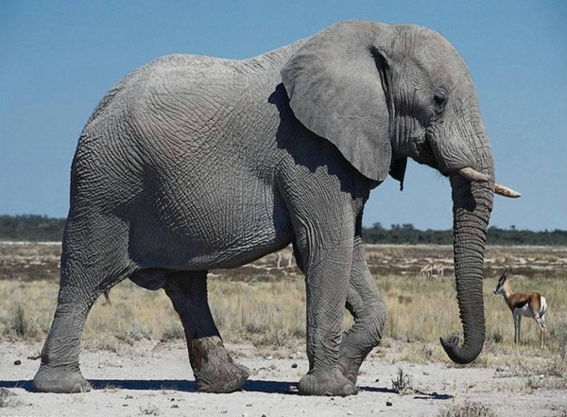
The elephant is tall
The elephant is big

Slide 4
Сравнительная степень прилагательных
Big - bigger
Tall - taller
The giraffe is taller than the elephant.
The elephant is bigger than the giraffe.

Slide 5
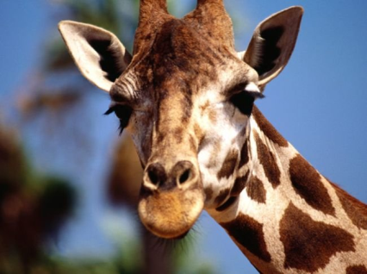
The giraffe is taller than the elephant.
The elephant is bigger than the giraffe.

Slide 6
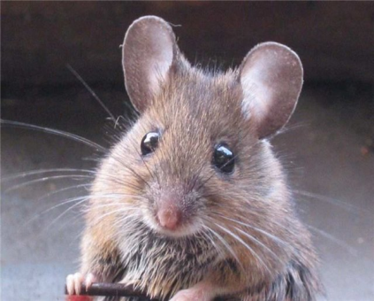
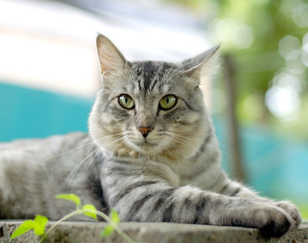
The mouse is smaller than the cat.
The cat is bigger than the mouse.

Slide 7
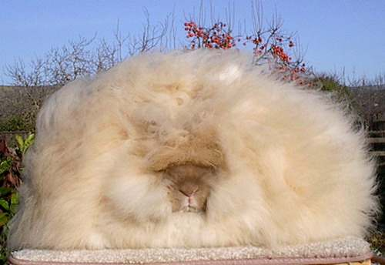
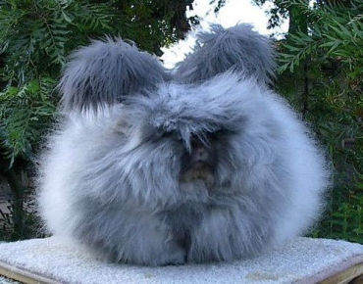
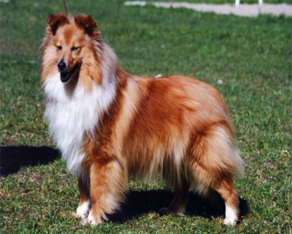
The rabbits are
fluffier than
the dog

Slide 8
Односложные прилагательные
tall –taller
big – bigger
fat – fatter
smart – smarter
slow – slower
fast – faster
small – smaller
long - longer
large – larger
cute – cuter
nice – nicer
heavy – heavier
fluffy – fluffier
happy - happier
funny – funnier
silly - sillier

Slide 9
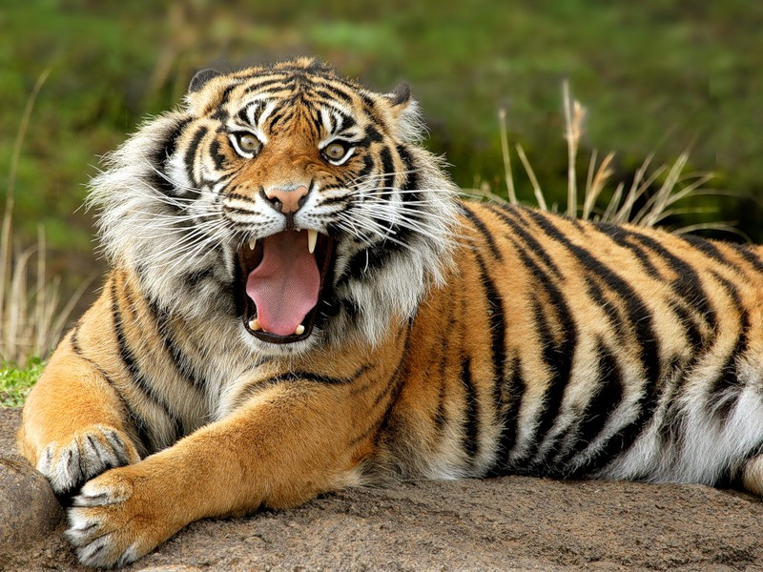
The tiger is dangerous.
The tiger is dangerous.

Slide 10
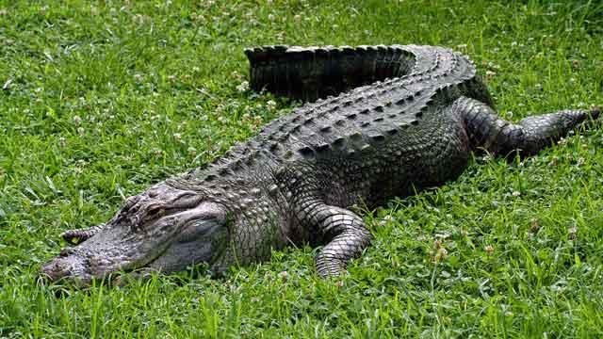
The crocodile is dangerous.
The crocodile is dangerous.

Slide 11
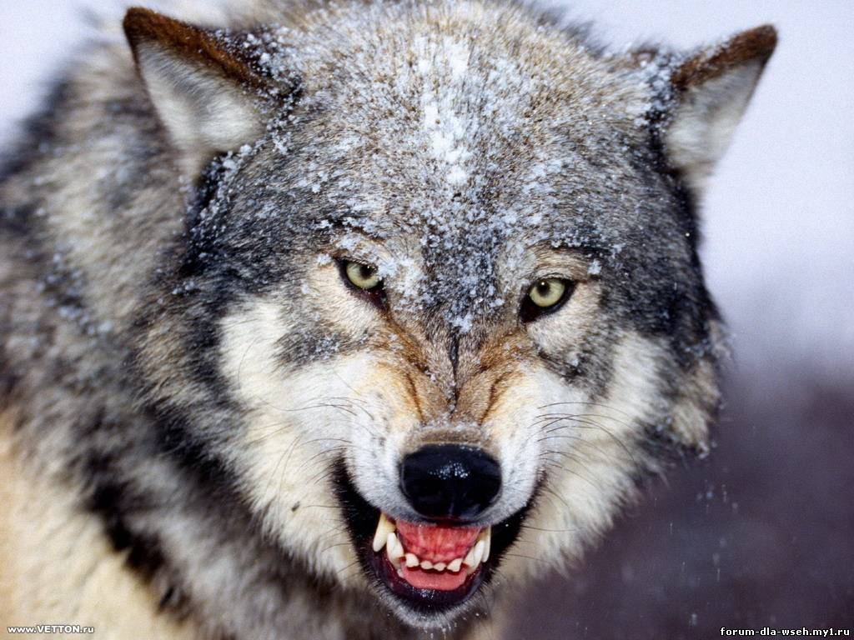
The wolf is dangerous.

Slide 12
Mногосложные прилагательные
more dangerous
more talented
more beautiful
more interesting
more difficult

Slide 13
Сравнительная степень многосложных прилагательных
The tiger is more dangerous (более опасный) than
the crocodile.
The crocodile is more dangerous (более опасный) than the tiger.

Slide 14
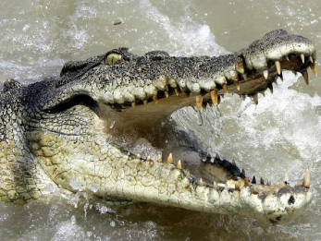
The tiger is more dangerous than
the crocodile.
The crocodile is more dangerous than the tiger.

Slide 15
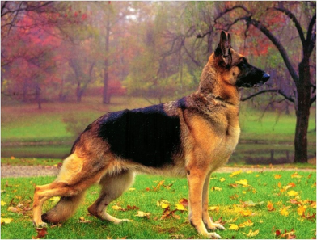
The wolf is more
dangerous than
the dog.
The wolf is stronger than
the dog.

Slide 16
Превосходная степень односложных прилагательных
the tallest
the biggest
The giraffe is the tallest
(самое высокое) animal in the
world.

Slide 17
Превосходная степень односложных прилагательных
the biggest
The elephant is the biggest
(самое большое) animal in the world.

Slide 18
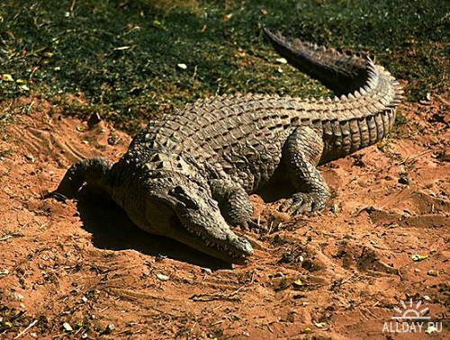
The alligator is the biggest reptile
in the world.

Slide 19
An ostrich is the heaviest bird.
An ostrich is the heaviest bird.
An ostrich is the biggest bird.

Slide 20
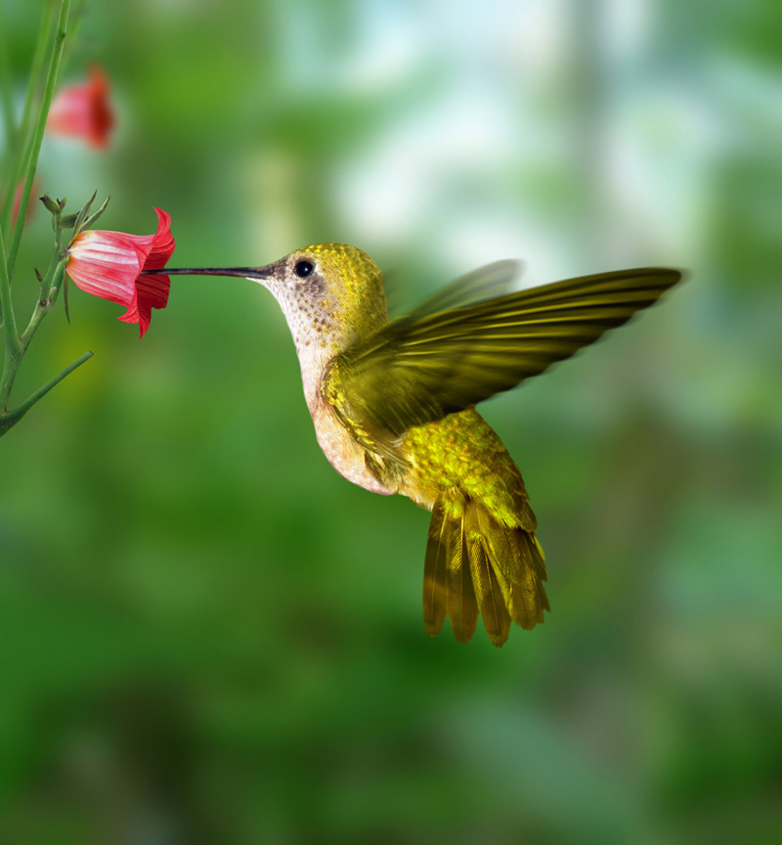
The humming bird is the smallest
bird in the world.

Slide 21
The python is the longest reptile
in the world.

Slide 22
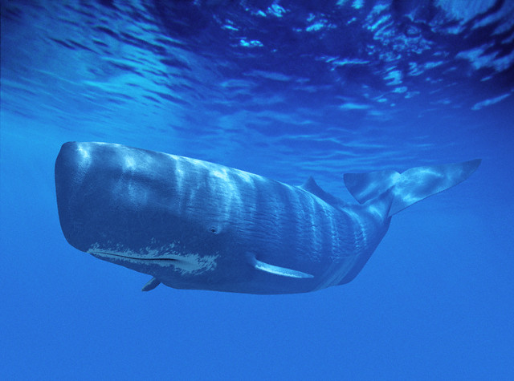
The most heavier animal in the word
The whale is the heaviest animal
in the world.

Slide 23
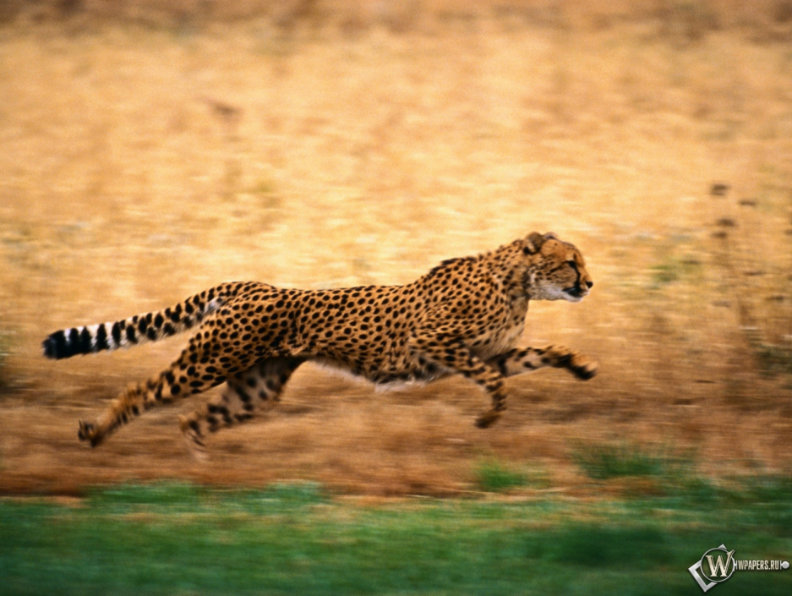
The cheetah is the fastest animal in the world.

Slide 24
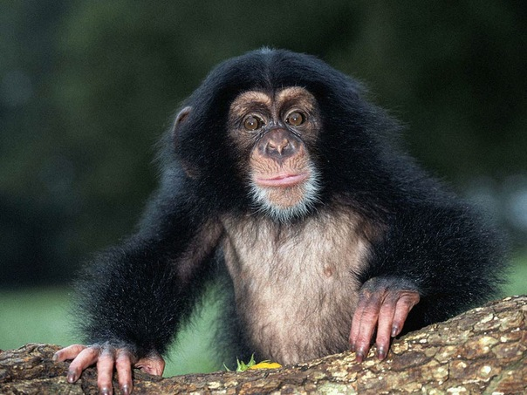
The chimpanzee is the smartest
animal in the word.

Slide 25
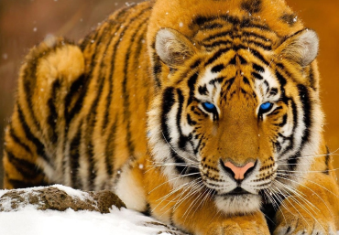
Превосходная степень многосложных прилагательных
the most
The tiger is the most dangerous (самое опасное)
animal in the zoo.

Slide 26
The crocodile is the most dangerous (самая опасная) reptile.
The crocodile is the most dangerous reptile.

Slide 27
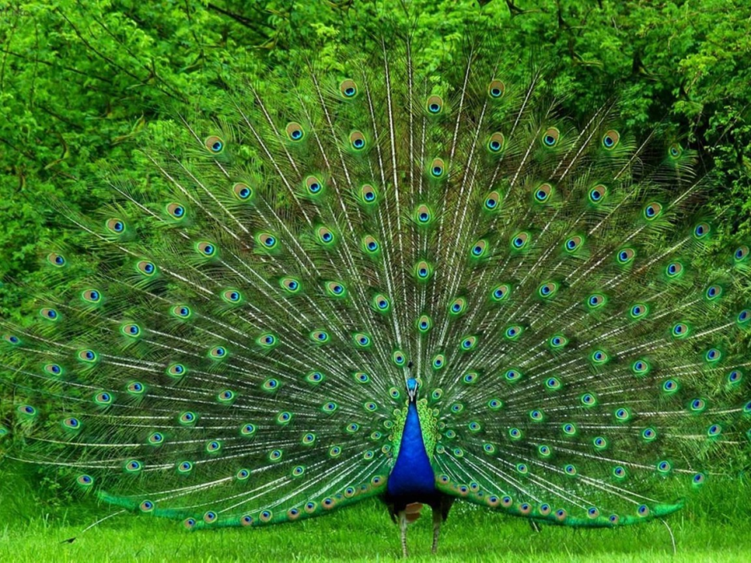
The peacock is the most
beautiful bird in the world.

Slide 28
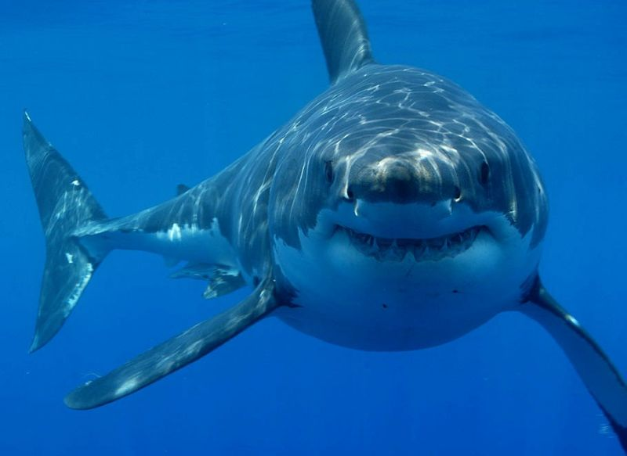
The shark is the most dangerous fish in the word.

Slide 29
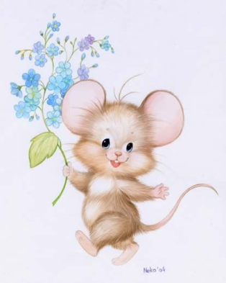
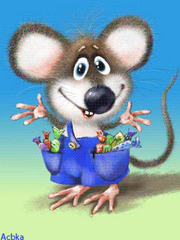
the happiest
happy
happier

Slide 30
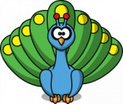
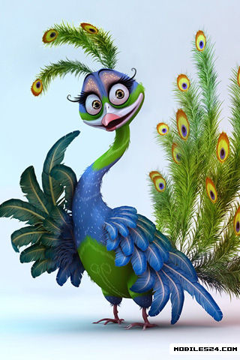
the most
beautiful
beautiful
more beautiful

Slide 31
запомнить
good - better - (the) best
хороший – лучше - самый хороший, лучше всех
bad - worse - (the) worst
плохой - хуже - самый плохой, хуже всех
little -less -(the) least
маленький - меньше - самый маленький, меньше всех

Slide 32
Выбери правильный вариант слов
Lions are (smart, smarter, the smartest) than tigers.
Monkeys are (funny,funnier,the funniest)animals in the zoo.
The mouse is(small,smaller,the smallest) than the rabbit.
Malvina is(good,better,the best) than Fox Alice.

Slide 33
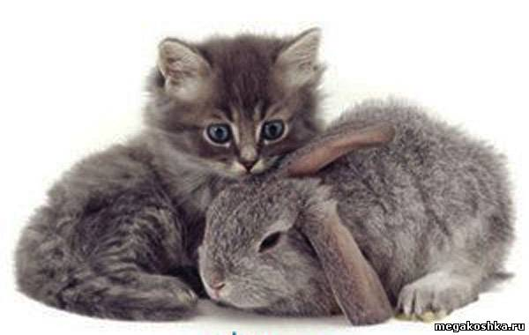
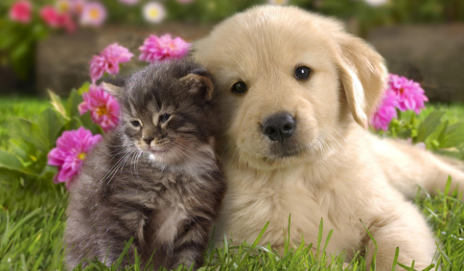
A kitten is
as fluffy as
a rabbit.
A cat is as
friendly as
the dog.

Slide 34
Guess the animal
It lives in Africa. It’s the biggest animal. It has got a very big nose.

Slide 35
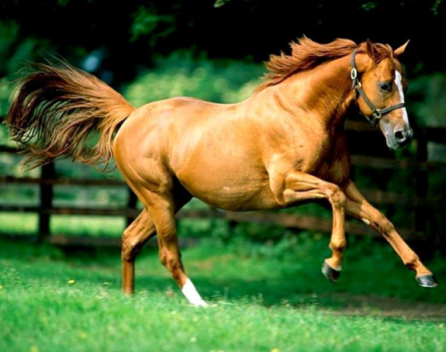
It is a big farm animal. It has got
long legs. It is very fast. You can
ride it.

Slide 36
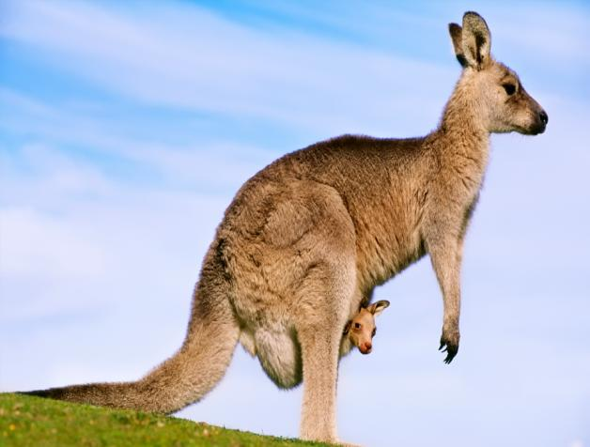
It lives in Australia. It’s the fastest animal. It has got a front pocket for a baby.

Slide 37
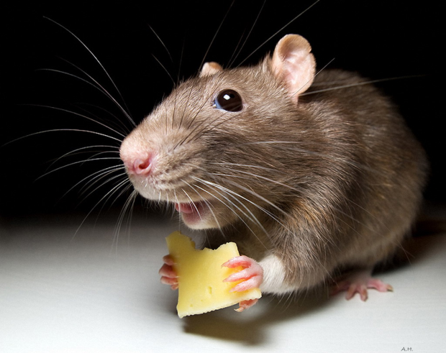
It’s the smallest animal. It has a long tail. It likes cheese.

Slide 38
Источник иллюстраций
Интернет-банк с фотографиями животных http://animalphotos.ru
Интернет-ресурс с фотографиями животных http://www.adme.ru/zhizn-zhivotnye/
Интернет-ресурсы:
http://www.google.ru/images и http://images.yandex.ru/
4. Английский язык: учебник для 4 кл. общеобразоват. учреждений Авторы: В.П. Кузовлев, Э.Ш. Перегудова, О.В.Дуванова, О.В.Стрельникова – M.: Просвещение, 2009.

