Slide 1
Listen to the song.
?
The song is about…..

Slide 2
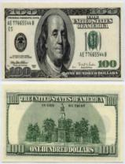
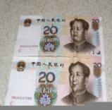
Money and we

Slide 3
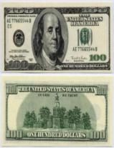
A lot of money [ ə lɒt ɒv ʹm˄ni ]
Currency [ ʹk˄rənsi]
A month [ ə m˄nϴ ]
Everyday necessity (food, bus, car, taxi) [ ʹevridei nəʹsesiti]
Education [ ʹedjuˏ keiʃn ]
Travelling [ ʹtrӕv(ə)liŋ ]
Entertainment [ ˏentəʹ teinment]
Achievement goal [ əʹtʃi:vment gəul ]

Slide 4
To visit [ tə ʹvizit ]
Can/Cannot solve problem [ kӕn/ ʹkӕnɒt sɒlv ʹprɒbləm ]
Can/Cannot buy anything [ kӕn/ ʹkӕnɒt bai ʹeniϴiŋ ]
To spend on [ spend ɒn ]
To earn [ tə 3:n ]
To buy [ tə bai]
To travel [ tə ʹtrӕv(ə)l ]
To go to [ tə gəu tə]

Slide 5
Hardworking [ ha:dʹw3:kiŋ ]
Honest [ ʹɒnist ]
Educated [ ʹedjuˏ keitid ]
Purposeful [ ʹp3:pəsful ]
Organized [ ʹϽ:gənaizd ]
Sociable [ ʹsəuʃəbl ]
Friendly [ ʹfrendli ]

Slide 6
Do you like money?
+Yes, I do. Because…
- No, I don’t.because…

Slide 7
- On what do you spend your money?
- I spend my money on…

Slide 8
It is dollar
It is currency of …

Slide 9
… Yuan
It is currency of …

Slide 10
… Pound
It is …

Slide 11
Euro

Slide 12
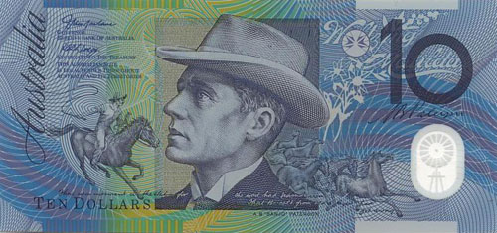
Dollar of Australia

Slide 13
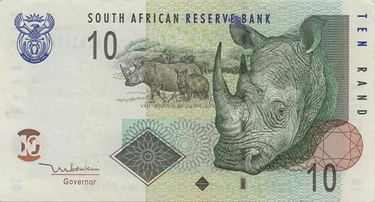
Rand of South Africa

Slide 14
Rouble

Slide 15
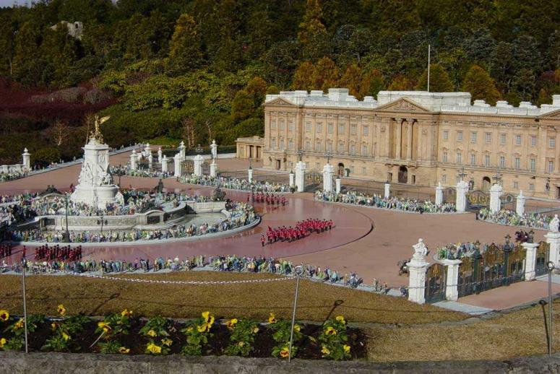
It is Residence of Queen
It is in England

Slide 16
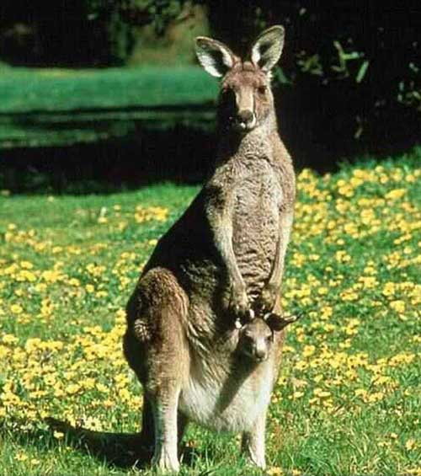
It is kangaroo
It is in …

Slide 17
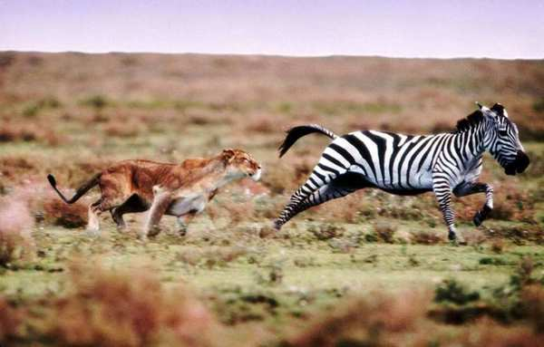
… wildlife
It is in …

Slide 18
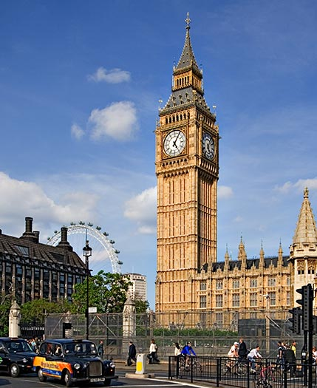
Big Ben.

Slide 19
Eiffel Tower.

Slide 20
Disneyland

Slide 21
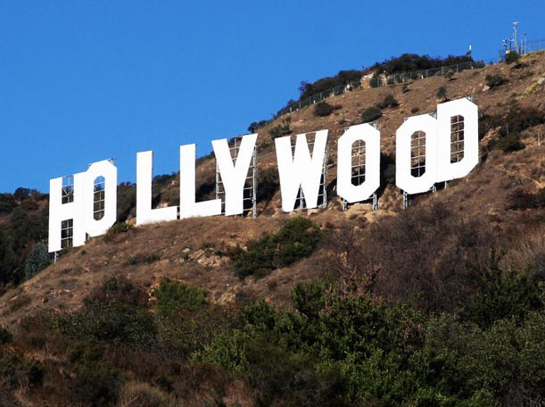
Hollywood

Slide 22
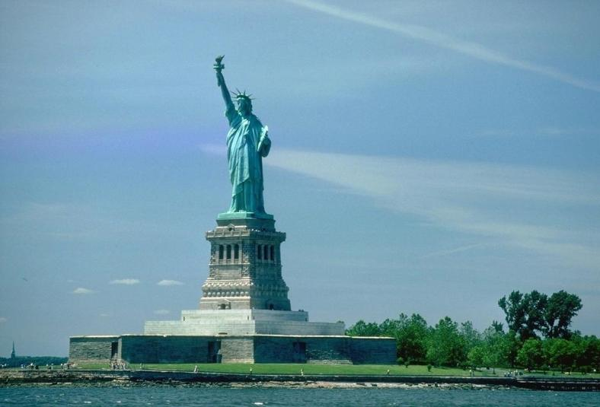
Statue of Liberty

Slide 23
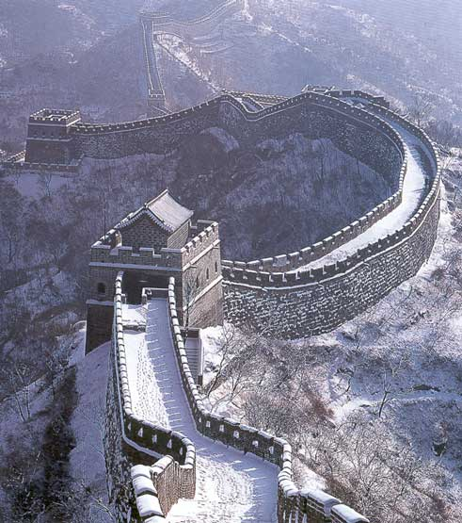
Great wall

Slide 24
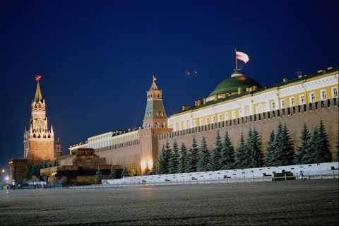
Red Square

Slide 25
If I had a lot of money, I would go to … to see…

Slide 26
- No pains, no gains. - Don’t have 100 roubles, but have 100 friends. - Health is better than wealth.

Slide 27
Professions | Everyday necessity | education | travelling | Car/house/bus | entertainment | internet | Achievement goal | family
A teacher
A doctor
A bisinessman
A driver
A student

Slide 28
Professions | Everyday necessity | education | travelling | Car/house/bus | entertainment | internet | Achievement goal | family
A teacher | + |  |  |  |  |  | + | +
A doctor |  | + |  |  |  |  | +
A businessman | + |  |  | + |  | + | + | +
A driver | + |  |  |  |  |  | + | +
A student | + | + | + |  | + | +

Slide 29
A teacher spends money on… A doctor spends money on… A businessman spends … A driver spends … A student ……

Slide 30
If I had a lot of money,
I would spend on…

Slide 31
education
family
car
cinema, theatre
achievement goal
If I had a lot of money,
I would spend on…
health
travelling
everyday
necessity

Slide 32
«More clever – more money»
MONEY | PLACES OF INTEREST
1 | 1
2 | 2
3 | 3
4 | 4

Slide 33
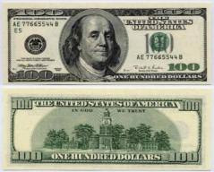
If you want to be successful and happy, you must be:

Slide 34
Your homework – write an essay «Money in our life».

Slide 35
Thanks for your attention and participation

