Slide 1
Chapter 1: Wonders of Novosibirsk State Public Science and Technology Library Novosibirsk Academ Town Novosibirsk Zoo Novosibirsk Theatre of Opera and Ballet The Globe Theatre The Red Prospect,the Bugrinsky Bridge Novosibirsk Planetarium Novosibirsk Metro Bridge
Chapter 2: Places to have a good time Chapter 3: Stadium of Sport «Sibir»

Slide 2
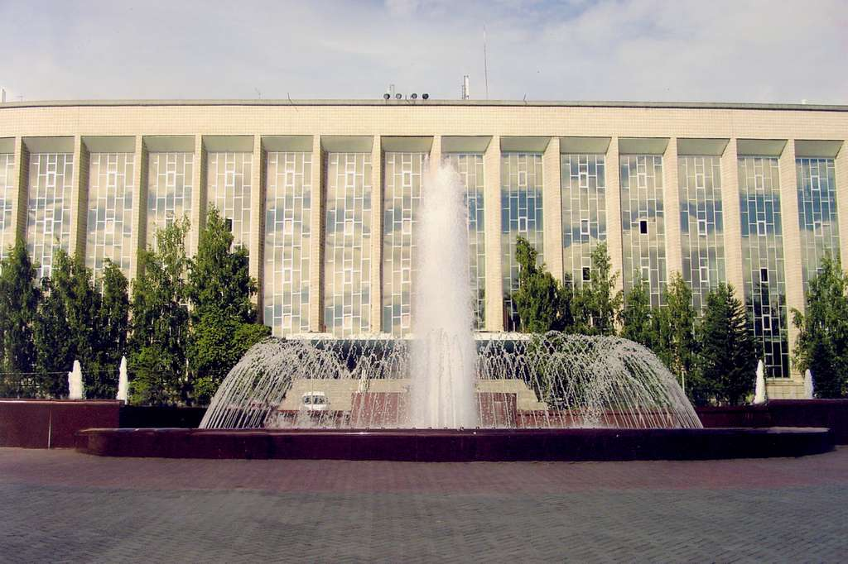
State Public Science and technology library
It was established in 1918

Slide 3
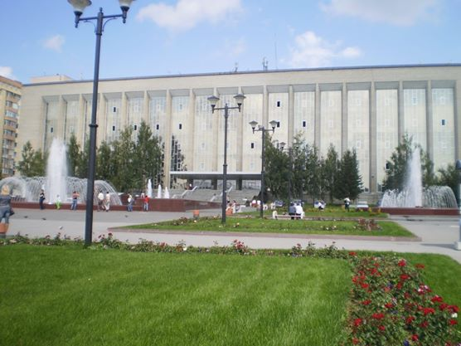
It is the largest fond of the world knowledge

Slide 4
It contains more than 14 million books

Slide 5
Every day about 1000 people visit it

Slide 6
If you love reading, come to Novosibirsk!!!

Slide 7
Novosibirsk Academ Town

Slide 8
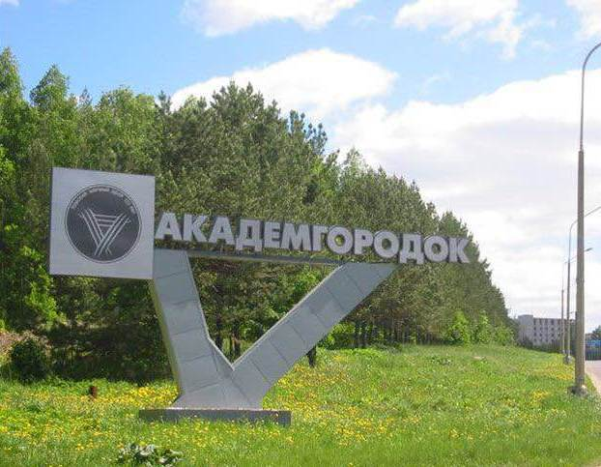
Novosibirsk Academ Town is situated twenty kilometers south of Novosibirsk

Slide 9
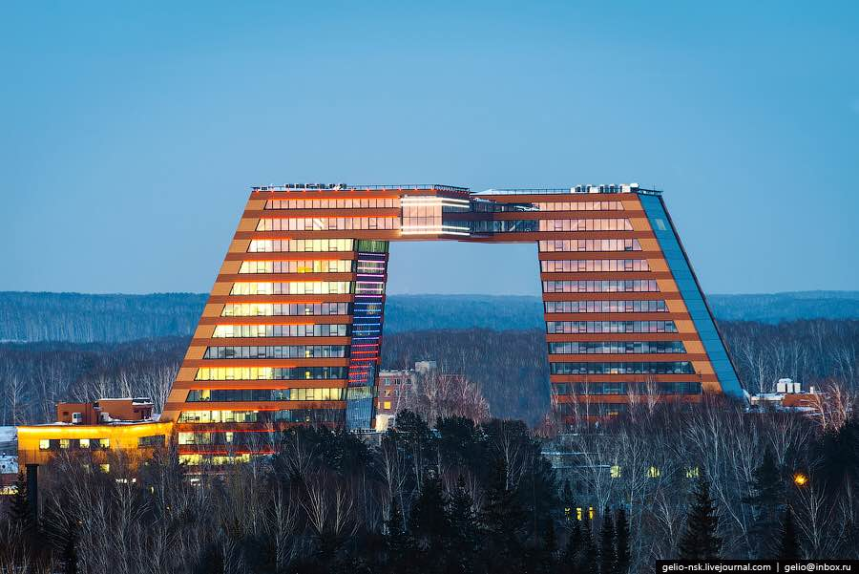
Academ Town is one of the most important scientific and educational centers of Russia

Slide 10
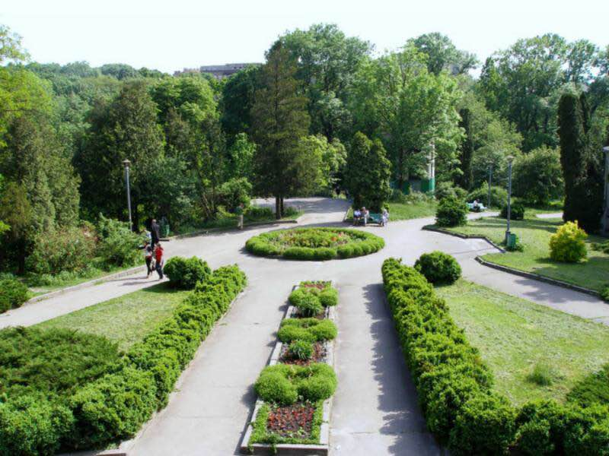
The Central Botanical Garden is in the Academ Town

Slide 11
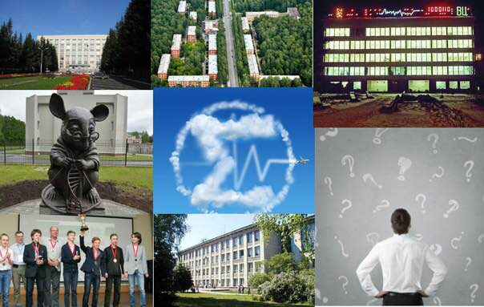
Come and visit us, we have a lot of interesting things!

Slide 12
Novosibirsk Zoo

Slide 13
Novosibirsk zoo is the largest zoo in Russia and it’s the only zoo in the world, located in the pine forest. The total area of the zoo is about 60 hectares.

Slide 14
There are animals that are in the Red Book

Slide 15
Novosibirsk zoo keeps a lot of rare felines

Slide 16
The emblem of the zoo is the snow leopard.

Slide 17
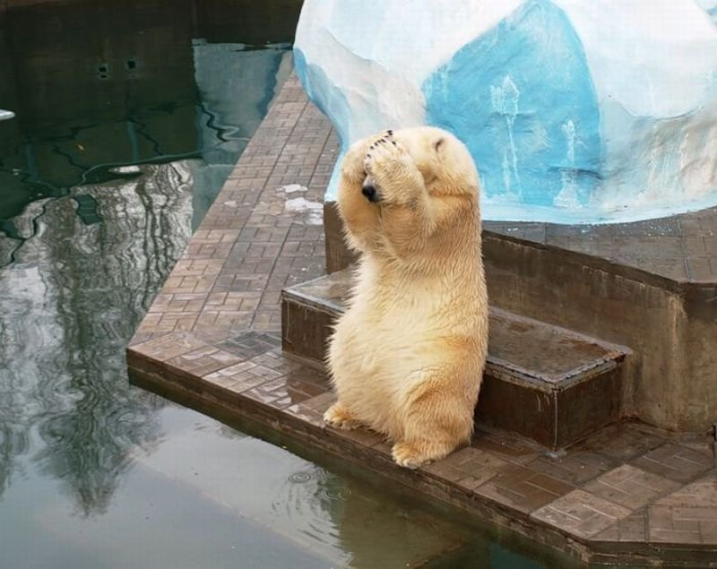
The polar bear is a big animal. It is a very good swimmer.

Slide 18
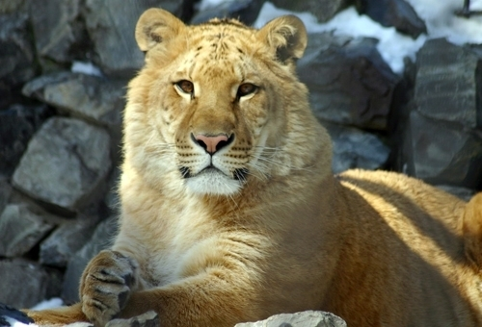
The liger cub is from the unusual family - the African lion and the Bengal tigress. It was born in 2004.

Slide 20
Novosibirsk Theatre of Opera and Ballet

Slide 21
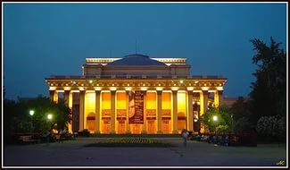
The Theatre of Opera and Ballet

Slide 22
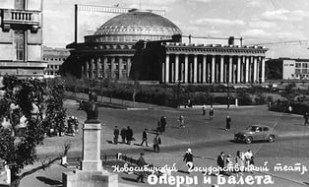
The Theatre of Opera and Ballet was opened on May 12, 1945.
It is the largest theatre in Russia.

Slide 23
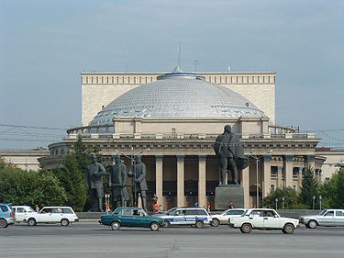
The theatre is situated in Lenin Square

Slide 24
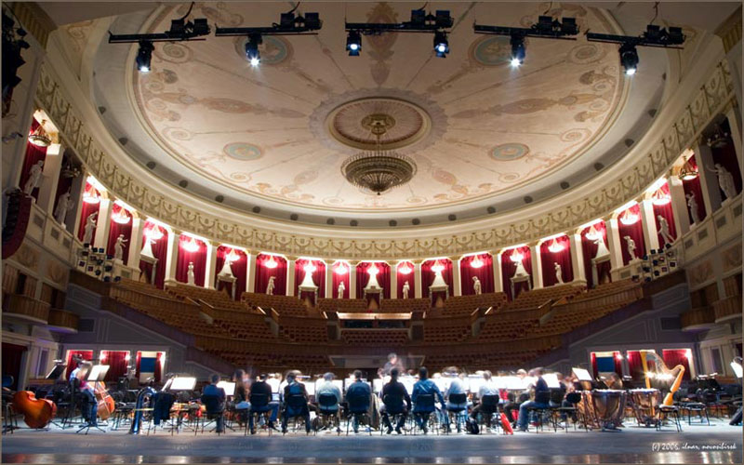
The main structure of the building is a huge dome

Slide 25
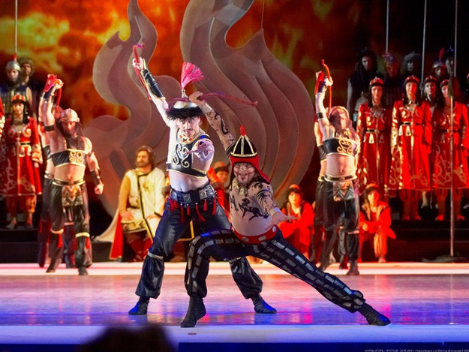
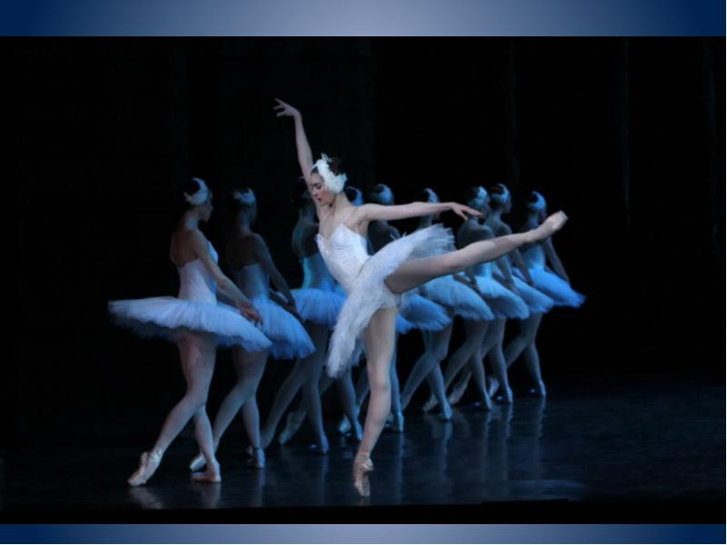
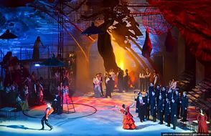
Amazing plays are shown in the theatre

Slide 26
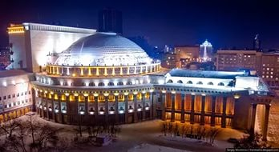
Welcome to the Theatre of Opera and Ballet!

Slide 27
The Globe Theatre

Slide 28
The Globe Theater is one of the oldest in the city. Nowadays it shows a lot of different and exciting plays to the people of all ages and tastes

Slide 29
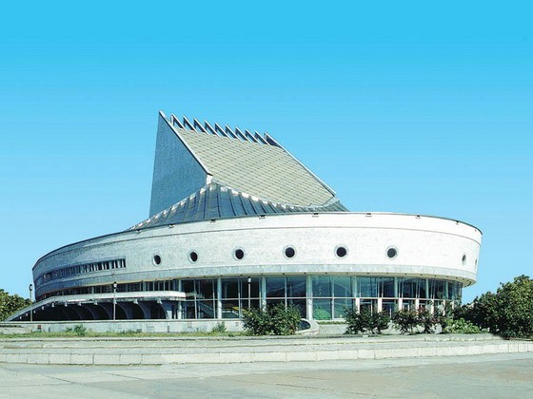
The original site was built in 1930. The theatre was renamed into the «Globe» in 1993.

Slide 30
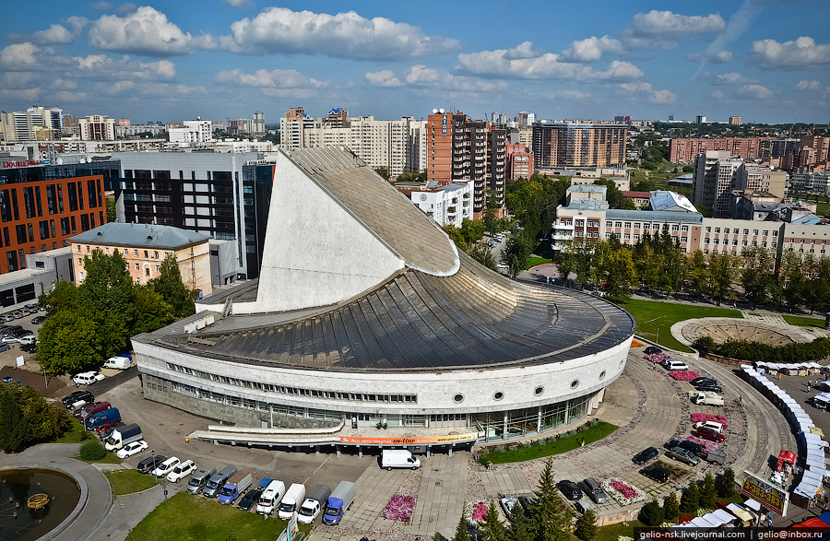
In 2008 the theatre became one of the «Wonders of Novosibirsk»

Slide 31
You are welcome to the Globe Theater!!!

Slide 32
The Red prospect The Bugrinsky Bridge

Slide 33
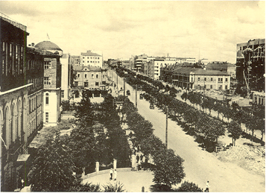
The Red Prospect was called Nicholas Prospect until 1920

Slide 34
It’s the central highway of Novosibirsk. The length is about seven kilometers.

Slide 35
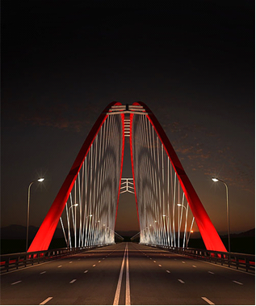
Bugrinsky Bridge is the third across the Ob river in Novosibirsk

Slide 36
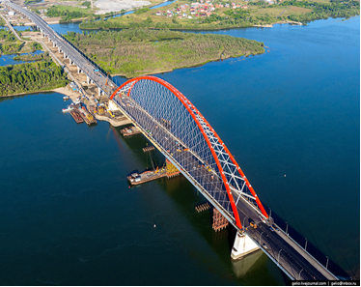
The construction began in 2010 and ended in 2014. It is one of the most spectacular bridges in our country

Slide 37
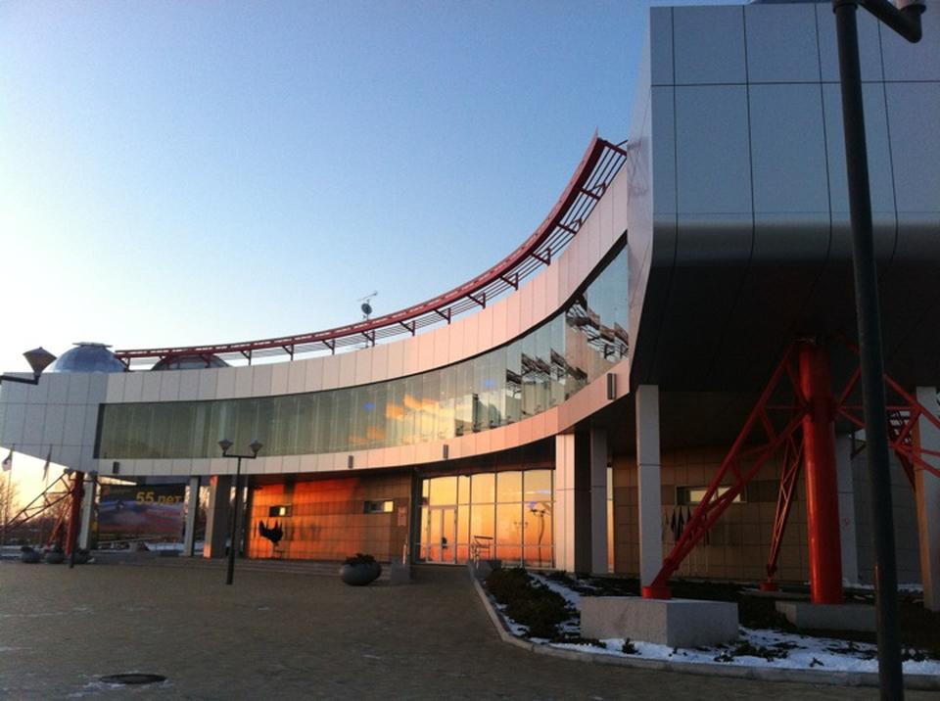
Novosibirsk planetarium

Slide 38
The planetarium is famous for its powerful telescopes

Slide 39
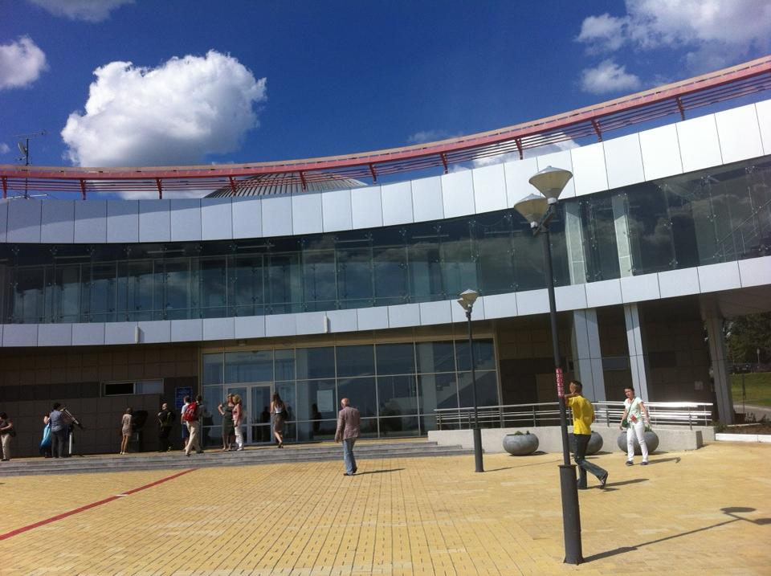
Our planetarium is one of the best in Russia

Slide 40
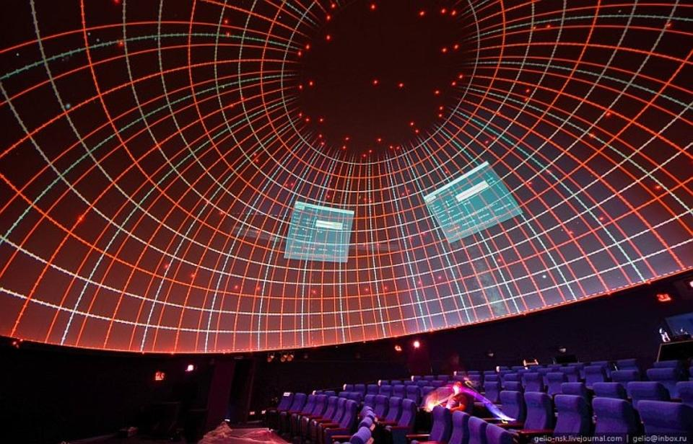
The most unique is the screen size - 16 meters in diameter

Slide 41
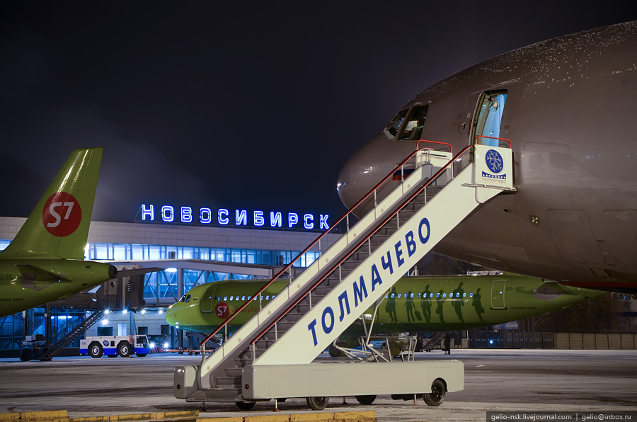
In Novosibirsk you can look at the stars and have fun

Slide 42
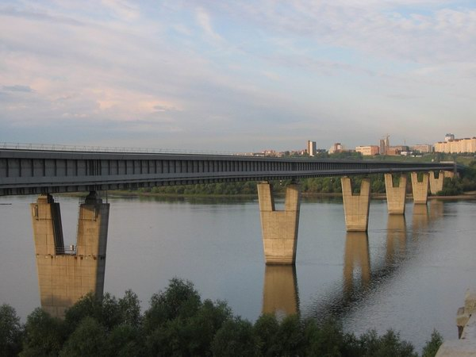
Novosibirsk metro bridge

Slide 43
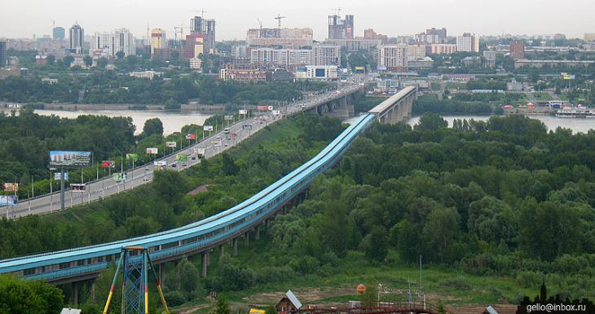
Its length is 2145 metres

Slide 44
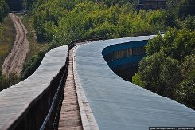
It is the world's longest metro bridge

Slide 45
Welcome to Novosibirsk!

Slide 46
Places to have a good time

Slide 47
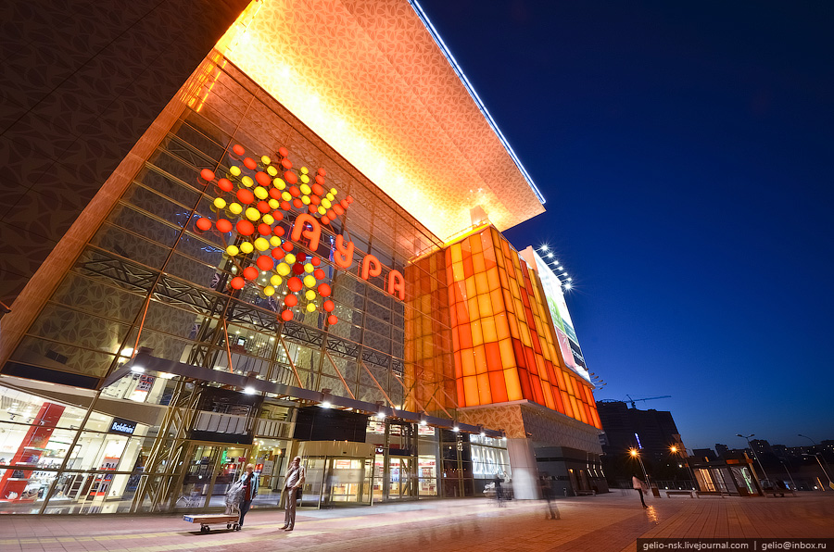
Shopping Centre Aura

Slide 48
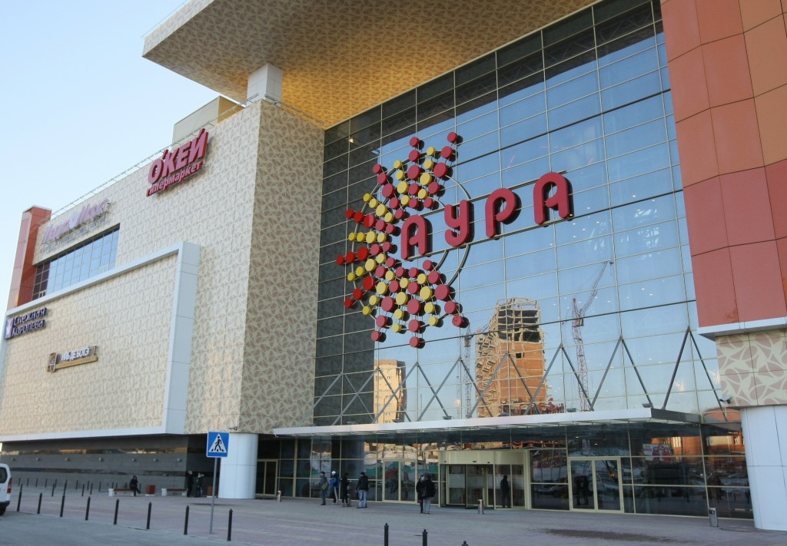
Here you can buy things, food,cosmetics, groceries and a lot of useful things

Slide 49
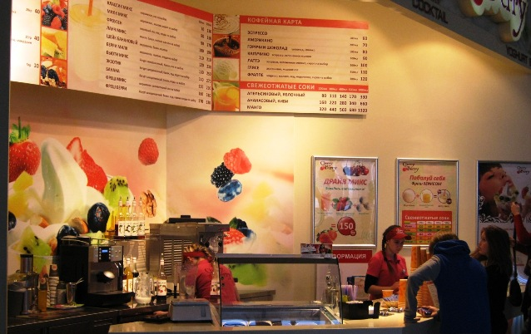
Cherry Berry
Here you can taste natural yogurt and delicious desserts

Slide 50
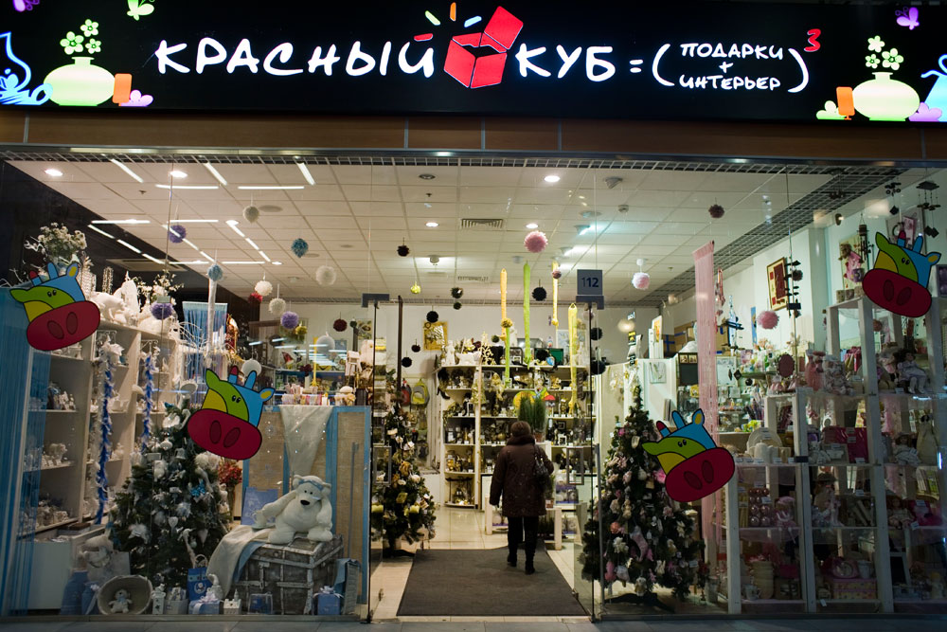
Red cube
You can buy gifts and souvenirs in the Red Cube

Slide 51
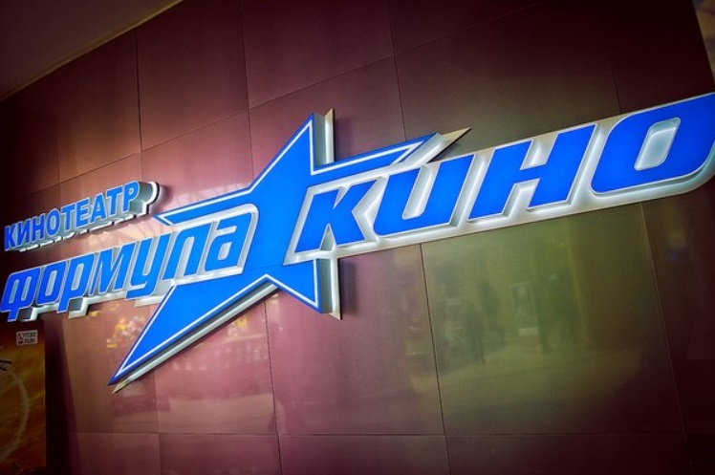
You can watch and enjoy new films in the «Cinema Formula»

Slide 52
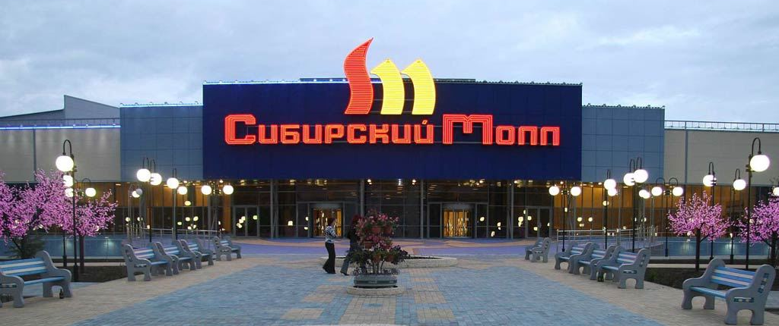
Siberian Mall
There are 140 cool shops in it

Slide 53
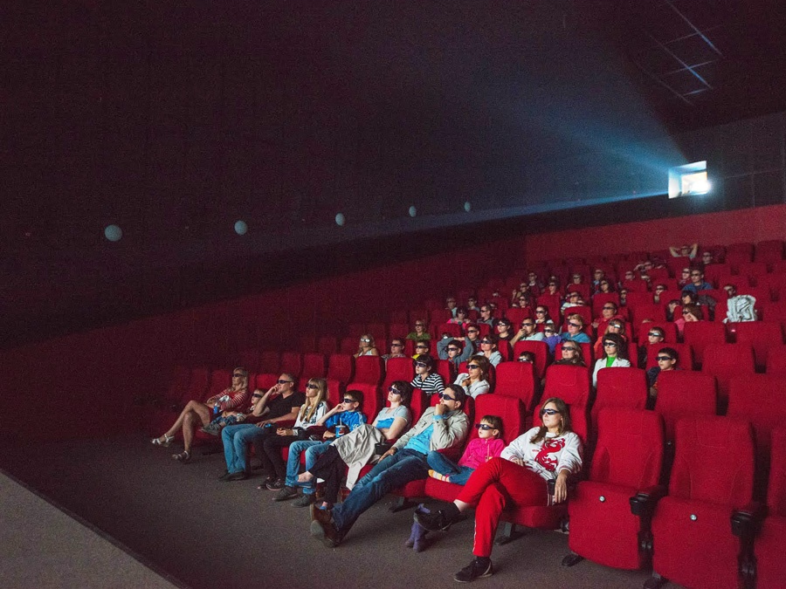
You can watch interesting films in the «Cinema Park» in «Siberian Mall»

Slide 54
Cafes: KFC Pechki Lavochki McDonalds
You can have a nice bite in KFC Pechki Lavochki McDonald’s New York Pizza

Slide 55
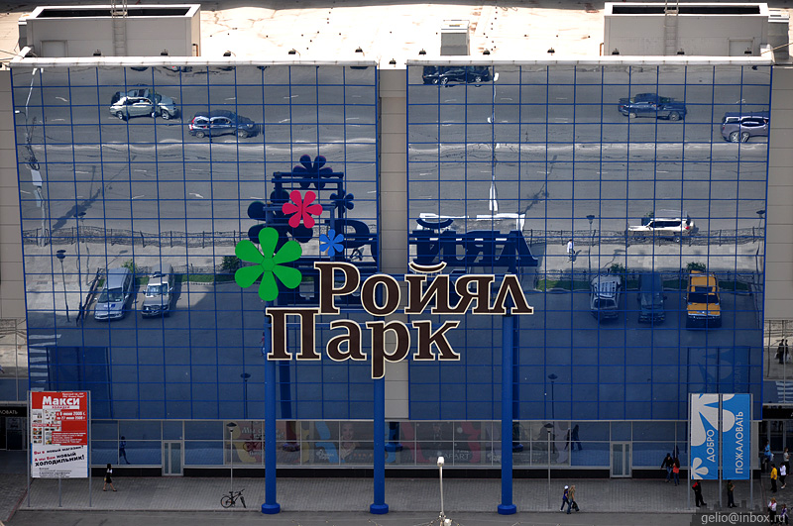
Royal Park

Slide 56
Royal Park is a big shopping center in Novosibirsk.
It has a beautiful big advert on its front part.

Slide 57
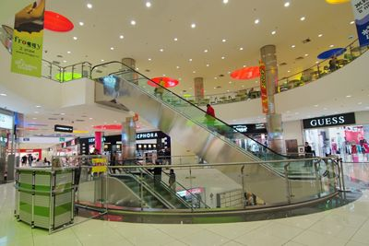
It has a lot of beautiful cafes and big and small shops

Slide 58
There is a grocery store «Megas» in Royal Park. It is a very big store with many kinds of products.

Slide 59
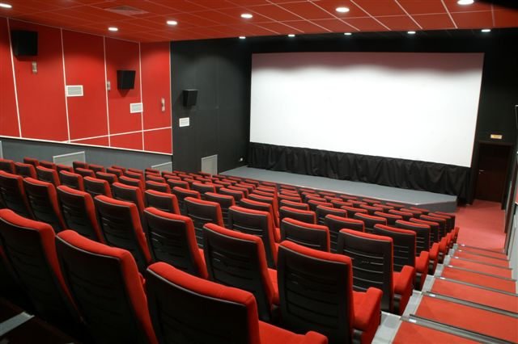
There is a cinema in Royal Park. It is called Cinema Park.

Slide 60
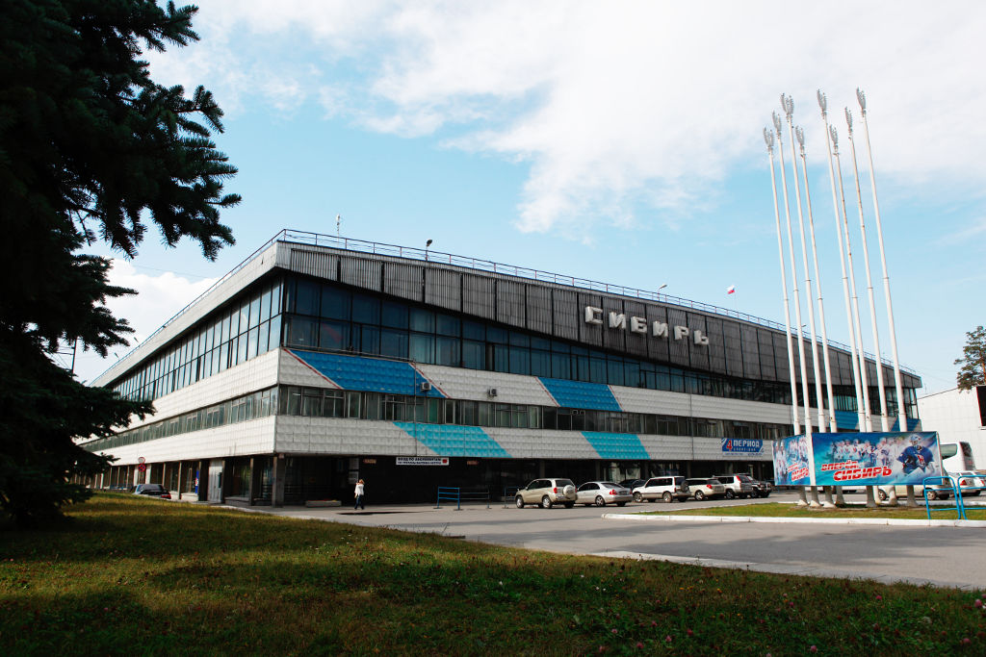
Stadium of sport «Sibir»

Slide 61
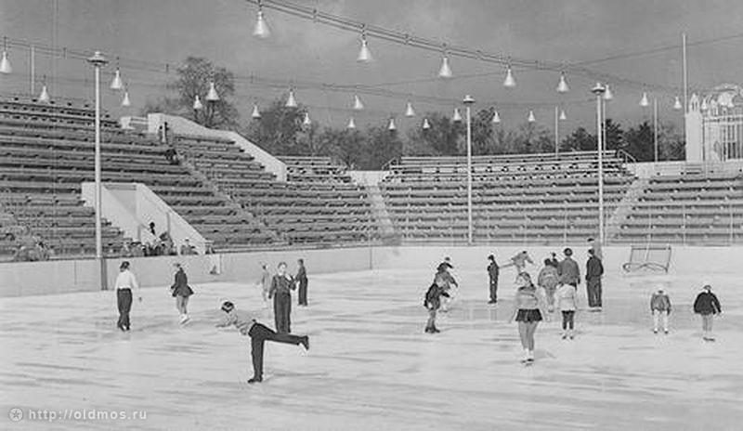
It was The best stadium in the USSR
stadium «Sibir»
was opened in
1964

Slide 62
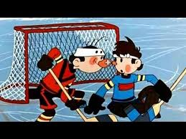
7300 spectators’ seats are in the sport palace

Slide 63
Sport stadium «Sibir» is the home arena of the hockey club Sibir

Slide 64
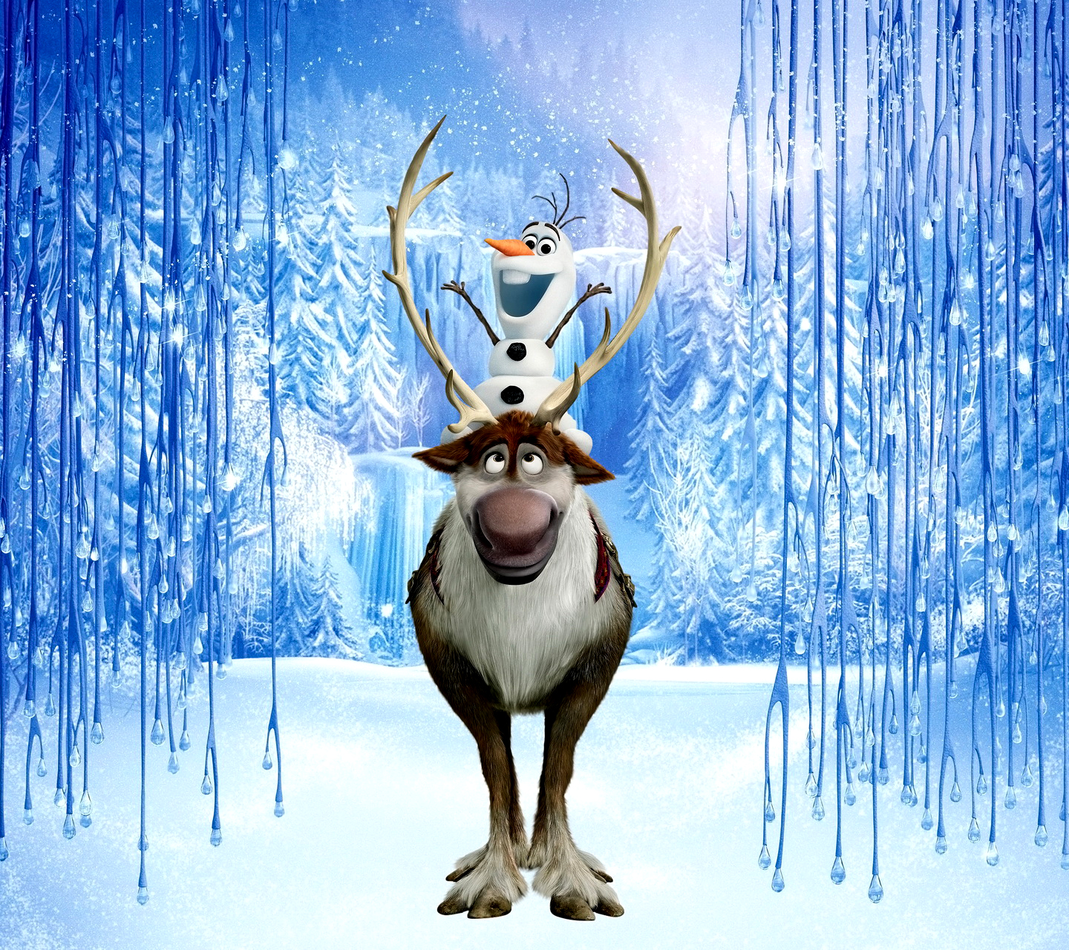
Welcome to Novosibirsk

