Slide 1
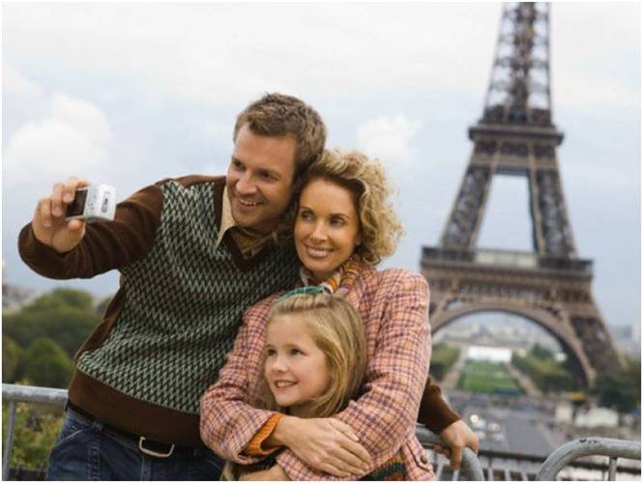
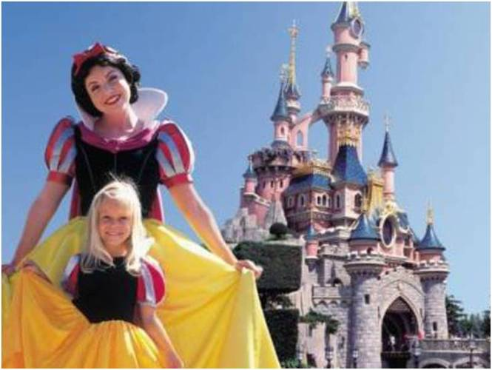
Утверждения: V2: V+ed (прав)/2 колонка (непр)
Отрицания: didn’t+V1
Megan ( visit) the Eiffel Tower last summer.
Hilda ( not visit ) the Eiffel Tower last summer.

Slide 2
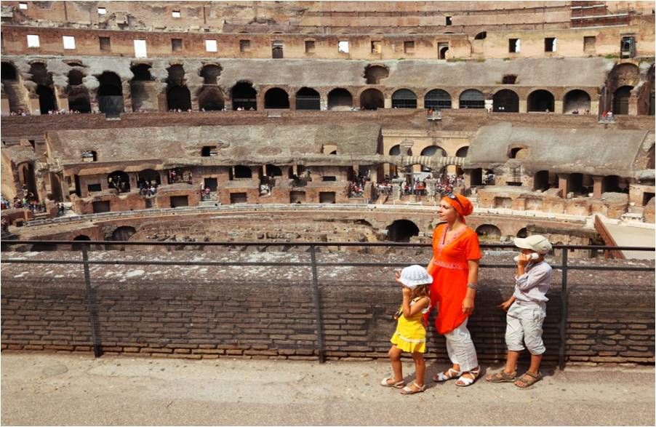
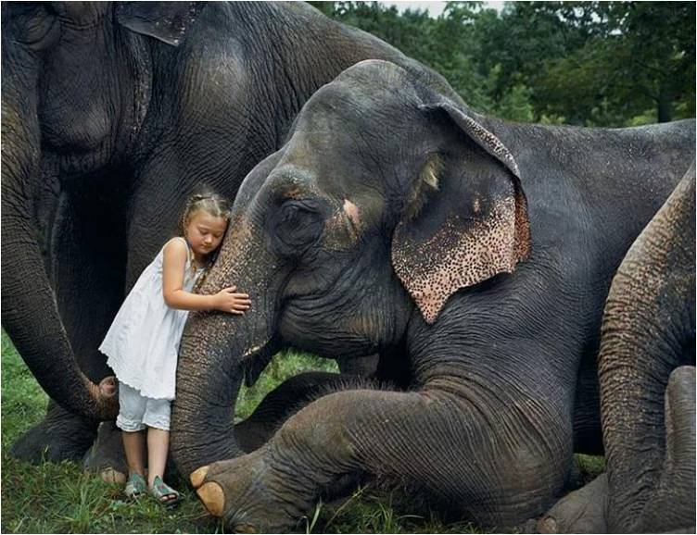
Утверждения: V2: V+ed (прав)/2 колонка (непр)
Отрицания: didn’t+V1
Greta ( go) to Rome last year.
Silvia ( not go ) to Rome last year.

Slide 3
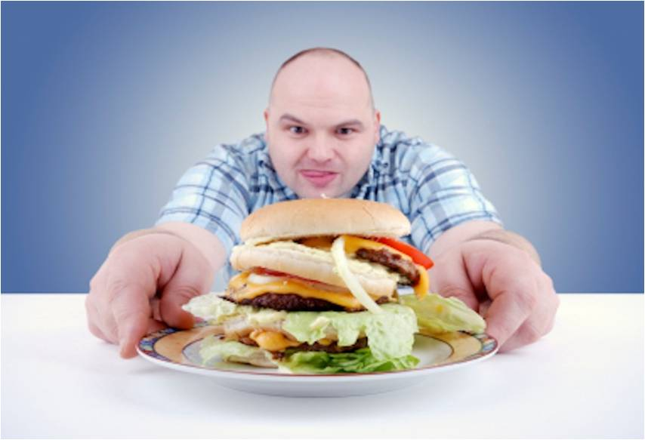
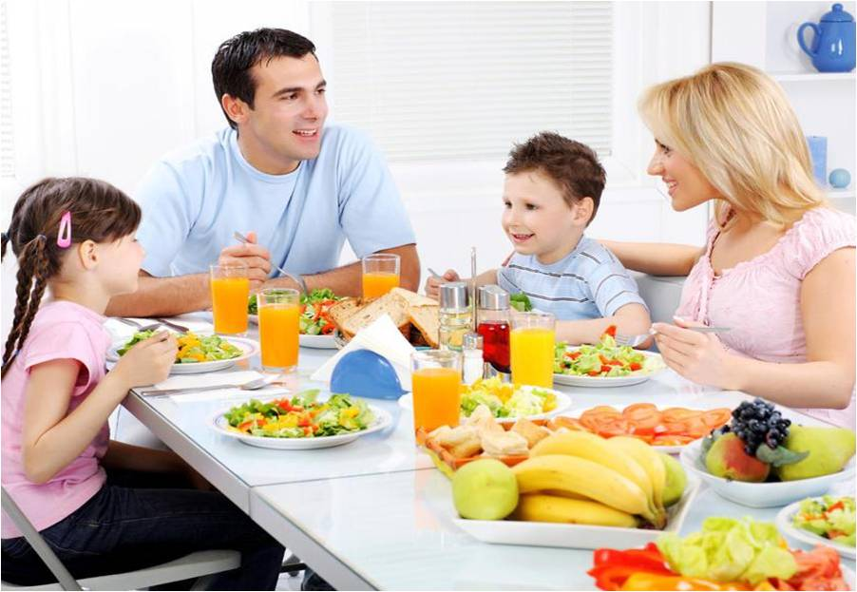
Утверждения: V2: V+ed (прав)/2 колонка (непр)
Отрицания: didn’t+V1
Uncle Jack ( eat ) fast food on holiday.
Our family ( not eat ) fast food on holiday.

Slide 4
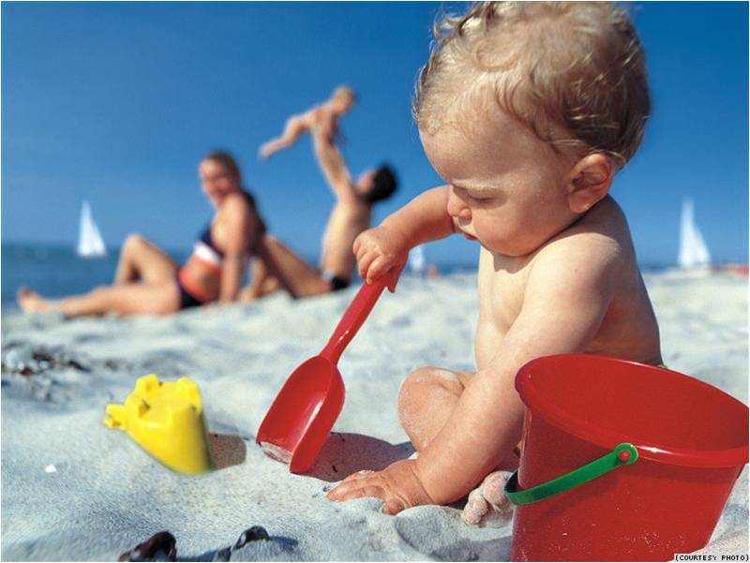
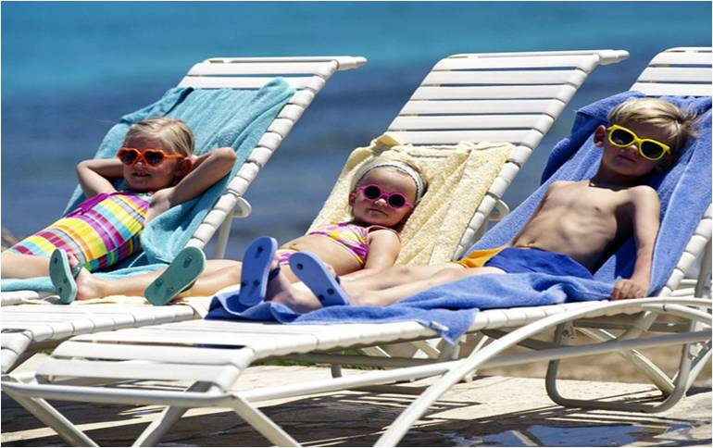
Утверждения: V2: V+ed (прав)/2 колонка (непр)
Отрицания: didn’t+V1
Little Franky ( build ) sandcastles on the beach yesterday morning.
Little Bobby( not build ) sandcastles on the beach yesterday morning.

Slide 5
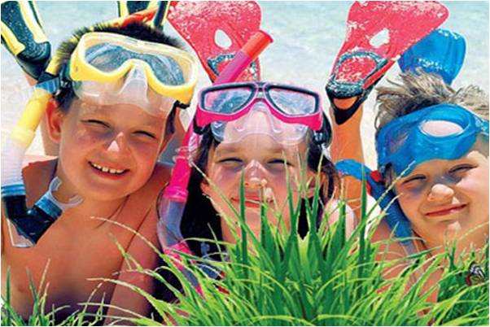
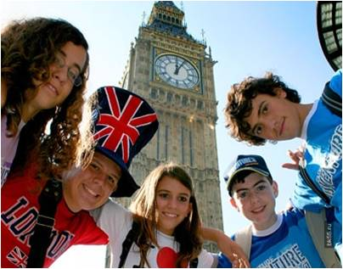
Утверждения: V2: V+ed (прав)/2 колонка (непр)
Отрицания: didn’t+V1
The French teenagers ( dive ) in the sea in June.
The Italian teenagers ( not dive ) in the sea in June.

Slide 6
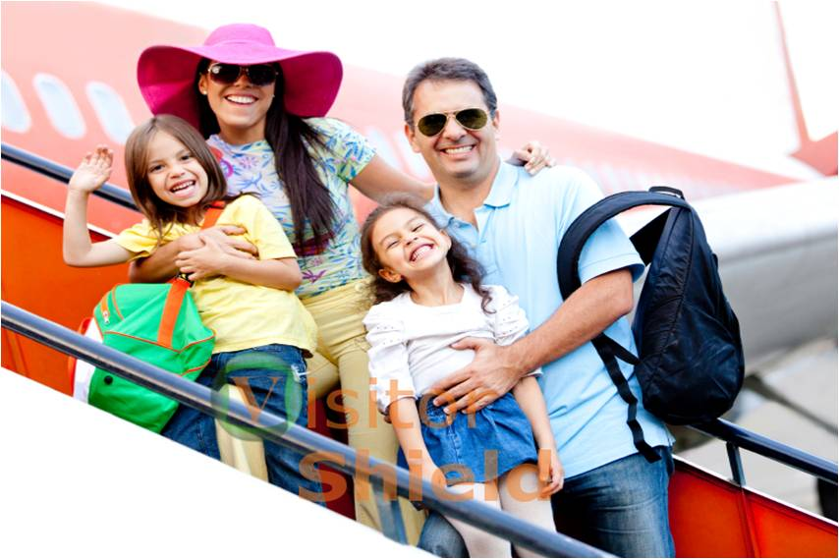
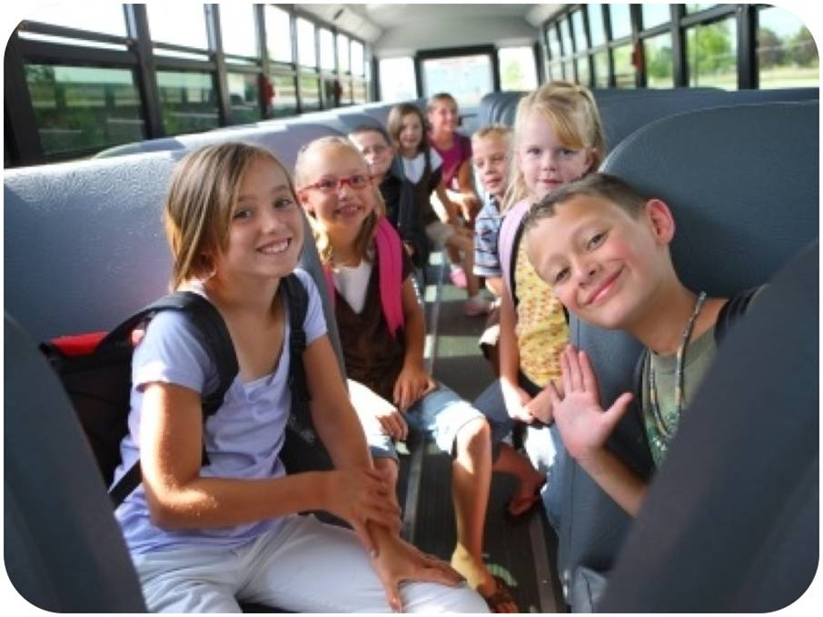
Утверждения: V2: V+ed (прав)/2 колонка (непр)
Отрицания: didn’t+V1
The Browns ( travel ) by plane.
These Swiss kids ( not travel ) by plane.

Slide 7
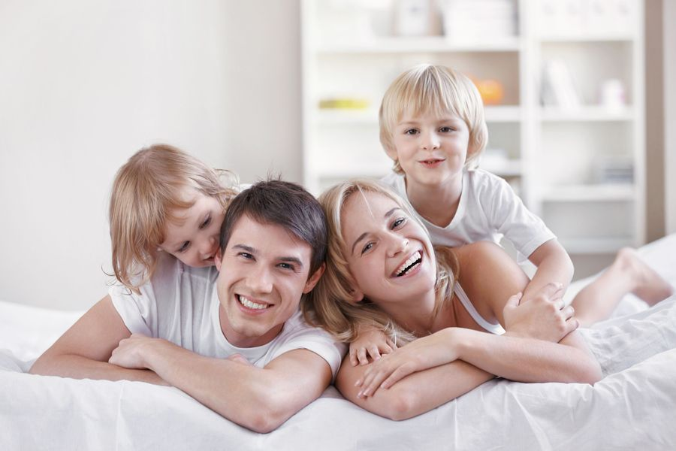
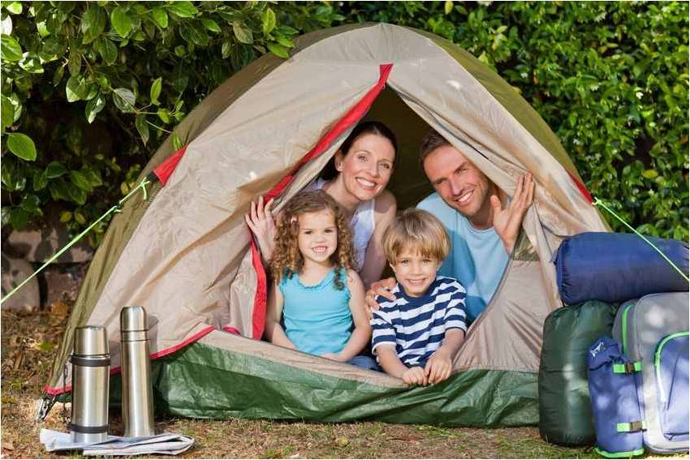
Утверждения: V2: V+ed (прав)/2 колонка (непр)
Отрицания: didn’t+V1
We ( stay ) at the hotel two days ago.
They ( not stay ) at the hotel two days ago.

Slide 8
Listening
Amazing – восхитительный
To be frightened of – бояться
an umbrella – зонт
an upset stomach –расстройство
желудка
a pill – таблетка
an opportunity - возможность
We had an ( возможность) to go sightseeing.
The trip to the river was (восхитительна).
Craig took a ( таблетку) from an (расстройства желудка).
Our big ( зонт) helped us not to get wet in the rain.
Some people ( боятся ) flying by planes.

Slide 9
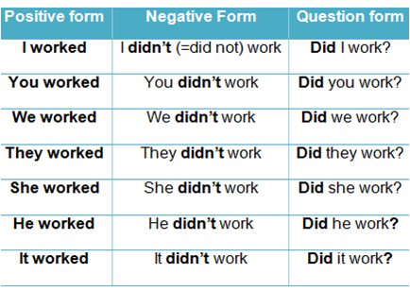
Complete the table with the information from the dialogue. Remember the rules!

Slide 10
Questions | + | -
Did she go to Washington?
Did she visit interesting places?
Did she travel by plane?
Did it take her long?
Did she stay at the camp?
Did she have good weather?
Did it snow?
Did she have expensive food?
Did she have an upset stomach?
Did she have an opportunity to speak English?

Slide 11
Questions | + | -
Did she go to Washington? |  | No
Did she visit interesting places? | Yes
Did she travel by plane? |  | No
Did it take her long? | Yes
Did she stay at the camp? |  | No
Did she have good weather? | Yes
Did it snow? |  | No
Did she have expensive food? |  | No
Did she have an upset stomach? | Yes
Did she have an opportunity to speak English? | Yes

Slide 12
Remember!
Where did you go?
Wh-?
did
подлежащее
V 1

Slide 13
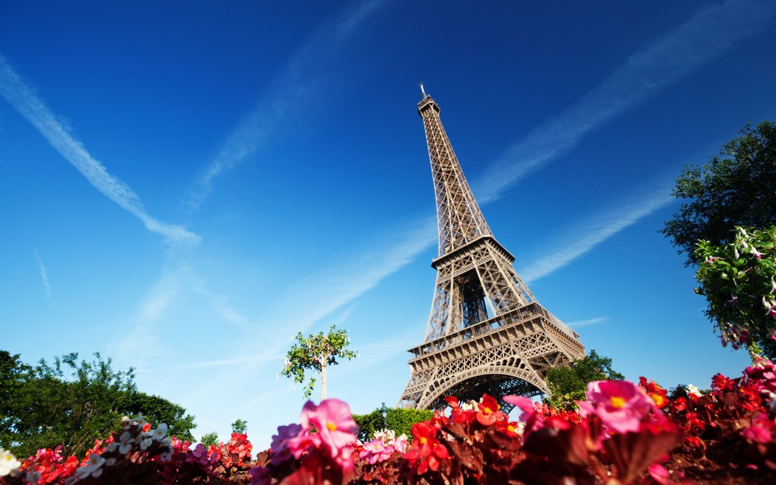
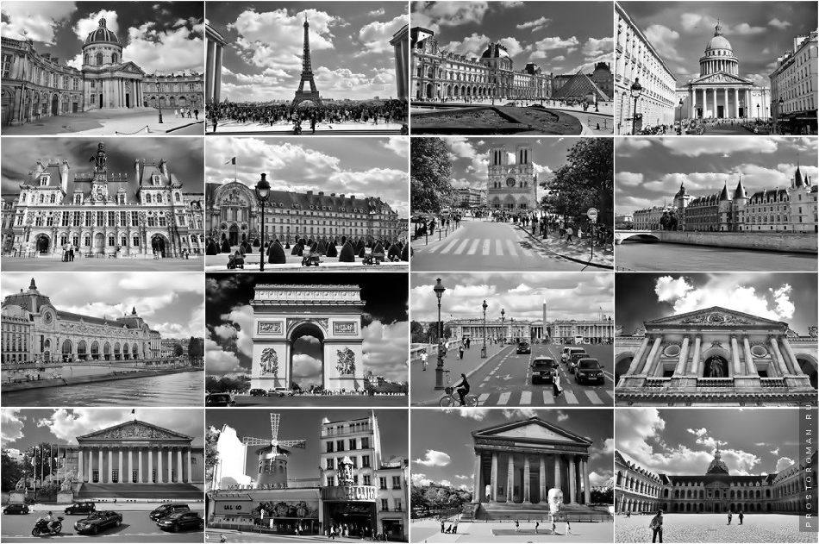
France
Wh-?+did+Подлежащее+V1
Where you ( go)?
I ---- -- Paris.
What you ( do)?
I --- --- s---------g.

Slide 14
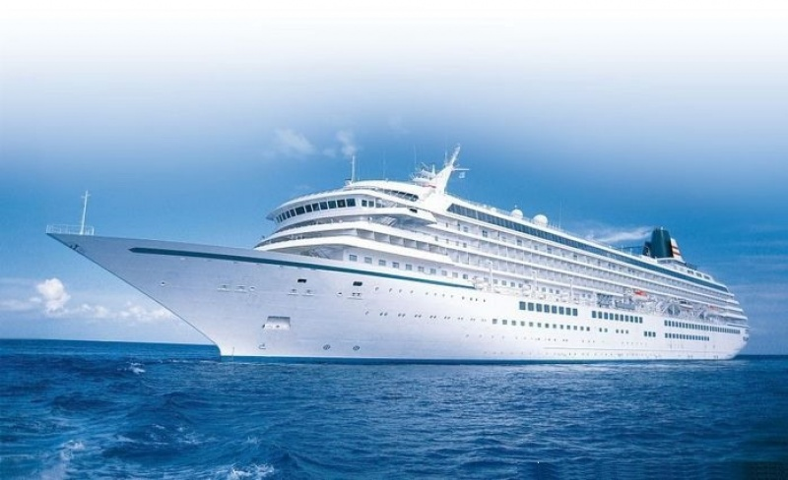
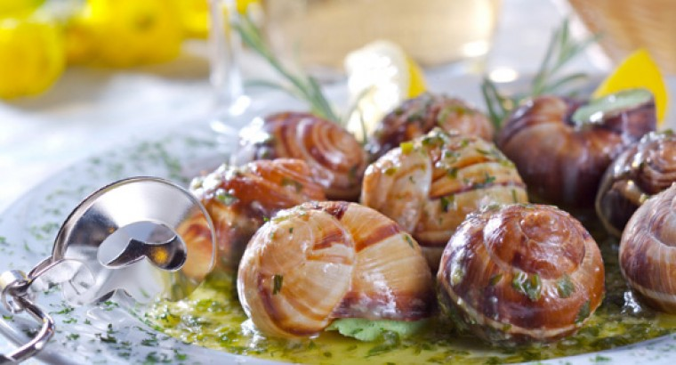
France
Wh-?+did+Подлежащее+V1
How you ( travel)? I ---- -- s---.
What you ( eat)? I --- typical F----- ----.

Slide 15
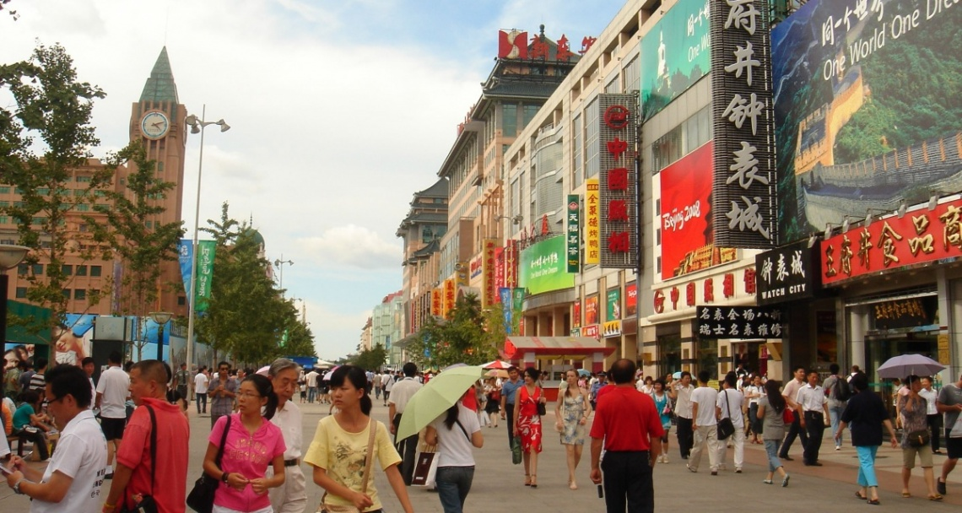
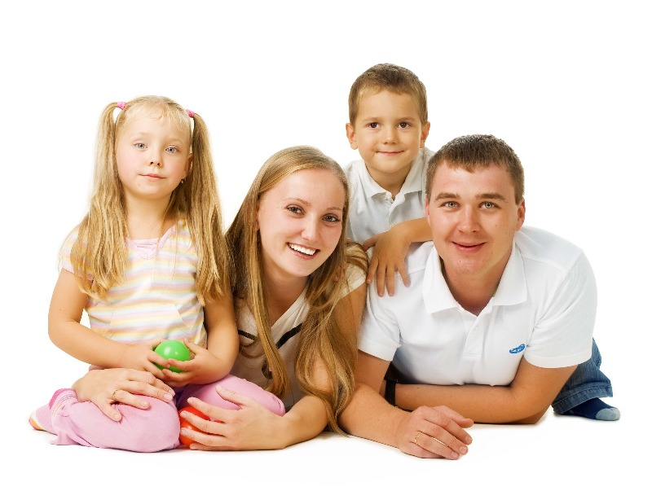
China
Wh-?+did+Подлежащее+V1
Where you ( go)? I ---- -- C----.
With whom you ( go)? I --- ---- -- p-----s.

Slide 16
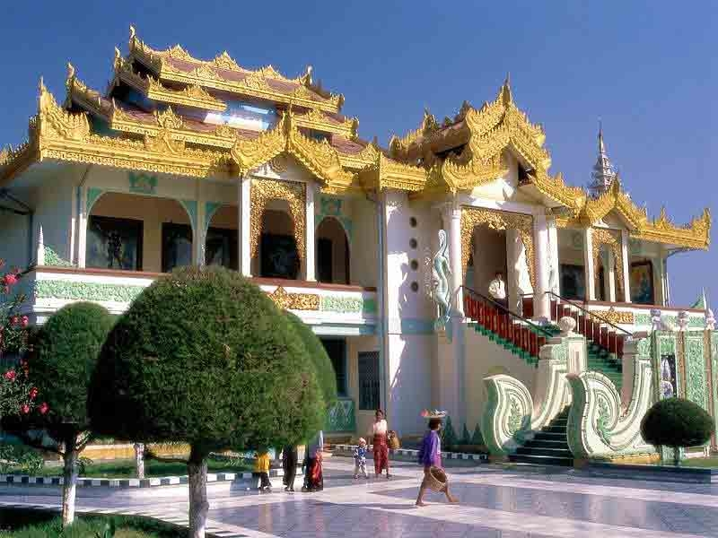
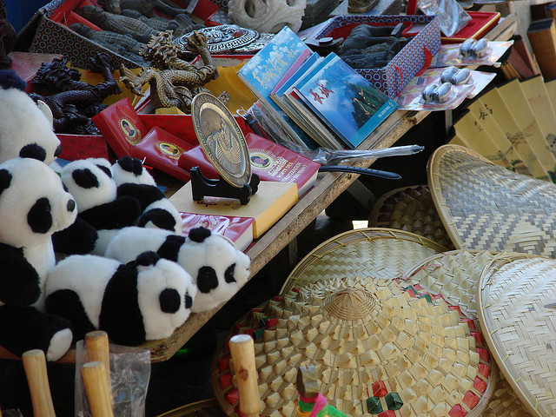
China
Wh-?+did+Подлежащее+V1
Where you ( stay)? I ------ -- --- h----.
What you ( buy)? I ------ s--------.

Slide 17
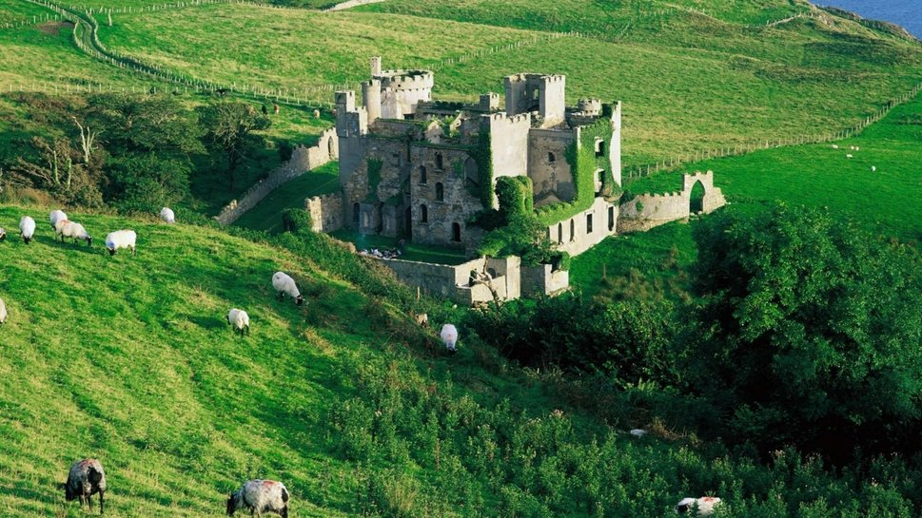
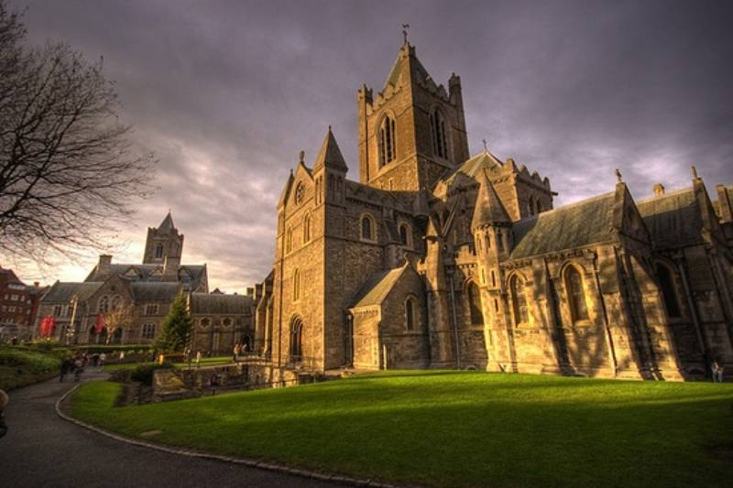
Ireland
Wh-?+did+Подлежащее+V1
Where you ( go)? I ---- -- I------.
What you ( do)? I --- s----------.

Slide 18
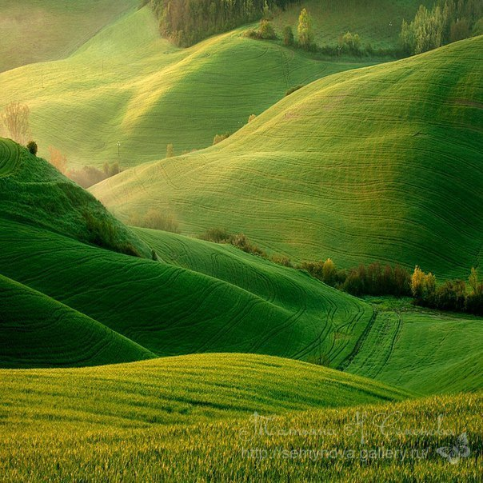
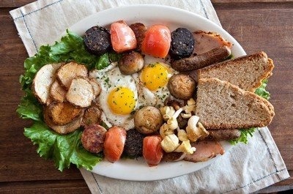
Ireland
Wh-?+did+Подлежащее+V1
What you ( see)? I --- the beautiful I---- n-----.
What you ( eat)? I --- traditional I---- ----.

Slide 19
Open the brackets and put the verbs into the Past Simple Tense

Slide 20
Last month, I (stay) at the Stella Hotel with my wife and two children. We (have) a fantastic holiday. We (love) the hotel and the people (be) very kind and nice to us. We (go) swimming every day from the lovely beach. It (be) only two minutes from the hotel. But the sun (not shine) very brightly. The rooms in the hotel (be) very comfortable, and the food in the dining room (be) good. The children (enjoy) the chips and pizza! I (not taste) this, I (eat) the local food but my wife (choose) the vegetarian one. We (spend) our holiday brilliantly!

Slide 21
Last month, I stayed at the Stella Hotel with my wife and two children. We had a fantastic holiday. We loved the hotel and the people were very kind and nice to us. We went swimming every day from the lovely beach. It was only two minutes from the hotel. But the sun did not shine very brightly. The rooms in the hotel were very comfortable, and the food in the dining room was good. The children enjoyed the chips and pizza! I did not taste this, I ate the local food but my wife chose the vegetarian one. We spent our holiday brilliantly!

Slide 22
Complete the sentences with the correct past form of the verbs given.
1 __________ (be) your hotel in Italy very big?
2 The dinner at the restaurant __________ (be) delicious.
3 I’m sorry. The bus __________ (be) late this morning because of the weather.
4 The weather __________ (not be) very good at the weekend.
5 __________ you at the concert on Friday?

Slide 23
Complete the sentences with the correct past form of the verbs given.
1 Was your hotel in Italy very big?
2 The dinner at the restaurant was delicious.
3 I’m sorry. The bus was late this morning.
4 The weather was not very good at the weekend.
5 Were you at the concert on Friday?

Slide 24
Find and correct the mistakes in the sentences. One sentence does not have a mistake.
1 Which club your brother was in last Friday night?
2 Janet goed to the USA for two weeks last year.
3 I saw Betty a week before and invited her to the party.
4 Did you be at the tennis competition on Saturday?
5 I couldn’t went with my parents to Russia last month because of school.

Slide 25
Find and correct the mistakes in the sentences. One sentence does not have a mistake.
1 Which club was your brother in last Friday night?
2 Janet went to the USA for two weeks last year.
3 I saw Betty a week before and invited her to the party.
4 Were you at the tennis competition on Saturday?
5 I couldn’t go with my parents to Russia last month because of school.

Slide 26
Read the letter from your English penfriend and do the task
Hi Yura,
Thanks for your letter, it was nice to read about your victory in the hockey match. How are you? How did you spend your autumn holidays? You asked me to tell you about my favourite holiday . OK. That’s really cool.
My favourite holiday was when I was about five years old. My mum and dad took me and my brother, James to Sweden for Christmas. I remember the journey on the boat. It took two days, and I felt very ill, but it was very exciting! The boat was fantastic!! When we arrived in Sweden, the weather was terrible. It was very cold, and there was a lot of snow. In England, we don’t usually get snow at Christmas, so it was wonderful for James and me. We drove for a long time, all through the night, and then we arrived at this small house. It was beautiful. There were about five little houses and a shop. In the house, there wasn’t a TV! We couldn’t watch films, so we played games with Mum and Dad. Also, we played a lot outside in the snow. It was the best holiday of my life!
Sorry but I should round up – mum’s calling me to walk out the dog. Tell me about your favourite holiday ! What was interesting ? What did you like in it?
Write back soon,
All the best,
John

Slide 27
Write your answer to John and tell him about your favourite holiday ( 60 - 80 words)
Remember the rules of writing an informal letter!

Slide 28
-contractions: I’ m, didn’t, aren’t
-paragraphs marking
-informal words and phrases
-starting a letter
-finishing a letter

Slide 29
Starting:
Hi Sam,
Hi,
Dear Sam,

Slide 30
Finishing:
Write back soon,
See you soon ( later),
All the best,
Cheers,
Best wishes

