Slide 1
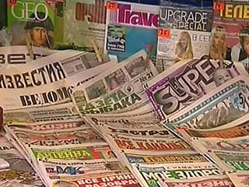
Mass Media
Prepared by: 9A
Guided by:Mikhailova Elena Nikolaevna
Taldom 2014

Slide 2
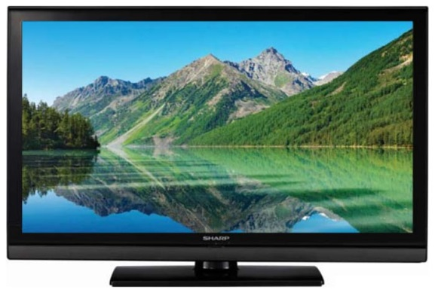
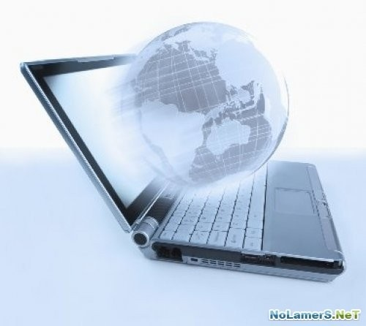
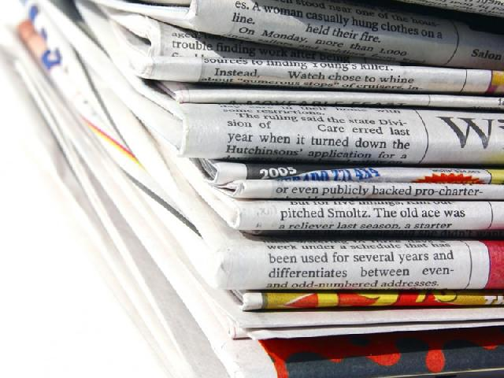
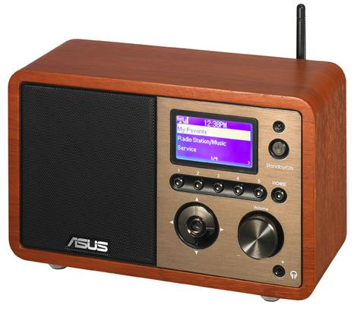
What is
the media?
TV
Internet
press
radio

Slide 3
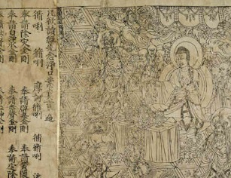
The first printed Chinese newspaper appeared
in 868 A.D.

Slide 4
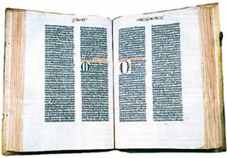
Europe saw its first book in 1453 when Johannes Guttenberg invented the printed press.

Slide 5
The influence
of mass media
Negative
influence
Positive influence
Manipulate the minds of people
Sometimes misinform
TV and the Internet cause addiction
Entertain people
Give necessary information
Educate people and allow them to communicate

Slide 6
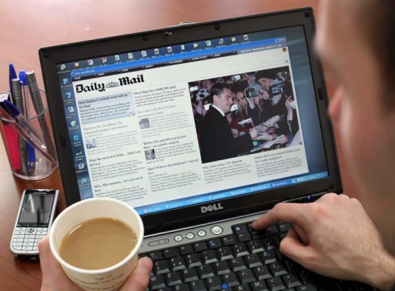
Nowadays the information can be useful for people. It is very important for everyone because there are lots of things happening every minute in the world which can affect our professional and private life.

Slide 7
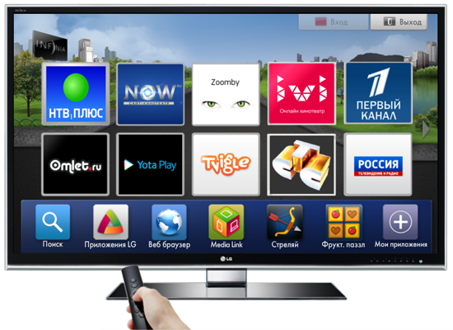
News
on the TV

Slide 8
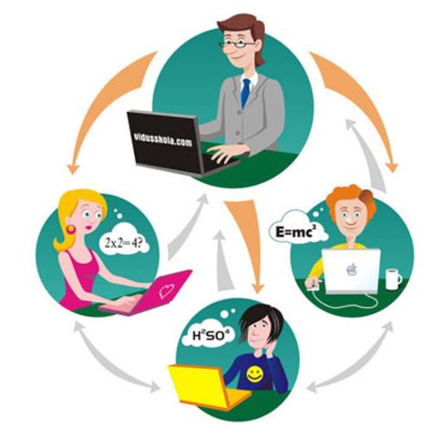
Mass media
for education

Slide 9
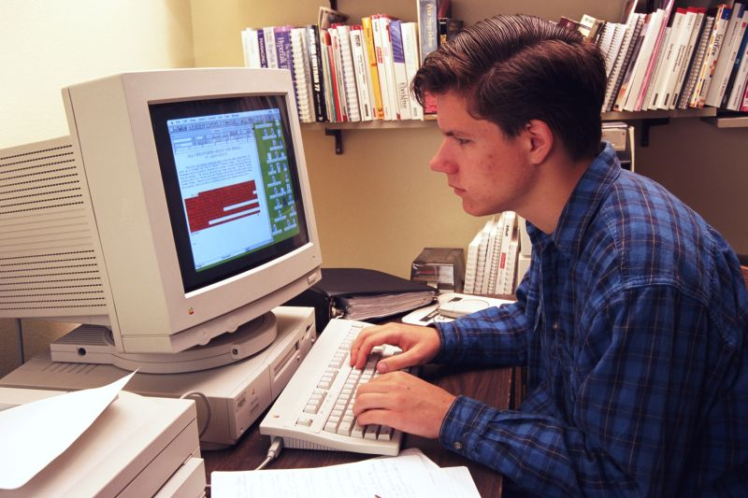
People gain knowledge from the Internet and TV programs.

Slide 10
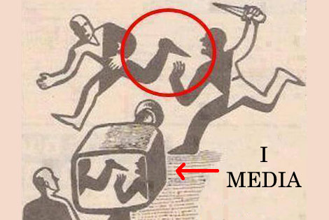
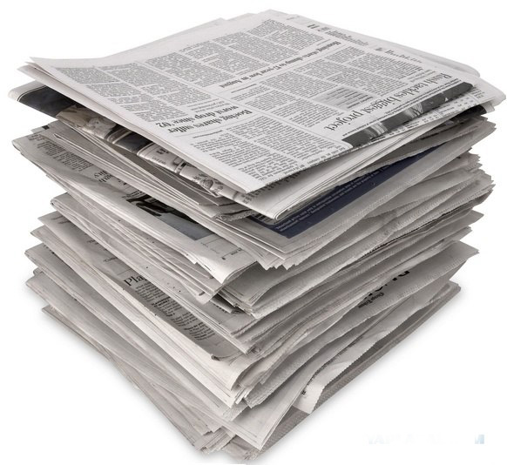
One shouldn`t rely on everything the newspapers say.

Slide 11
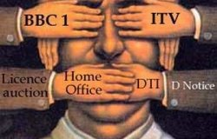
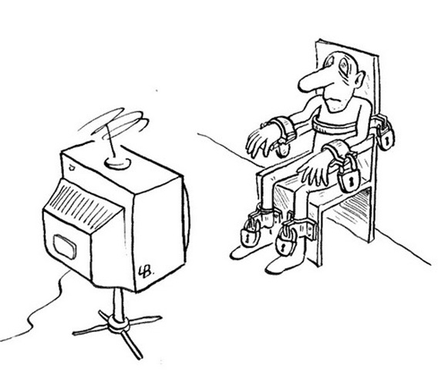
Mass media can also manipulate the minds of the audiences.

Slide 12
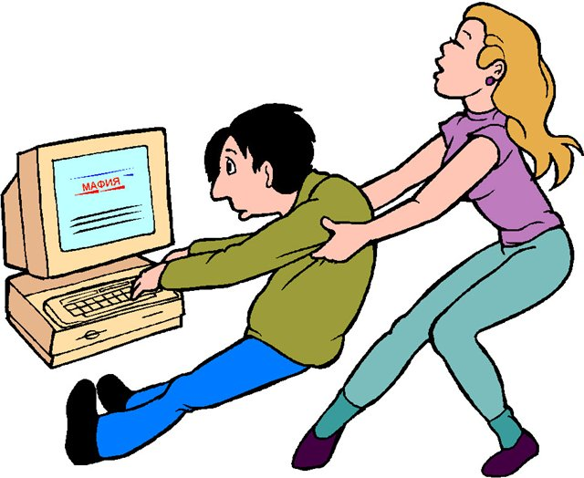
Tons of meaningless TV-shows, glossy magazines and social networks steal young people`s time.

Slide 13
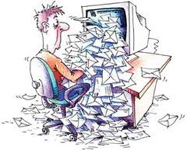
We should be careful and filter all information we get.

Slide 14
Thank you for your attention!

Slide 15
There lived a king. And he had 3 sons. But the last was a fool.
Queen Elizabeth II was born on 21 April 1926. She is the Head of the Commonwealth.
The final of this competition takes place every May at the famous Wembley stadium in London.
Britney Spears is one of the world`s pop princesses. She has a big house in Beverly Hills and recorded her third album.
The international community has banned together to condemn a terrorist attack as 35 people were killed in a bombing inside Moscow`s Domodedovo airport.

Slide 16
Television
Newspaper
Advertisement
Quiz
Tabloid
Talk show
The Internet
Handbook
Radio
Music program
Soap opera
Sports news
Encyclopedia

