Slide 1
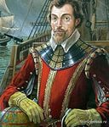
Francis Drake quiz

Slide 2
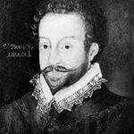
1. Francis Drake was …
a) a sea captain
a sea captain,
a navigator, a privateer
c) a veterinarian

Slide 3
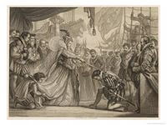
2. He was knighted by …
a) Queen Elizabeth II
b) Queen Victoria
c) Queen Elizabeth I

Slide 4
3. Francis Drake was born …
a) in 1540
b) in 1544
c) between 1540-1544

Slide 5
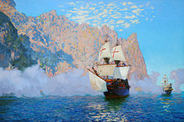
4. Drake started his career as a sailor in the age of …
a) 21
b) 30
c) 12

Slide 6
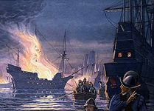
5. Francis Drake captured Spanish ships and stole …
a) their sailors
b) their maps
around 20 tons
of silver and gold

Slide 7
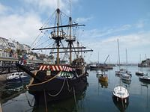
6. The name of Drake’s ship was …
a) The Black Stone
b) The Golden Hind
c) Victoria

Slide 8
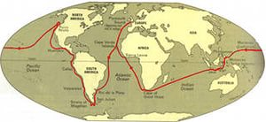
7. Who was the first Englishman to circumnavigate the Earth?
a) Nathan Drake
b) Francis Drake
c) Nelson

Slide 9
8. Who became a life long enemy for Francis Drake?
a) John Hawking
b) Queen Elizabeth
c) The Spanish

Slide 10
9. Drake was appointed … against the Spanish Armada
a) Vice Admiral of the English Fleet
b) the captain of the Golden Hind
c) a Minister

Slide 11
10. The Spanish Armada was …
a) the English fleet
b) the Spanish fleet
c) the main ship in Spain

Slide 12
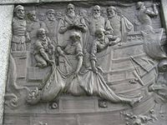
11. Francis Drake was buried …
a) in Westminster Abbey
b) in Spain
c) at sea

Slide 13
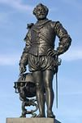
12. Sir Francis Drake will be remembered in…
a) names of some places
in British TV series and
in the video game industry
c) names of some places,
in British TV series and
in the video game industry

Slide 14
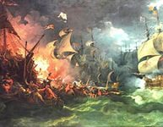
Describe the pictures using Past Perfect/ Past Simple Tenses
As the Spanish (destroy) his ships, they (become) a life long enemy for Drake.

Slide 15
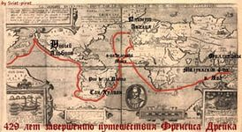
Drake (return) to England as a hero, because he (become) the first Englishman to circumnavigate the Earth.

Slide 16
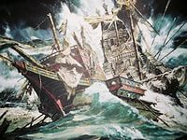
Drake (take part) in the battle with the Spanish Armada, he (become) Vice Admiral of the English Fleet.

Slide 17
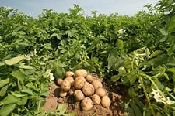
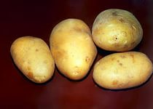
Many poor people (respect) Drake, as he (bring) potato to Europe.

Slide 18
Let’s sum up!
During today’s lesson I have learnt…/
found out…/
remembered…
It was interesting for me that…
Your home task:
Ex. 7 p. 55
To read the text p. 55
To find the info about a Russian traveler

