Slide 2
Тема:«Загрязнение воздуха в помещении. Как защитить себя от загрязнителей воздуха внутри помещений?»
УМК ‘Spotlight 10’ (Афанасьева, Михеева
В.Эванс).
Преподаватель английского языка ФГКОО Московское Суворовское военное училище: Оникийчук Наталия Петровна

Slide 3
1. How do you understand this wisdom?
2. What problem does it touch on?
3. Is it so important to discuss this problem?

Slide 4
Indoor pollution
Indoor pollution
How To Protect Yourself From Indoor
Pollutants?

Slide 5
Silent Killers In Your House
Indoor air can be 2 to 5 times
More polluted than the air
Outside your house
(some organizations raise this
numbmer to 100 times)
5
1
Outdoor air
Indoor air

Slide 6
Silent Killers In Your House
3000 cases of cancer
are caused by exposure
To indoor air pollutants
every year

Slide 7
Silent Killers In Your House
50% of ALL illnesses are
caused or aggravated
by polluted indoor air

Slide 8
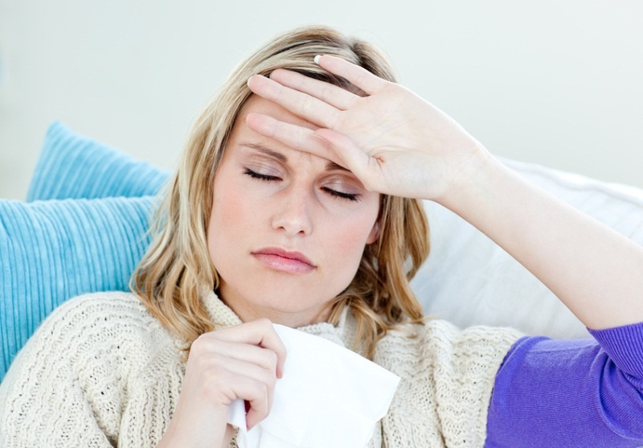
Silent Killers In Your House
50% of ALL illnesses are
caused or aggravated
by polluted indoor air

Slide 9
Types Of Airborne Pollutants

Slide 10
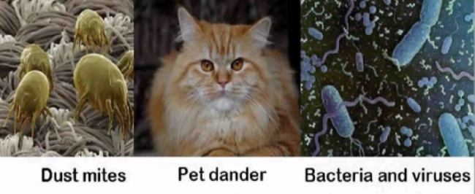

Slide 11
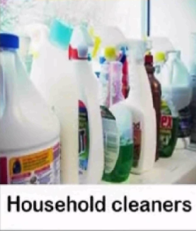
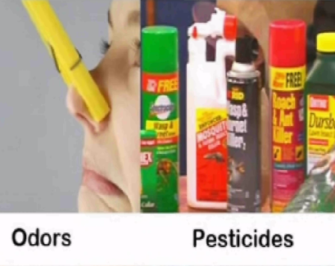
Almost all household cleaning products use VOCs - Volatile Organic Compounds

Slide 12
So, How Do We Protect
Ourselves?
First, we need to understand what
these airborne pollutants are and
where they come from

Slide 13
So, How Do We Protect
Ourselves?
Second, eliminate those pollutions
sources if possible and neutralize the
pollution itself.

Slide 14
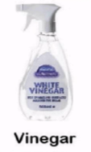
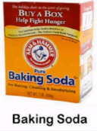
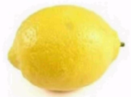
What Can We Do To Protect
Ourselves?
Use non-toxic cleaning products.

Slide 15
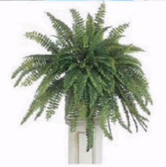
What Can We Do To Protect
Ourselves?
2. Take advantage from indoor plants
• Indoor plants clean air naturally and return oxygen into the air.
• Plants regulate air humidity, eliminate toxins, filter chemicals.
• Leafy plants are most effective for indoor air purification.

Slide 16
What Can We Do To Protect
Ourselves?
3. Regularly air your house
The most effective way of getting rid of indoor pollutants is
exchange your indoor air.
Open the windows wide or run exhaustion fans.
Always open window in your bedroom after you wake up and leave them open for several hours.
In cold weather, open windows and doors wide for a few
minutes, this is more effective than microventilation.

Slide 17
What Can We Do To Protect
Ourselves?
4. Minimize pollution
• Remove clutter that collects dust.
• It’s a good idea not to wear shoes indoors.
• Don’t allow pets in your bedroom, especially if they spend time
outside.
• Regularly clean your house with a wet cloth ( water only, no
chemicals) – furniture, floor, windows, etc.
• Avoid smoking indoors.

