Slide 1
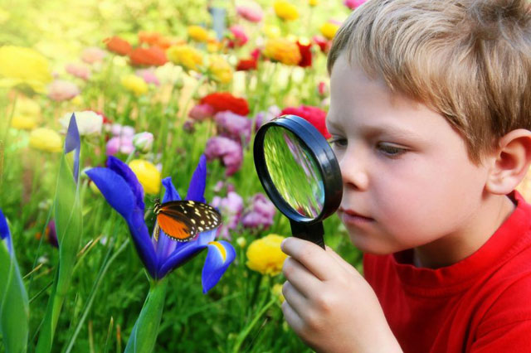

Slide 2
EARTH
DAY

Slide 3
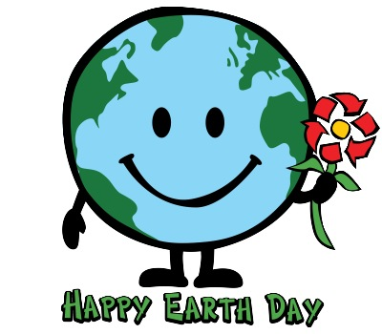
The first Earth Day was - in 1917 - in 1970 - in 2007

Slide 4
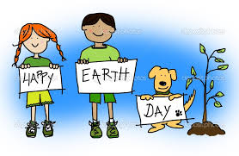
2. Earth Day was born
In Russia
- in Great Britain
In America

Slide 5
3. More than - 100 countries - 50 countries - 200 countries celebrate Earth Day

Slide 6
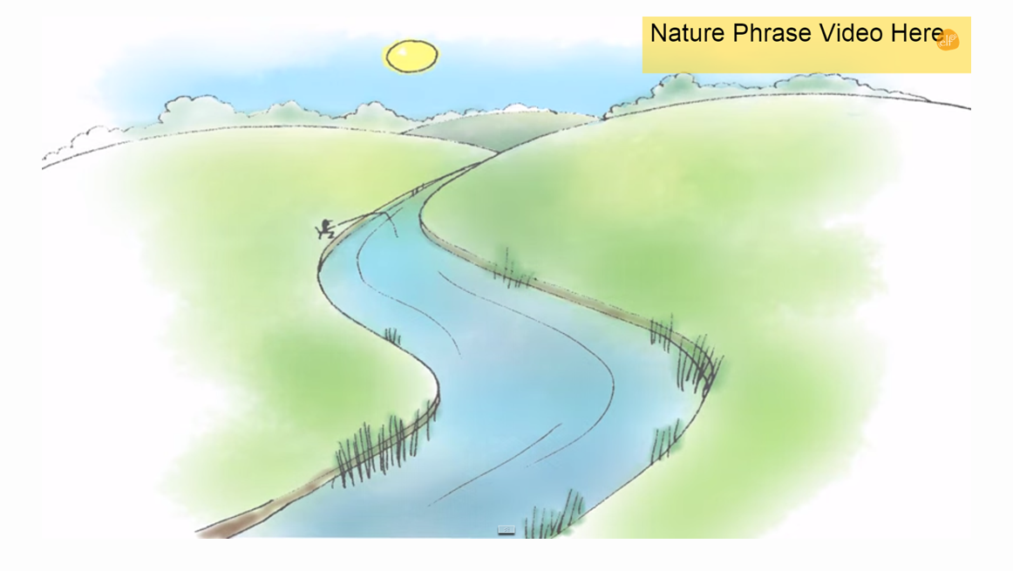
Ссылка на видео: http://www.youtube.com/watch?v=PaiNKEcaHEc

Slide 7
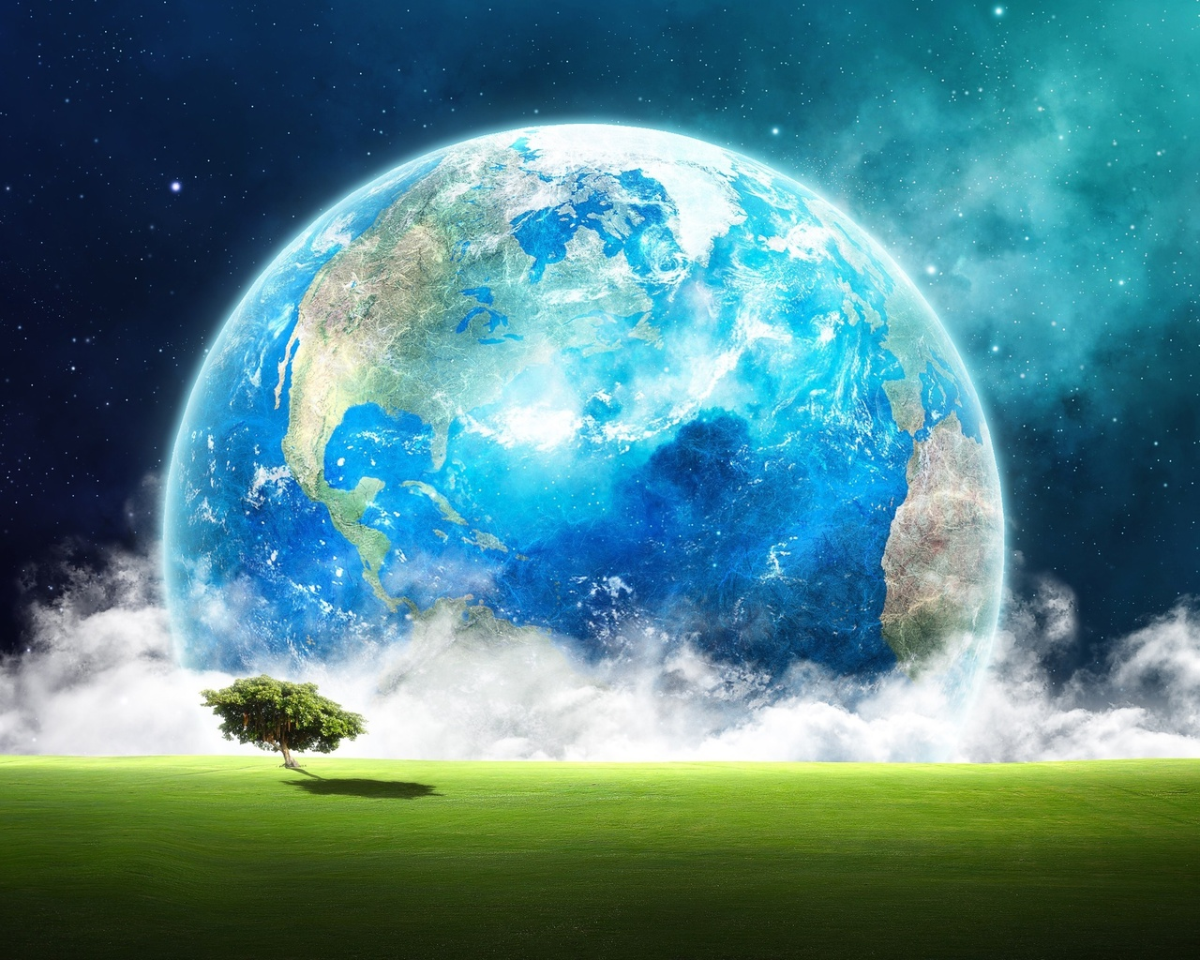

Slide 8
Land
Beach - grass
-desert - jungle
- farm - leaf
-flower - mountain
forest - tree

Slide 9
Lake Ocean Pond River
WATER

Slide 10
-Cloud -moon -star -rain -storm -rainbow -sun -snow -wind
SKY

Slide 11
Varuni, 9 (India)

Slide 12
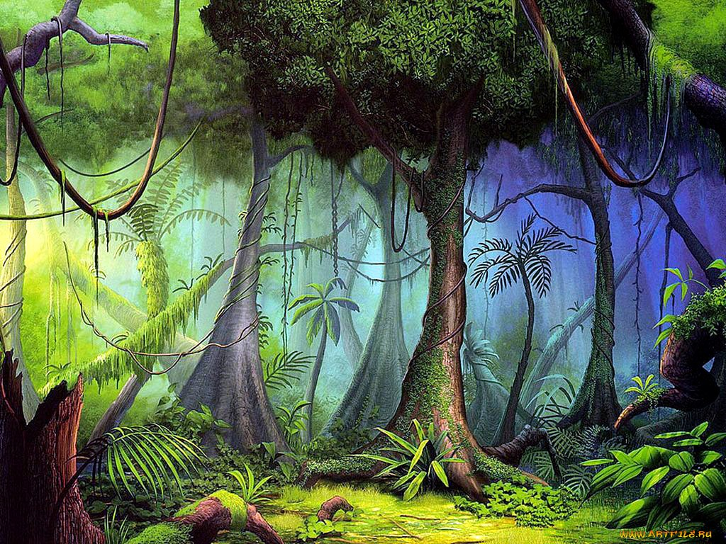

Slide 13
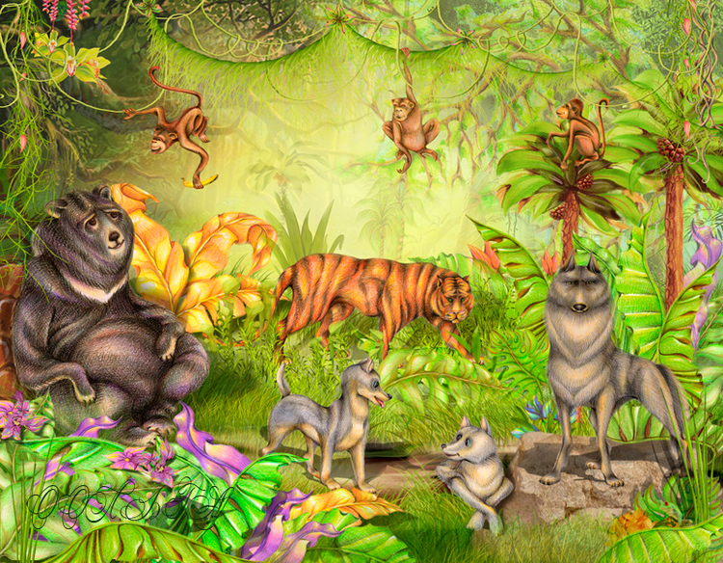

Slide 14
TRUE or FALSE? 1. TRUE 2. FALSE 3. TRUE 4. TRUE 5. FALSE

Slide 15
Ссылка на видео:
http://www.youtube.com/watch?v=GoSq-yZcJ-4

Slide 16
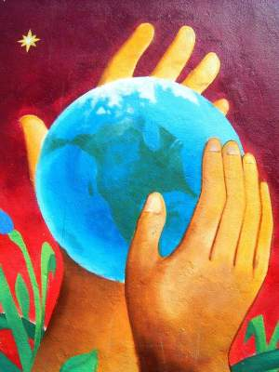
Helping the Earth

Slide 17
PUZZLE TIME

Slide 18
Ссылка на видео:
http://www.youtube.com/watch?v=um_Myo_K8_w

