Slide 1
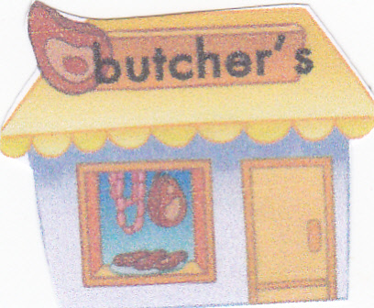
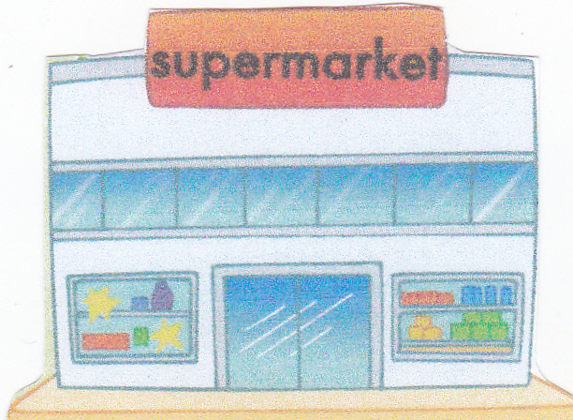
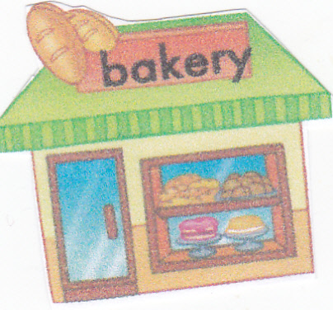
SHOPPING,
Made by George Gengera, the pupil of the 6a form
SHOPPING,
LET’S GO SHOPPING!

Slide 2
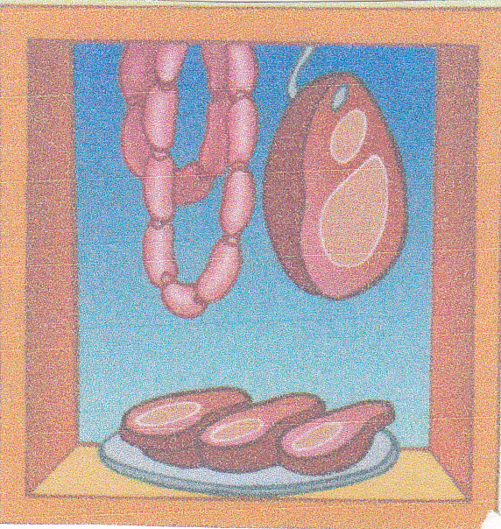
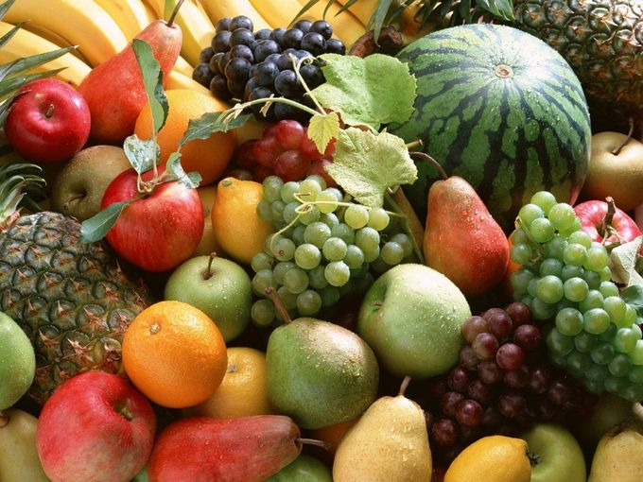
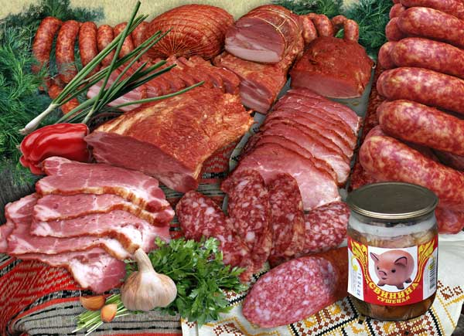
I SHALL BUY
A LOT OF FOOD:

Slide 3
BREAD

Slide 4
AND BUTTER,

Slide 5
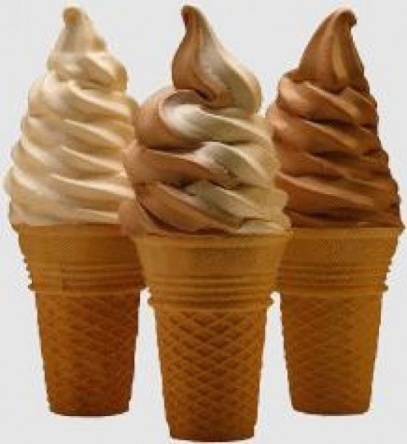
CHEESE
AND ICE – CREAM.

Slide 6
I THINK IT TASTES SO GOOD!

