Slide 1
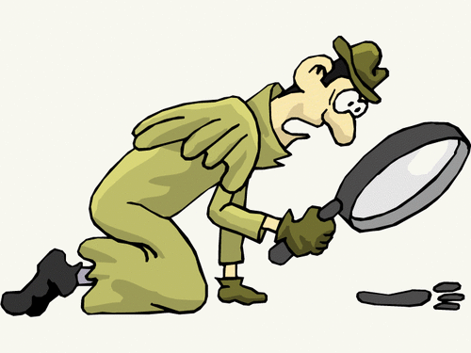
A SICRET CODE
1,
12, 9, 11, 5;
19, 8, 15, 16, 16, 9, 14, 7.

Slide 2
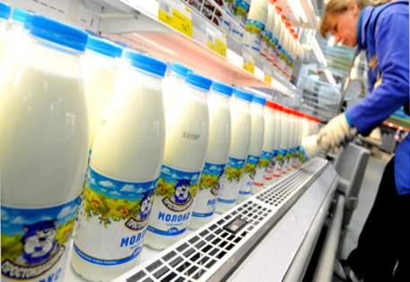
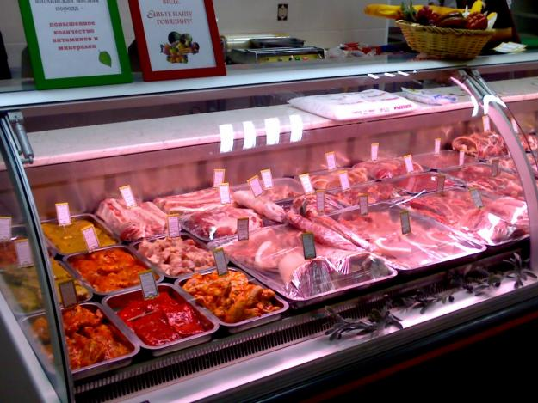
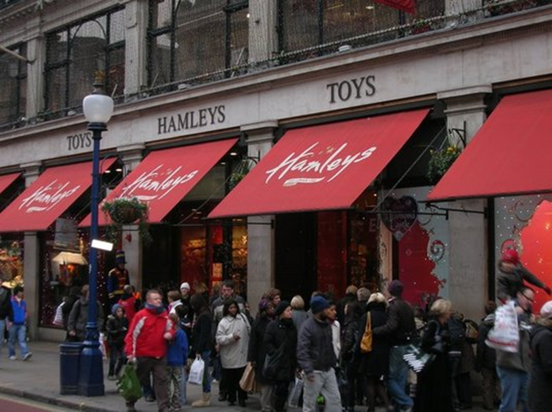
“I LIKE SHOPPING!”

Slide 3
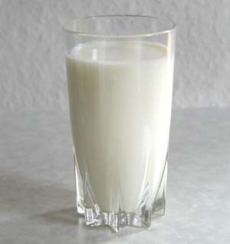
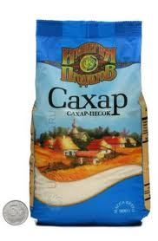
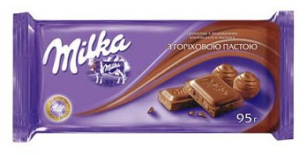
Match the packing to the food:

Slide 4
Shopping for food
.
.
Match the words:
.
a glass of
sweets
.
a loaf of
milk
.
a kilo of
bread
.
a bar of
tea
a cup of
honey
a jar of
cake
a slice of
chocolate
a piece of
meat

