Slide 1
The world around us

Slide 3
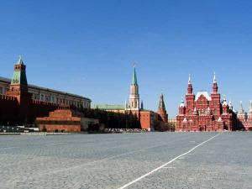
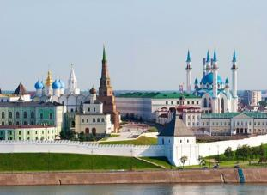
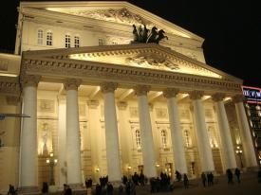
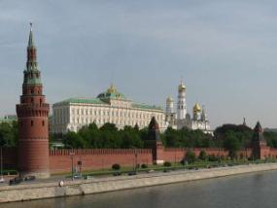
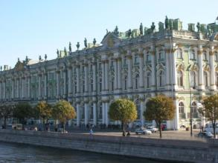
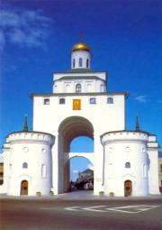
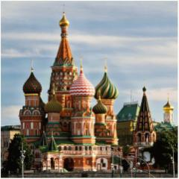

Slide 5
The sights of Germany

Slide 6
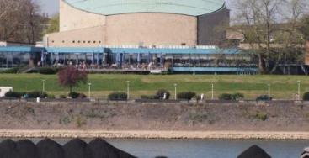
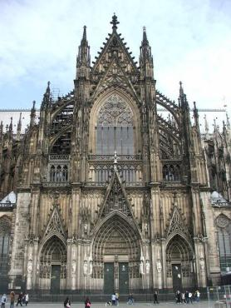
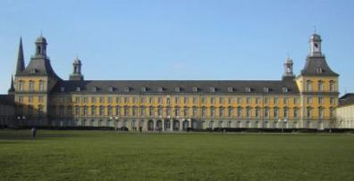
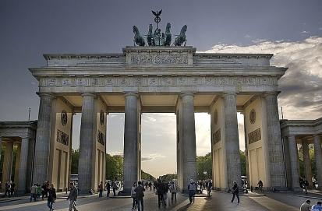
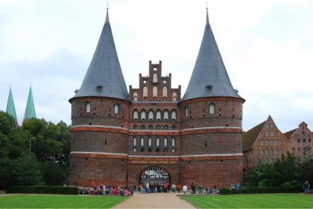

Slide 8
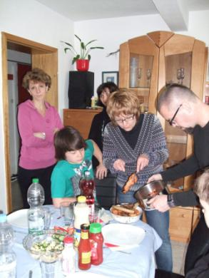
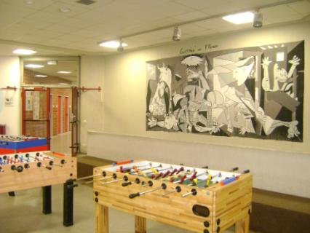

Slide 9
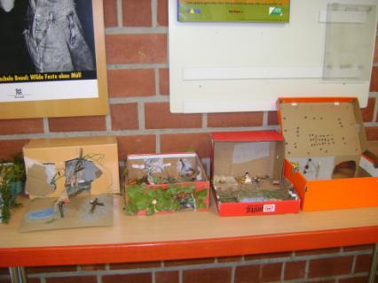
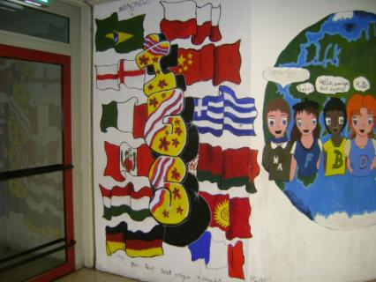

Slide 10
NAME:
TOWN:
AGE:
HOBBY:
NATIVE LANGUAGE:
FOREIGN LANGUAGE:
FAVOURITE HOLIDAY:
SYMBOL:
PROJECT:
PRESENT:

Slide 11
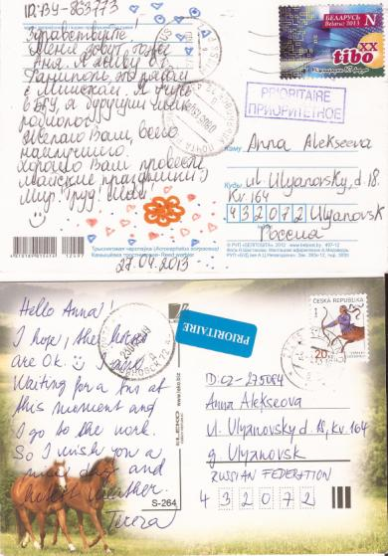
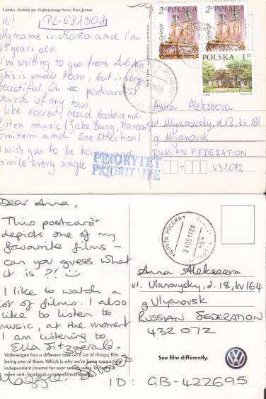
Postcrossing

Slide 12
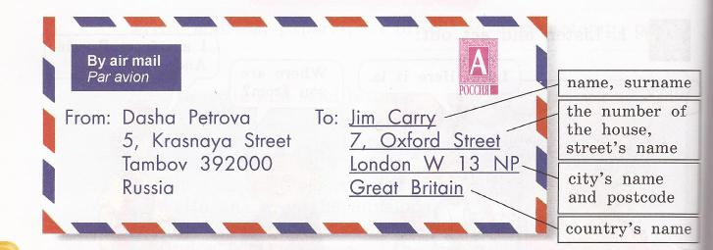
Hello,
My name is_____
I’am________
I’m from___________
My hobby_____________
Have a blessed and happy Easter!
May chocolate be plenty and hags be many! Happy Easter!
Best wishes,
______

Slide 13
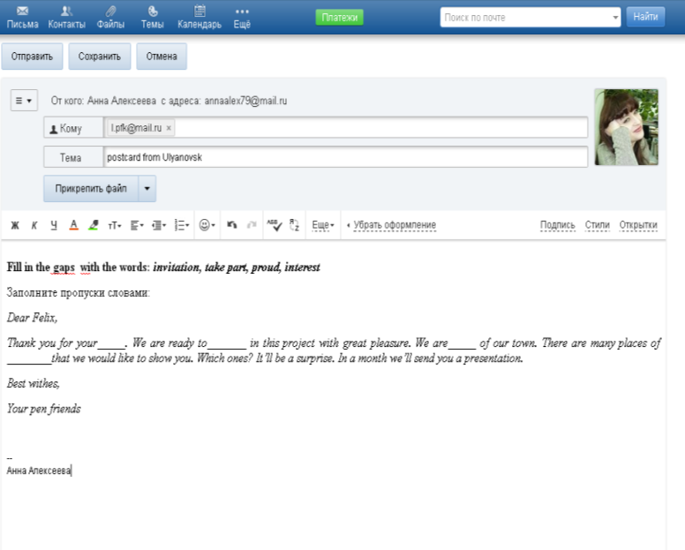

Slide 14
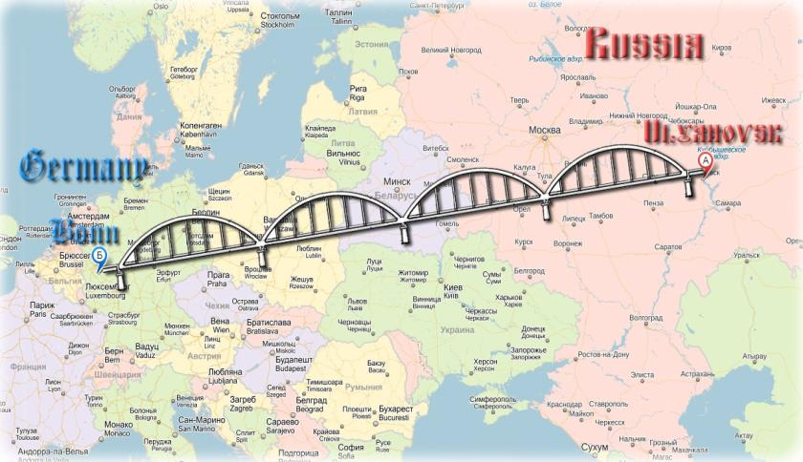

Slide 15
Клуб интернациональной дружбы
“We are together"
We are different but we are together
Муниципальное бюджетное образовательное учреждение
«Средняя общеобразовательная школа №63»

