Slide 1
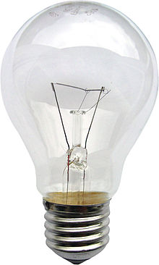
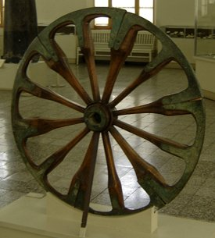
Progress and development

Slide 2
The aims of the lesson:
* work with the topic of the lesson
* use the new vocabulary in monological and dialogical
speech
* listen to people speaking about computers and express
your opinion
* discuss the benefits and drawbacks of using
computers
* mind the use of grammar rules : conditional
sentences

Slide 3
Quotаtions of famous people
“The future is not a gift- it is an achievement”.
“All good things are difficult to achieve”
“Empty pockets never held anyone back. Only empty heads and empty hearts can do that”

Slide 4
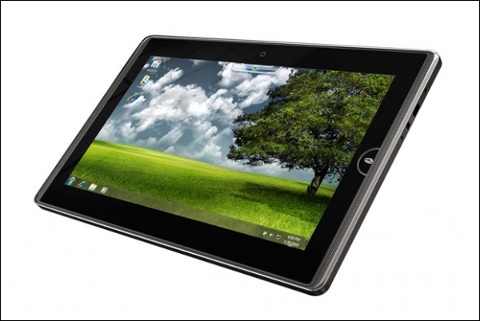
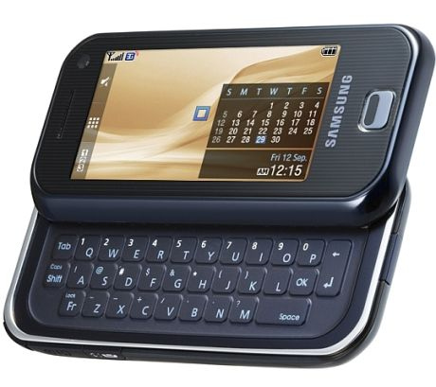
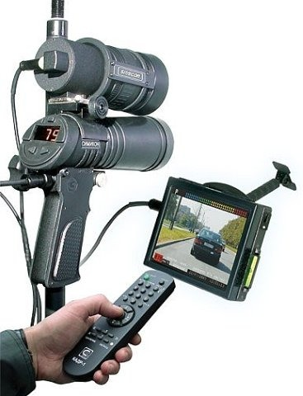
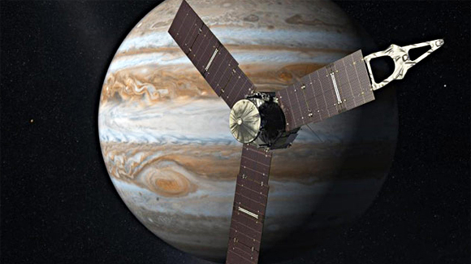
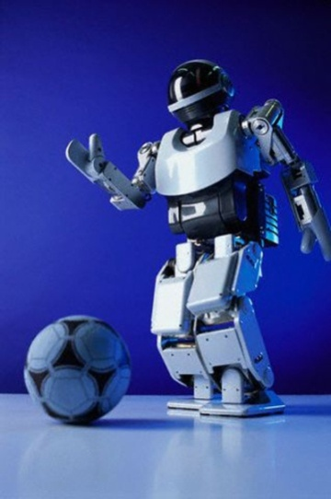
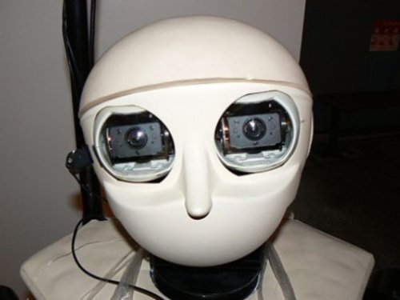
Modern Technologies and Their Influence on Our Life and Language

Slide 5
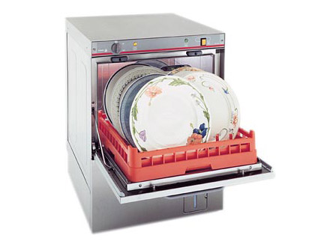
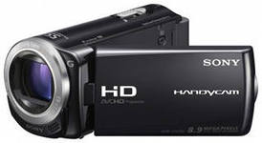
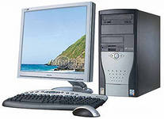
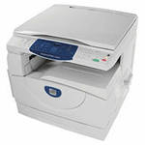
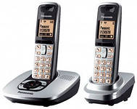
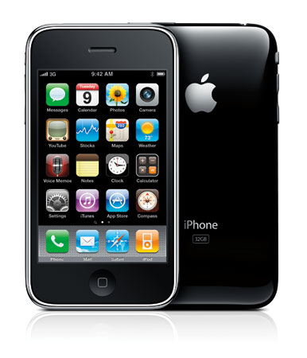
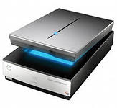
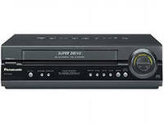
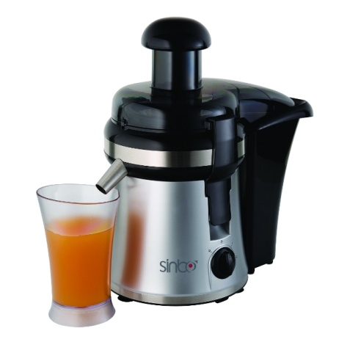
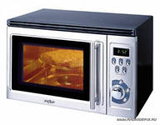
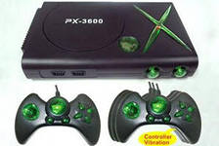
Up-to-date Inventions

Slide 6
Households
Science
Education
Technology
Communications
Entertainment
Film industry

Slide 7
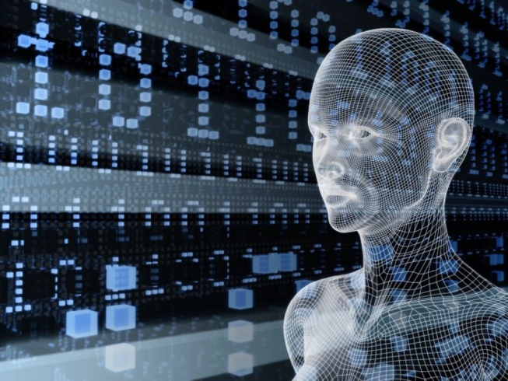
Why do people use them?

Slide 8
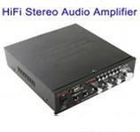
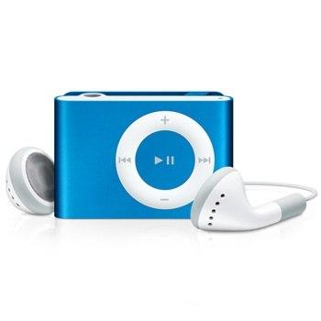
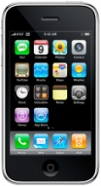
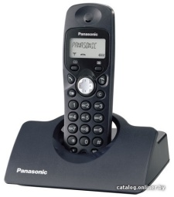
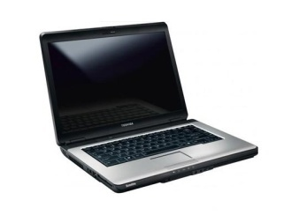
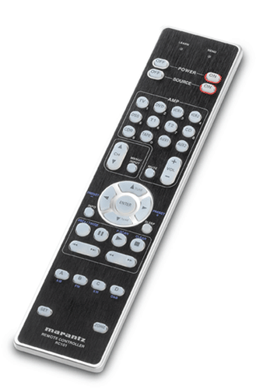
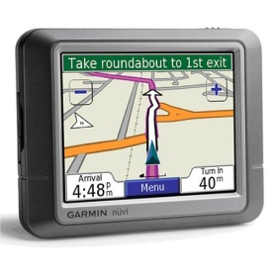
What things are the most important for you? Why?

Slide 9
We can not imagine our life without computers. What do you use computers for?

Slide 10
Are you for or against computers?

Slide 11
Benefits
- we depend on technologies in all aspects of life
- it is a source of information
- it is a way of communication
- computers are necessary tools at our workplace
- we get skills that are necessary in the information age
- it is a good friend for disabled people
- distance learning has a great importance
- it is important for security and safety

Slide 12
Drawbacks
- we spend more and more time in front of computers
- we have no time for sport activities and become lazy and passive
- there are a lot of violent information about murders, killers and criminals
- it is harmful for our health, some people suffer from disease connected with computers
- they often break

Slide 14
Work in pairs. Agree or disagree with these statements. Give your reasons.

Slide 15
What would you do if these things hadn’t been invented.
Our life would be so boring and uninteresting
It would be difficult to invent new things
It would be no progress in the future

Slide 16
Conditionals
Second | If- PAST SIMPLE | , would infinitive
Third | If- PAST PERFECT | , would past participle
Mixed conditionals | If – PAST PERFECT If – PAST SIMPLE | , would infinitive , would past participle

Slide 18
What would you do…
If you were invisible
If you were genius
If you could read people’s thoughts
If you were famous and rich

Slide 19
We can see some opportunities people can have using different gadgets. Read the text, changing the highlighted words.
When I bought a computer fifteen years ago, it was an__
(achieve). It was just a glorified typewriter. I had no Internet___(connect), no printer. But after the___(technology) revolution of the last few years, I can not believe how my computer has changed my life. I use the Internet for___( shop). But the biggest change has been in my working life. My husband is an artist and now does a lot of____(draw). As for me, I work as a____(consult). And now I work from home. Fifteen years ago it was a dream but now it seems____(nature) to work in my living room.

Slide 20
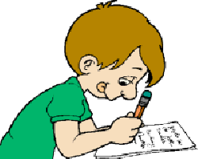
To sum up…
Progress has brought about many changes. Inventions that were once considered amazing are now everyday household items which make life easier and provide entertainment and security. There is no doubt that technological advances have changed people’s lives significantly.
Homework: you should write a composition
“Do we benefit or suffer from computers?”
Ex 66 p 107 SB
Your marks : Well done!
Thank you for the lesson! Good luck!

Slide 21
Linking words and phrases
Sequence | Beginning | First(ly) First of all
 | Going further | Second(ly)/third(ly)
 | Concluding | Summing up/to sum up To conclude/in summary Finally In short/in brief
Addition | Besides Moreover What is more
Personal or other people’s opinion | Personal opinion |  | In my opinion/In my view/To my mind Personally I believe that/ I think that It seems to me that
 | Another source |  | It’s popularly believed that People often claim that Some people argue that
Comparison/Contrast | But\However On the contrary On the one hand\On the other hand
Emphasis | In fact/actually Especially Needless to say As a matter of fact
Clarification | In other words For example/for instance Such as
Result | Conjunctions |  |  | because, as, since , so
 | Transitions |  |  | therefore, consequently, as a result
 | Prepositions |  |  | due to , because of.

Slide 22
Plan
make an introduction( state the problem)
express your personal opinion and give 2-3 reasons for your opinion
express an opposing opinion and give 1-2 reasons for the opposing opinion
explain why you don’t agree with the opposing opinion
make a conclusion

Slide 23
Do We Benefit or Suffer from Computers?
People have always been …since times immemorial (in resent years). Today …getting more and more popular.
How do …influence…(Why do…)?
In my opinion…First of all… Secondly…As a result… Moreover…
However (On the other hand) some people complain(argue)…Besides
I strongly disagree with this opinion, because…
Despite other people’s opinion(Nevertheless) I still believe…

