Slide 1
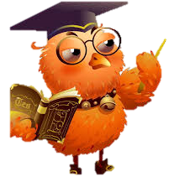
What do you spend your free time? What do you like to do in your free time?

Slide 2
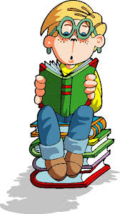
I- my he- his she- her it- its we- our you- your they- their

Slide 3
1. Kate likes to play the piano.
2. Children are fond of travelling.
3. His elder brother doesn’t like jogging.
4. My sister and my aunt went to the cinema yesterday.
5. We painted this picture ourselves.

Slide 4
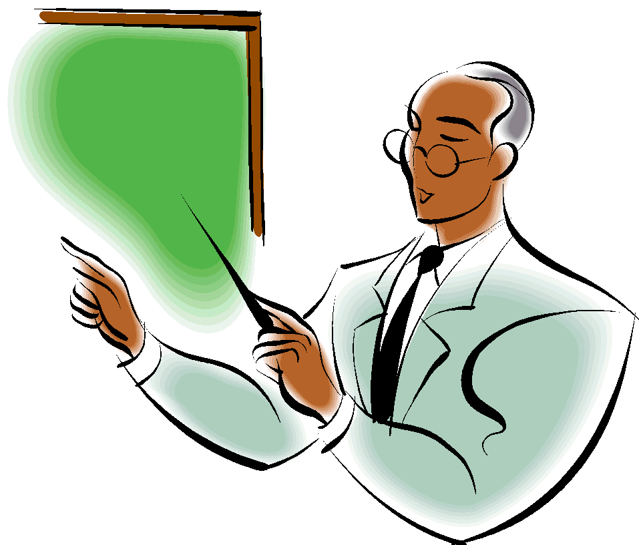
Reflexive Pronouns Возвратные местоимения

Slide 5
I- my-myself
he- his-himself
she- her-herself
it- its-itself
you- your-yourself
we- our-ourselves
you- your-yourselves
they- their- themselves

Slide 6
Himself
Itself
Myself
Herself
Ourselves
Themselves

Slide 8
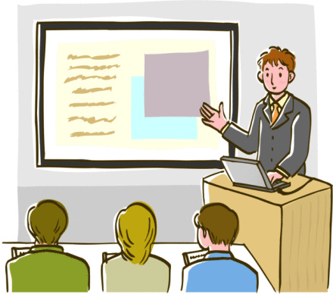
I knew
(я узнал…)
I can
( я могу)
I would like to know
(мне бы хотелось узнать, сделать).

