Slide 1
Where are from?
What countries do you know? What is the name of our
country?

Slide 3
What do we call people living in Russia? (Who) What nationality lives in Britain, America, Australia, New Zealand??

Slide 5
Do you know her?
Avril Lavighne

Slide 6
Where is she from?
She is from Canada

Slide 7
Who is he ?

Slide 8
He is from France
Where is he from?

Slide 9
Who is it ?
Batman

Slide 10
Where is he from?
He is from from USA

Slide 11
Who is it ?
Jude Law

Slide 12
Where is he from ?
He is from Great Britain

Slide 13
Who is he ?

Slide 14
Where is he from ?
He from is Japan

Slide 15
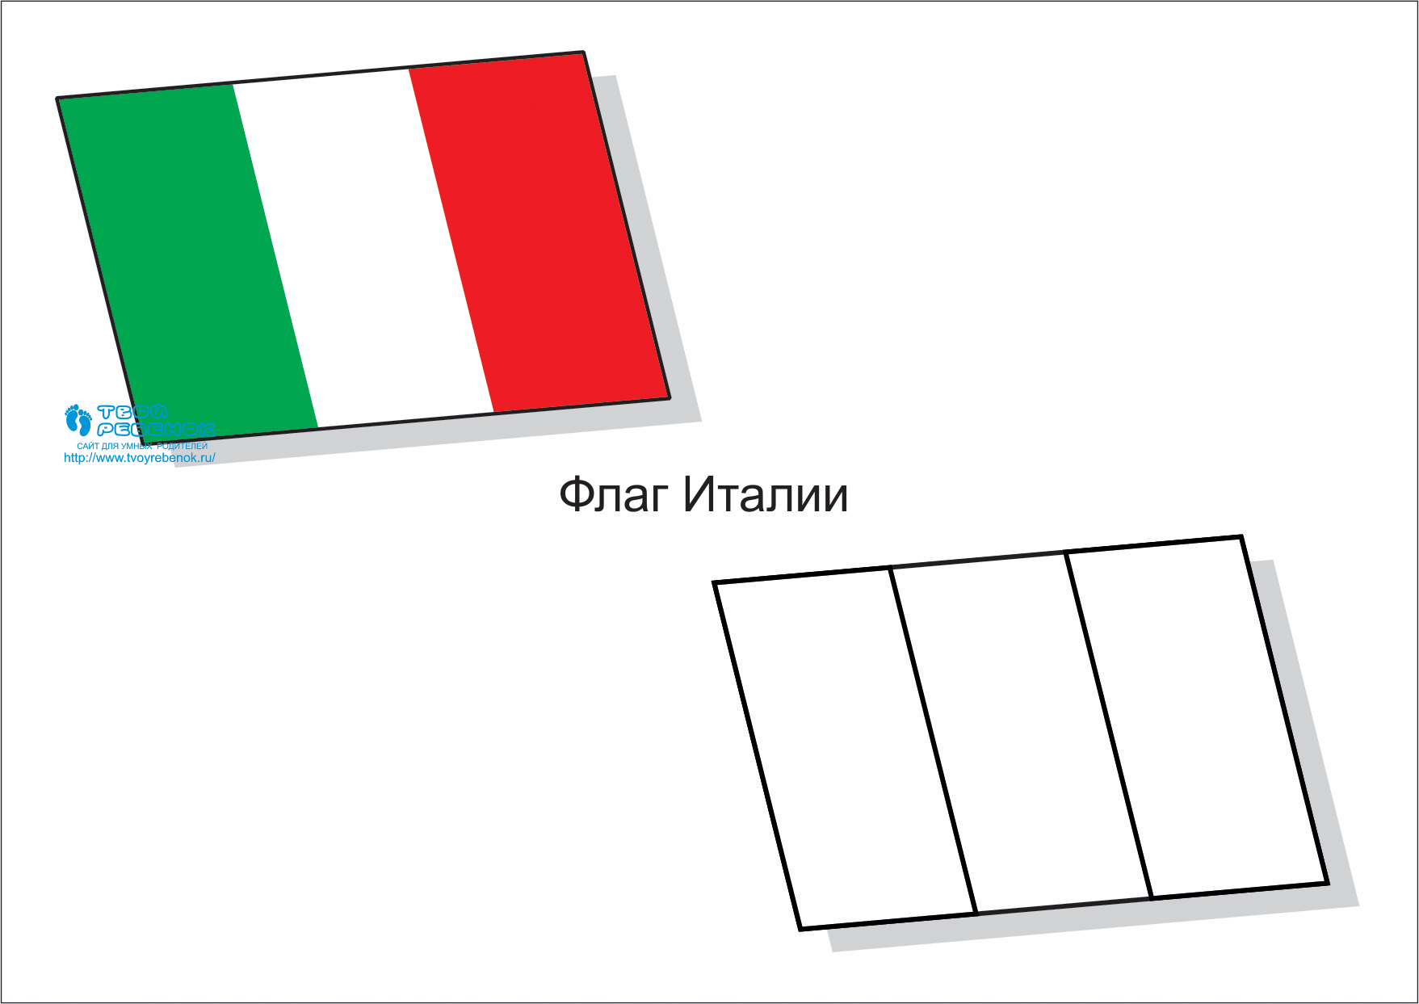
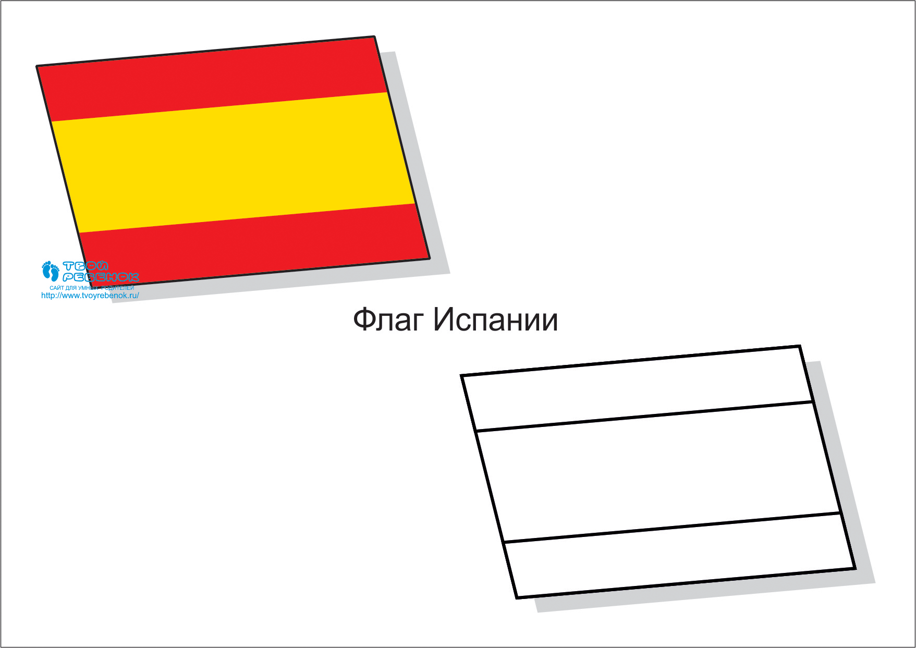
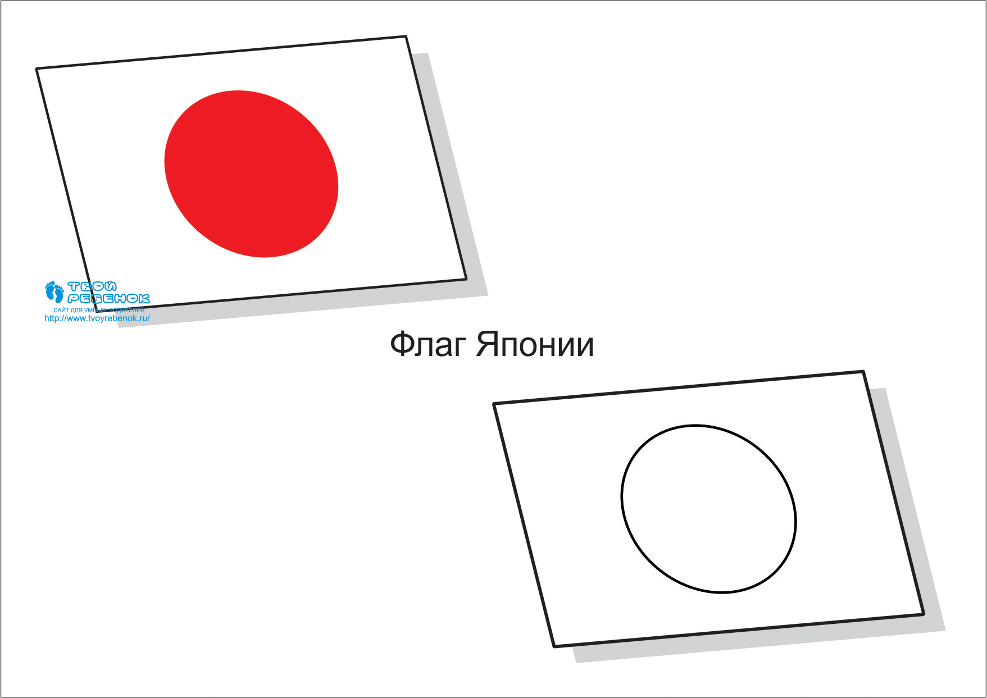
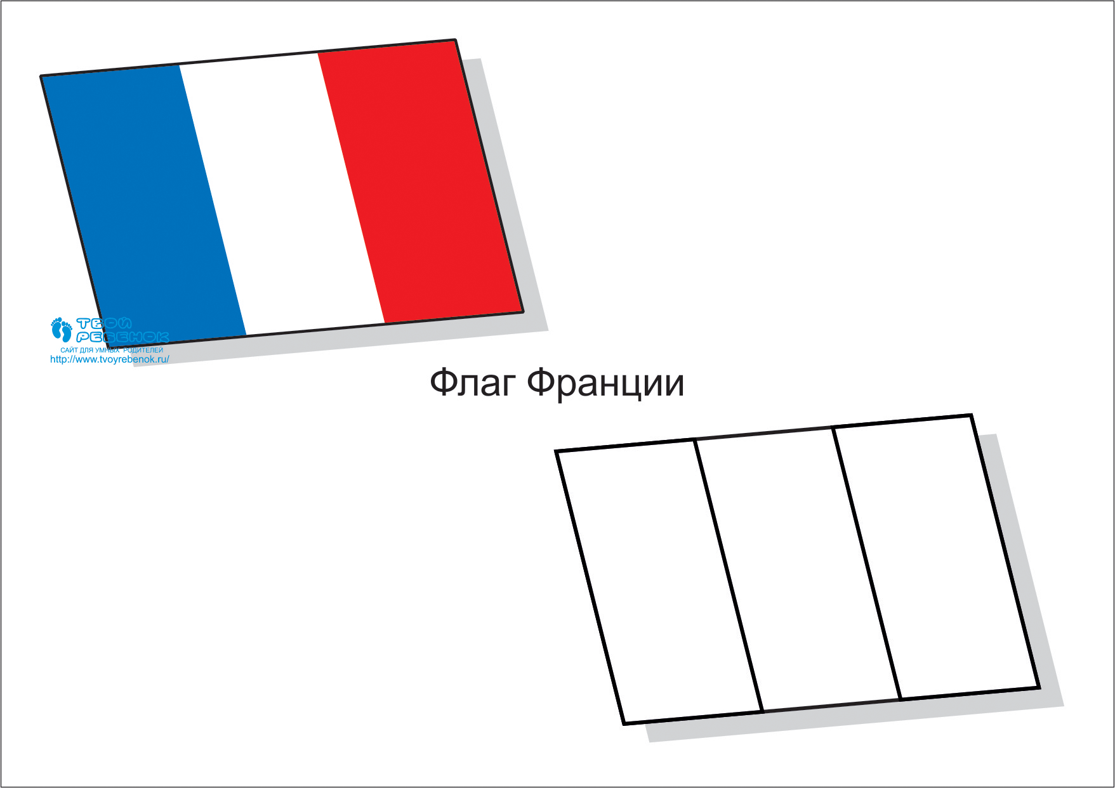

Slide 16
Where are you from ?
I am from …
I can speak English, but I can’t speak Russian

Slide 17
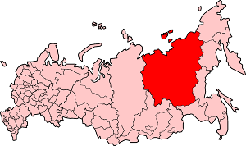
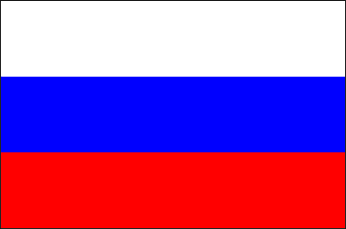

Slide 19
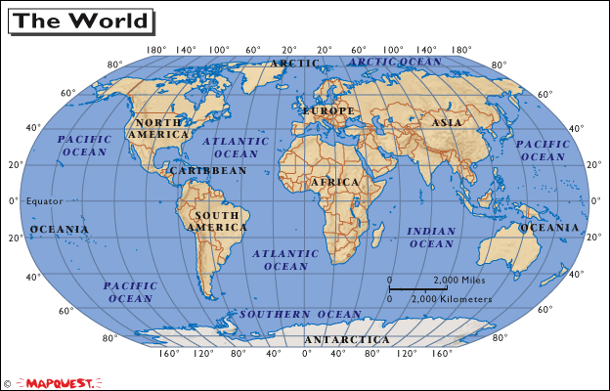
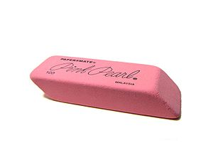
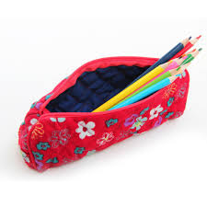
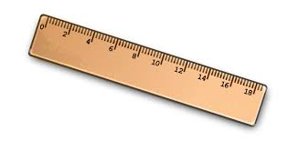
Have you got…

Slide 20
Let’s play
Draw a flag where is from Italian,
English, Spanish, Japanesse, American

Slide 21
Paint the flag

Slide 22
Reflexion
What the most do you like in this lesson ?
What can you do?

