Slide 1
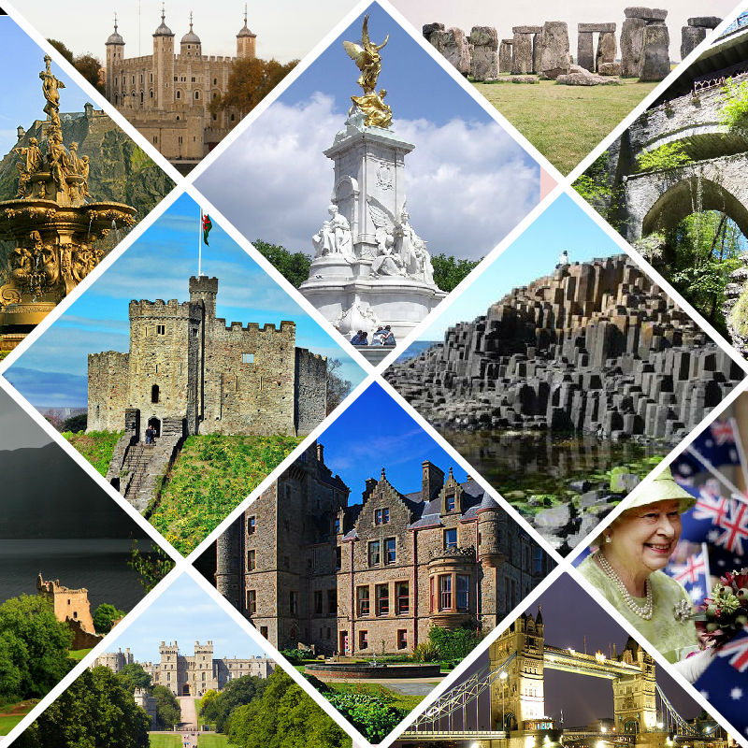
“Great Britain in pictures”
Игра в форме викторины
«Великобритания
в картинках»

Slide 2
Flags & Coat of arms | Symbols & Capitals | Christmas symbols
Sights of Wales & Northern Ireland | Sights of England | Sights of Scotland
Geography | Holidays | Patron Saints & Royal Family of the UK
HEADINGS
1
1
1
2
3
1
1
2
3
2
2
4
5
6
2
4
5
6
3
3
3
7
8
9
4
4
4
1
1
2
3
1
2
5
1
3
2
4
5
6
3
4
2
3
7
8
1
2
3
1
1
2
3
2
1
2
3
4
5
6
4
5
6
4
3

Slide 3
Whose flag is this?
BACK

Slide 4
Whose flag is this?
BACK

Slide 5
Whose flag is this?
BACK

Slide 6
Whose flag is this?
BACK

Slide 7
Whose symbol is this?
BACK

Slide 8
Whose symbol is this?
BACK

Slide 9
Whose symbol is this?
BACK

Slide 10
Whose symbol is this?
BACK

Slide 11
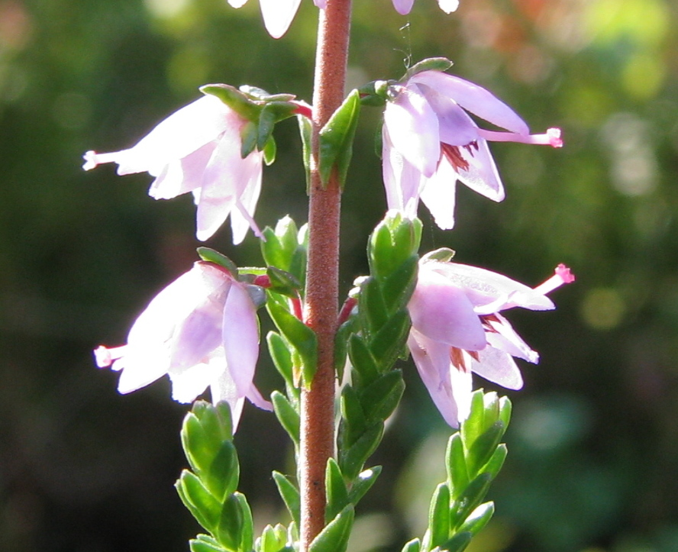
Whose symbol is Heather? Is it true that Wearing a sprig of heather is believed to bring good luck?
BACK

Slide 12
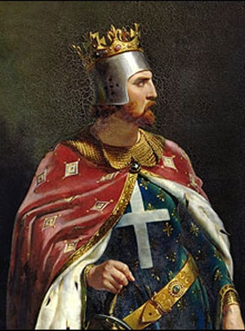
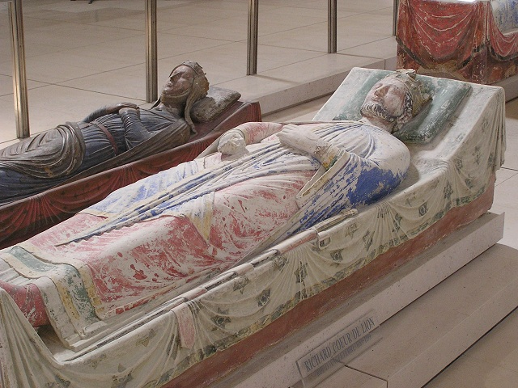
Whose national animal is the lion? Whose medieval warrior nickname was it?
BACK

Slide 13
Whose national tree is the oak?
BACK

Slide 14
Whose national tree is the pine?
BACK

Slide 15
Whose national animal is the unicorn?
BACK

Slide 16
Whose national animal is the red kite?
BACK

Slide 17
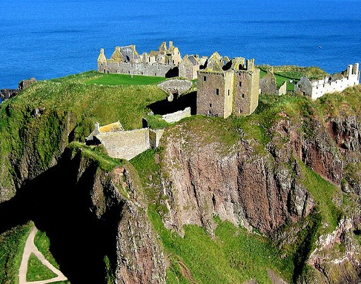
What capital is this?
BACK

Slide 18
What capital is this?
BACK

Slide 19
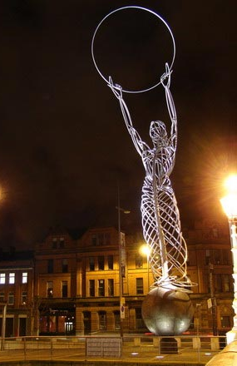
What capital is this?
BACK

Slide 20
What capital is this?
BACK

Slide 21
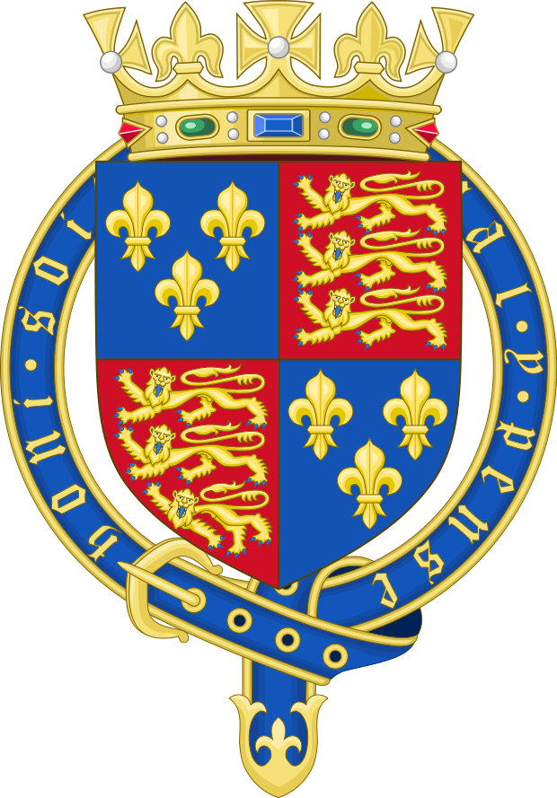
Whose coat of arms is this?
BACK

Slide 22
Whose coat of arms is this?
BACK

Slide 23
Whose coat of arms is this?
BACK

Slide 24
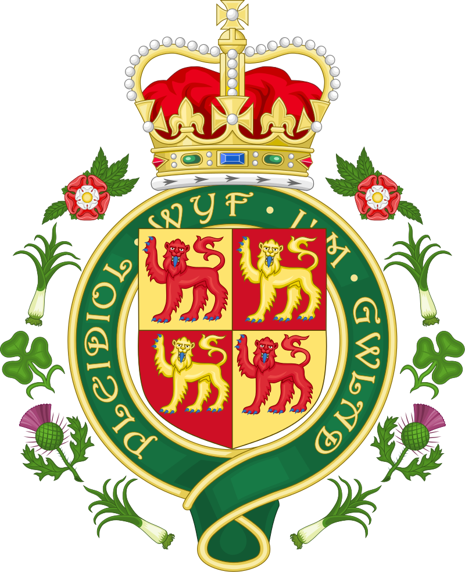
Whose coat of arms is this?
BACK

Slide 25
What is the sightseeing?
BACK

Slide 26
What is the sightseeing?
BACK

Slide 27
What is the sightseeing?
BACK

Slide 28
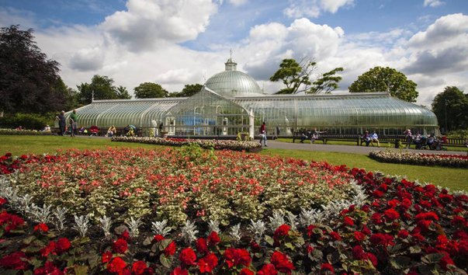
What is the sightseeing?
BACK

Slide 29
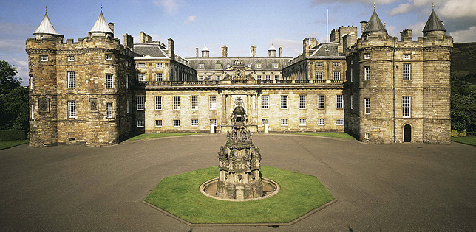
What is the sightseeing?
BACK

Slide 30
What is the sightseeing?
BACK

Slide 31
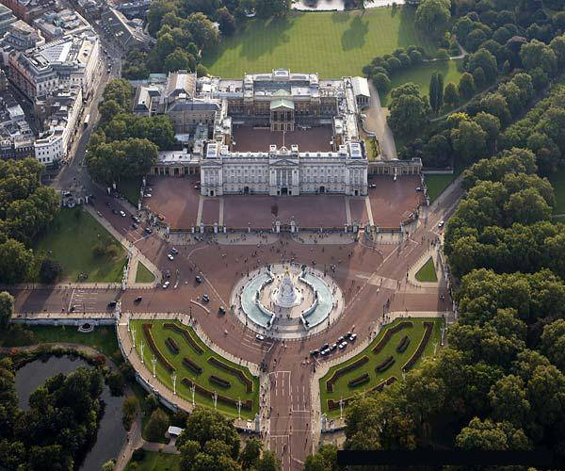
What is the sightseeing?
BACK

Slide 32
What is the sightseeing?
BACK

Slide 33
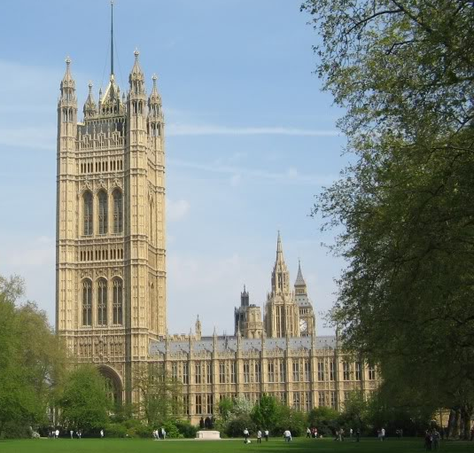
What is the sightseeing?
BACK

Slide 34
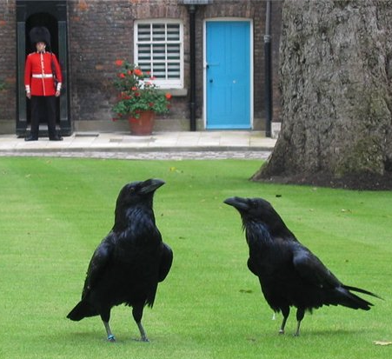
What is the sightseeing?
BACK

Slide 35
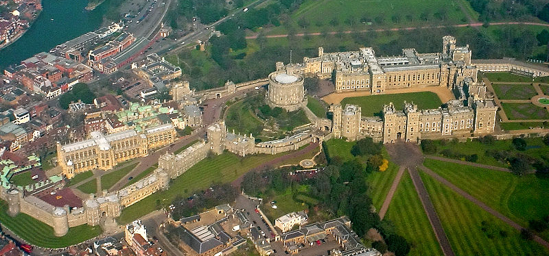
What is the royal residence at Windsor in england?
BACK

Slide 36
What is the square in the heart of london wit a column of a great British naval hero ?

Slide 37
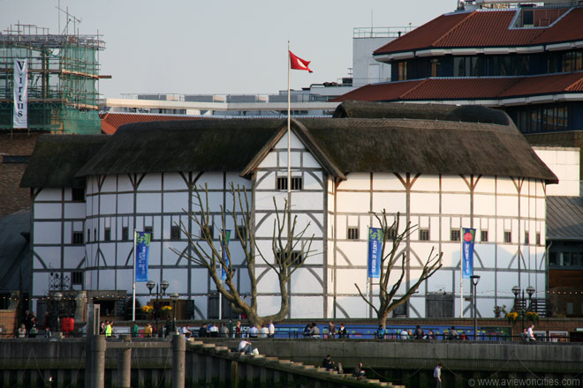
What is the theatre in London associated with William Shakespeare?
BACK

Slide 38
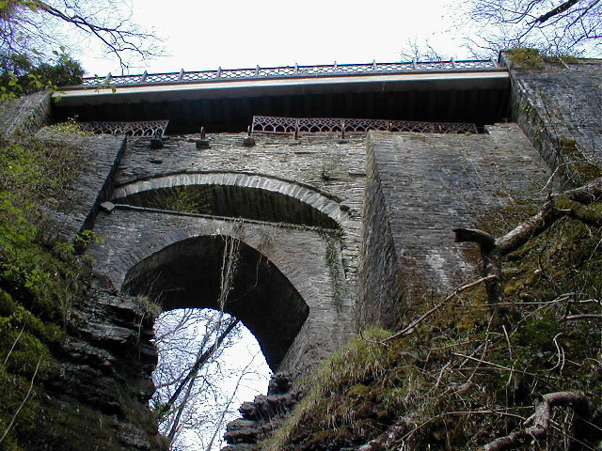
What is the sightseeing?
BACK

Slide 39
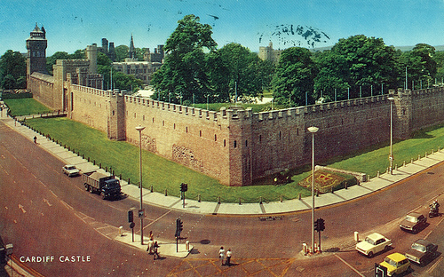
What is the sightseeing?
BACK

Slide 40
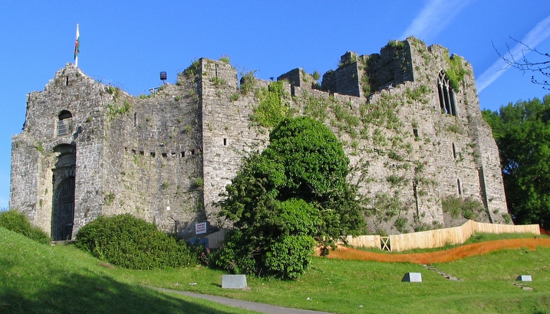
What is the sightseeing?
BACK

Slide 41
What is the sightseeing?
BACK

Slide 42
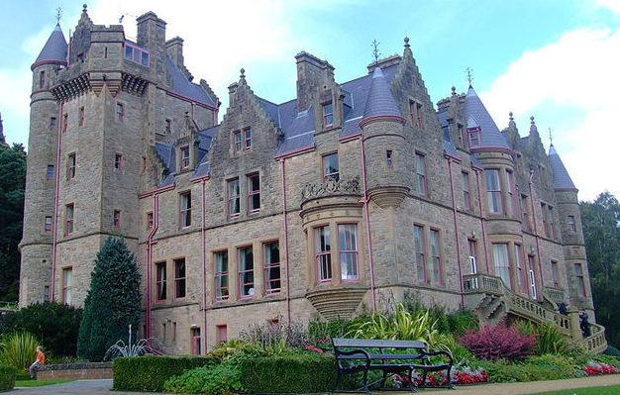
What is the sightseeing?
BACK

Slide 43
What is the sightseeing?
BACK

Slide 44
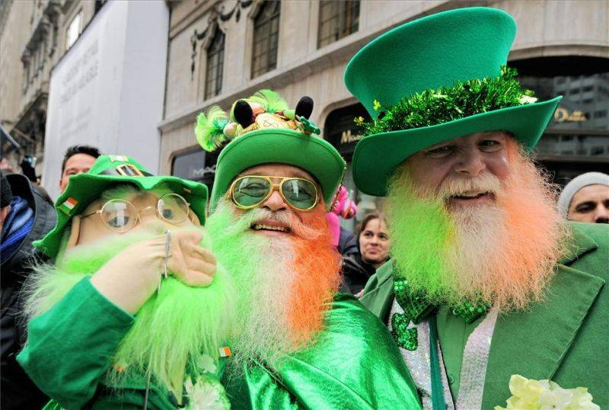
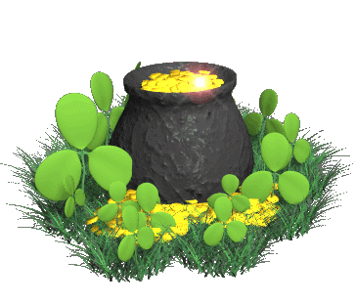
What holiday is it? When do the British celebrate it?
BACK

Slide 45
What holiday is it? When do the British celebrate it?
BACK

Slide 46
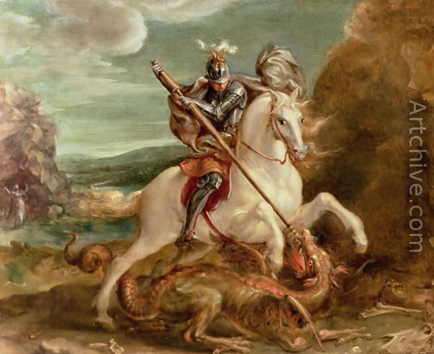
What holiday is it? When do the British celebrate it?
BACK

Slide 47
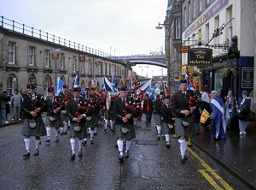
What holiday is it? When do the British celebrate it?
BACK

Slide 48
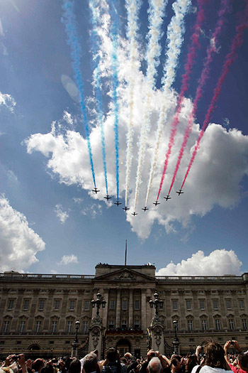
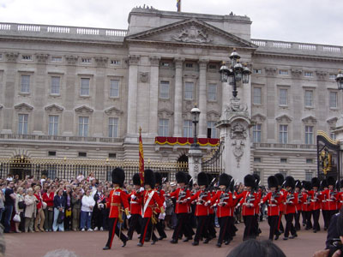
What holiday is it? When do the British celebrate it?
BACK

Slide 49
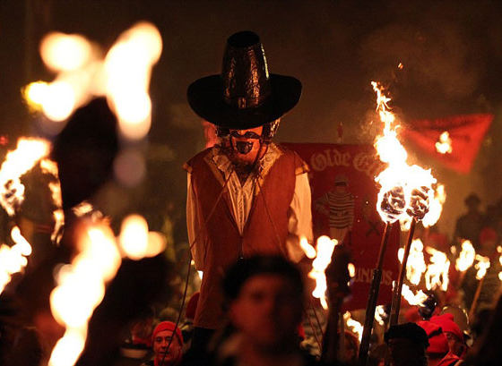
What holiday is it? When do the British celebrate it?
BACK

Slide 50
What christmas symbol is it?
BACK

Slide 51
What christmas symbol is it?
BACK

Slide 52
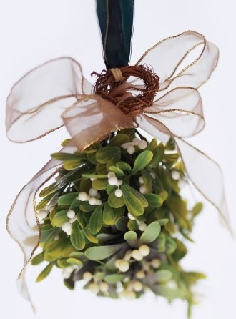
What christmas symbol is it?
BACK

Slide 53
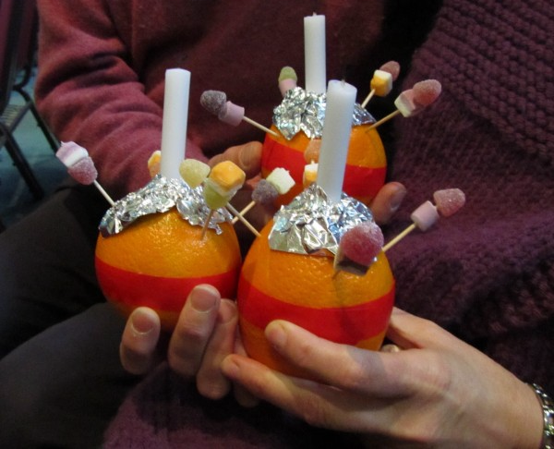
What christmas symbol is it?
BACK

Slide 54
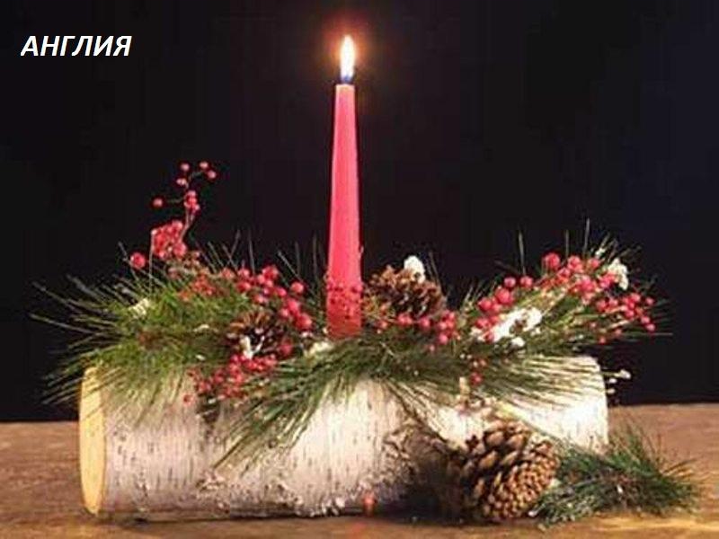
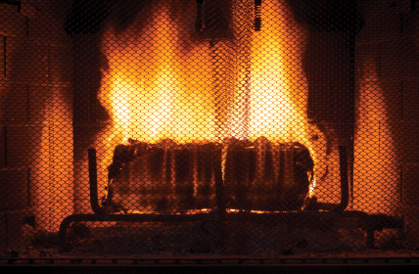
What christmas symbol is it?
BACK

Slide 55
What christmas symbol is it?
BACK

Slide 56
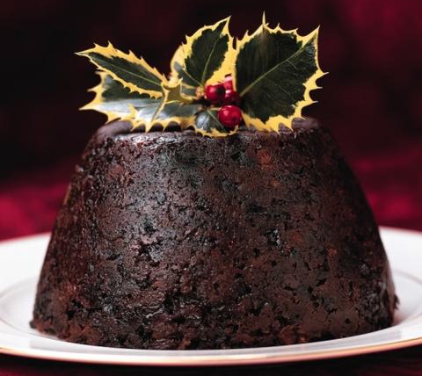
What christmas symbol is it?
BACK

Slide 57
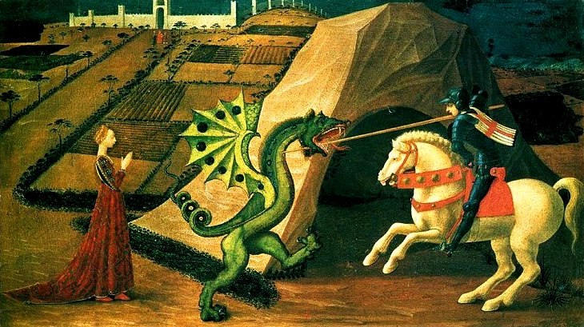
He is the patron saint of….
BACK

Slide 58
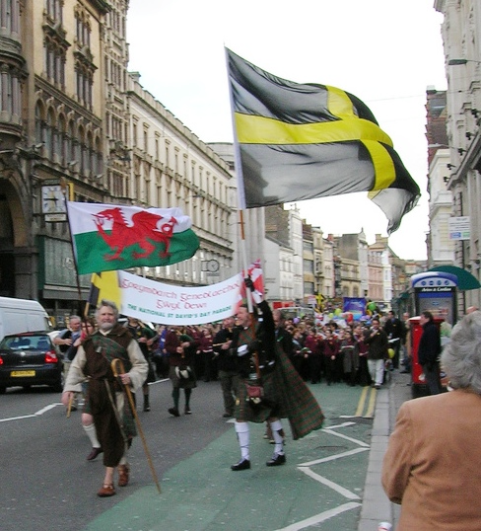
He is the patron saint of….
BACK

Slide 59
He is the patron saint of….
BACK

Slide 60
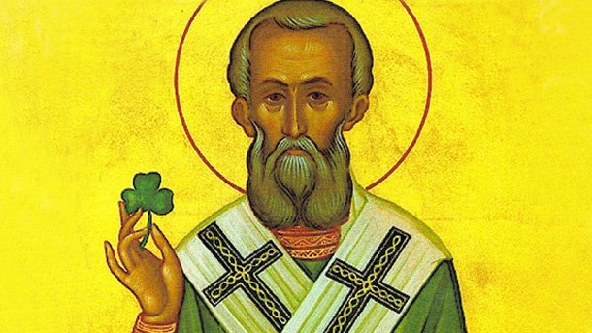
He is the patron saint of….
BACK

Slide 61
What is the highest mountain in Scotland?
BACK

Slide 62
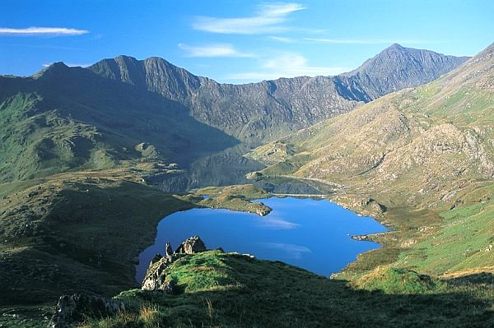
What is the highest mountain in Wales?
BACK

Slide 63
What is the longest river in England and the second longest in the United Kingdom, after the River Severn?
BACK

Slide 64
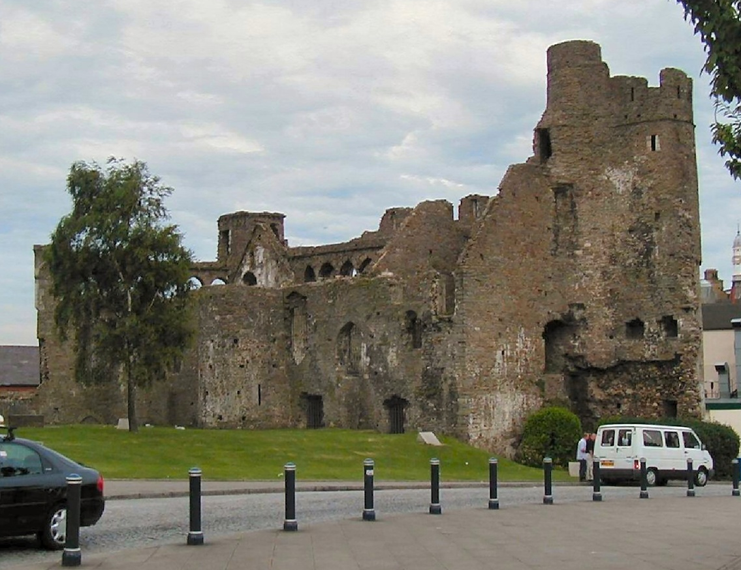
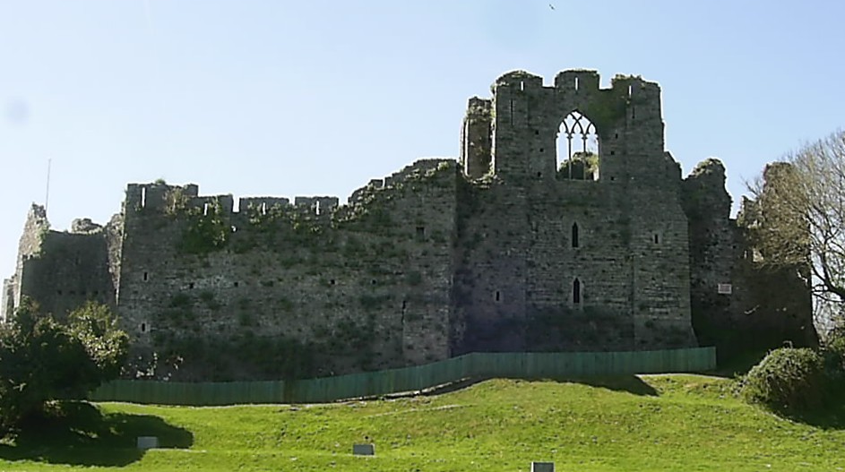
What is Wales's second largest city after cardiff?
BACK

Slide 65
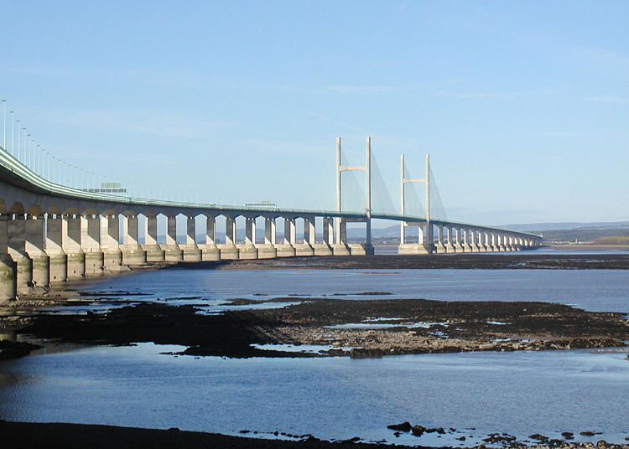
What is the longest river in the United Kingdom, in Wales (about 354 km)?
BACK

Slide 66
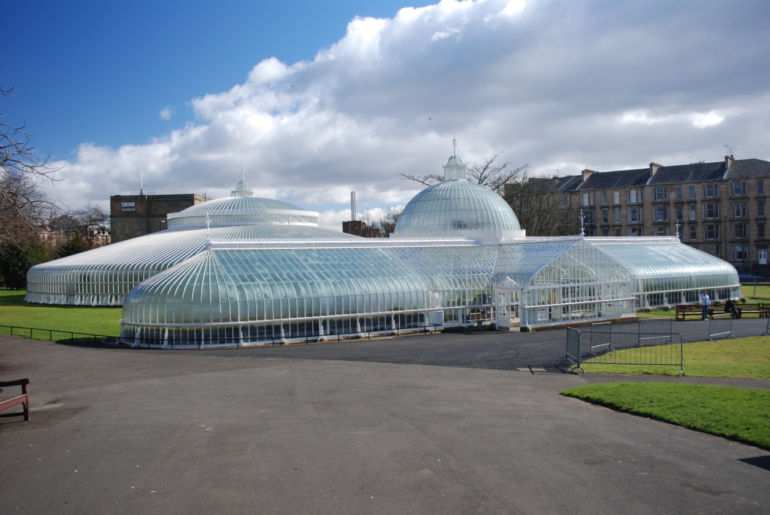
What is the largest city in Scotland?
BACK

Slide 67
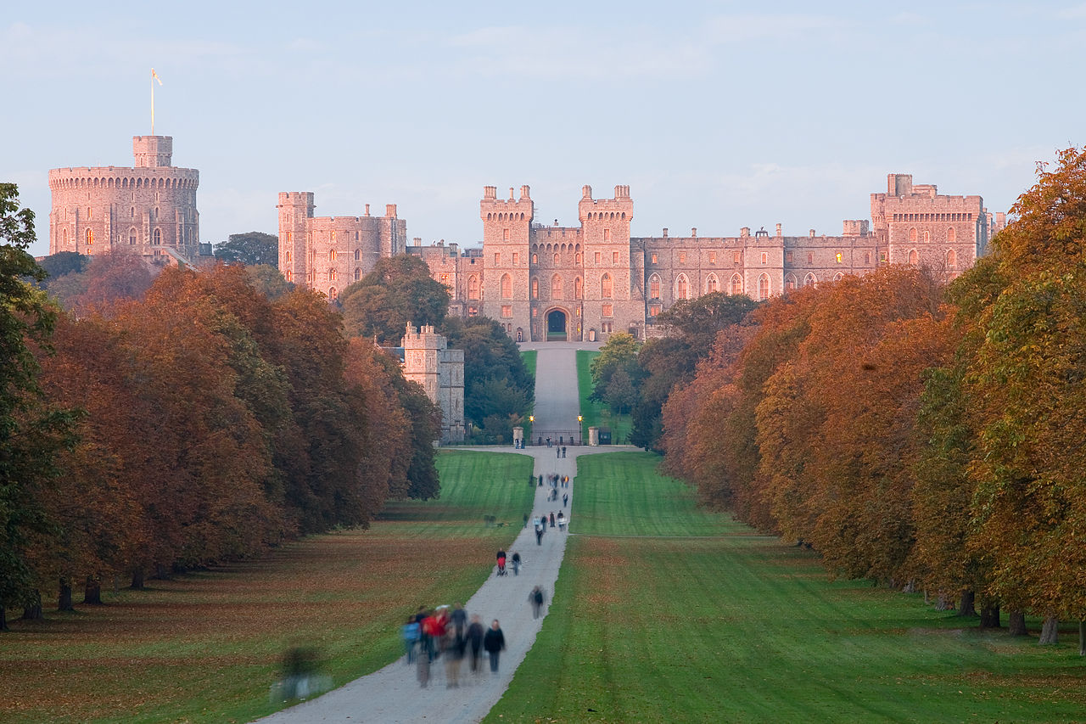
the royal house of the United Kingdom that was founded by King George V who changed the name of the British Royal Family from the German Saxe-Coburg and Gotha (a branch of the House of Wettin) to the English.
BACK

Slide 68
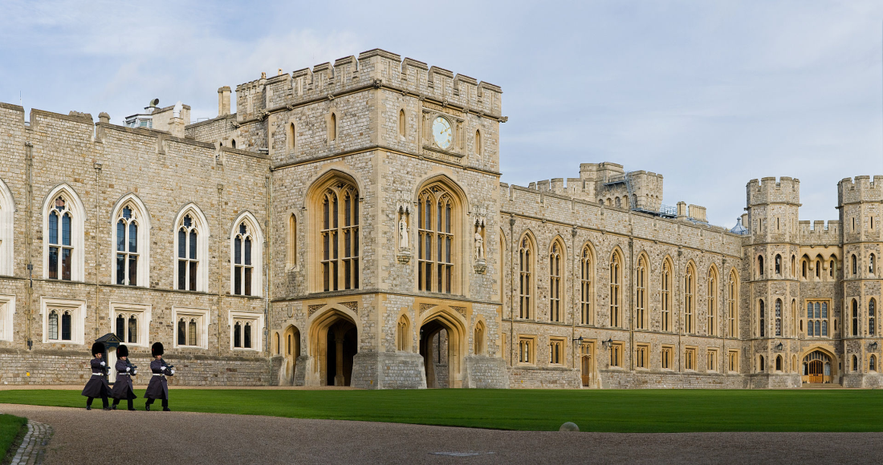
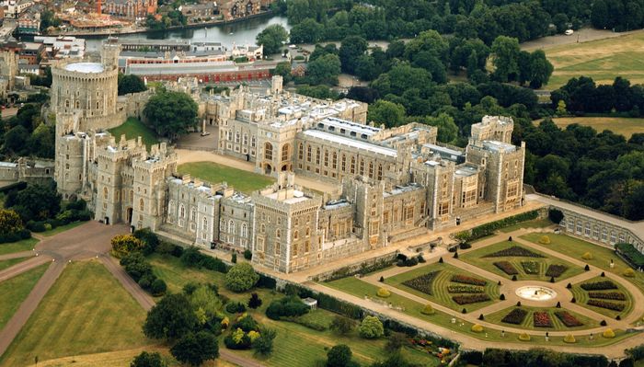
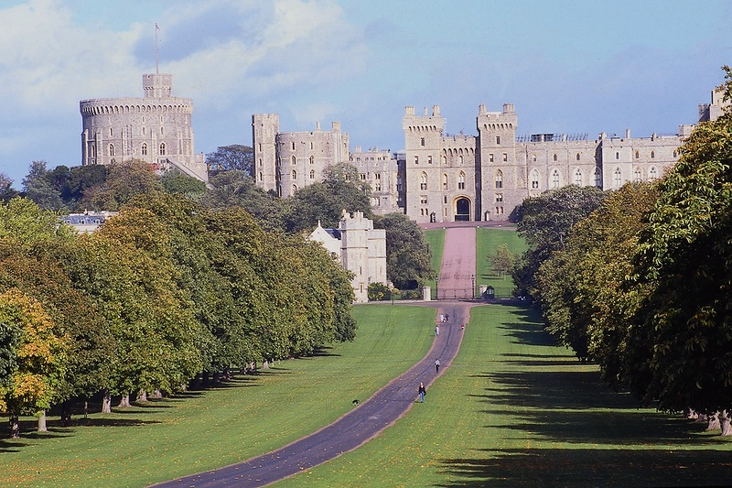
What is a royal residence (a castle) at Windsor in the English county of Berkshire?
BACK

Slide 69
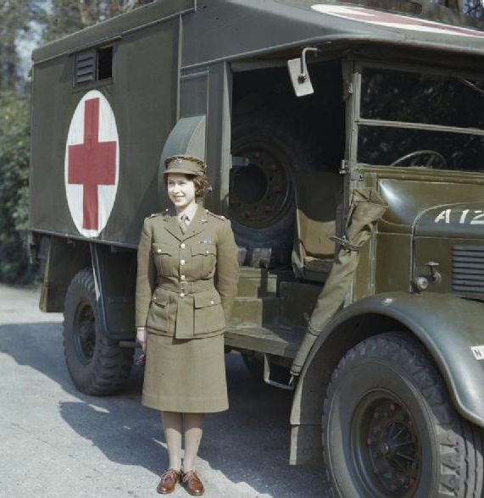
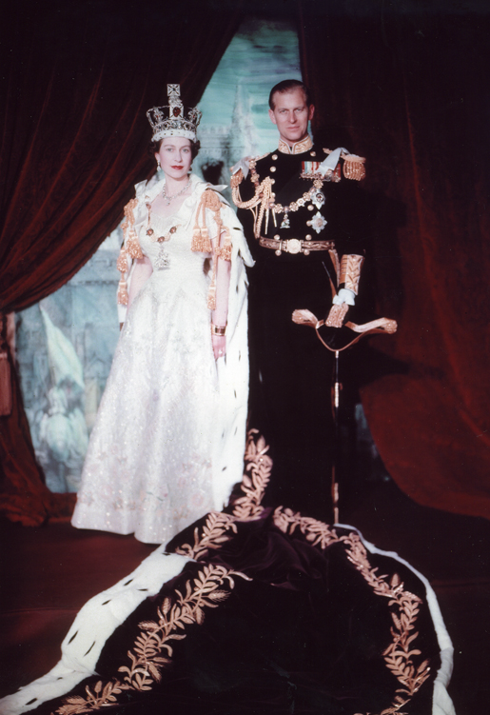
Current head of the house of windsor
BACK

