Slide 1
Seasons and weather

Slide 2
There are four seasons in the year.

Slide 3
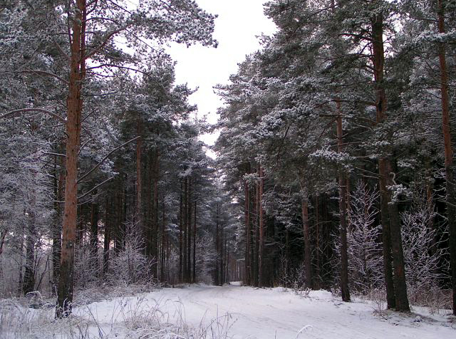
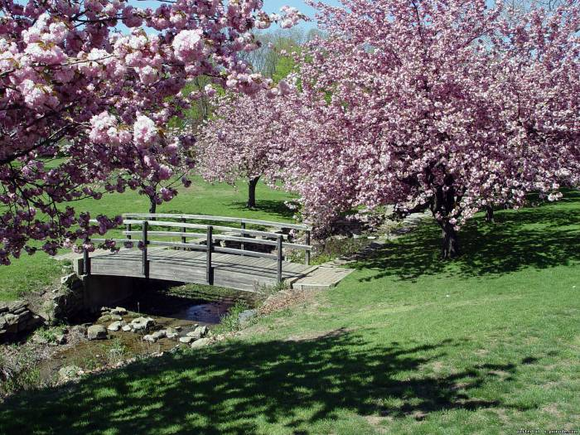
Winter [ˈwɪntə ]
December [dɪˈsembə ]
January [ˈdʒænjuəri ]
February [ˈfebruəri ]
Spring [sprɪŋ]
March [mɑːʧ ]
April ['eɪpr(ə)l]
May ['eɪpr(ə)l]

Slide 4
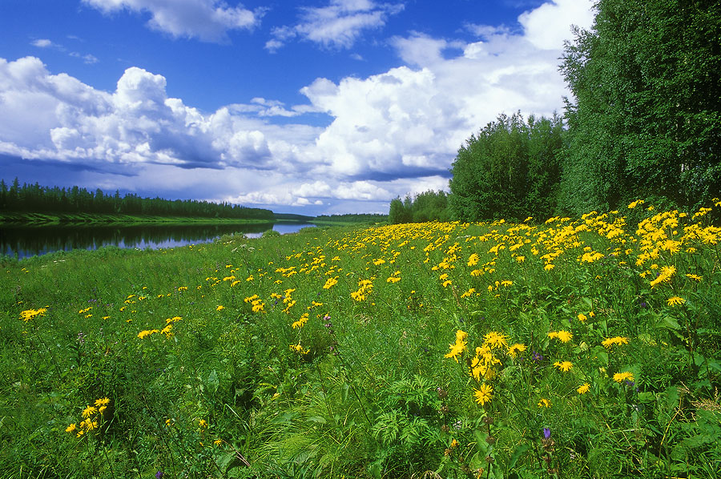
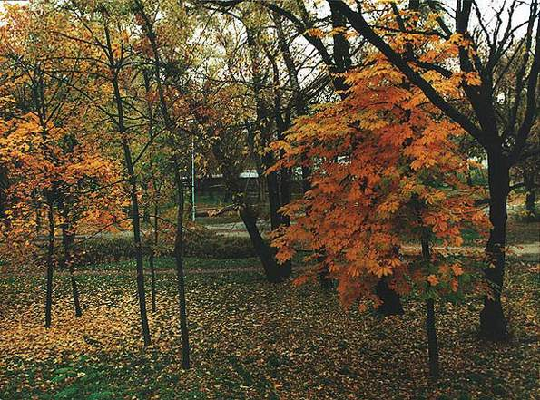
Summer [ˈsʌmə ]
June [dʒuːn ]
July [dʒuˈlaɪ ]
August [ˈɔːɡəst ]
Autumn [ˈɔːtəm ]
September [sepˈtembə ]
October [ɒkˈtəʊbə ]
November [nəʊˈvembə ]

Slide 5
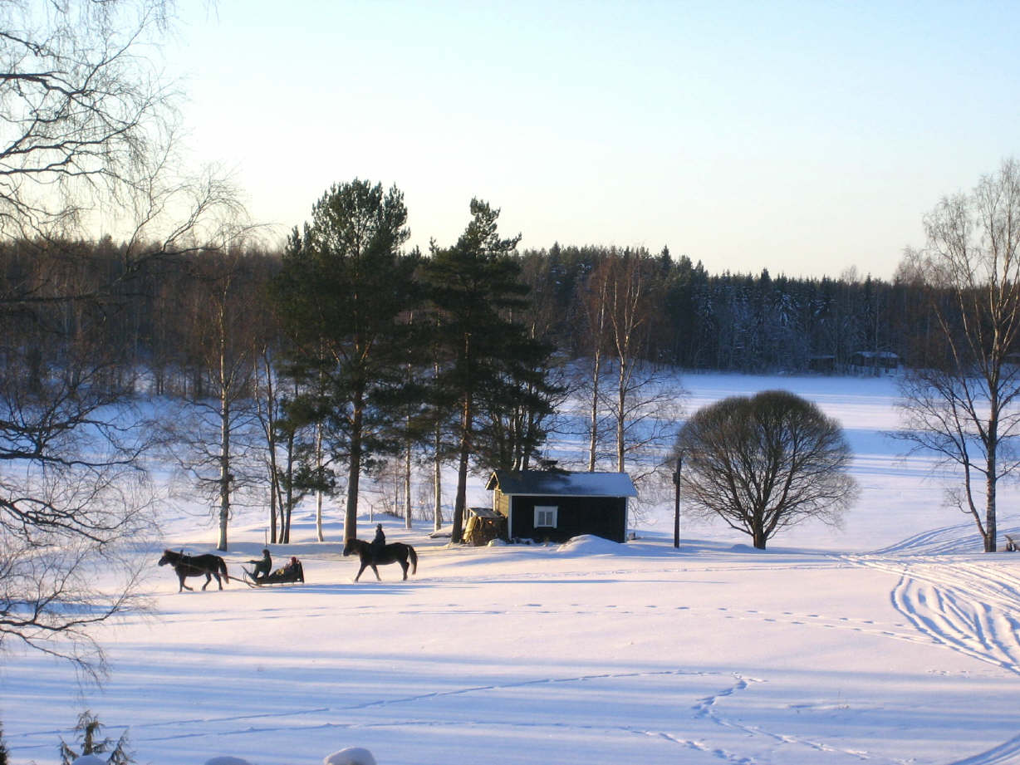
They are: winter
winter

Slide 6
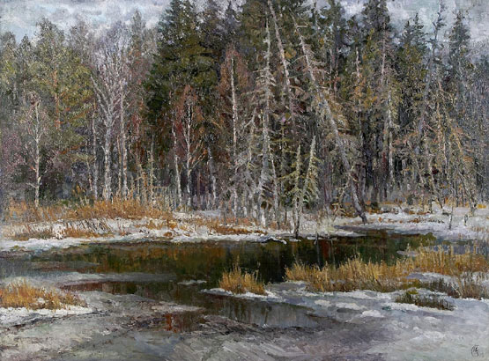
spring
Spring

Slide 7
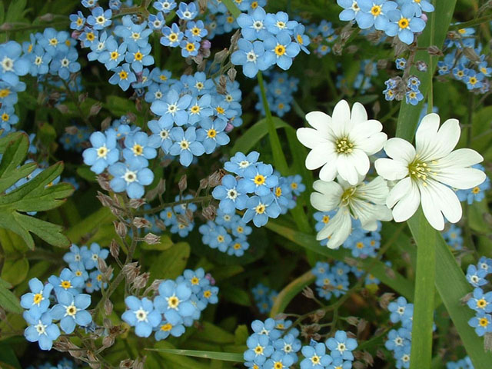
summer
summer

Slide 8
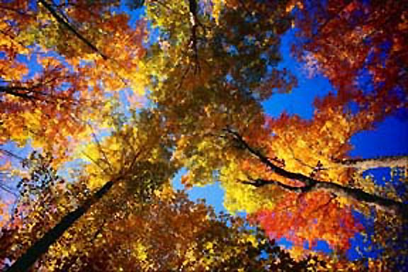
autumn
autumn

Slide 9
Давайте вспомним слова!
Солнечно Sunny
Ветрено Windy
Облачно cloudy
Снежно snowy
Жарко hot
Холодно cold

Slide 10
Windy

Slide 11
HOT

Slide 12
rainy

Slide 13
cloudy

Slide 14
snowy

Slide 15
cold

Slide 16
sunny

Slide 17
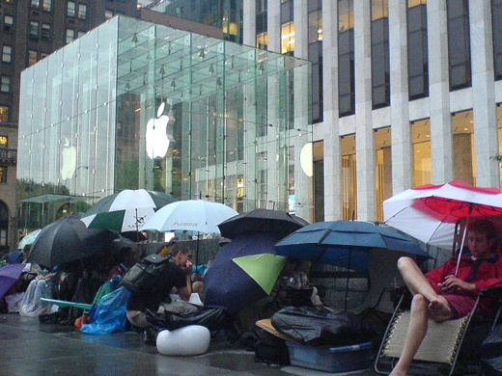
Какая погода в разных странах?
It is ……………. In America
rainy

Slide 18
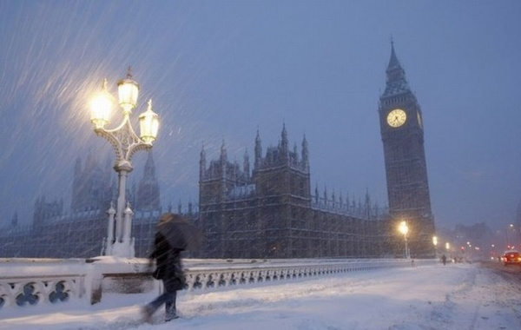
It is……. In England
Snowy

Slide 19
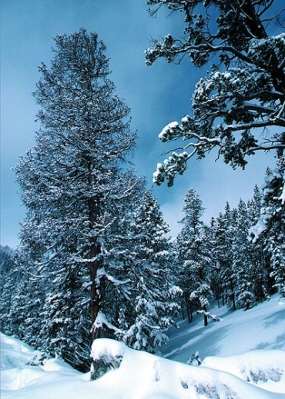
It is…………..in Russia
Cold

Slide 20
It is………. in Africa.
Hot

Slide 21
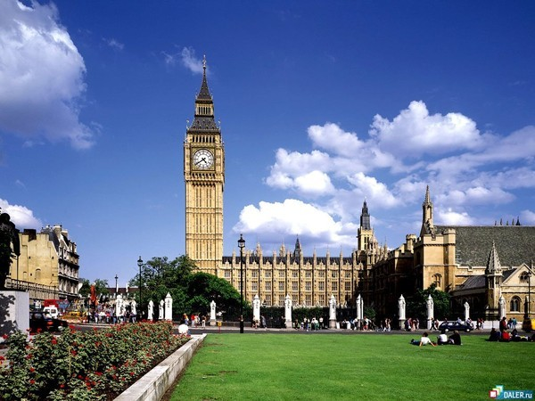
It is …….. in England.
Sunny

Slide 22
 | summer |  | it is sunny
I like | winter | because | it is green
 | spring |  | it is hot
 | autumn |  | it is frosty
 |  |  | it is cold and clean
 |  |  | it is warm

Slide 23
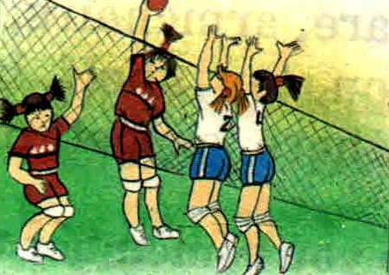
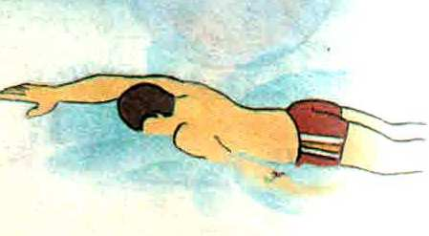
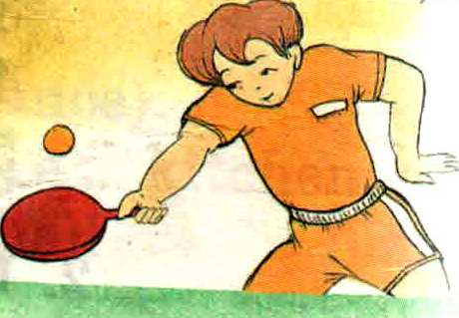
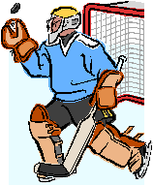
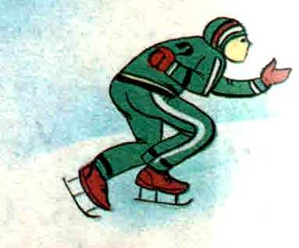

Slide 24
IN WINTER IT’S SNOWY, SLIPPERY, FOGGY,
IN SUMMER IT’S SUNNY AND FINE,
IN AUTUMN IT’S CLOUDY, WINDY AND RAINY,
IN SPRING YOU MAY JUMP UP TO THE SKY.

