Slide 1
The Great
Patriotic War

Slide 2
On the 9th of May, 2015 it will be 70 years of victory in The Great Patriotic War.
What associations come to your mind when you hear about The Great Patriotic War?
For how long did it last?
What were the two sides fighting?

Slide 3
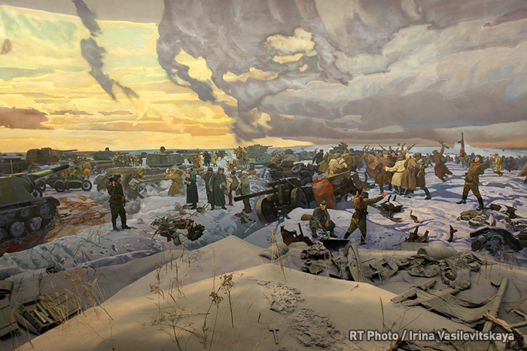
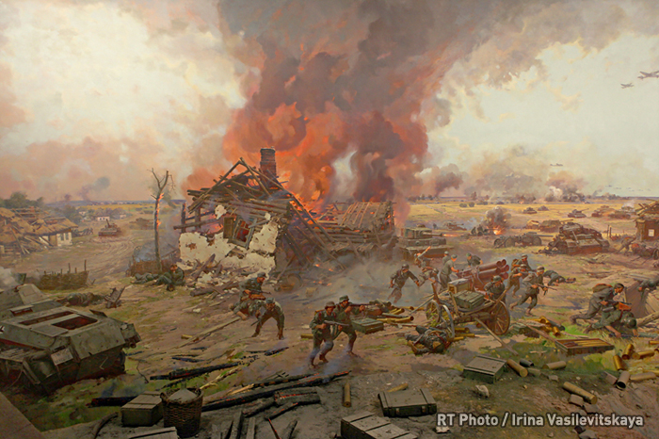
The term Great Patriotic War (Russian: Velíkaya Otéchestvennaya voyná) is used to describe the period from the 22th of June, 1941 to the 9th of May, 1945 in the campaign of World War II between the Soviet Union and Nazi Germany.
The Battle Of Stalingrad
The Battle Of Kursk

Slide 4
War is an organized and often prolonged conflict that is carried out by two or more states. It is usually an arm-used event.
Did you know that…
Some scholars see warfare as an inescapable and integral aspect of human nature while others argue that it takes place only due to socio-cultural circumstances.
What is your opinion on this issue?
Do you believe warfare is a part of human nature? Why (not)?
Or do you think wars happen because of political or economical circumstances?
Do you think wars can be inevitable?
Is it possible to prevent them?
If it is, how can people prevent wars?

Slide 5
Leningrad’s siege was one of the most horrible events in world history. It lasted for 900 days, from September 1941 to January 1944.
What do you know about the siege of Lelingrad?
What did the siege mean to ordinary people?
What was the life in that period like?

Slide 6
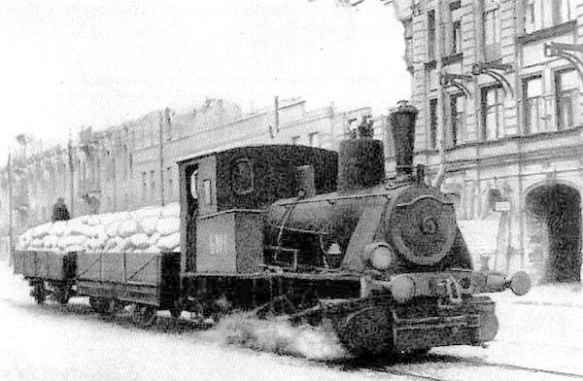
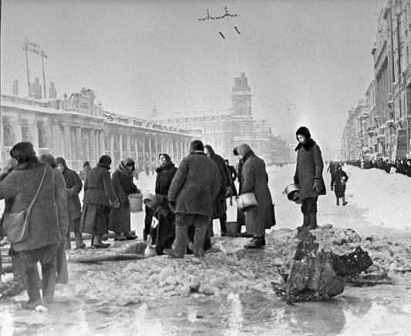
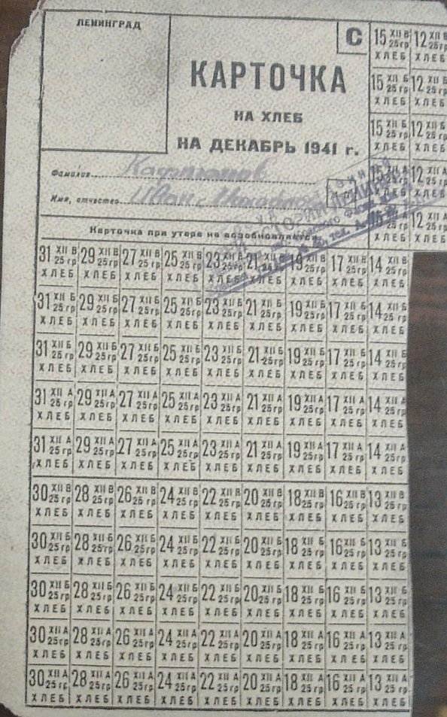
The supply of flour, 1942
The people of Lelingrad are collecting water which appeared in the shell-holes after the air attack
December, 1941
The card for bread

Slide 7
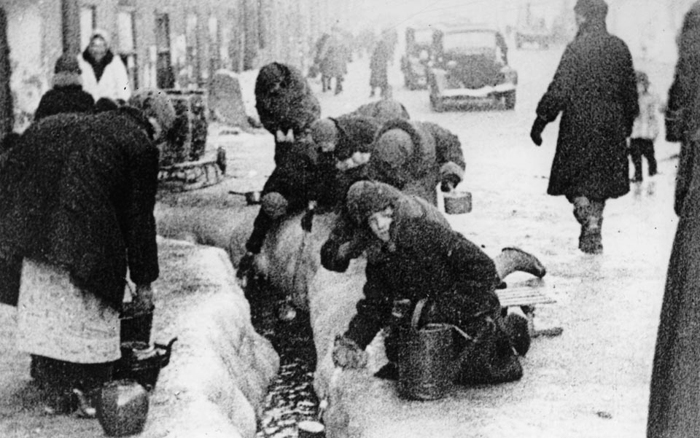
Citizens of Leningrad dig for water from a broken main during the winter of 1942.

Slide 8
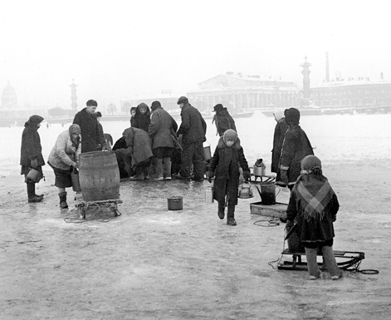
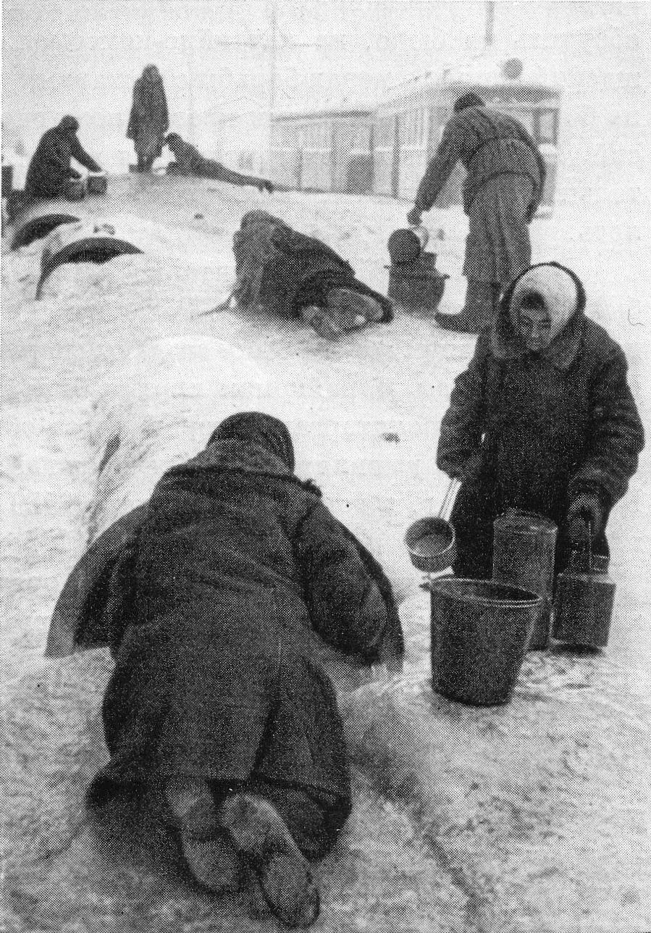
In the middle of the siege period the Neva river became the only source of water for people
The famine and the harsh winter made people weak. Many people died because they had no strength to carry the water buckets

Slide 9
Let us have
a break

Slide 10
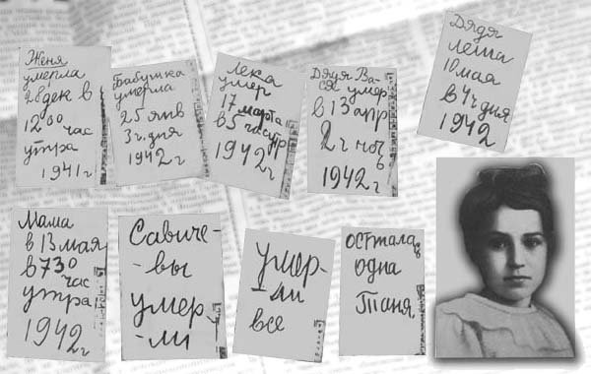
The Diary of Tanya Savicheva
What did Tanya write in the diary?
What role does her memory play for modern people?

Slide 11
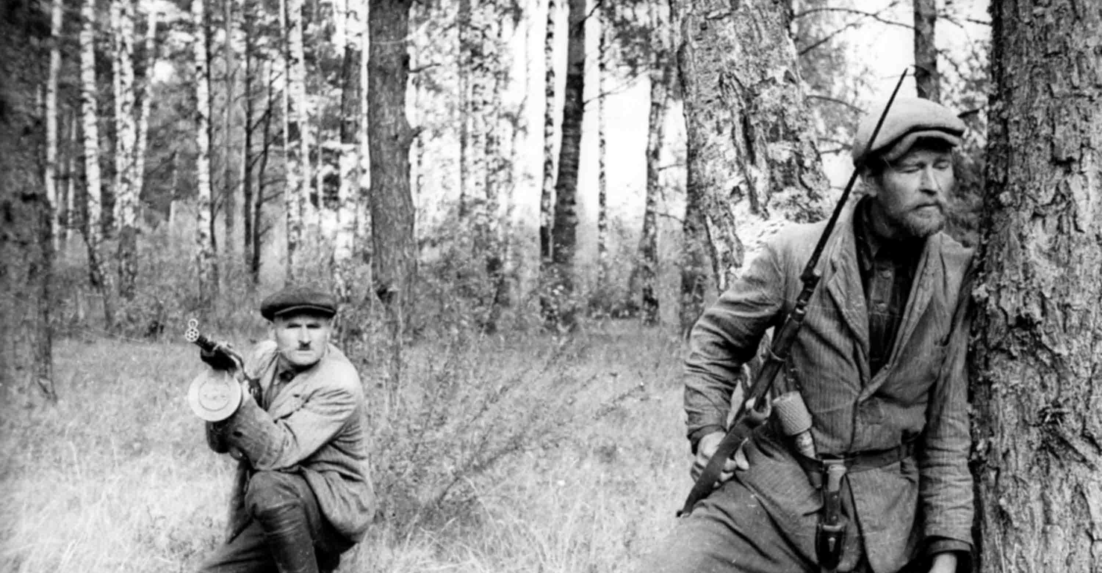
The Partisan Movement played a significant role in the Great Patriotic War.
Do you know what the partisan movement is?
What idea were the soviet partisans united by?
What was the role of the Soviet partisans in the War?

Slide 12
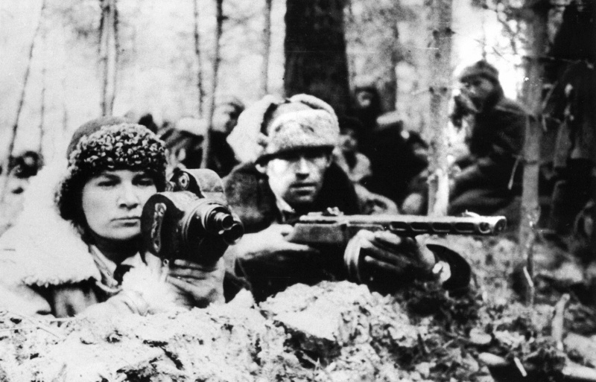
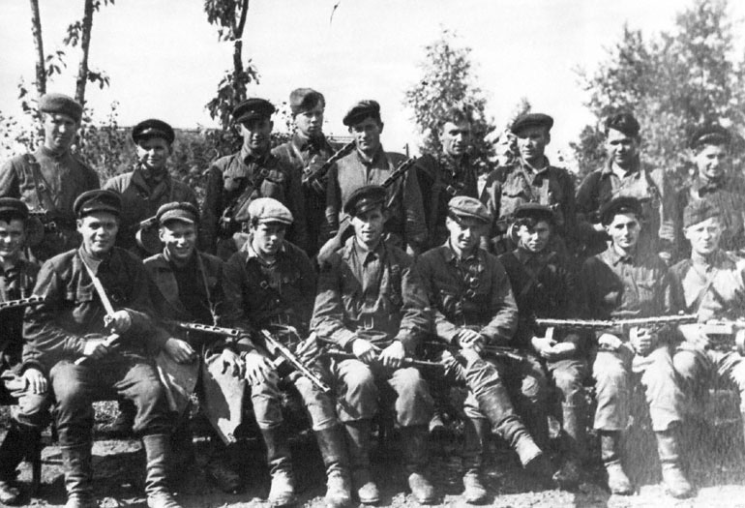
The partisans wanted to protect their families, their villages or cities. They did everything possible to protect themselves from the german military operations. The partisans attacked rail lines, killed the german soldiers, destroyed tanks and military supplies of the enemy.
The Soviet partisans were united by the idea of resistance movement. The partisan movement was created by ordinary people. They were both city dwellers and people living in villages. Not only men participated in the partisan operations. There were women and even children among them.

Slide 13
Did you know that…
Over 20,000,000 Soviet citizens and soldiers died in the struggle to liberate the Motherland from the fascist aggressors.
What do you feel considering these horrible figures?
What did the War mean to people?
What, do you believe, united people during the Great Patriotic War?

Slide 14
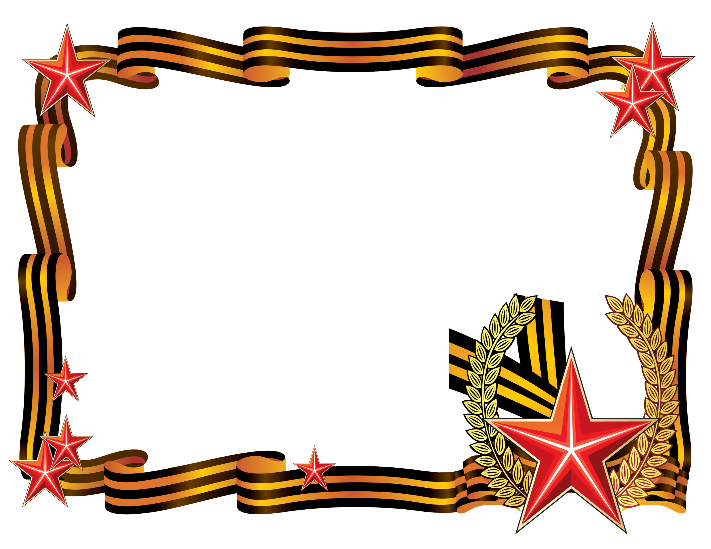
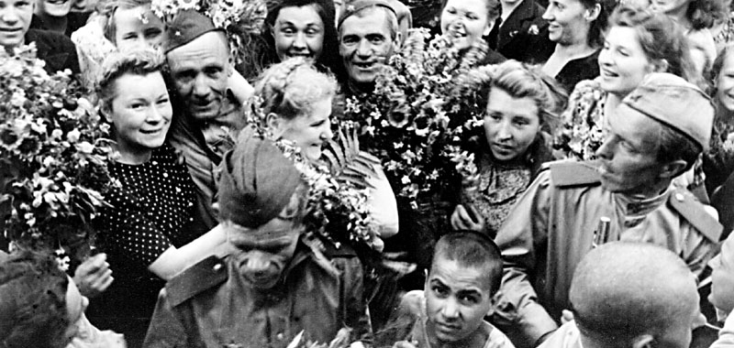
For people of the Soviet Union the 9th of May was the day of Victory over the Nazi Germany. It was the day of liberty and freedom.
For modern people the 9th of May is the day when we commemorate those who participated in the Great Patriotic War. The 9th of May of 2015 marks the 70 years of victory of the Soviet Union.

Slide 15
Are there members in your family who participated in the Great Patriotic War or lived during the war? Did they tell you anything about the war time?
Do you believe, people who lived in the war period can tell us more about the war than books or other written sources?
Should we preserve the heritage of the veterans of the Great Patriotic war?
What is the lesson of the Great Patriotic war?

