Slide 1
IN THE COUNTRY, IN THE CITY
Выполнила:
Резниченко Елена Викторовна,
учитель английского языка
МБОУ «СОШ № 97»

Slide 2
[i:] tree
eagle
[o:] sheep
[a:] ocean
sea

Slide 3
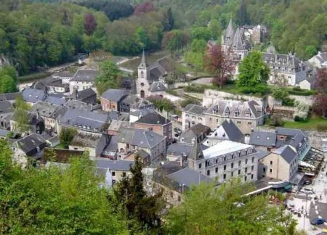
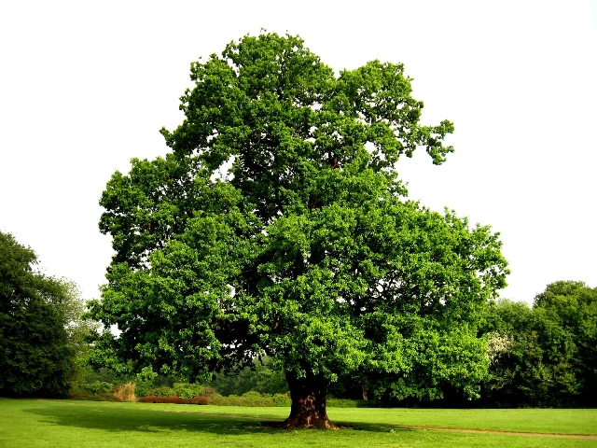
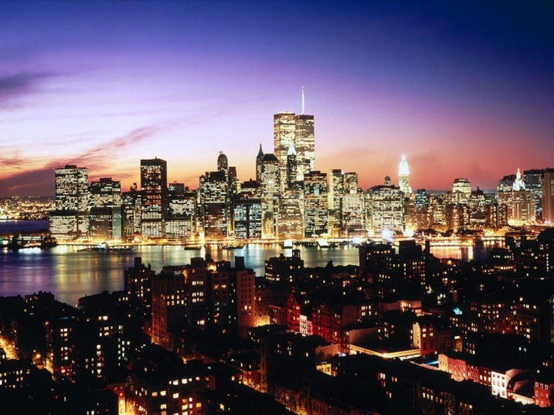
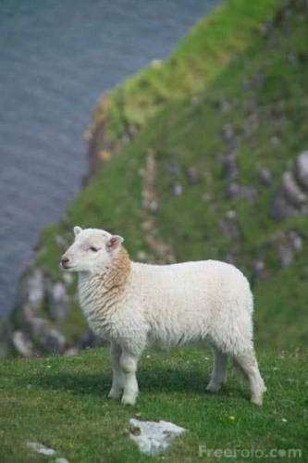
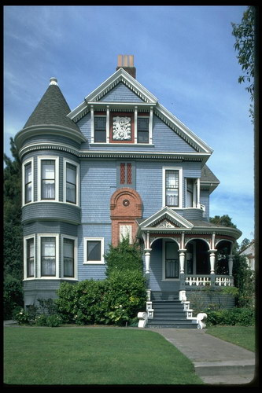
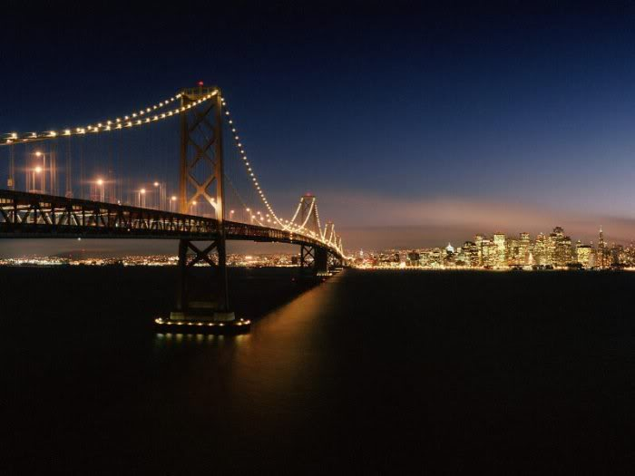
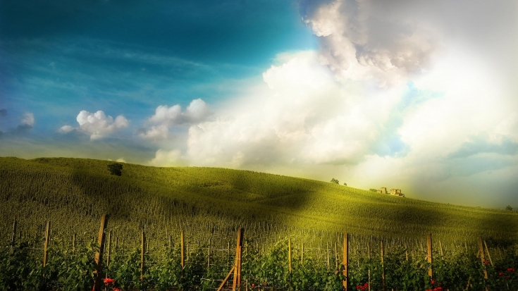
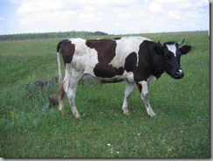

Slide 4
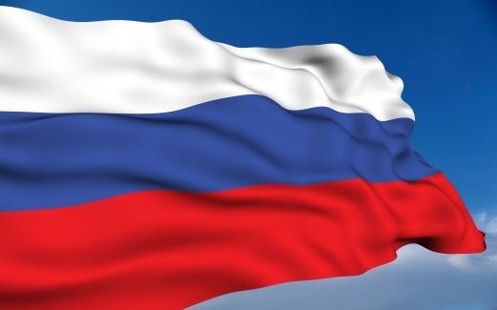
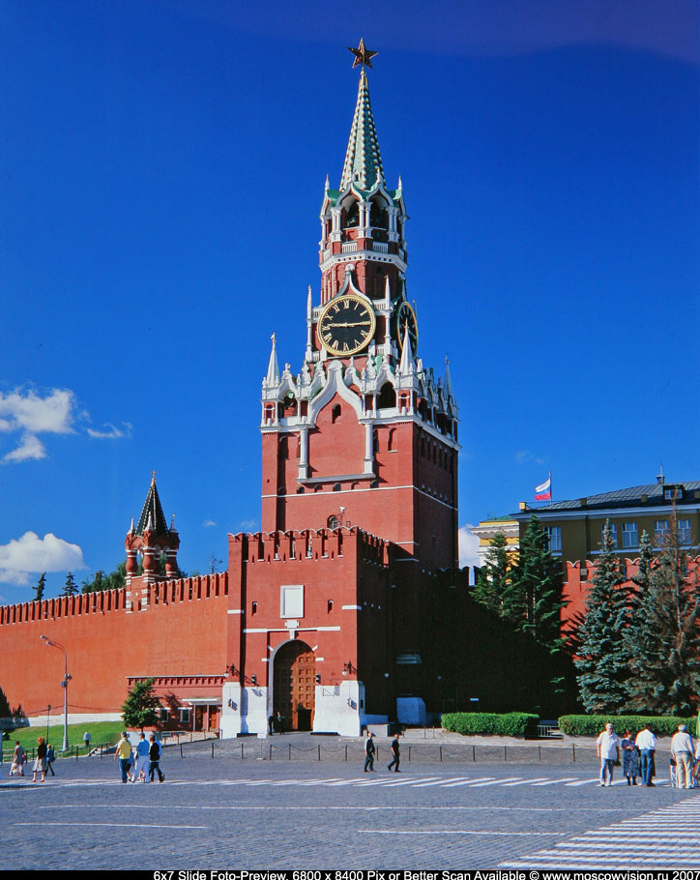
RUSSIA
MOSCOW

Slide 5
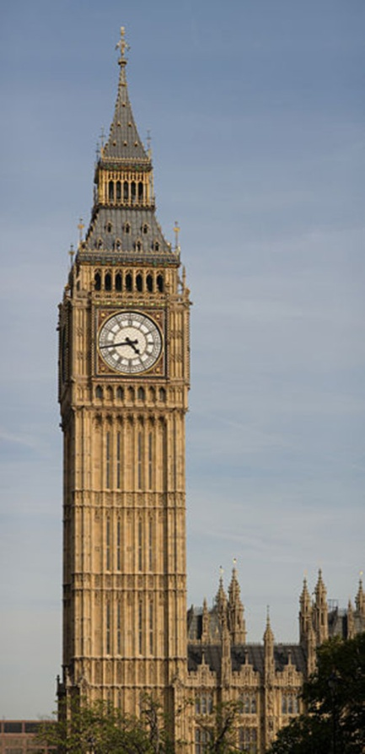
GREAT BRITAIN
LONDON

Slide 6
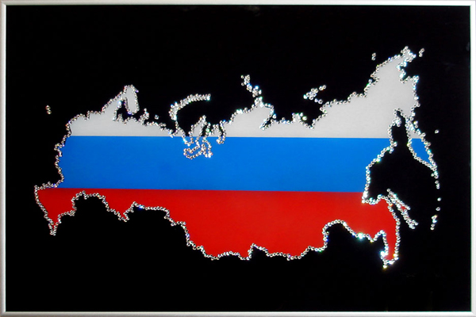
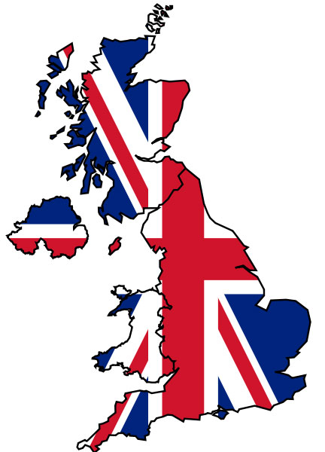
CHECK YOURSELF
Russia is bigger than Great Britain.
Great Britain is smaller than Russia.
Russia is the best.
Great Britain is warmer than Russia.
Russia is a beautiful country.
Russia is colder than Great Britain

Slide 7
Wb ex. , p.

