Slide 1
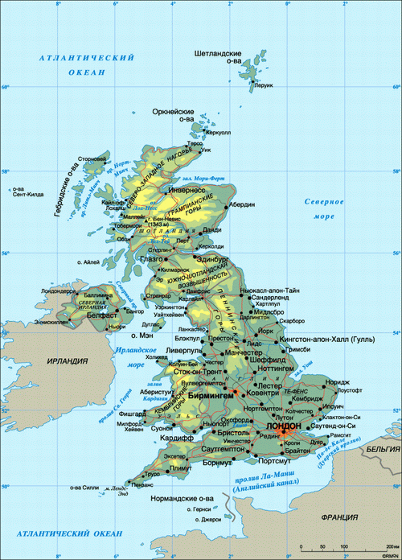
How do languages ​​in the UK coexist ?
By Koroleva Elena

Slide 2
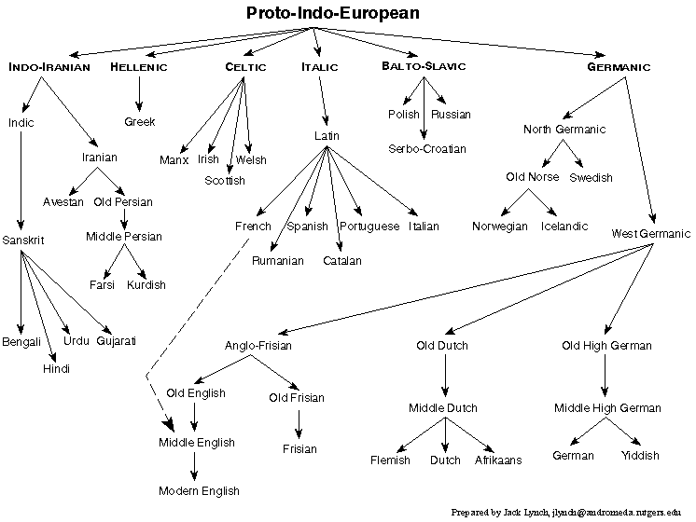
Places of Languages

Slide 3
Languages of United Kindom.

Slide 4
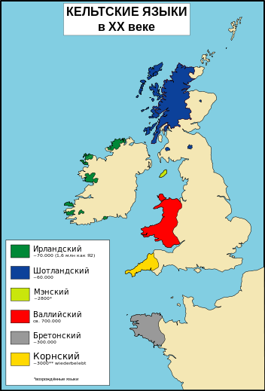
distribution of Celtic languages

Slide 5
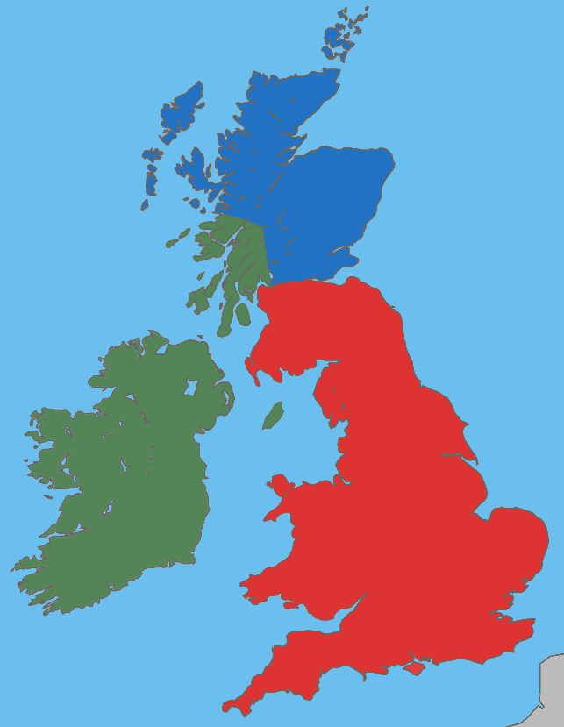
The first population.
The first people of Britain were the Iberians.
Picts
The next settlers were Celts :
Britons, Gael and Picts
Gael
Britons

Slide 6
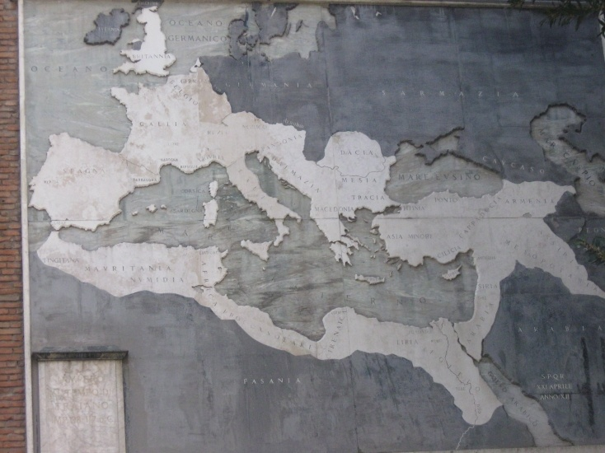
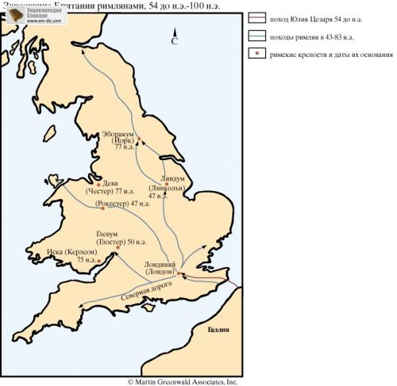
Roman conquest
In the 1 century BC Roman legions invaded the British Isles. Britain, except Scotland and Wales, turned into a colony of the Roman Empire

Slide 7
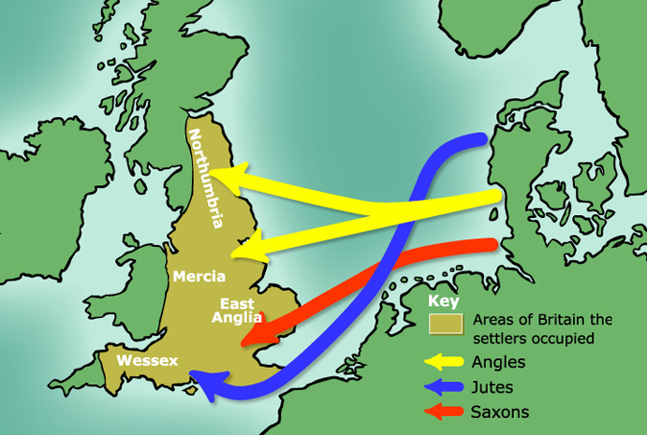
Germanic tribes conquest
In 408 the Roman legions left Britain, and in 410 Rome fell because of the German barbarian tribes.
West German tribes were represented by the Angles, Saxons, Jutes and Frisians

Slide 8
Futhark
Futhark - Anglo-Saxon runic alphabet evolved from older Futhark, included - 26-33 runes.
Anglo-Saxon runes used to write Old English and Frisian, dating from about the 5th century BC and to the 11th century.

Slide 9
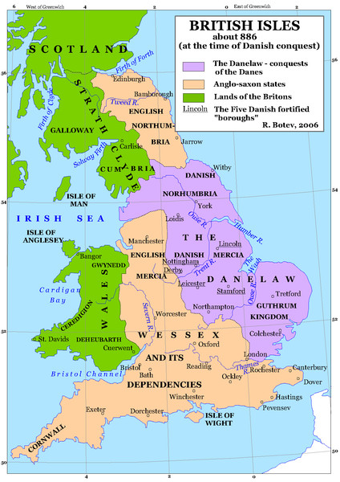
Scandinavian conquest
there are 3 periods in the history of the Scandinavian invasions :
1. 787-850 - foray 2. 850-878 - Scandinavians looking for places to permanent settlement 3. 878-1042. -renewal of raids
As a result, the Scandinavians gradually dissolved among the Anglo-Saxon and Scandinavian language had a significant impact on the English language.

Slide 10
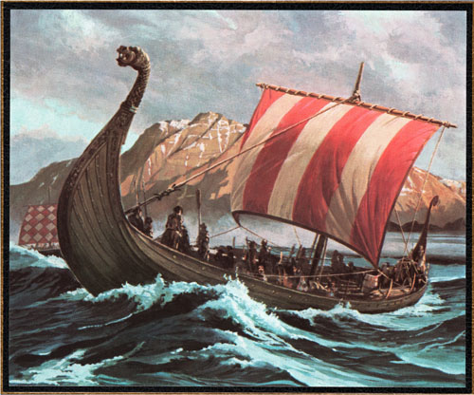
1. Law - Lawyers, legal terms 2. Words related to the war; barda, cnearv (seagoing vessels) 3. Every day concepts: bag, skin, call,
take, die, guess, want, sky, egg 4. Some function words and pronouns:
thei; their, both 5. Prepositions: till 6. though

Slide 11
Scandinavian Younger Futhark
Scandinavian Younger Futhark (Fittings) consist of 16 runes - Danish, Norwegian, Swedish and Icelandic versions (600-1200 years.)

Slide 12
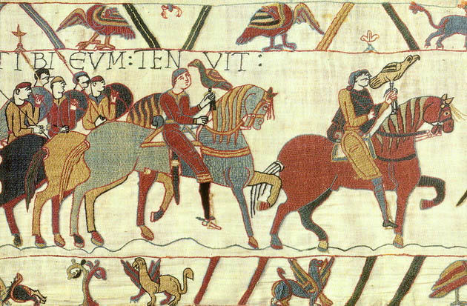
Norman conquest
The Normans - descendants of the Vikings. The conquest of England began with the victory of the Normans at the Battle of Hastings in 1066. It continued till the 1070-1075

Slide 13
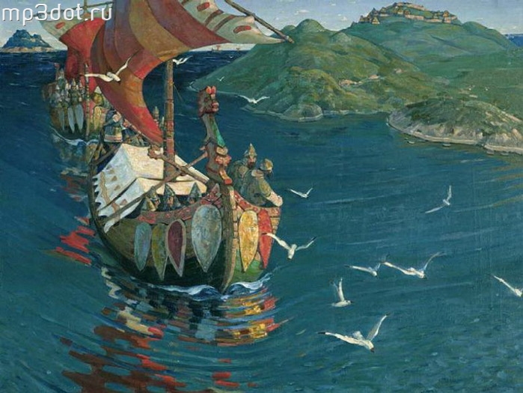
Norman’s influence
1. Control: parliament, assembly, noble, duke, royal
2. military terminology: army, battle, navy, soldier, officer, enemy
3. Law and Justice: judge, court, justice, accuse (blame)
4. Religion and the church: saint, abbey, confession, religion
5. Urban crafts: tailor, painter, butcher, grocer, carpenter
6. Arts and Literature: art, image, music, paint, column
7. Entertainment: pleasure, leisure, joy, dance, cards
8. Gen: table, chair, wardrobe, curtain, plate

Slide 14
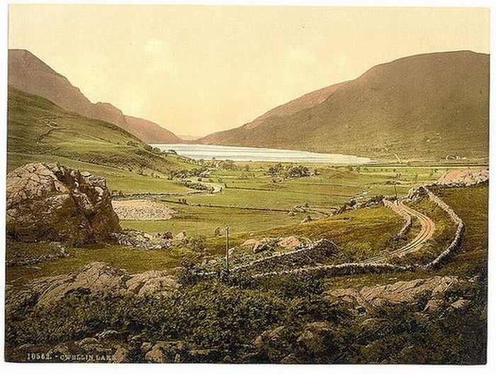
Wales
Wales - one of the historic areas of Britain, inhabited by people of the Celtic language group - Welsh. It was conquered by England in 1536. Despite strong effect of England Wales has saved national identity, culture and partly native language.

Slide 15
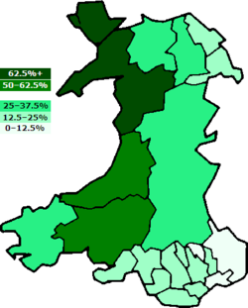
Welsh
According to the 2001 census, 611,000 people, or 20.5%(200 000) of the population of Wales, are Welsh owned (compared to 18.5% in 1991)
Wales can be considered bilingual, although only a third of the population is fluent in both English and Cymric. (Welsh)

Slide 16
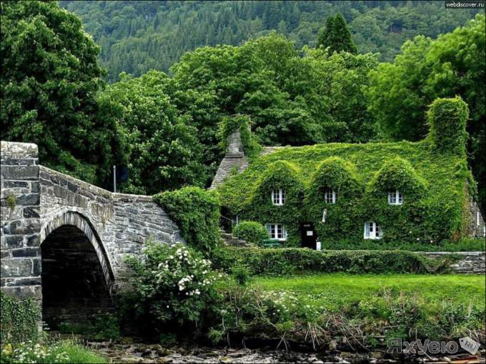
The word "Wales" also has Anglo-Saxon origin and means "country of strangers." Welsh Celtic themselves prefer the term "Cymru", translated as a "country fellow", but outside Wales it is not applied. The spread of the term "England" on Wales perceived by its residents as an insult.

Slide 17
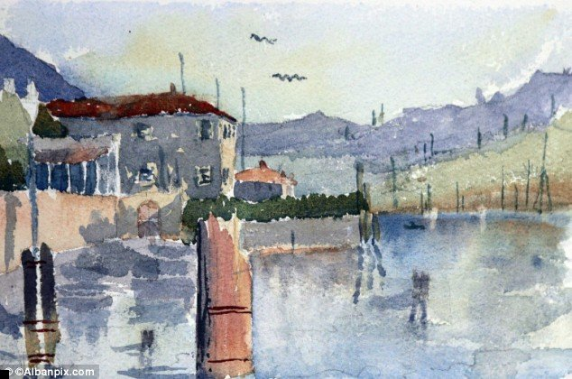
Today, all the inscriptions in Wales are in Welsh; it is taught in schools, and the law of public administration in state institutions should be bilingual. Teachers, social workers must know Welsh. Welsh radio and television does much to native language to transfer it to the next generation.

Slide 18
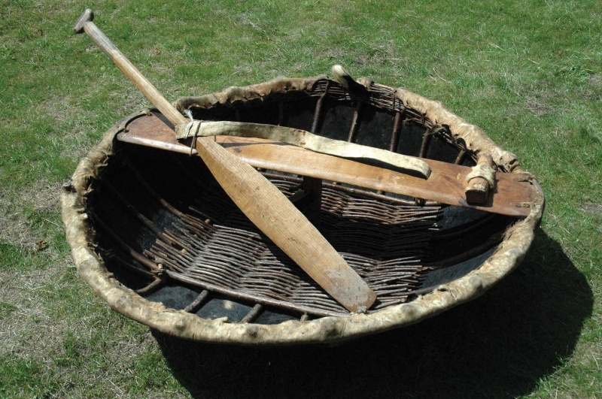
Borrowings from Welsh to English:
coracle –a fishing boat

Slide 19
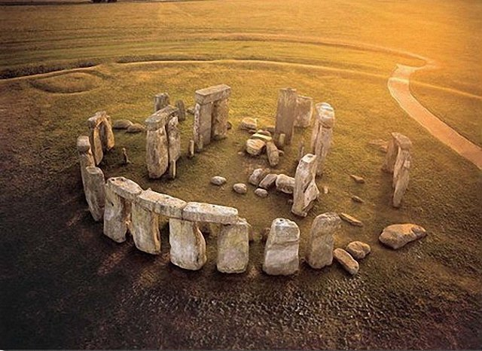
cromlech
eisteddfod
- meeting Welsh bards
flannel

Slide 20
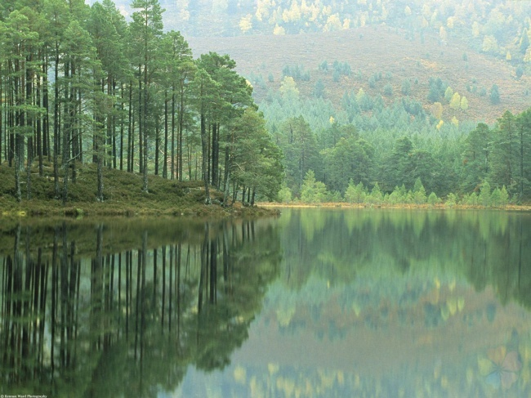
Scotland

Slide 21
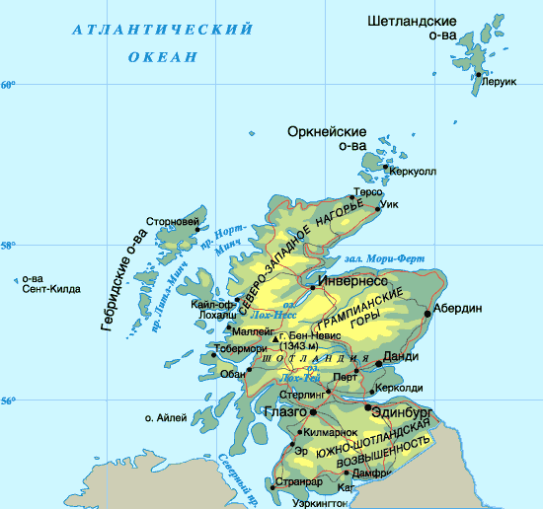
Scotland joined England in 1707.

Slide 22
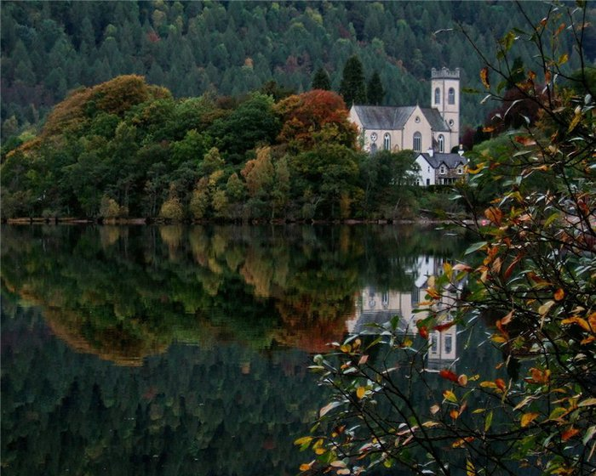
Anglo-Scottish and Scottish Celtic (Gaelic) languages
English is one of the national languages ​​of the country since Scotland officially became part of the United Kingdom. However, it is not the only language of Scotland, spoken by the natives: Anglo-Scottish( 1,5 millions.) and Scottish Celtic (Gaelic) language (58 652) are official languages of Scotland.

Slide 23
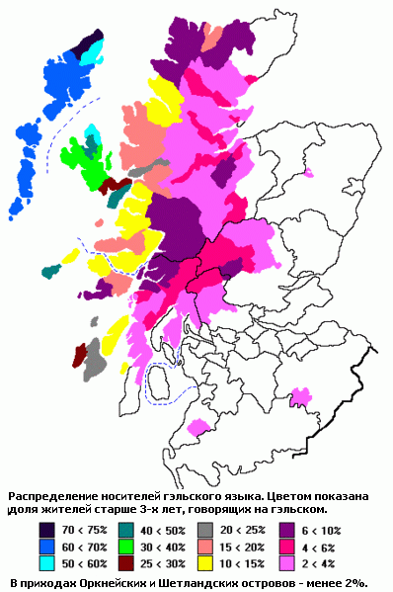
distribution of Gaelic in Scotland

Slide 24
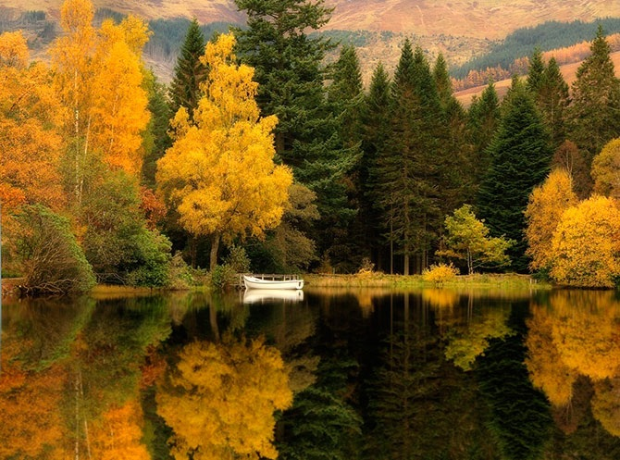
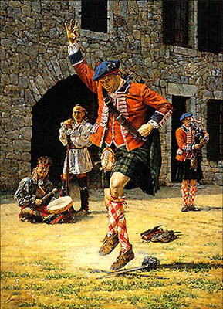
Borrowings
сlan
veel
slogan
glen
Loch
сrag
tartan

Slide 25
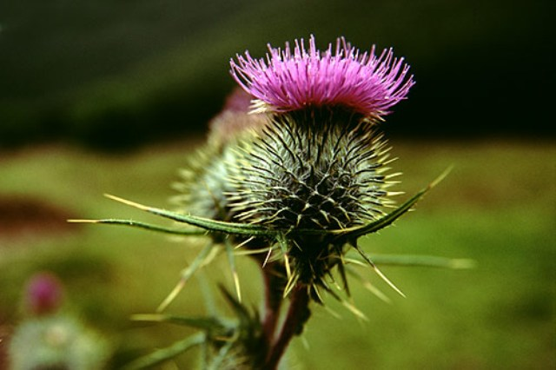
thistle is the symbol of Scotland

Slide 26
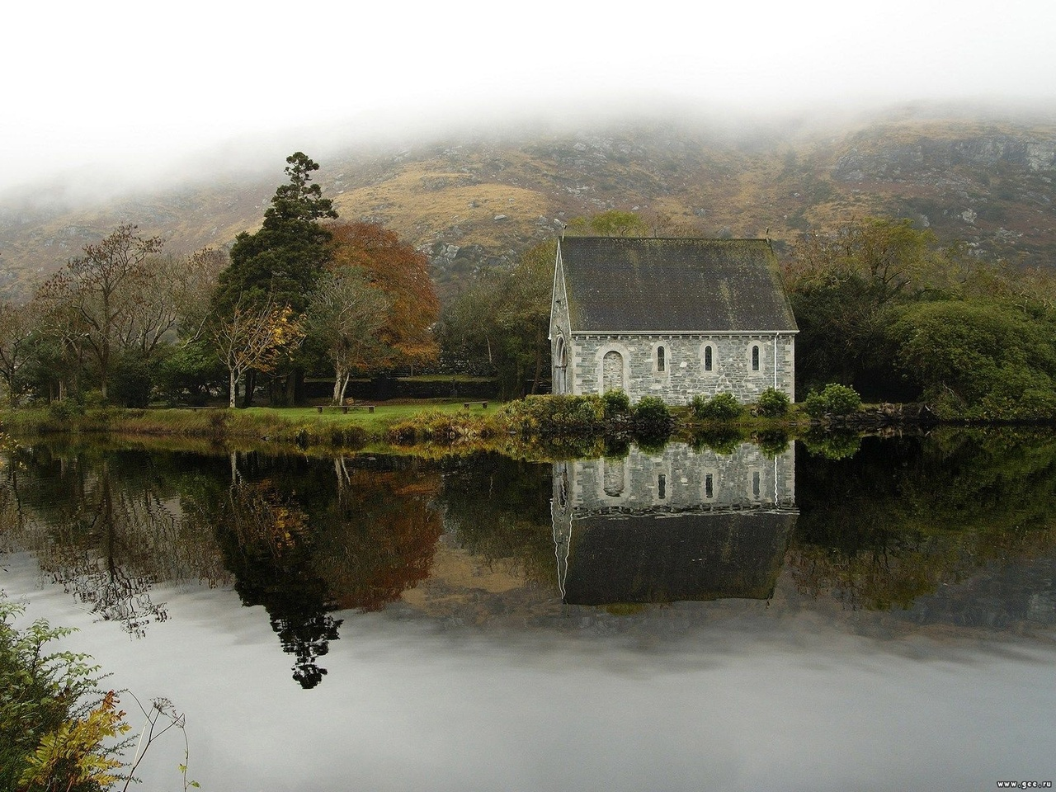
Ireland

Slide 27
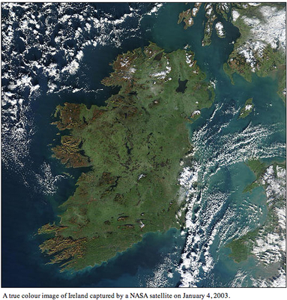
The concept of "Ulster colony" originated in the 18th century and is directly linked with the English colonization of Ireland. First English knights appeared on Irish soil in the 12th century. For several centuries, the English feudal managed to win only a small area in the east of the country.
British government achieved Unia in 1800

Slide 28
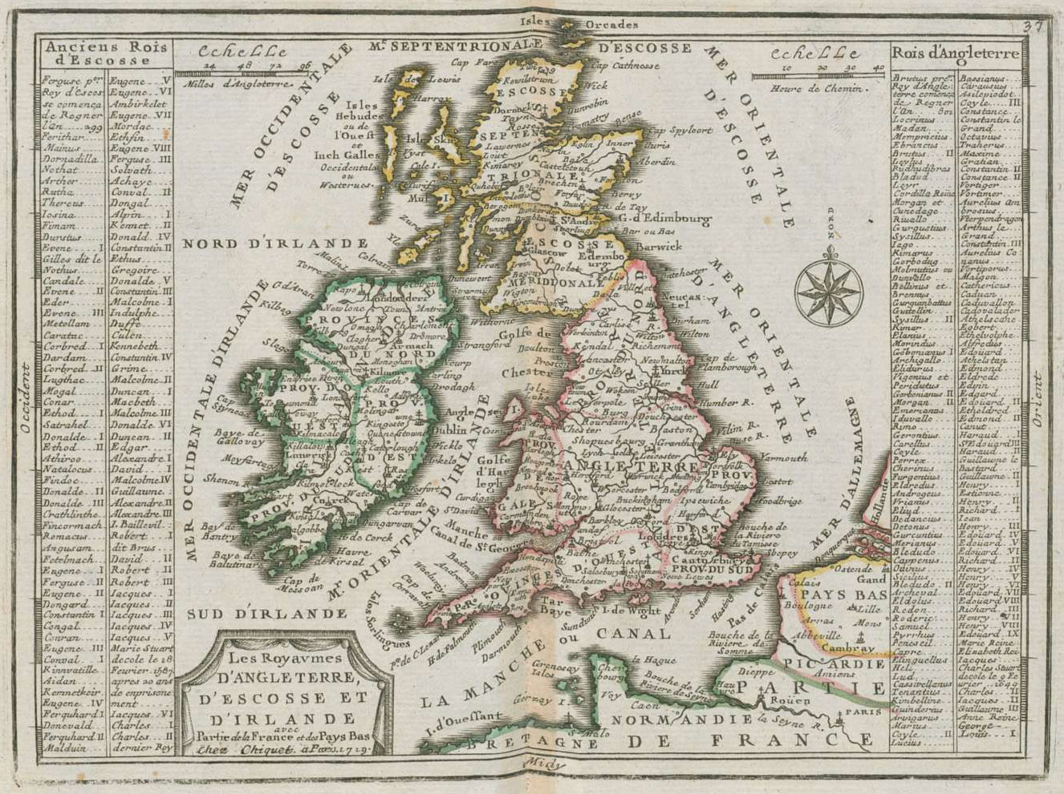
For many years a fierce struggle is in a colony of Great Britain - Northern Ireland attached to the British government in 1922. The rest of Ireland achieved independence

Slide 29
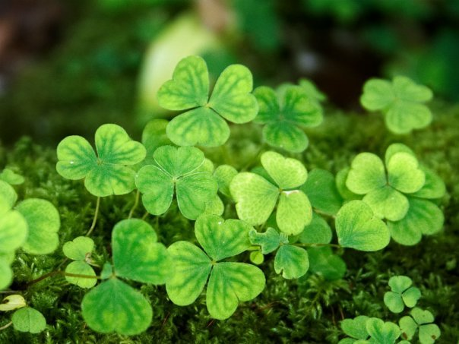
Borrowings from Irish
shamrock is a symbol of Ireland
bog
banshee
galore
shamrock
shillelagh
spalpen
tory

Slide 30
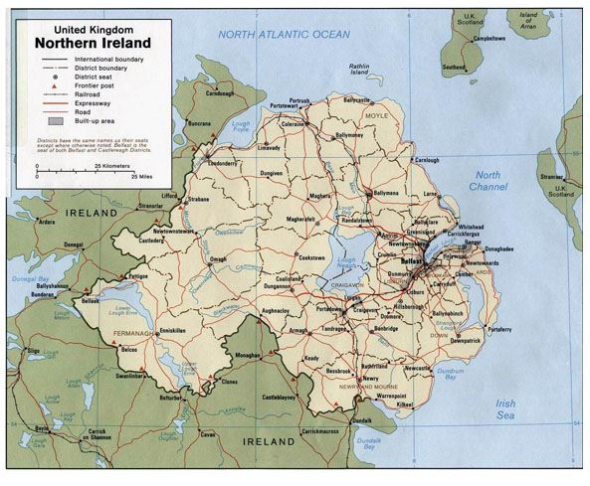

Slide 31
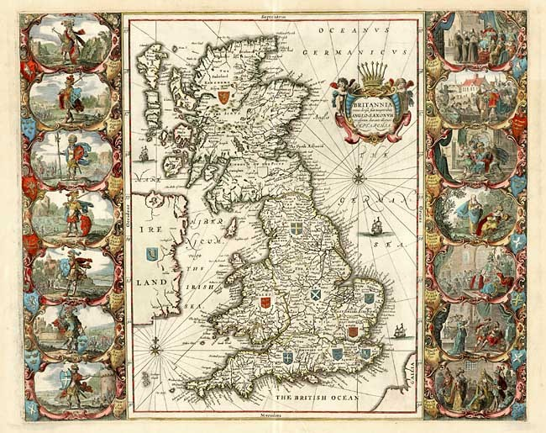

Slide 32
The End

