Slide 1
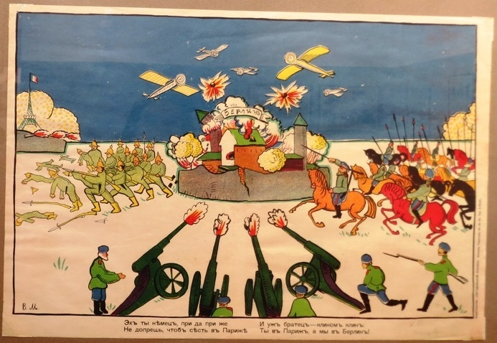
Propaganda posters WWI Mainly posters of World War I can be divided into three broad categories independently from the country where they were issued.

Slide 2
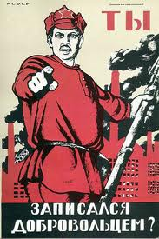
The first one relates to recruiting young men to serve their country.
The most famous recruiting posters are posters twins which appeared in England, the United States and Russia.

Slide 3
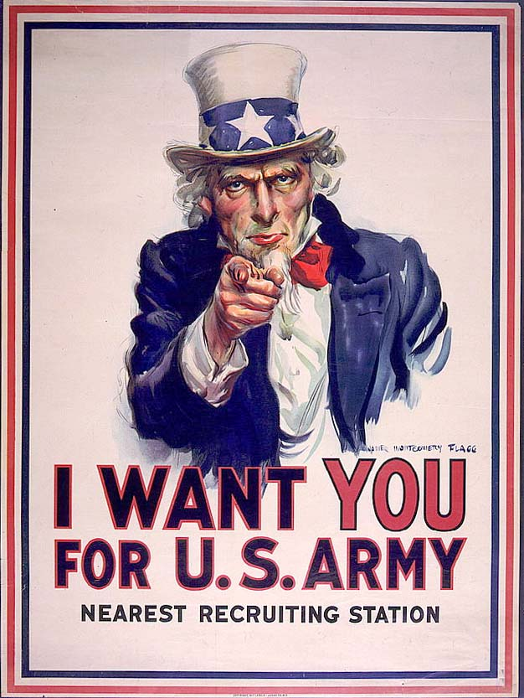
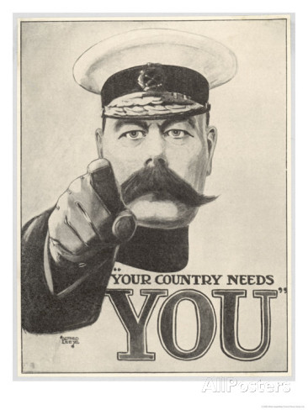
Your Country Needs You
They were created under the obvious influence of the well-known French artist Noah De Lacroix "To the barricades!"

Slide 4
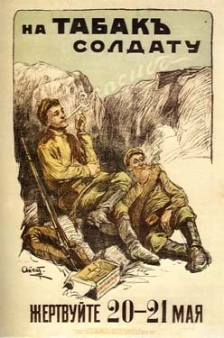
The second group is devoted to collecting money.
Due to the economic hardship of war and food shortages in different countries there were posters, calling to conserve food and fuel resources, give money to hospitals and the like.

Slide 5
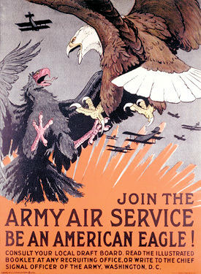
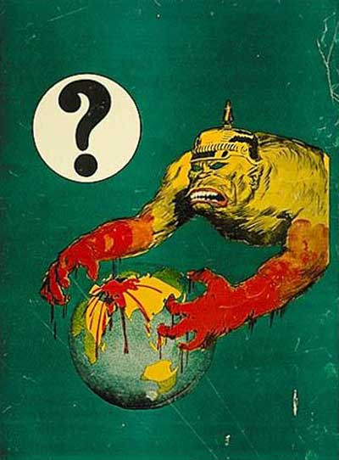
The third category depicted the appalling face of the enemies or laughed at them.

Slide 6
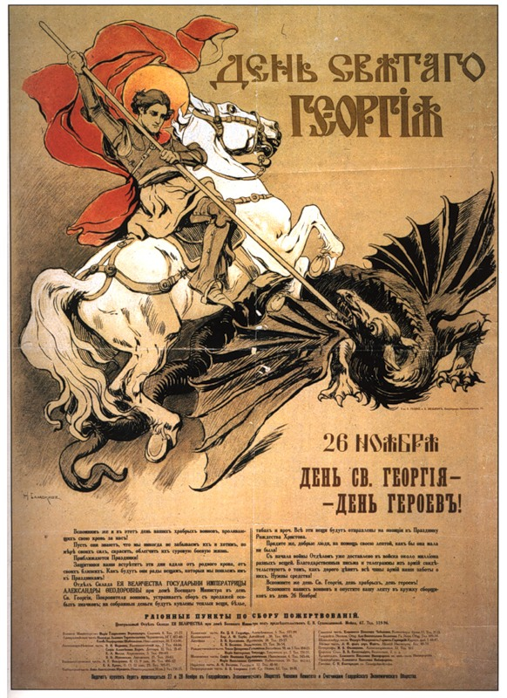
Other posters showed the battle of Good against Evil. Here, St. George slaying the dragon represents the "good".

Slide 7
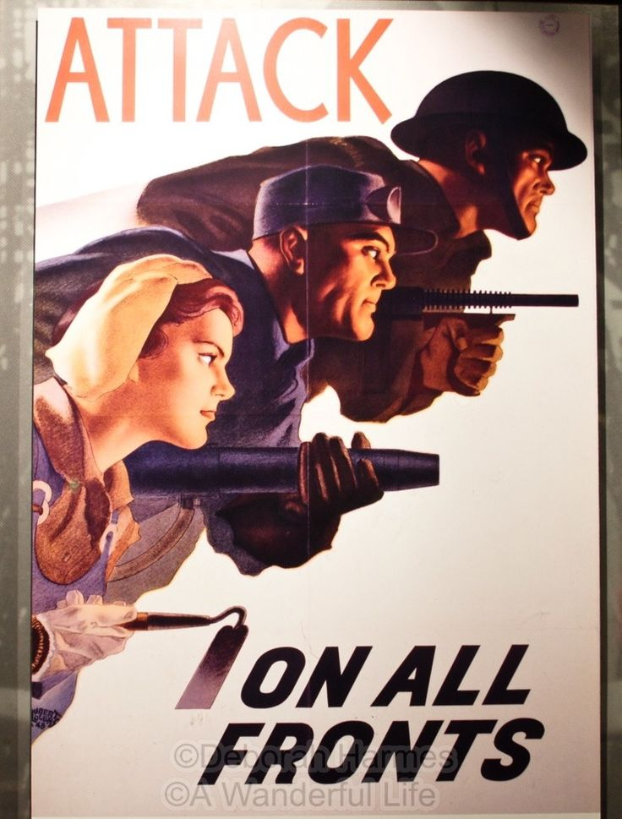
War-time posters are very emotional, psychologically sharp and full of pathetic feelings.
They performed two important functions: informed and created a clear negative image of the enemies, and therefore encouraged people to fight against them and help the state in every possible way.

