Slide 1
Чтение английских звуков в транскрипции
[ i:] | [e] | [а:] | [3:]
green | friend | smart | mermaid
he | merry | dancing | her
she | yellow | Barney | purple
reading | helping | are | pur-pur

Slide 2
I am a dog
My pet is Mike
His name is good friends
He is nice and merry
We are playing together
We like Cherry

Slide 3
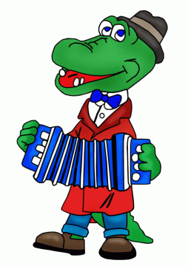
Любимые герои

Slide 4
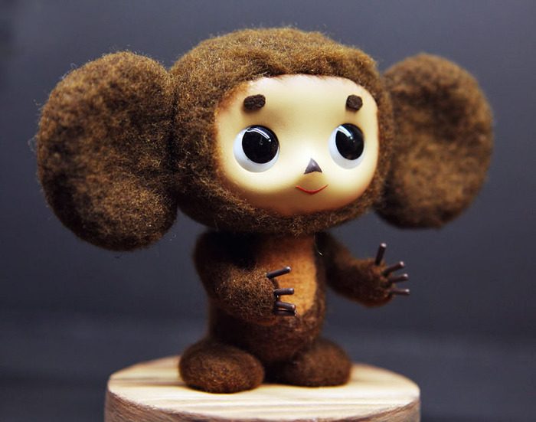

Slide 5
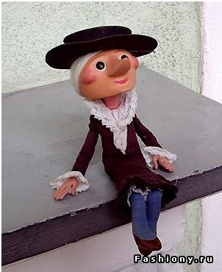

Slide 6
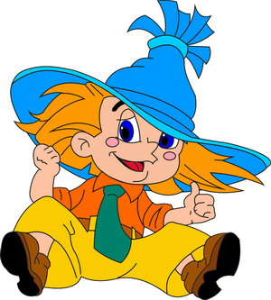

Slide 7
Исправьте ошибки
Hi, Mr Mouseling,
I am Leopold the cat.
I like Mouseland and I like you.
You are kind and smart.
I like Angelina. Angelina is nice.
She is a talented ballerina.
I am friendly and merry. I like mice.
I like singing and playing.
Leo

