Slide 1
ROBERT BURNS, Scotland’s Favourite Poet

Slide 2
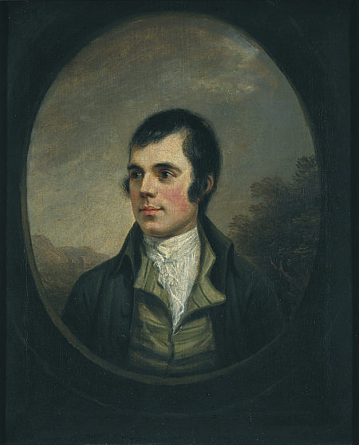
Robert
Burns
25 January 1759 – 21 July 1796

Slide 3
Scotland,
the
Beautiful

Slide 4
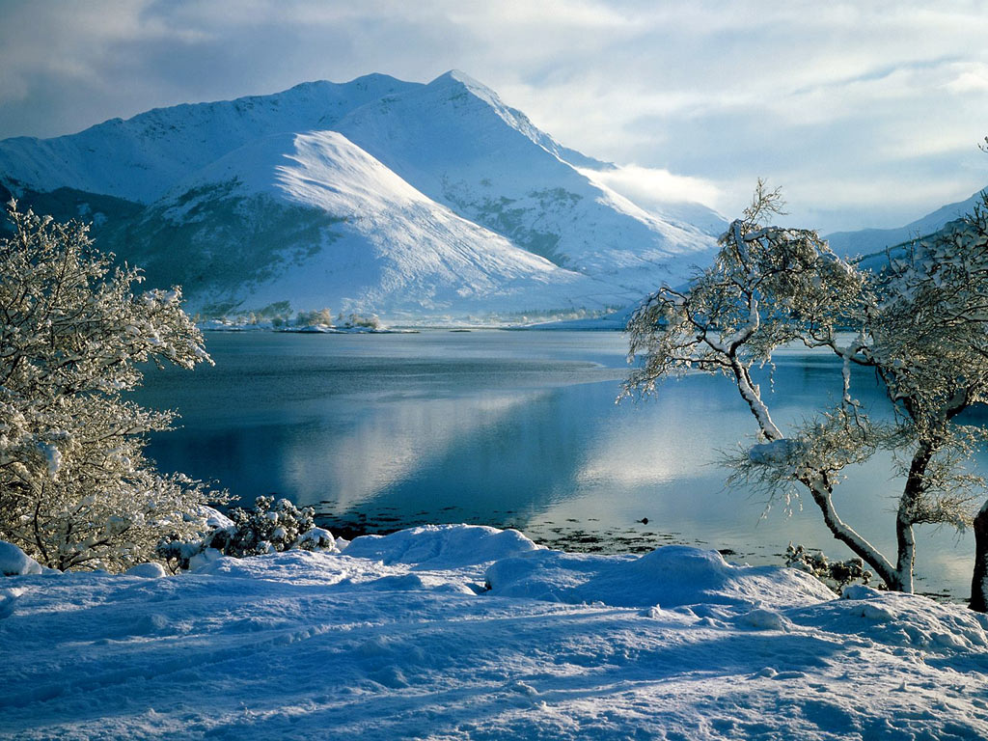

Slide 5
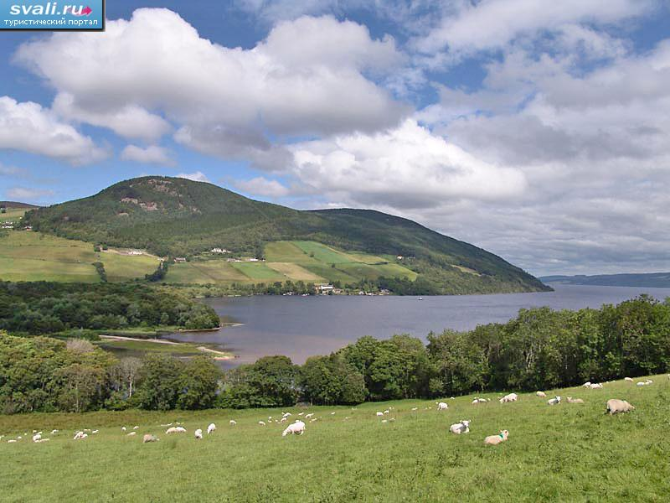

Slide 6
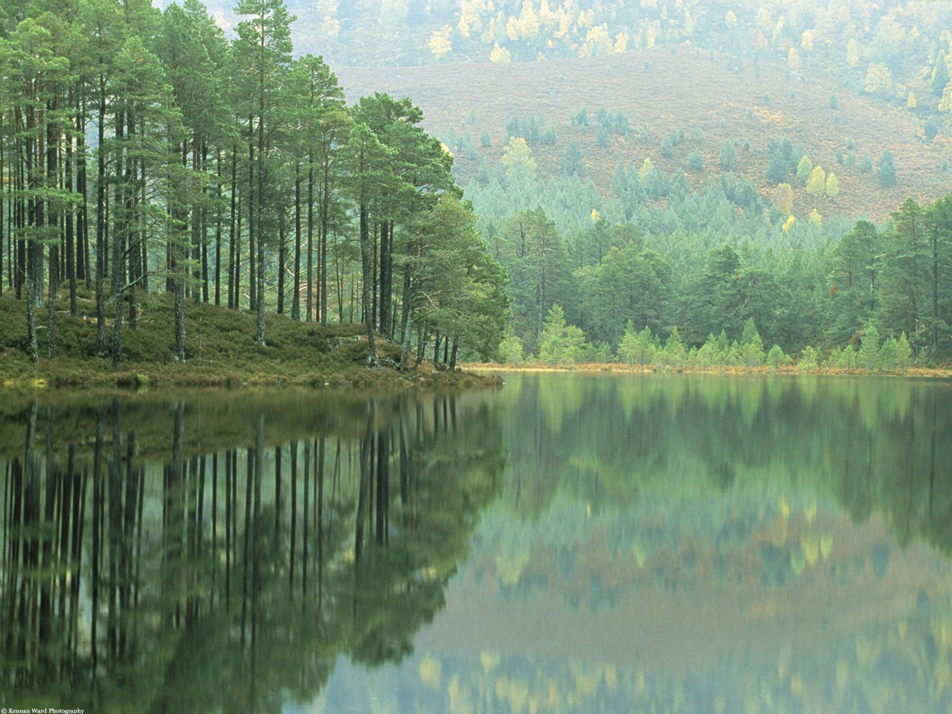

Slide 7
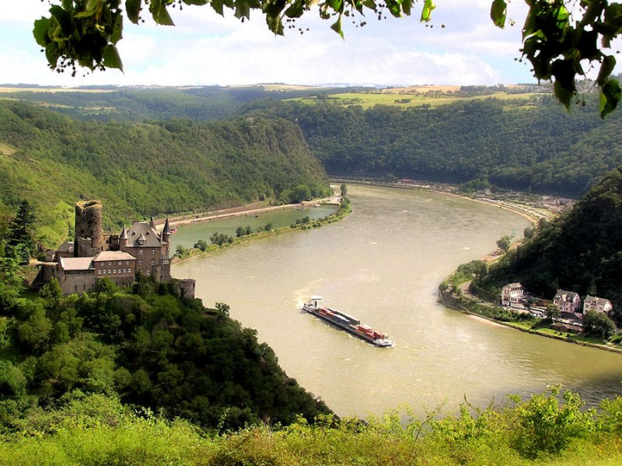

Slide 8
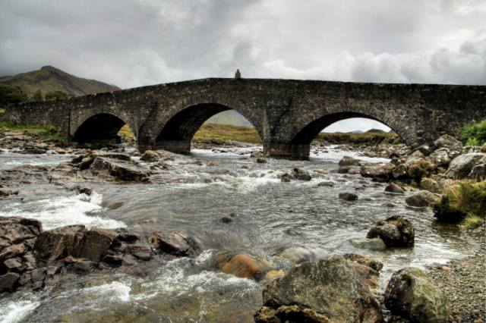

Slide 9
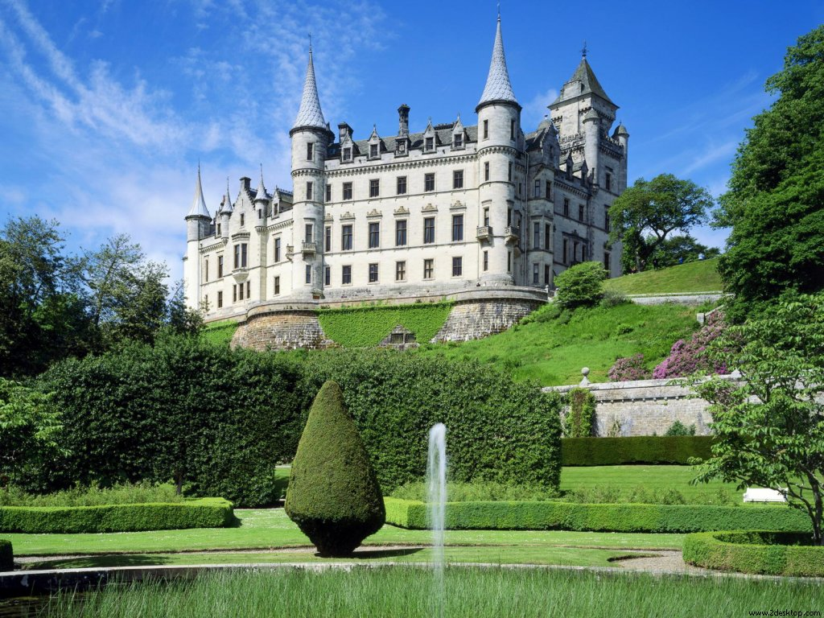

Slide 10
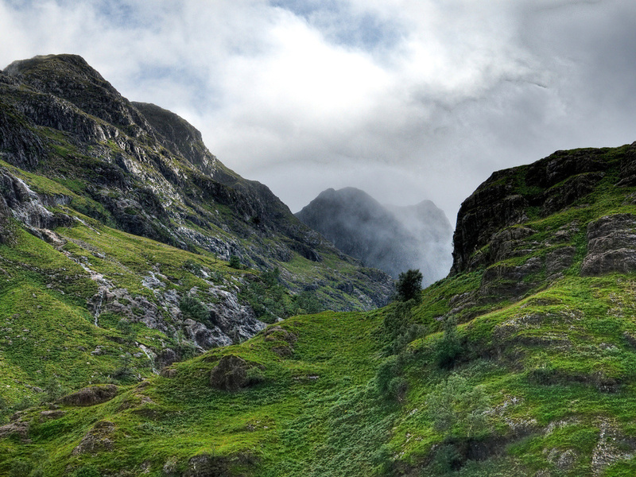
My Heart’s in the Highlands
Robert Burns

Slide 11
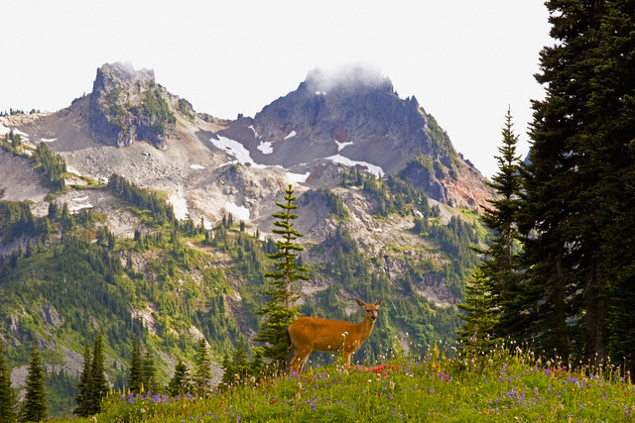
My heart’s in the Highlands, my heart is not here, My heart’s in the Highlands a-chasing the deer, A-chasing the wild deer and following the roe - My heart’s in the Highlands, wherever I go!

Slide 12
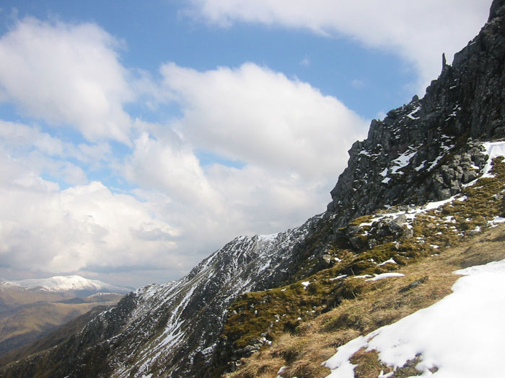
Farewell to the Highlands, farewell to the North, The birthplace of valour, the country of worth! Wherever I wander, wherever I rove, The hills of the Highlands for ever I love. Farewell to the mountains high covered with snow, Farewell to the straths and green valleys below, Farewell to the forests and wild-hanging woods, Farewell to the torrents and loud-pouring floods!

Slide 13
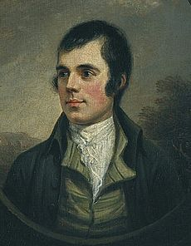
Robert Burns, Scotland’s favourite son, the Ploughman Poet, the national poet of Scotland, was born on January 25, 1759 two miles south of Ayr, in Alloway. Robert was the eldest of the seven children of William Burns and Agnes Brown.
There was a lad was born in Kyle, But whatna day o‘ whatna style,
I doubt it's hardly worth the while
To be sae nice wi’ Robin.
…..
(Robert Burns “Rantin’, Rovin’, Robin”)

Slide 14
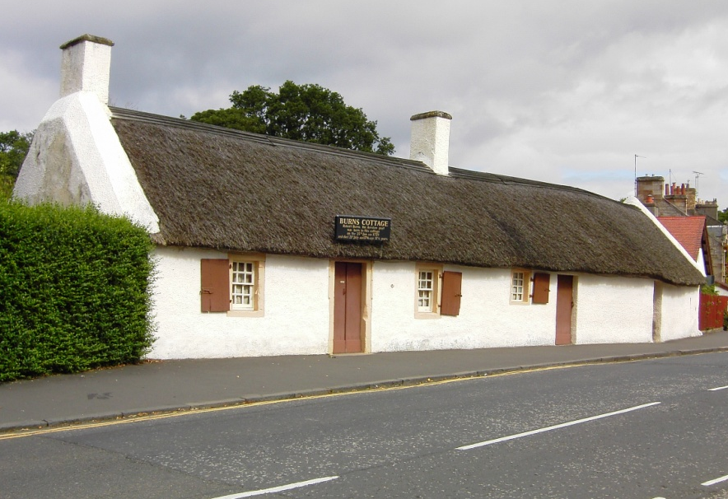
.
Robert was born in a house built by his father. When Robbie was seven years old, William Burns sold his house and settled on the farm southeast of Alloway. Here Burns grew up in poverty and hardship.
My father was a farmer upon the Carrick border,
And carefully he bred me in decency and order; He bade me act a manly part, though I had ne'er a farthing; For without an honest manly heart, no man was worth regarding.
.....
(Robert Burns “My Father Was A Farmer”)
Burns Cottage in Alloway, Scotland

Slide 15
Robert's mother knew many Scottish songs and ballads and often sang them to her children.
His father knew the value of a good education, and he tried to give his children the best education he could.

Slide 16
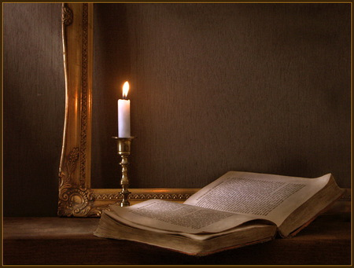
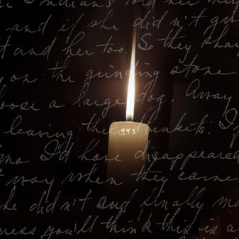
Robert supplemented his education by continuous reading.
Evenings would find him reading by candlelight or writing poems.

Slide 17
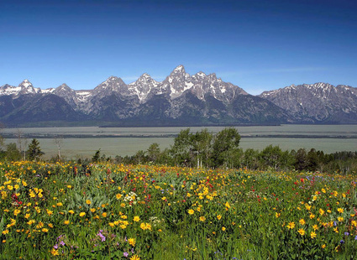
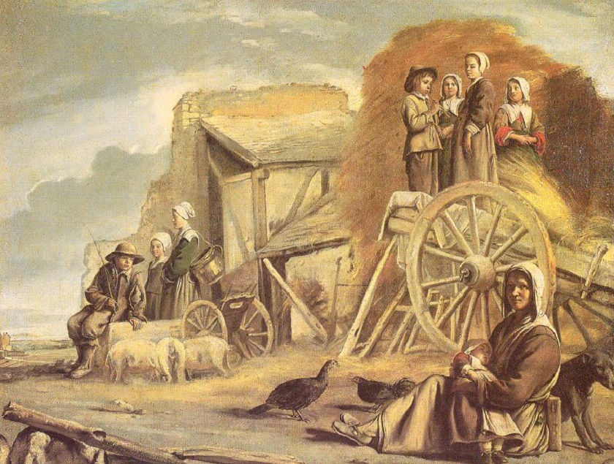
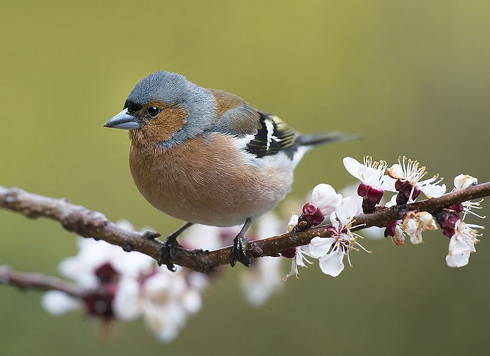
He wrote about what he knew personally: the flowering fields and birds singing in the trees, the life of Scottish peasants and the cares of his own heart.
The best Robert Burns’ poems are songs of love and nature.

Slide 18
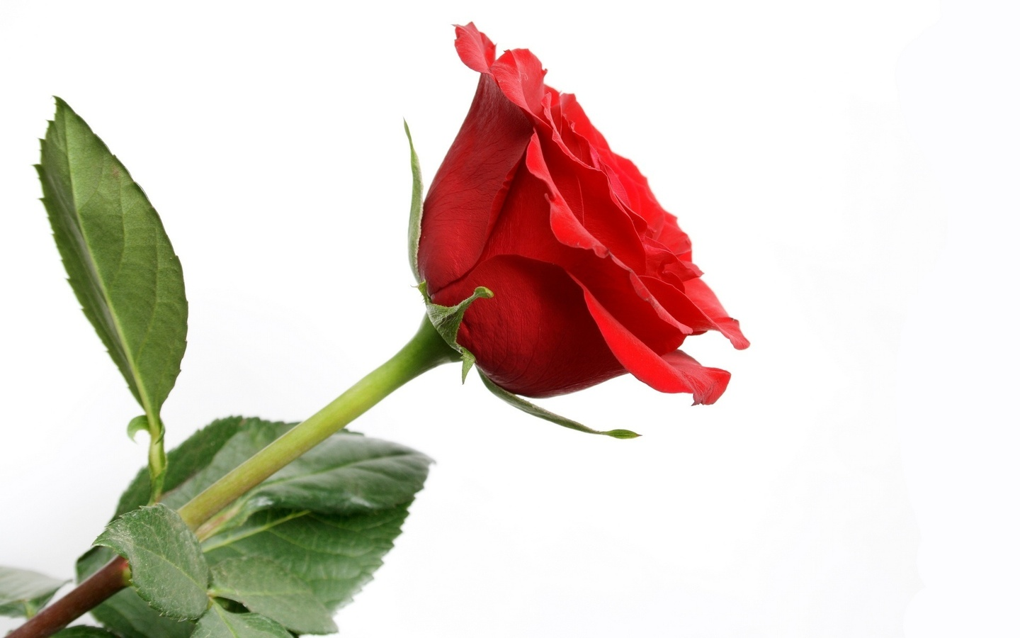
O, my love is like a red, red rose, That's newly sprung in June. O my love is like the melody, That's sweetly played in tune. As fair art thou, my bonny lass, So deep in love am I; And I will love thee still, my dear, Till all the seas gang dry.
Till all the seas gang dry, my dear, And the rocks melt wi’ the sun; And I will love thee still, my dear, While the sands of life shall run. And fare-thee-well, my only love! And fare-thee-well, a while! And I will come again, my love, Tho' it were ten thousand mile!
Robert Burns
A Red, Red
Rose

Slide 19
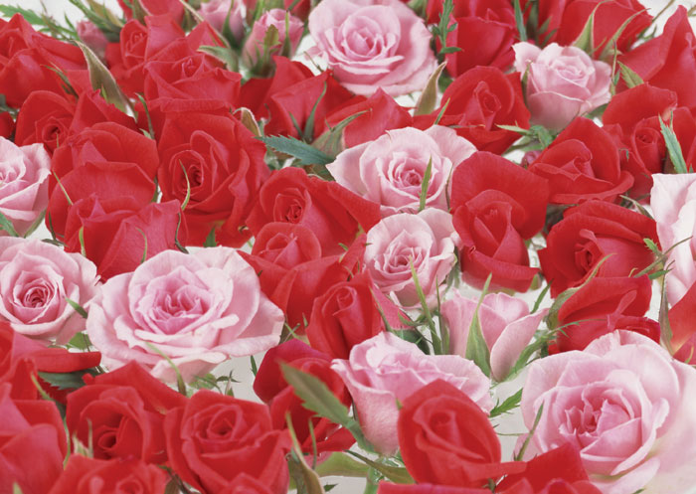

Slide 20
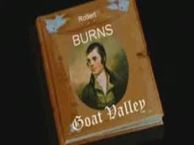
Robert Burns wrote his first poem “O, Once I Lov’d a Bonnie Lass” in 1774 when he was fifteen years old.
O, once I lov’d a bonnie lass
An’ aye I love her still,
An’ whilst that virtue warms my breast
I’ll love my handsome Nell.
…
A bonnie lass I will confess,
Is pleasant to the e’e,
But without some better qualities
She’s no a lass for me.
(Robert Burns “O, Once I Lov’d a Bonnie Lass”)
After his first poem Robert Burns wrote more than 600 verses and songs.

Slide 21
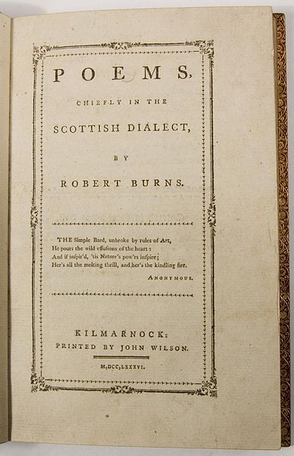
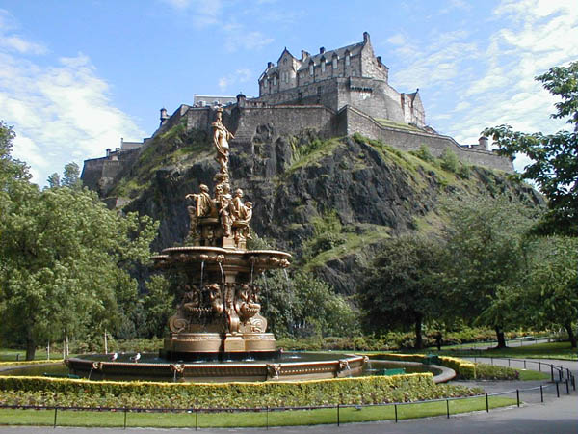
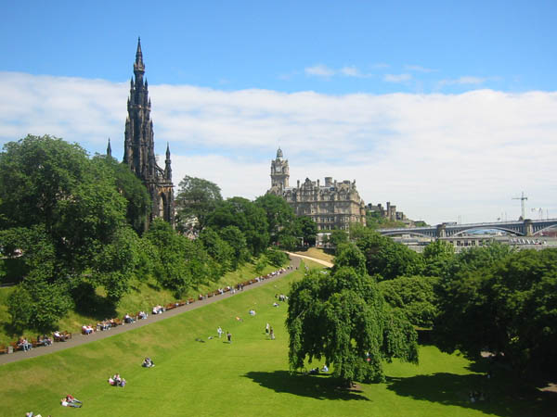
At the age of twenty-seven Robert Burns published a volume of his poetry “Poems, Chiefly in the Scottish Dialect”.
To his surprise it was a success and he went to Edinburgh to arrange for the second edition.

Slide 22
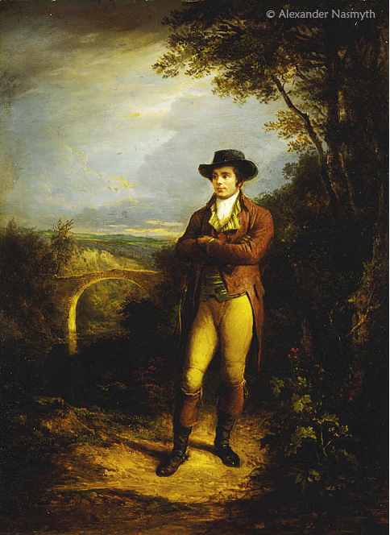
In Edinburgh Burns became a celebrated figure among his admiring readers.
But Burns knew that his social success wouldn’t last long and returned to the world that he knew so well. He took the post of government inspector for the region around Dumfries and combinated his new duties with farming and writing poetry.

Slide 23
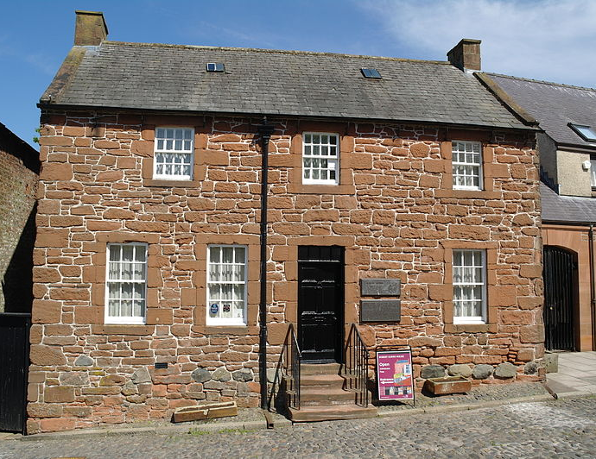
At Dumfries, married to the sweetheart of his youth Jean Armour, Robert spent the last years of his life. His best known songs date from these final years.
Burns devoted to Jean many beautiful poems, such as "I love my Jean", "Bonnie Jean – A Ballad" and many others.
There was a lass, and she was fair,
At kirk or market to be seen;
When a’our fairest maids were met,
The fairest maid was bonie Jean.
(Robert Burns “Bonnie Jean”)
Burns’ house in Dumfries

Slide 24
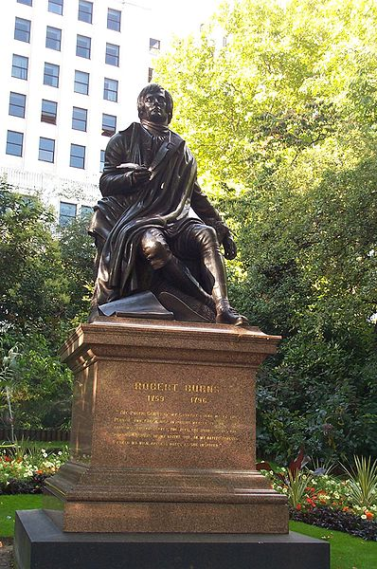
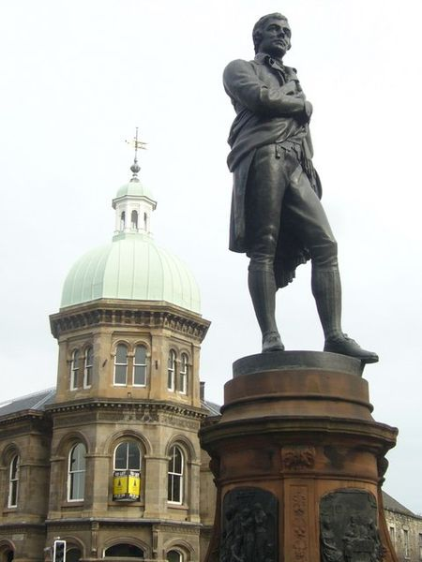
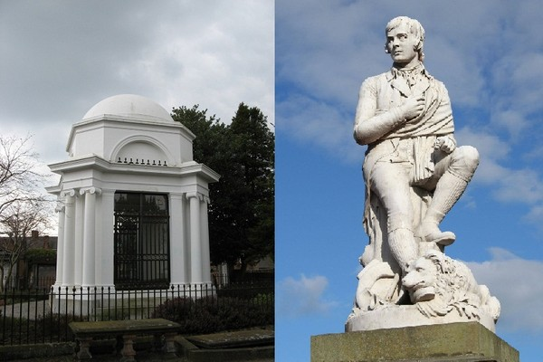
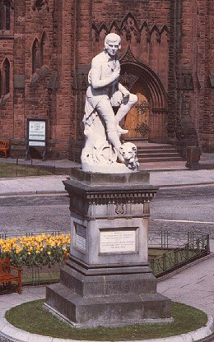
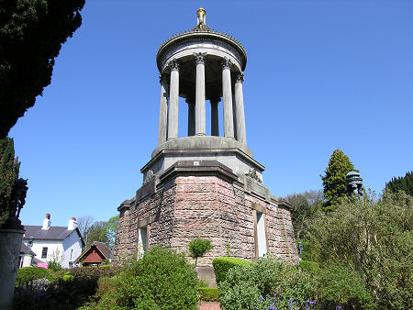
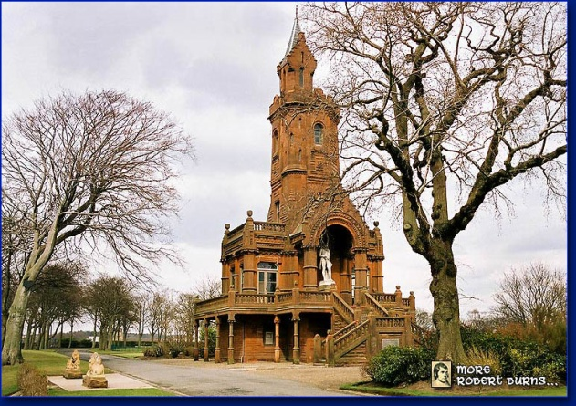
Today, throughout Britain there are monuments, museums dedicated to Robert Burns.
Robert Burns Mausoleum and Statue in Dumfries
Burns statue in Leith
Burns Monument in London
Burns Monument in Alloway
Statue of Burns
in Dumfries town centre
Burns Monument in Kilmarnock

Slide 25
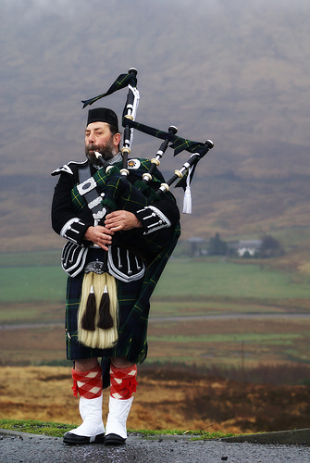
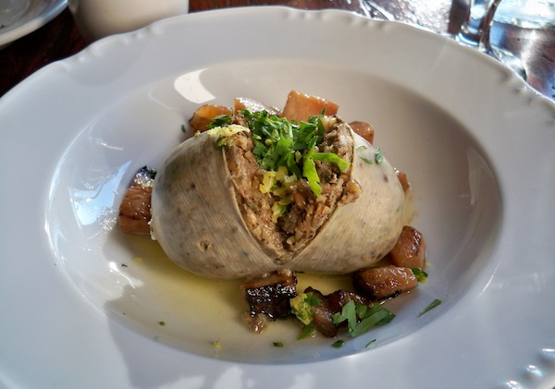
Burns Night
For Scotsmen Robert Burns is a symbol of national pride. That’s why every year on January 25 his birthday is widely celebrated in Scotland and all over the English-speaking world. The celebration is known as Burns Night.
Burns Night is usually held in the form of a supper – Burns Supper.
The celebration usually begins with addressing to a haggis. During the celebration Burns’ poems are recited and Scottish bagpipers play.

Slide 26
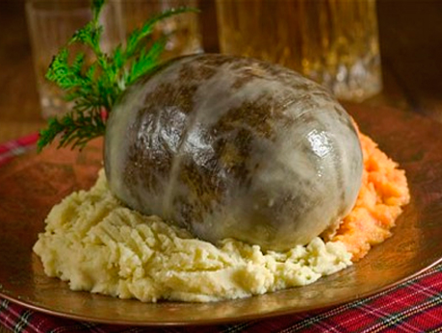
“Ode To Haggis”
Haggis is a mixture of heart, liver and lungs of a sheep combined with oats, suet, herbs and spices, all cooked in a casing traditionally made of the animal’s stomach.
Butchers usually throw in
their own secret ingredients.
«Ода шотландскому пудингу «Хаггис»

Slide 27
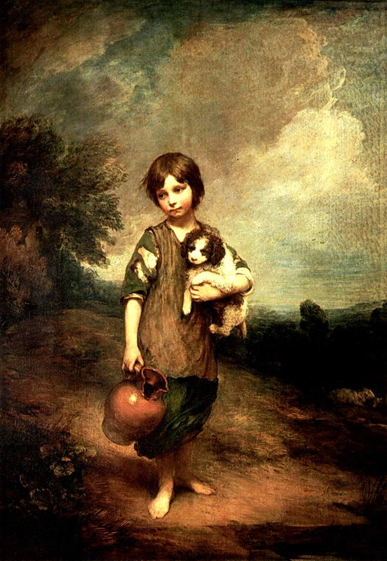
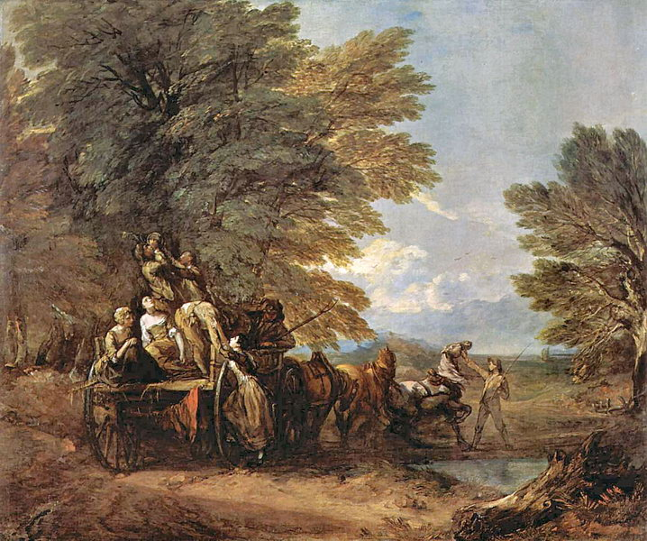
“A Man’s A Man For A’ That”
«Честная бедность»

Slide 28
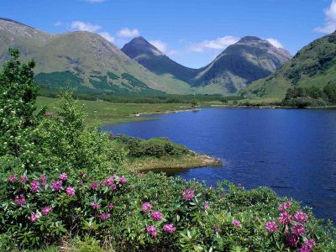
“The Winter Of Life”
«Зеленый дол»

Slide 29
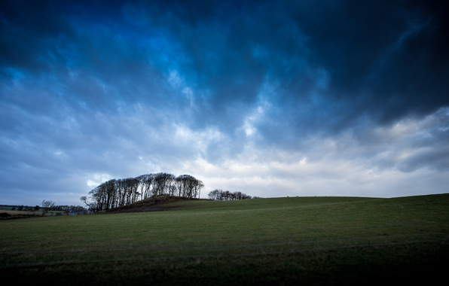
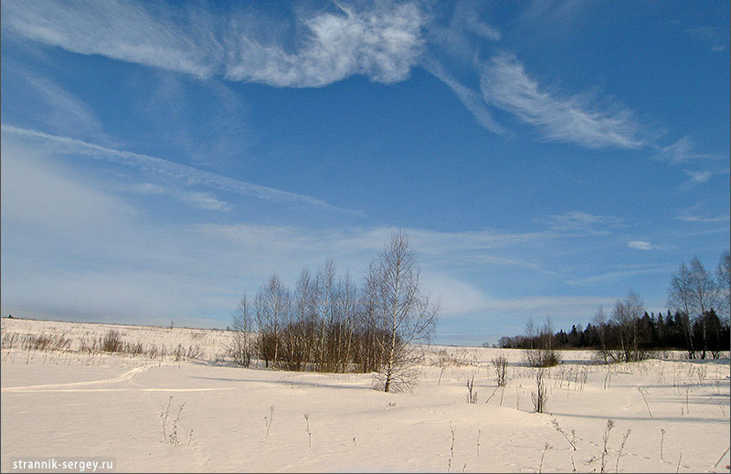
“O, Wert Thou In The Cauld Blast”
«В полях под снегом и дождем»

Slide 30
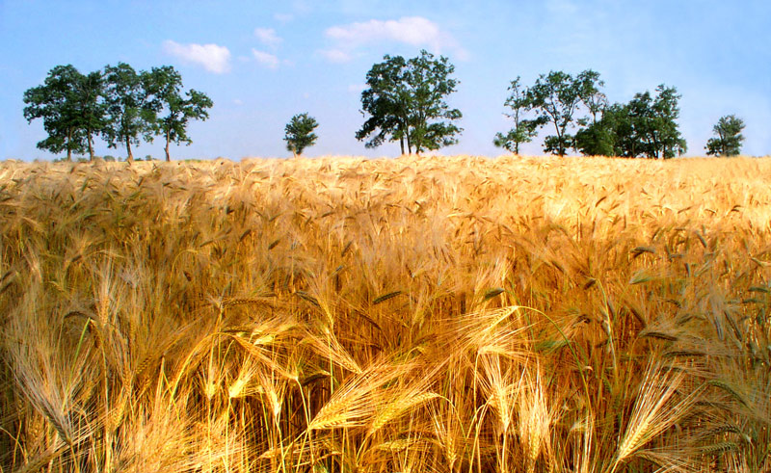
“Coming Through The Rye”
«Пробираясь до калитки»

Slide 31
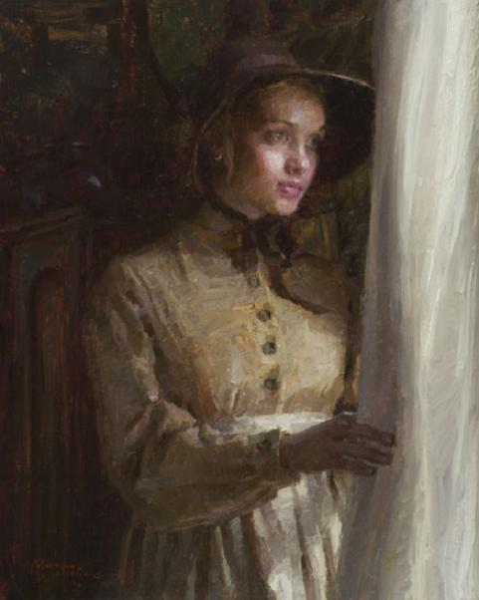
“Whistle, And I’ll Come To You, My Lad”
«Ты свистни – тебя не заставлю я ждать»

Slide 32
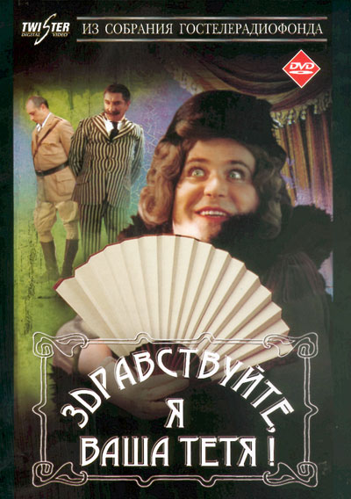
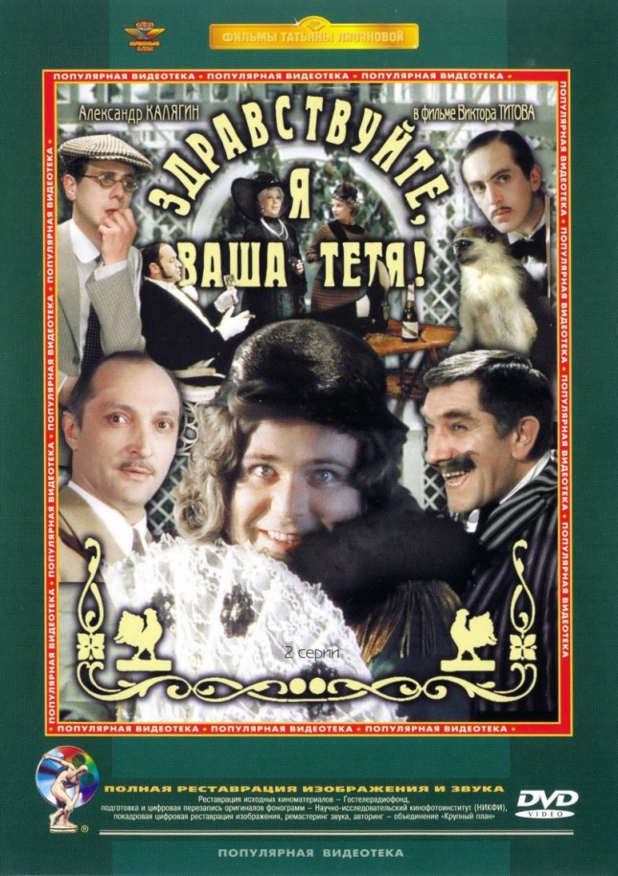
“Poortith Cauld And Restless Life”
«Любовь и бедность»
“Hello, I’m Your Aunt!”

Slide 33
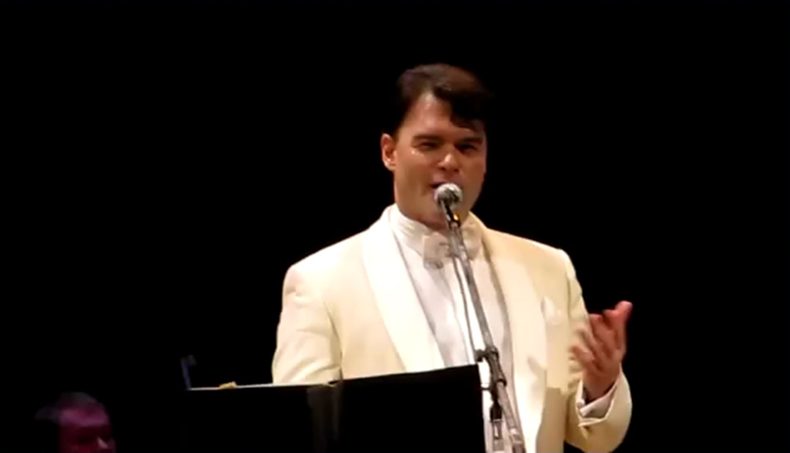

Slide 34
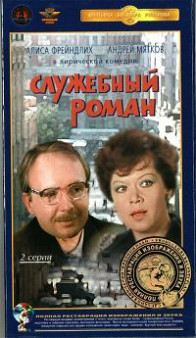
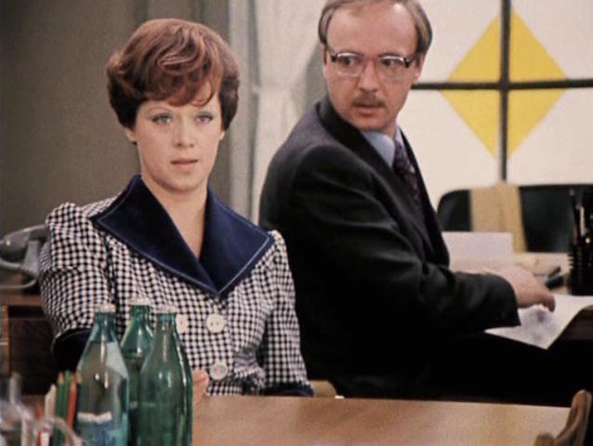
“For The Sake Of Somebody”
«Моей душе покоя нет»
“Office Romance”

Slide 35
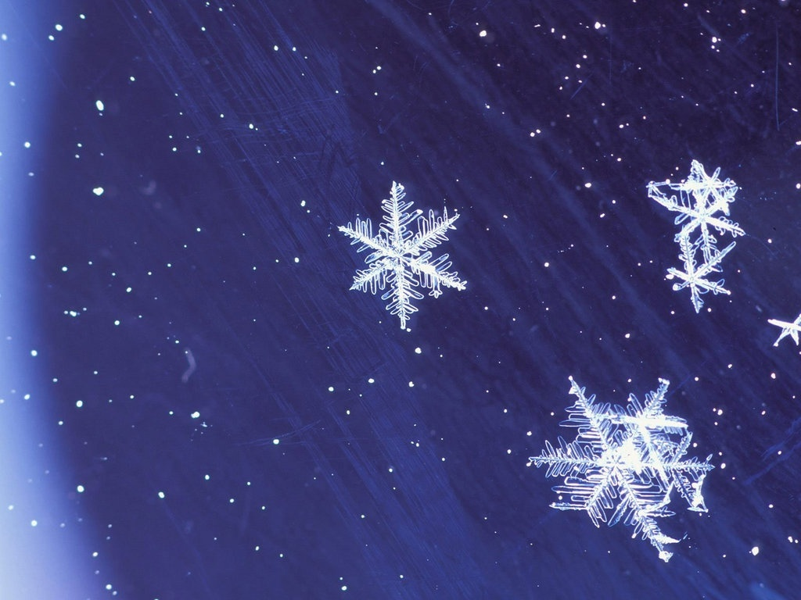
Auld Lang Syne
Should auld acquaintance be forgot,
And never brought to mind?
Should auld acquaintance be forgot,
And auld lang syne!
For auld lang syne, my dear,
For auld lang syne,
We’ll take a cup o’ kindness yet,
For auld lang syne.

