Slide 1
Урок английского языка в 8 классе
“Our newspaper”

Slide 2
Newspapers are world’s mirrors
Газеты –зеркала мира
Неизвестный автор

Slide 3
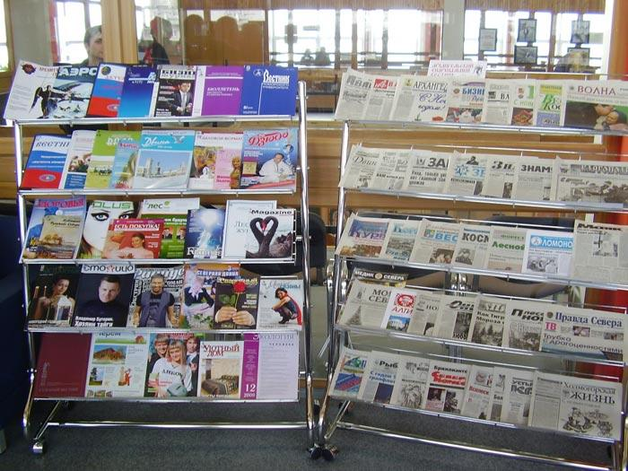
From the history

Slide 4
the 5th century
Italy
Julius Caesar
" The day events"

Slide 5
1663 England
London
“The Informator"

Slide 6
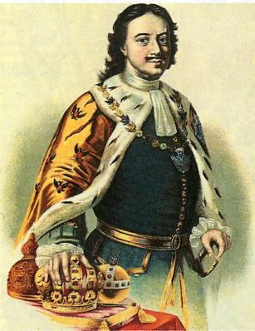
Russia
Peter I
" Vedomosty"

Slide 7
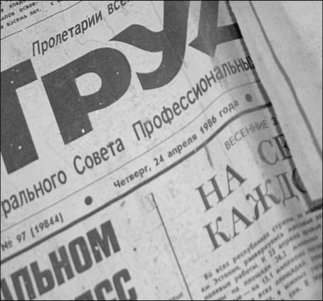

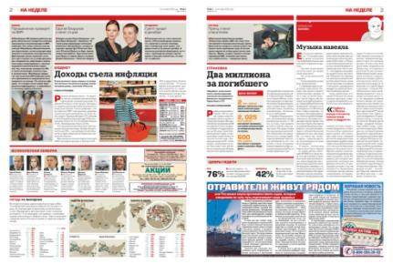
Central

Slide 8

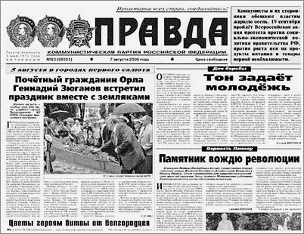
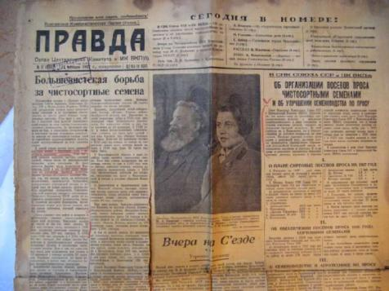

Slide 9
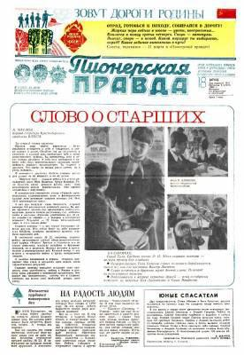
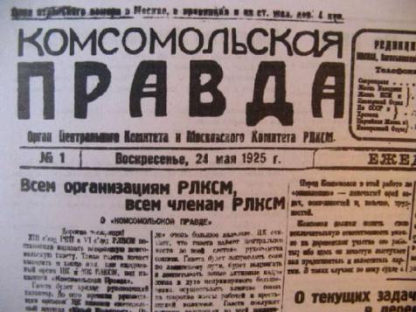
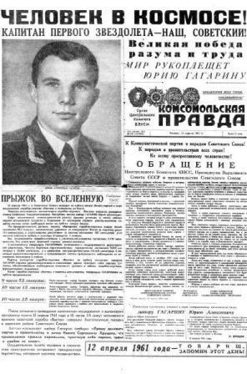

Slide 10

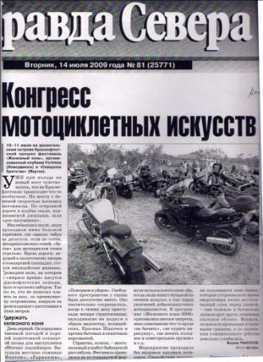
Regional

Slide 11
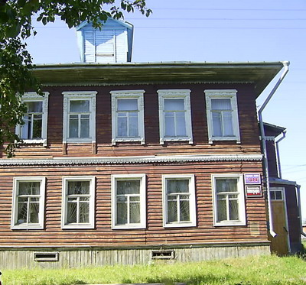
Local
" Zarya”

Slide 12
Task:
If you were a foreigner, what would you like to know about our local newspaper
“ Zarya”?

Slide 13
Questions:
What do you know about the past of the newspaper?
How often is the paper printed?
What is the staff of the paper?
What do you read?

Slide 14
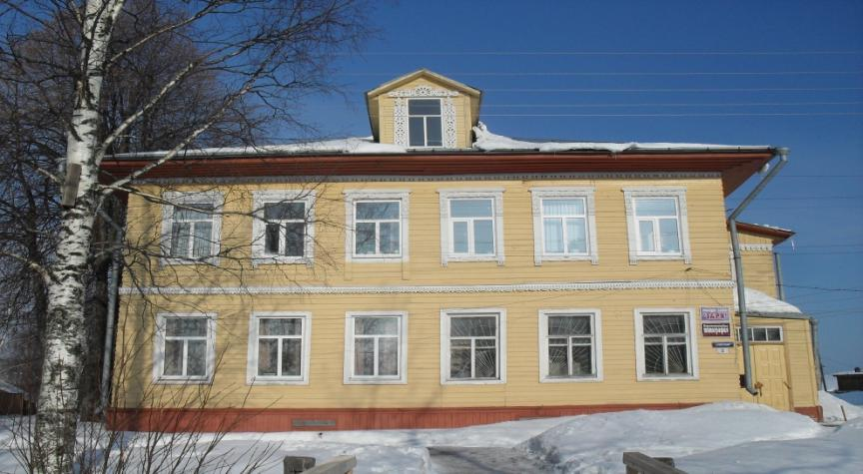

Slide 15
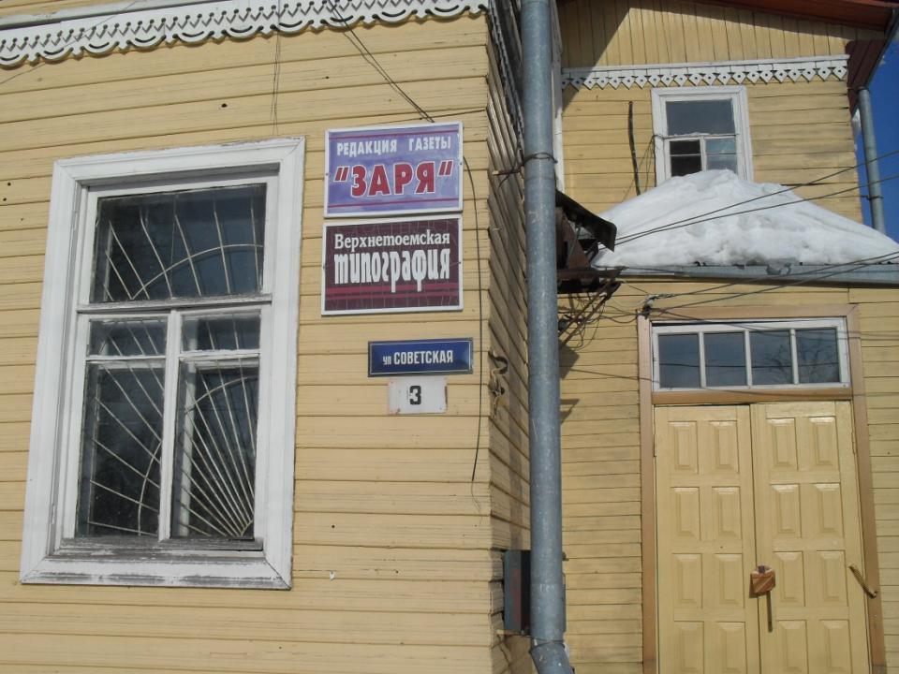
Editorial office
Printing-house

Slide 16
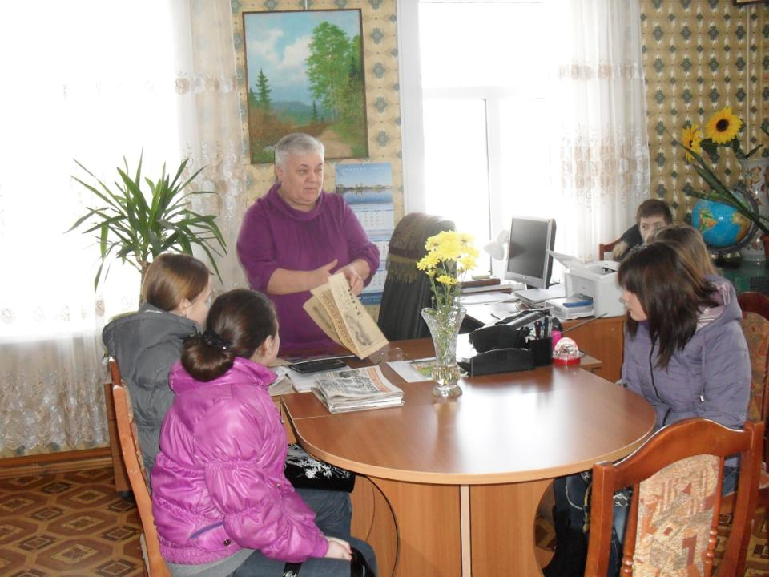
Editor-in-chief

Slide 17
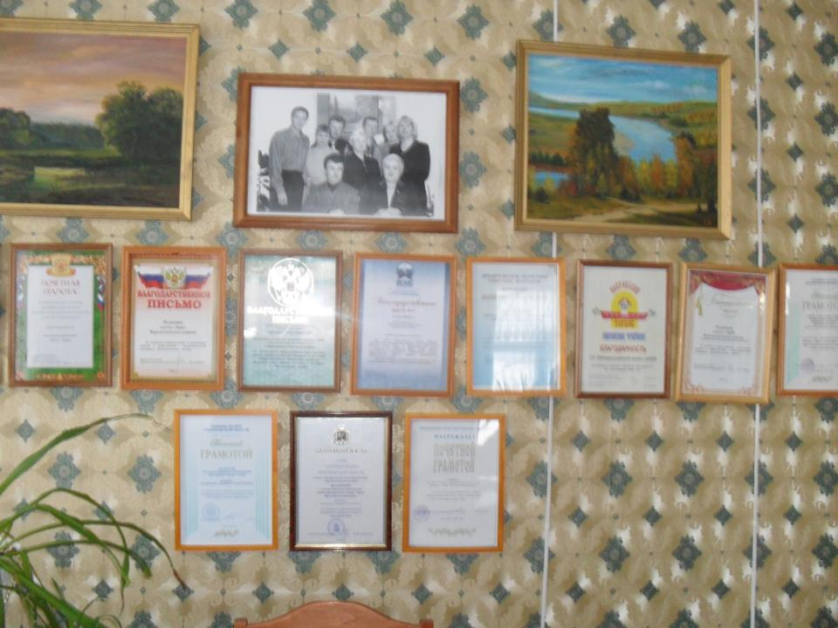
Editorial staff

Slide 18
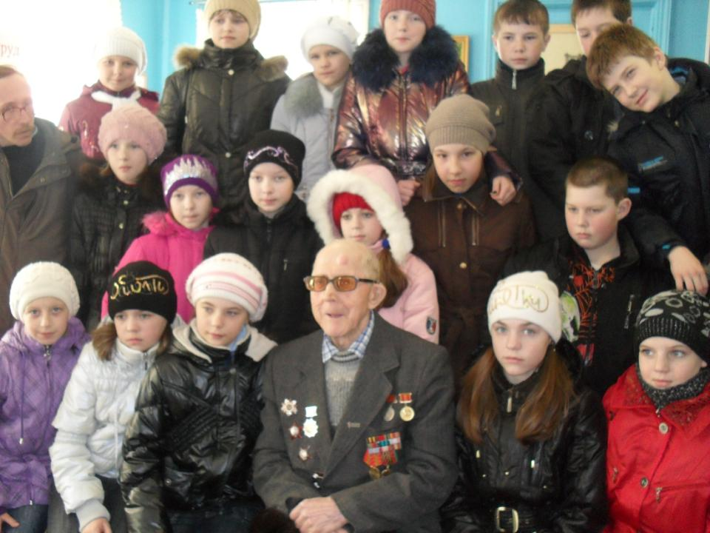

Slide 19
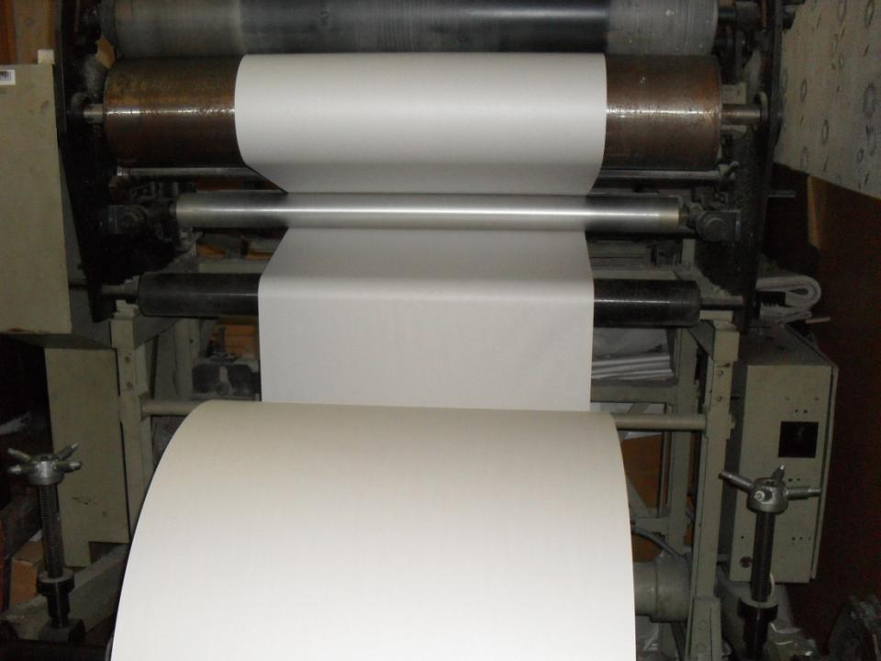
In the printing - house

Slide 20
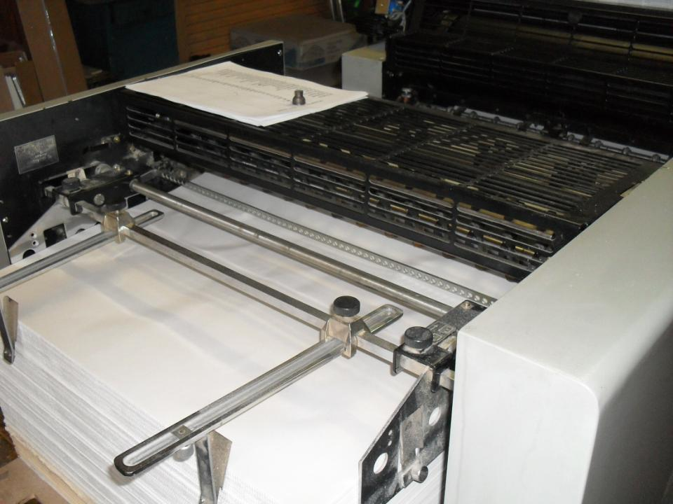

Slide 21
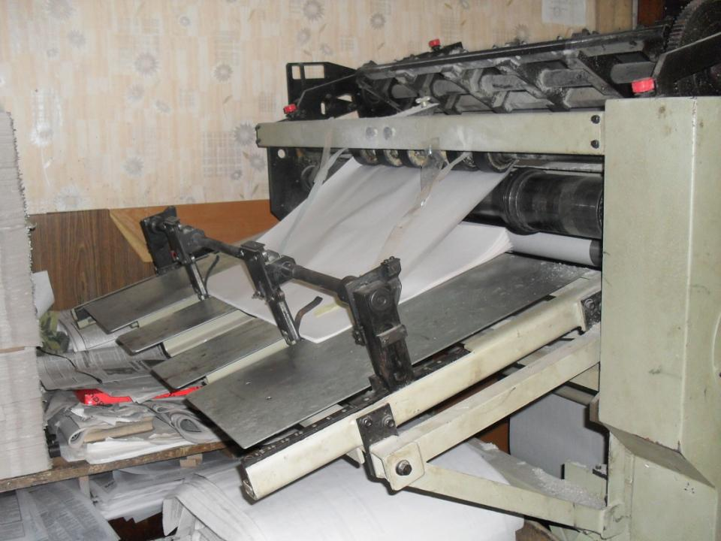

Slide 22
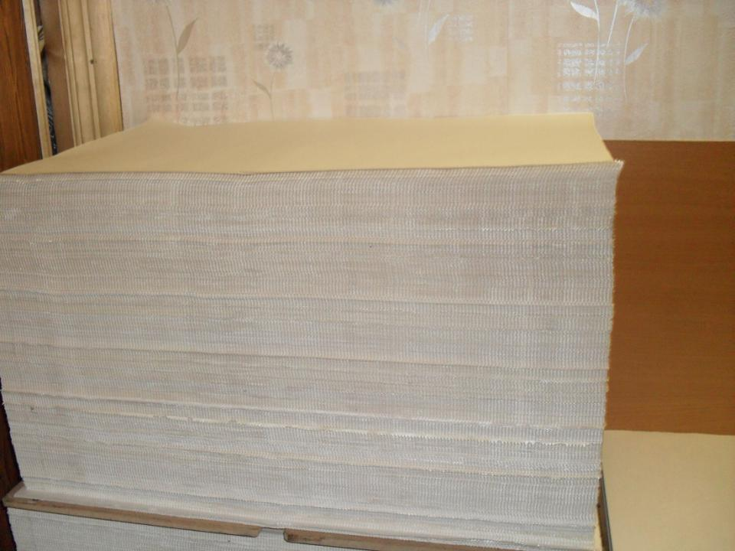

Slide 23
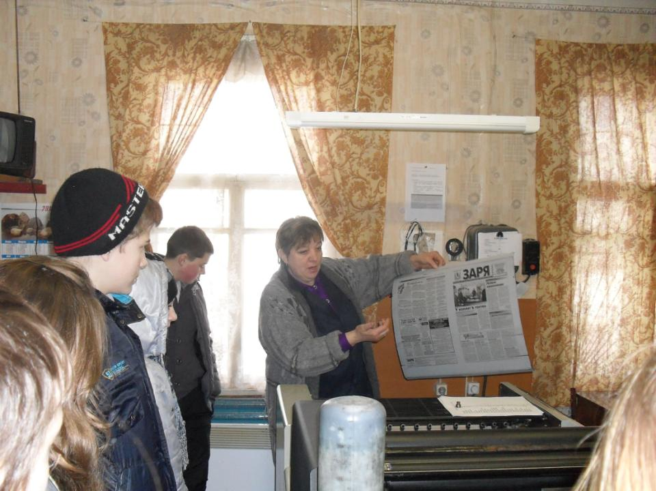

Slide 24
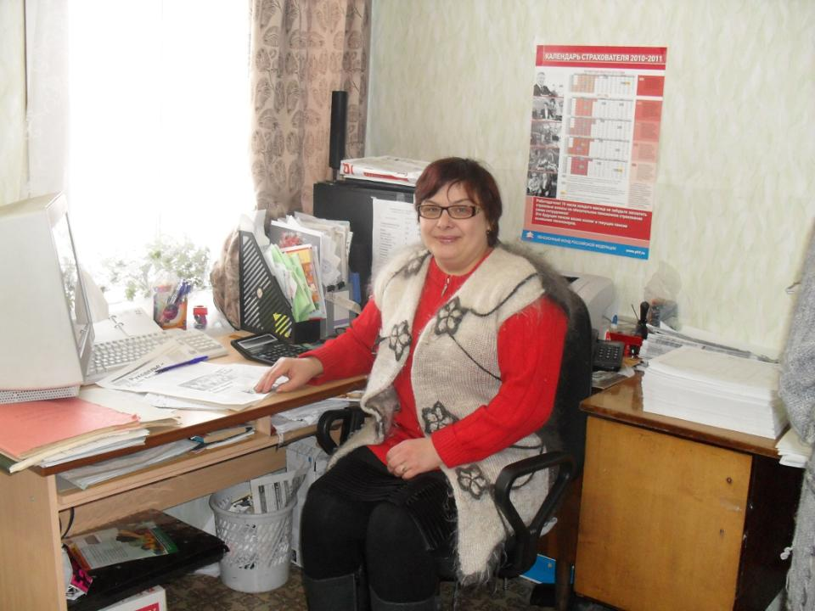

Slide 25
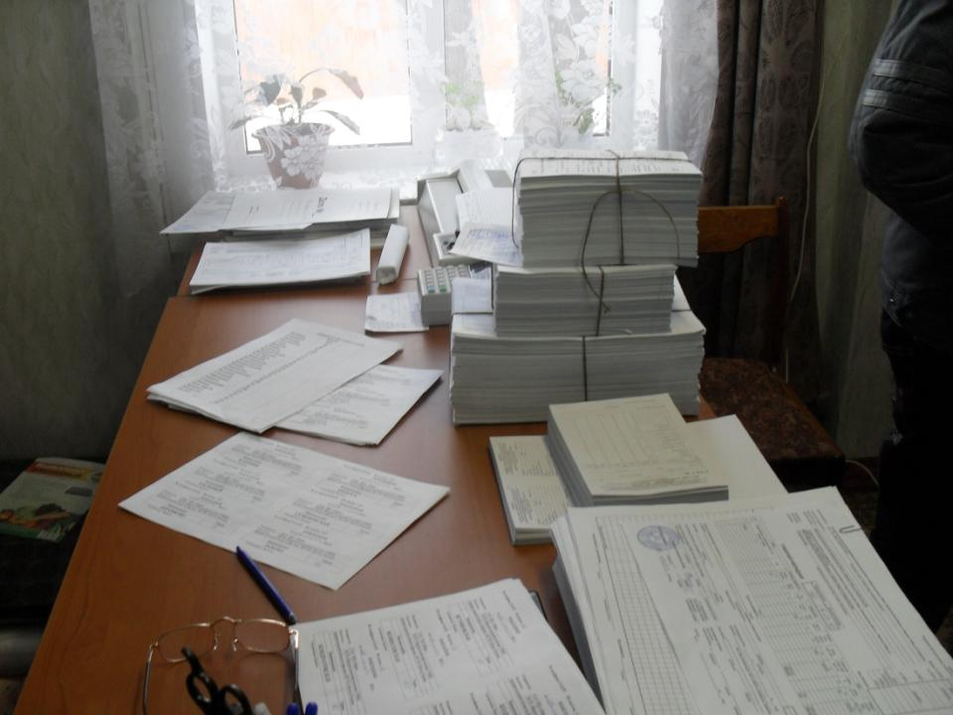

Slide 26
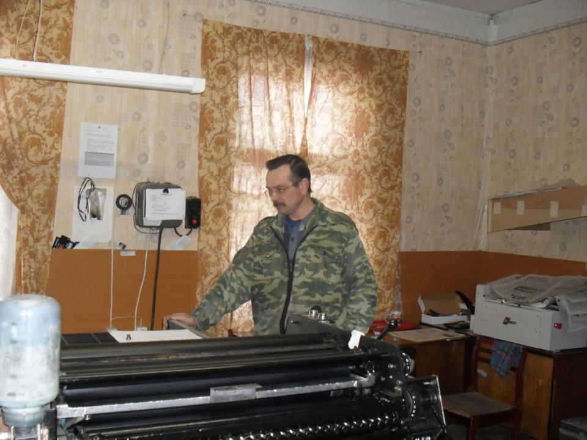

Slide 27
Headings
Sport
Events
Poet’s corner
Ecology
TV programme

Slide 28
Task
You can hear five speakers. Try to guess about what headings do they speak?

Slide 29
Heading | Ecology | Event | Sport | TV Progra-mme | Poet’s corner
Speaker
Points

Slide 30
Heading | Ecology | Event | Sport | TV Progra-mme | Poet’s corner
Speaker | 2 | 5 | 4 | 1 | 3
Points

Slide 31
Some interesting facts about paper
Participants: 52 pupils of our school
Forms: 7a,7b, 9a,10,11

Slide 32
1. Do you like to read “ Zarya”?

Slide 33
2. Do you subscribe or buy it?

Slide 34
3. My favourite headings

Slide 35
4.Have you ever written an article to the paper?

Slide 36
5. Have you ever read about yourself in the paper?

Slide 37
Task
Make your own survey ( опрос).
Ask your partner some questions about paper and write down on the card.

Slide 38
Card 2 Ask your partner and write down
1. Do you like to read “ Zarya”? Yes No
2. Do you subscribe? Yes No
Do you buy it? Yes No
3. What is your favourite heading?
4.Have you ever written an article to paper?
Yes No
5. Have you ever read about yourself in the paper? Yes No

Slide 39
Task
Look at the photo and give the title

Slide 40
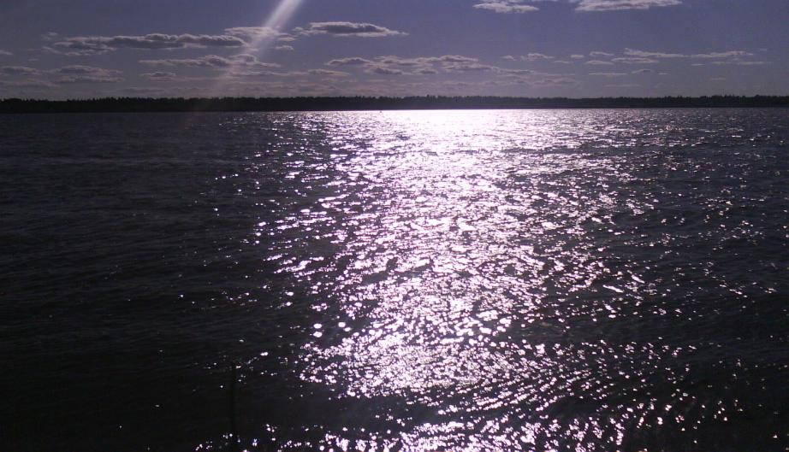
Sunrise on the Northern Dvina

Slide 41
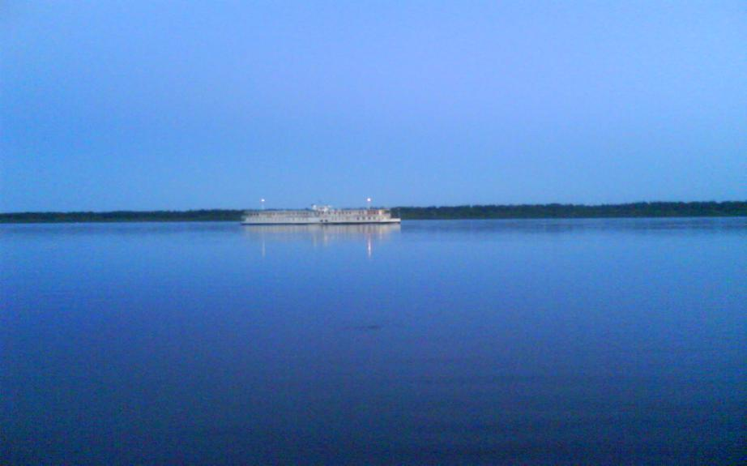
“Pink sails” on Dvina

Slide 42
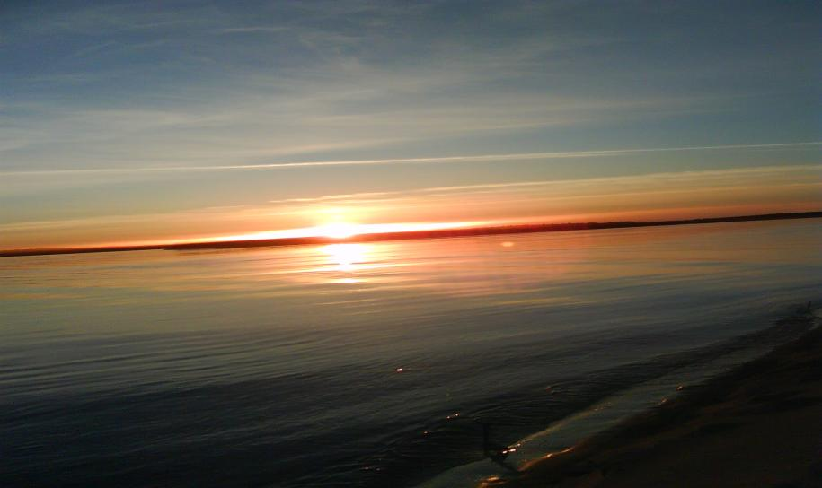
Sunset on Dvina

Slide 43
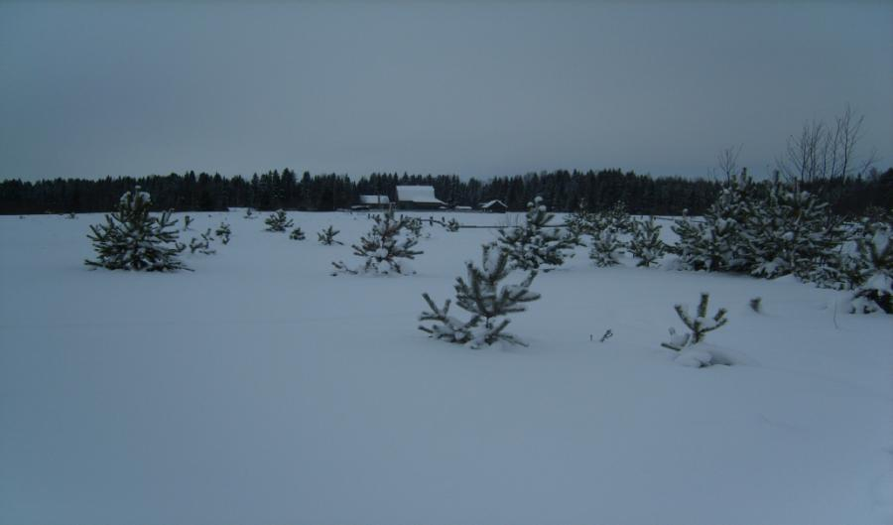
Winter. Snow. Village.

Slide 44
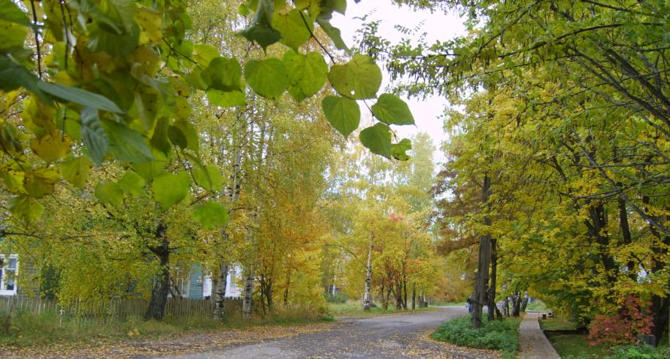
“Golden autumn”

Slide 45
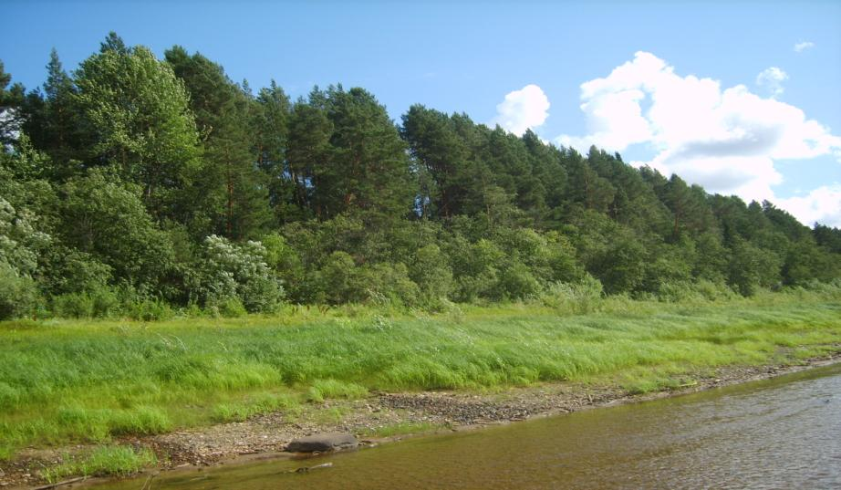
Stones. Water. Greens.

Slide 46
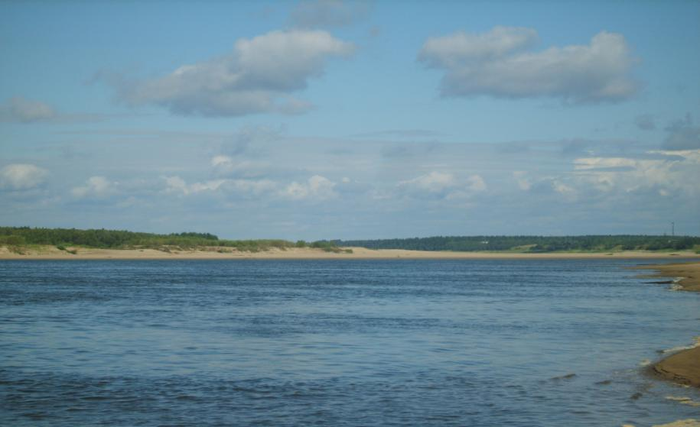
The Dvina’s banks

Slide 47
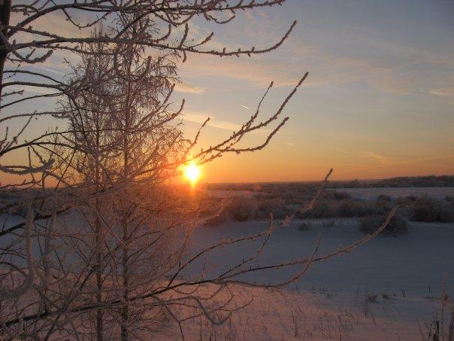
Winter in Timoshino

Slide 48
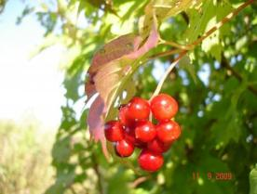
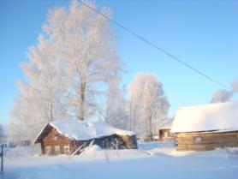
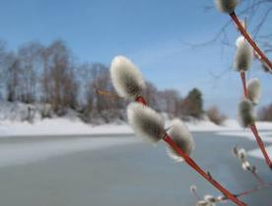
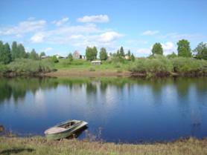
Autumn. Winter. Spring.
Summer.

Slide 49
New words ( borrowings)
digest ( дайджест)-
Краткое или сокращённое изложение
( short and condensed summary)
a digest of the week’s news

Slide 50
Tell your partner about the paper
What do you know about the past of the newspaper?
How often is the paper printed?
What is the staff of the paper?
What do you read?

Slide 51
Thanks for attention!

