Slide 1
How do you know your native town?
Lesson – quiz

Slide 2
General Information

Slide 3
General Information

Slide 4
Geographical position

Slide 5
Industry of our town

Slide 6
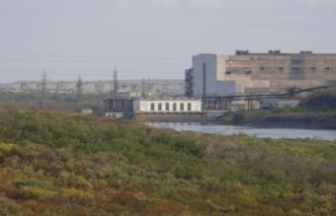
Industry of our town

Slide 8
Places of interest

Slide 9
Places of interest

Slide 10
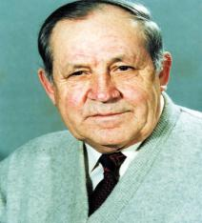
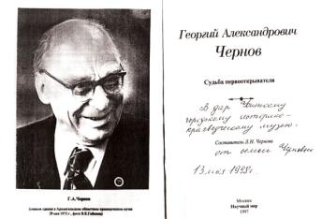
Famous people

Slide 11
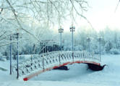
Vorkuta is my native town!

