Slide 1
Автор: Дмитриева О.В.
“Travel Broadens the Mind”
учитель английского языка
ГБОУ СОШ №158,
г. Санкт-Петербург
Notes:
Автор

Slide 2
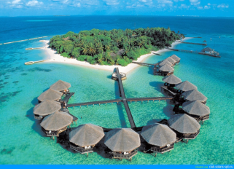
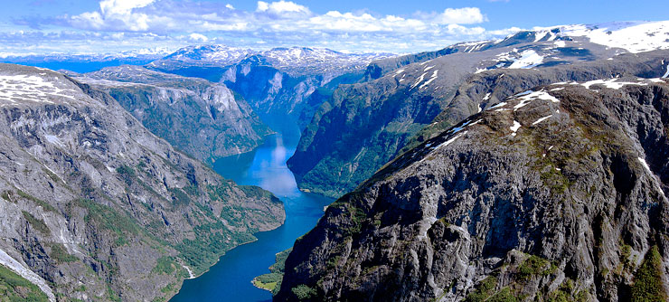
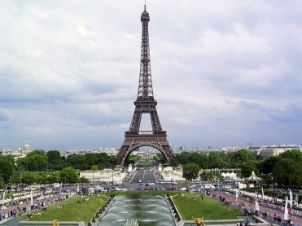
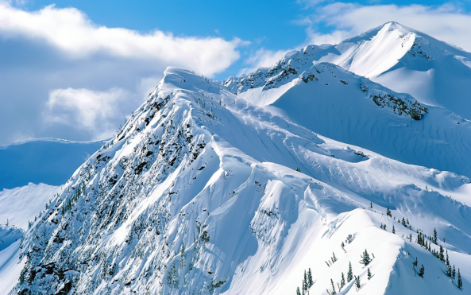
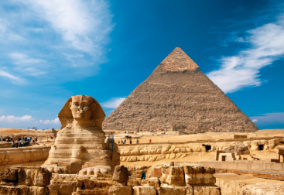
What do you know about these places? Have you ever visited them? Which would you like to visit? Why?

Slide 3
Travel Broadens the Mind
How is the title related to the pictures?

Slide 4
Which of the following do you think you can do in each place? You can add your ideas.
visit galleries/museums/ancient castles/historical sites
see animals in their natural environment
go scuba diving/snorkelling/hiking/kayaking/white-water rafting
walk along white sandy beaches
try delicious local cuisine
see spectacular waterfalls
buy handmade souvenirs
admire interesting architecture

Slide 5
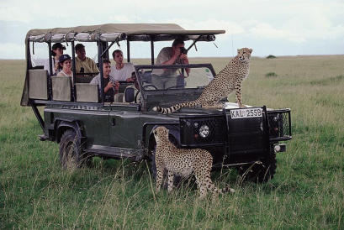
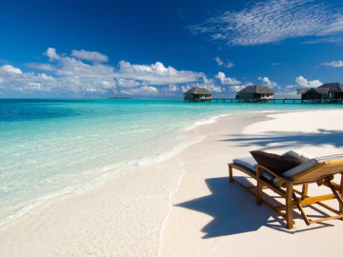
Types of holidays
downhill skiing holiday
activity holiday
Safari holiday
sightseeing holiday
beach holiday

Slide 6
Imagine you went on either a beach or a sightseeing holiday. Use these adjectives to tell your partner about the holiday.
Place/streets/hotel: quiet ≠ noisy/crowded
Place: crowded ≠ deserted/secluded; clean ≠ dirty
Weather: scorching hot ≠ freezing hot
City: exciting ≠ boring; modern ≠ historic
Hotel/restaurant: cheap ≠ expensive
Locals: friendly ≠ unfriendly

Slide 7
What makes a description interesting?
using a variety of adjectives (huge, amazing, etc.)
using a variety of adverbs (horribly, astonishing, etc.)
using modifiers (adverbs of degree)

Slide 8
Replace the adjectives in bold with other appropriate ones from the list.
delicious
enjoyable
warm
picturesque
cosy
freezing cold
friendly
We stayed in a 1) nice chalet in the 2) nice mountains in Bulgaria. The people were 3) good and 4) nice. The weather was 5) bad, but we didn’t mind. The home-cooked food was 6) good and we had a(an) 7) nice time skiing every day. I can’t wait to go back again next year.

Slide 9
Using modifiers (adverbs of degree):
+ | a little, slightly, a bit
++ | rather, pretty, quite, fairly
+++ | very, really, extremely

Slide 10
Choose the correct word.
The hotel was extremely/rather expensive, but not beyond our budget.
The weather was slightly/pretty worse than we expected, but it didn’t spoil our trip.
The boat trip was a little/really disappointing, but enjoyable nonetheless.
The museum was very/fairly interesting. In fact it was one of the best I’ve been to.
The town centre was a bit/really busy, but not crowded.

Slide 11
Describing pictures.
Talk about:
people
place
time of day
weather
activities
clothes
feelings
Imagine you are describing the picture to a person who can’t see it, so be as detailed as possible.

Slide 12
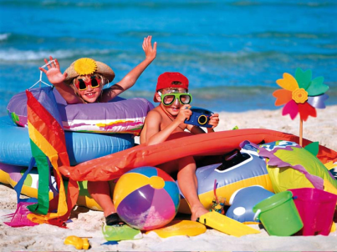
Look at the picture and complete the description.
I can see 1)……………. children in the picture. There is a young girl and a young 2)…………… . They are at the 3)……………. . I can see the sea in the background. I think it’s noon because the 4)…………… is very bright. It’s a beautiful day and it is probably quite hot. The children are smiling. It’s hard to see what they are wearing, but I guess they are wearing their swimsuits or T-shirts and shorts. The girl is wearing a straw 5)………… with a large yellow 6)……….. on it. The boy is wearing a red baseball 7)………… and is holding a 8)………… . Both children are wearing colourful swimming goggles. I’m sure they are having a great time.

Slide 13
Check your answers.
I can see 1)two children in the picture. There is a young girl and a young 2)boy . They are at the 3)beach . I can see the sea in the background. I think it’s noon because the 4)sun is very bright. It’s a beautiful day and it is probably quite hot. The children are smiling. It’s hard to see what they are wearing, but I guess they are wearing their swimsuits or T-shirts and shorts. The girl is wearing a straw 5)hat with a large yellow 6)flower on it. The boy is wearing a red baseball 7)cap and is holding a 8)camera . Both children are wearing colourful swimming goggles. I’m sure they are having a great time.

Slide 14
Pay attention to:
I can see two children in the picture. There is a young girl and a young boy . They are at the beach . I can see the sea in the background. I think it’s noon because the sun is very bright. It’s a beautiful day and it is probably quite hot. The children are smiling. It’s hard to see what they are wearing, but I guess they are wearing their swimsuits or T-shirts and shorts. The girl is wearing a straw hat with a large yellow flower on it. The boy is wearing a red baseball cap and is holding a camera . Both children are wearing colourful swimming goggles. I’m sure they are having a great time.

Slide 15
Look at the two photos of people travelling in order to compare and contrast them. The following ideas may help you, but you can suggest others as well.
the setting
comfort and speed
the impact on health and the environment
your preferences
anything else

Slide 16
Compare and contrast. Use words and phrases below.
delayed flights
air travel
rucksack/backpack
frustration
stress
hill walking
a sense of freedom
jet lag
carbon dioxide emissions

Slide 17
Ask your partner the following questions:
What can people do to protect the environment while on holiday?
What are your favourite ways of travelling and why?

Slide 18
“Too often travel, instead of broadening the mind, merely lengthens the conversation” Elizabeth Drew (American journalist)
Do you agree with this statement or not? Why?

Slide 19
“If you look like your passport picture, you probably need the trip”.

