Slide 1
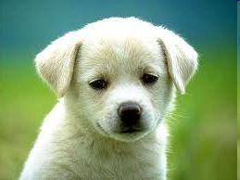
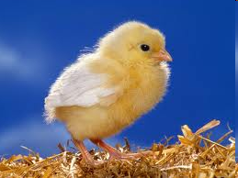
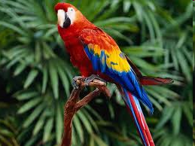
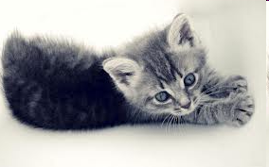
Pets

Slide 2
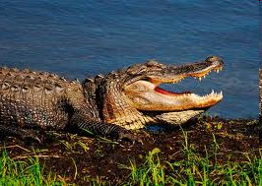
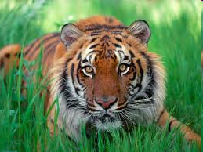
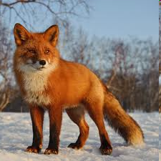
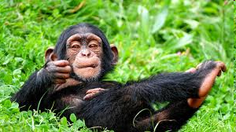
and Other Animals

Slide 3
Wild animals
Grammar:
Test test
The parts of the body
Comparative and superlative degrees of the adjectives
Cardinals (количественные числительные)
1 – 100
Pets and Other Animals
Pets and Other Animals
Ordinals (порядковые числительные)
1 – 12,
13-19
My pet
Verb «Must»
Ordinals (порядковые числительные)
20 - 100
Home Reading
«The funny animal»

Slide 4
Итоговая контрольная работа
I. Выберете правильный вариант порядковых и количественных числительных:
1. I like … room.
a) two b) second c) the second;
2. Room … is nice.
a) four b) fourth c) the fourth;
3. Where is Book…?
a) Three b) third c) the third;
4. Do you like … book?
a) Three b) third c) the third;
II. Напишите числительные цифрами:
Seventh, twelfth, third, fifteenth, eleventh, second, first, thirteenth, twentieth

Slide 5
III. Выберете правильный вариант:
You must … after your pet.
a) look b) to look c) looking
2. He … to look after his pet.
a) can b) must c) likes
3. You must … your homework.
a) do b) to do c) doing
4. He … to do his homework.
a) can b) must c) wants
5. You must … your hands.
a) wash b) to wash c) washing
6. He … to wash his hands.
a) can b) must c) wants

Slide 6
Степени сравнения имен прилагательных
Выберете правильный вариант:
Oleg is .. boy in our class.
a) short b) shorter c) the shortest
2. This pencil is … than that pencil.
a) long b) longer c) the longest
3. Monkeys are cleverer … hamsters.
a) than b) then c) –
4. Cats are cleverer … mice.
a) than b) then c) –
5. Tamara is … girl in our class.
a) short b) shorter c) the shortest
6. This apple is … than that apple.
a) big b) bigger c) the biggest
4. Dogs are cleverer … rabbits.
a) than b) then c) –
5. This doll is … than that doll.
a) old b) older c) the oldest
6. That apple three is … three in our
a) is she b) isn’t she c) isn’t it
7. Horses are cleverer … cows.
a) than b) then c) –
8. Paul is … pupil in his class
a) clever b) cleverer c) the cleverest
9. This elephant is … than that elephant
a) big b) bigger c) the biggest

Slide 7
Pets and Other
Animals
Warming up
Grammar test №2
Verb ‘Must’
Listening and Reading
«I love my dog»
Cardinals
Количественные
числительные
‘At the Zoo’
Speaking
Asking for Information
‘My Pet’
Ordinals
Порядковые
числительные
Homework
Communication: Talking
about Pets
Grammar test №1
Cardinals
/Ordinals

Slide 8
Цели:
Тренировка навыков монологической и диалогической речи по темам «Животные», «Количественные и порядковые числительные»
Активизация изученной лексики и грамматики по теме «Pets and Other Animals» в знакомых речевых образцах
Тренировка в употреблении модального глагола «Must»
Воспитание гуманного отношения к домашним и диким животным

Slide 9
Имя числительное ( Numeral )
Количественные
числительные
отвечают на
вопрос How many?
– сколько?
Two – два
Twenty - двадцать
Употребляются без артикля
Порядковые числительные отвечают на вопрос Which? – который?
Second – второй
First – первый
Обычно употребляются с артиклем ‘the’
Образуются путем прибавления суффикса –th к количественному числительному

Slide 10
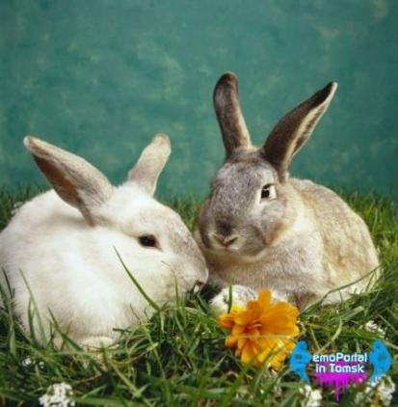
How long can the animals live?
Rabbits can live 5 years.
5 years

Slide 11
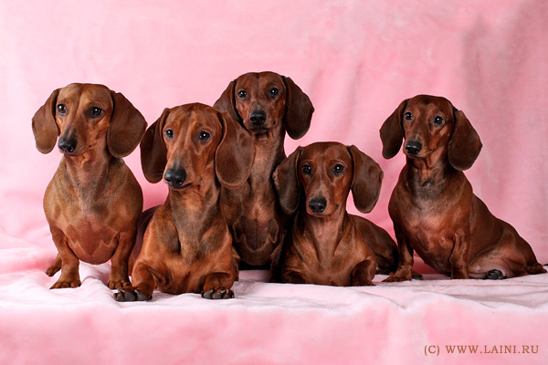
Dogs can live 15 years
15 years

Slide 12
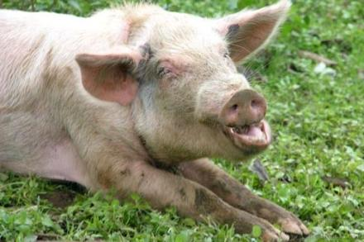
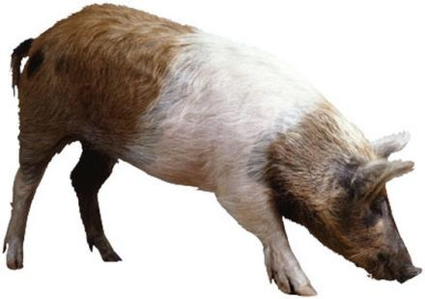
Pigs can live 25 years
25 years

Slide 13
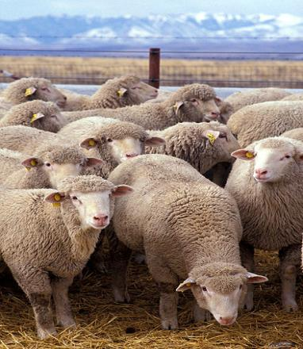
Sheep can live 12 years
12 years

Slide 14
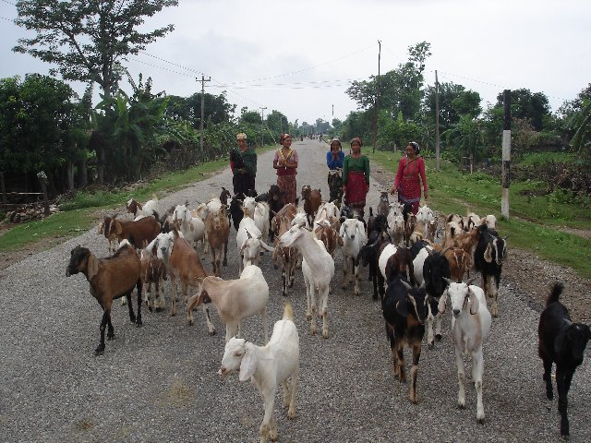
15 years
Goats can live 15 years

Slide 15
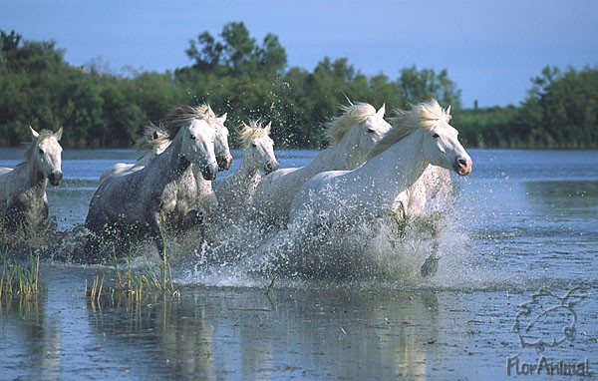
30 years
Horses can live 30 years

Slide 16
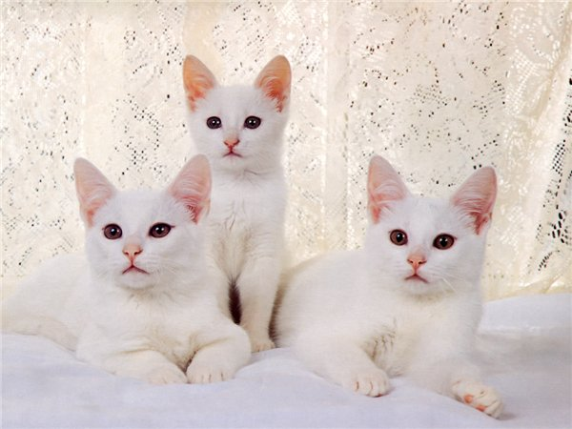
13 years
Cats can live 13 years

Slide 17
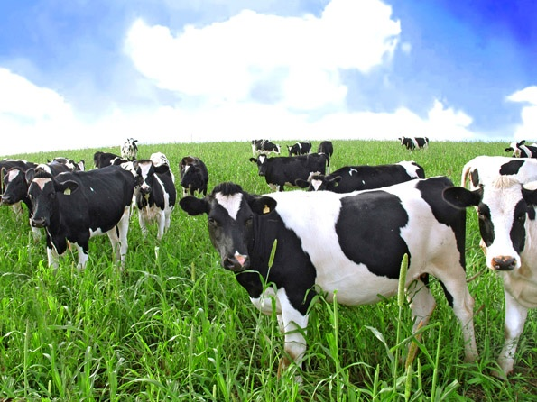
Cows can live 25 years
25 years

Slide 18
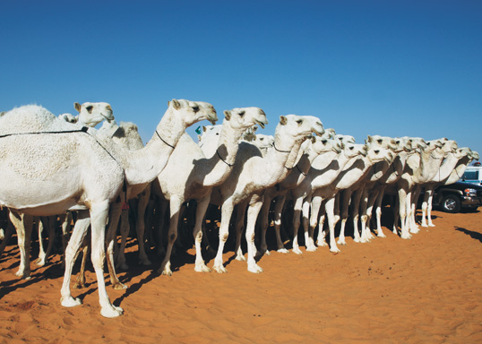
40 years
Camels can live 40 years

Slide 19
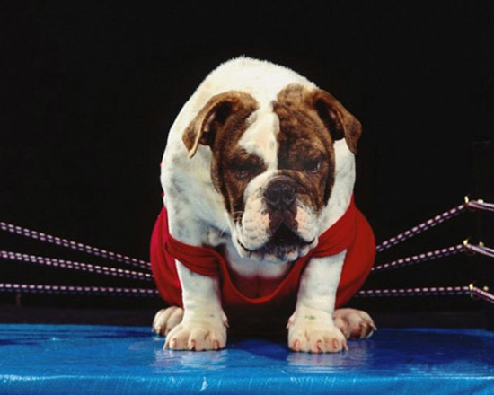
Look at the pictures of these animals and say which of them is the first (the second, the third…)
1
1
1

Slide 20
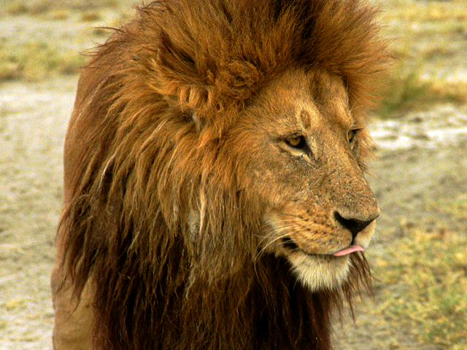
2

Slide 21
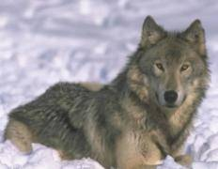
3

Slide 22
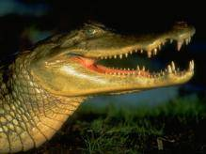
4

Slide 23
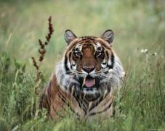
5

Slide 24
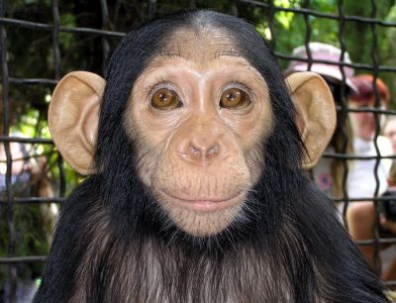
7

Slide 25
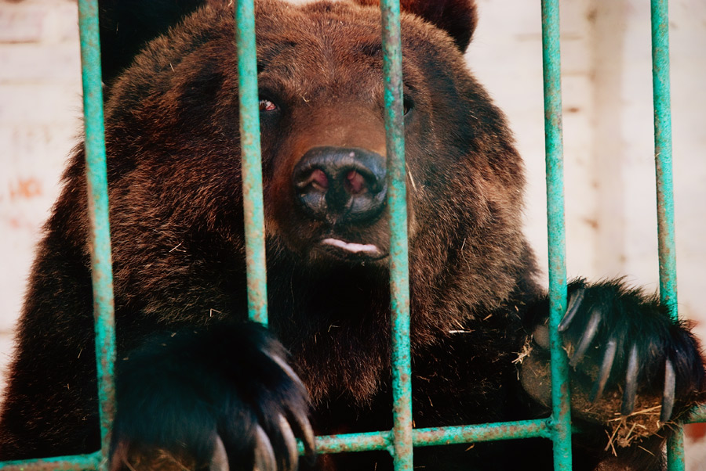
9

Slide 26
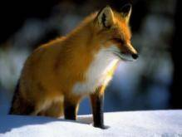
11

Slide 27
Who knows English Ordinals and Cardinals better?
Test №1. Отметьте правильный вариант перевода порядковых и количественных числительных:
2nd 5. 22nd
(the) second a) twenty - two
Two b) (the) twenty - second
Twelve c) twenty
2. 8th 6. 11th
Eight a) eleventh
Eighteenth b) eleven
(the) eighth c) eleventeen
17th
Seventeen
Seventy
(the) Seventeenth
4
Four
(the) fourth
forty

Slide 28
Translate from Russian into English
Сегодня 12 февраля
Январь первый месяц в году
Мой День Рождения 25 декабря
1) Today is the 12th of February.
2) January is the first month of the year.
3) My birthday is on the 25th of December

Slide 29
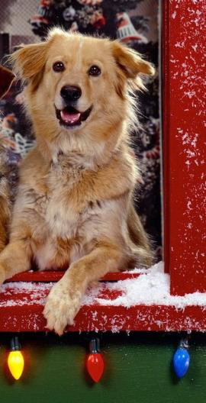
Listening and Reading
The poem ‘I love my dog’
I” ve got a dog
His name is Jack
He can do this
He can do that
Look at my dog
Tricks he can do
I love my dog
He loves me too.

Slide 30
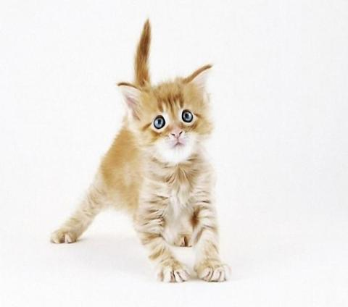
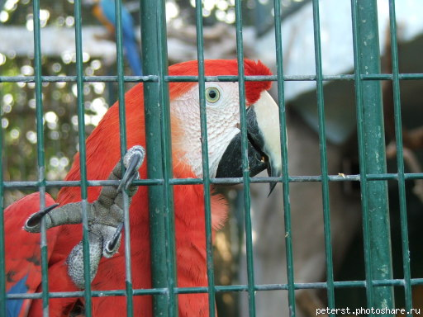
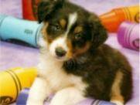
Asking for Information ‘My pet’

Slide 31
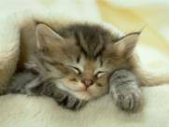
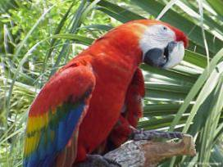
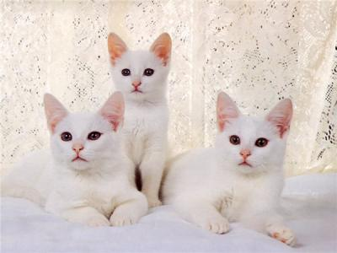

Communication: Talking about favourite Pets

Slide 32
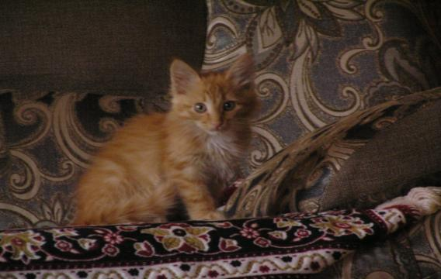
MY PET

Slide 33
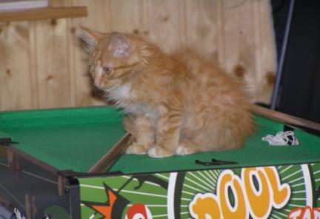
HELLO! My name is Marsel.
I have got a cat. His name is Red.
My pet answers to his name. My cat is nine months.
He is red. My pet is little.

Slide 34
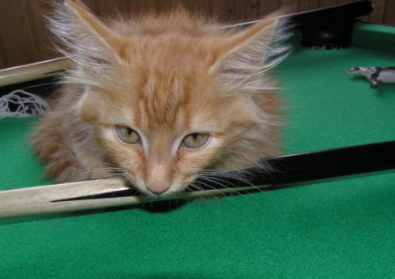
I teach my cat to catch mice.
My Red is a clever cat. Red can play with the ball.
I give my pet milk and meat. My Red likes milk and omelette.
I don‘t take my cat for a walk.
I love my cat Red!

Slide 35
Fill in:
Must or Mustn’t
You must give milk to kittens
You mustn't give dogs big bones, you must give them small bones
Your pets must have fresh water
You must walk your dog
You mustn't give sweets to pets
You mustn't take pets to school
You must look after your pet
You must feed animals

Slide 36
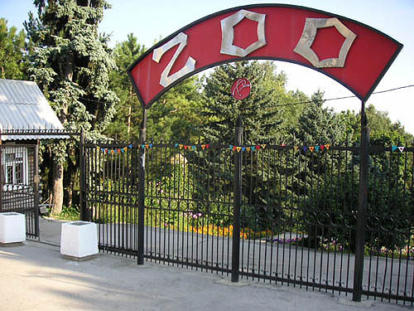
At the Zoo

Slide 37
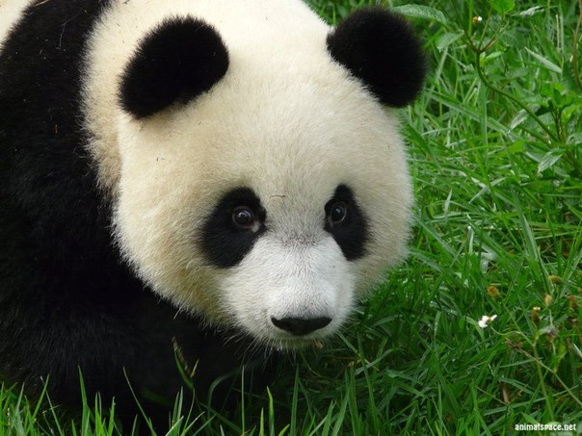
Panda

Slide 38
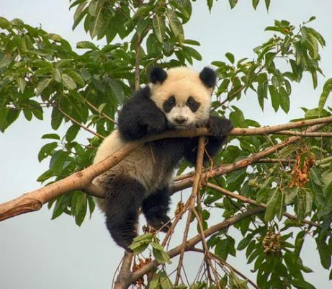
Panda lives in trees in China. It has got thick fur and sharp claws for climbing. It is white and black.

Slide 39
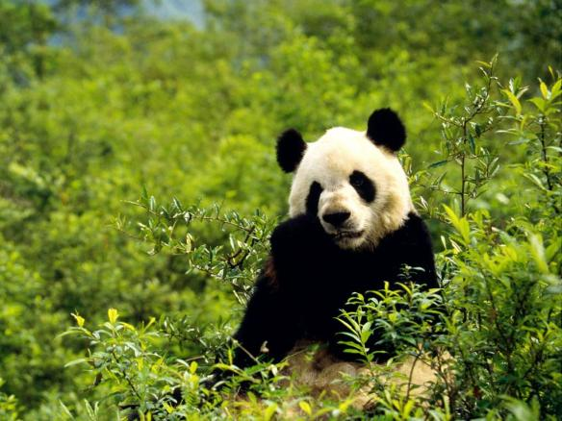
Pandas eat leaves. They are cute, they are soft, but they are wild.

Slide 40
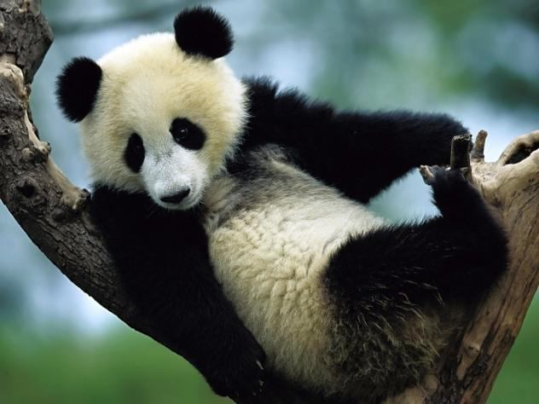
Panda looks like a big soft toy. It is a very nice animal! I like panda very much.

Slide 41

The Arabian Camel

Slide 42
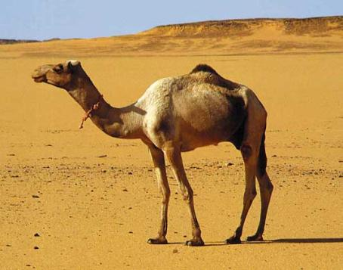
The Arabian Camel lives in North Africa and the Middle East in dry places like deserts.

Slide 43
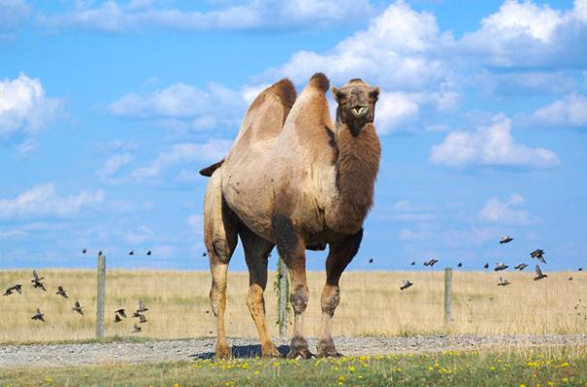
It is brown with short fur and long thin legs. The camel has got a large body and a long neck. It has got humps with fat on the back.

Slide 44
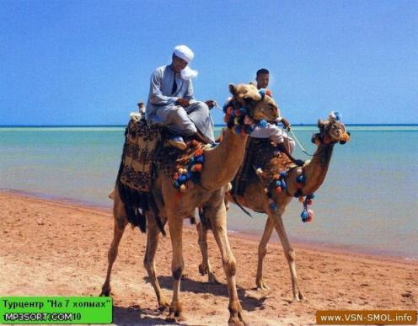
The camel can live three weeks without water. It carries people on its back for miles.
Camels are friendly animals.

Slide 45
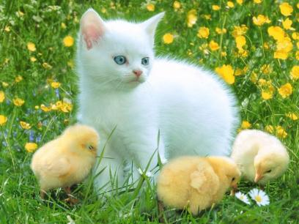
" Мы в ответе за тех, кого приручили"
А. Сент - Экзюпери

Slide 46
Thank you!
Goodbye !

