Slide 1
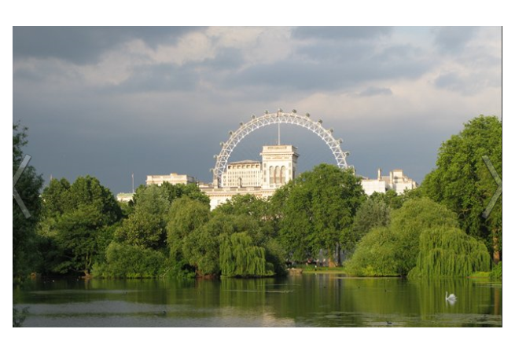
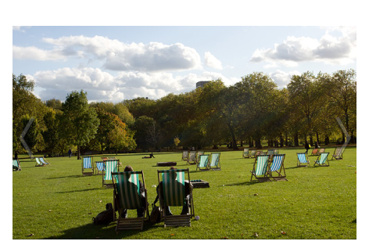
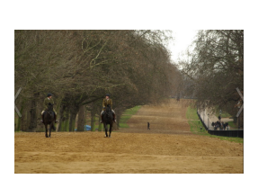
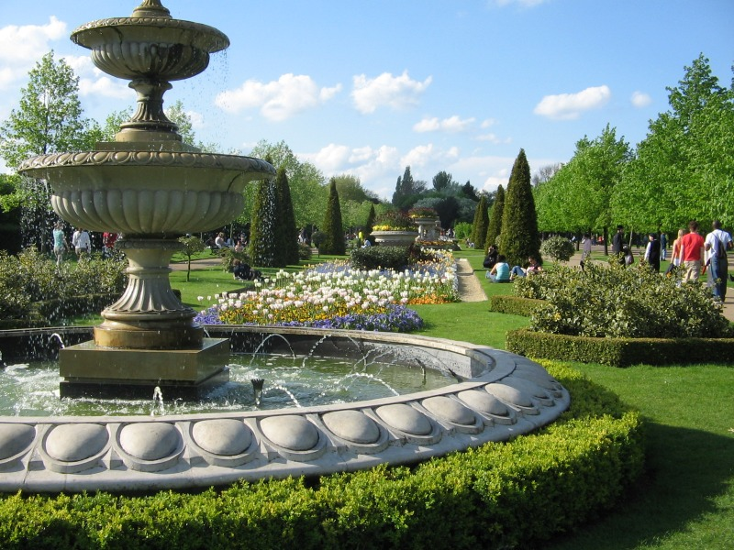
Let’s go to Hide Park!

Slide 2
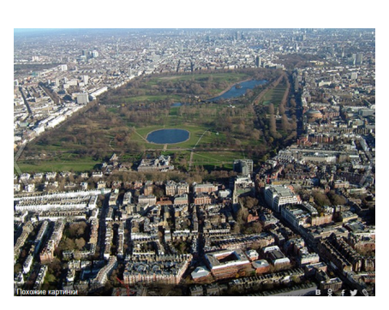
Гайд- парк в Лондоне
Hyde Park

Slide 3
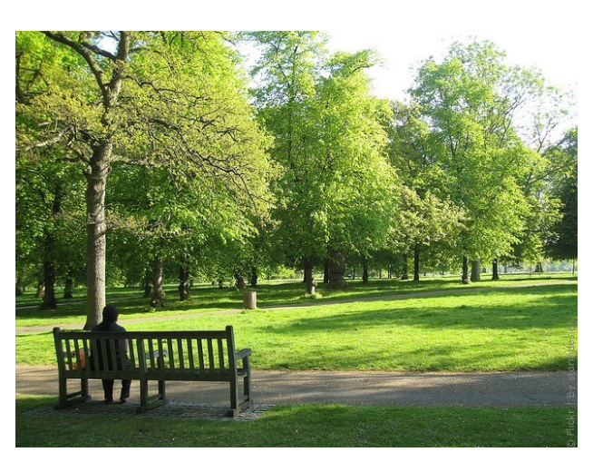
I want to sit on the bench.

Slide 4
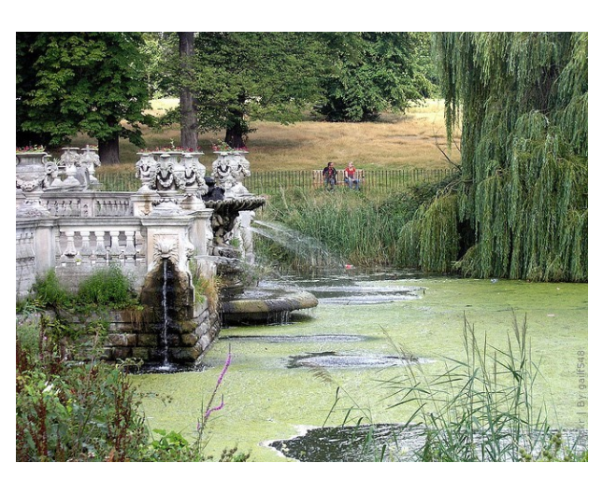
I want to go to the park with your friend.

Slide 5
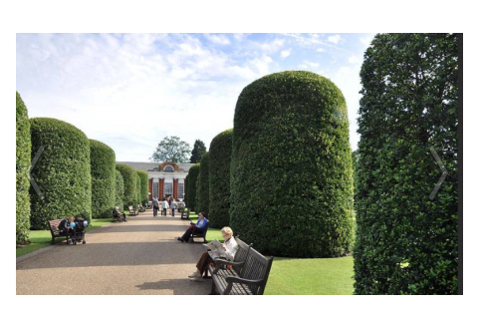
I want to sit in the sun and read.

Slide 6
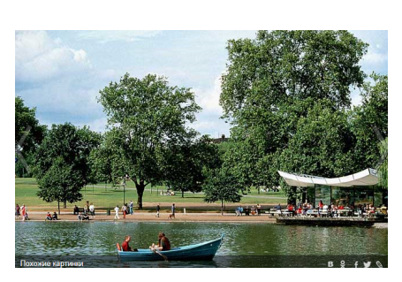
I want to go rowing.

Slide 7
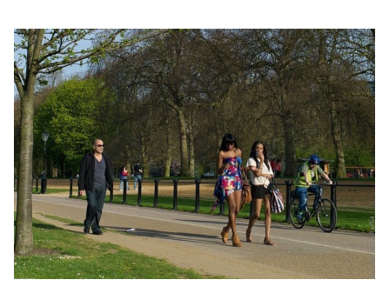
I want to ride a bike.

Slide 8
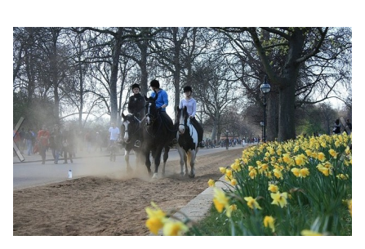
I want to ride a horse.

Slide 9
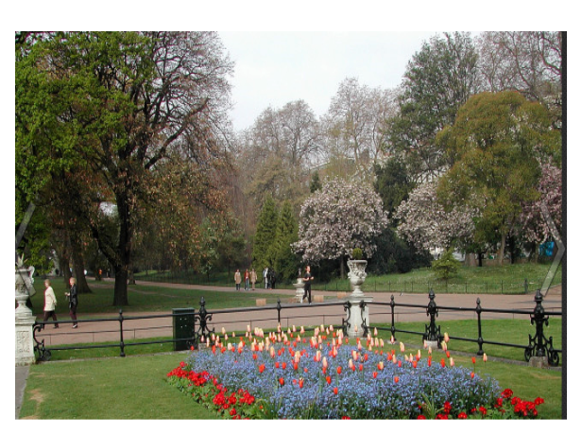
I want to walk in the park.

Slide 10
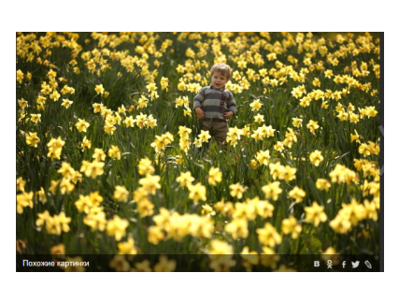
I want to see many daffodils.

Slide 11
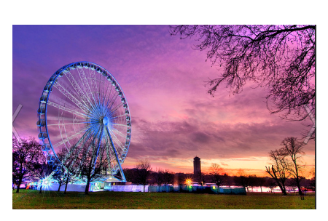
I want to ride on a big wheel.

Slide 12
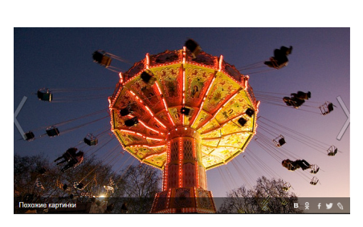
I want to ride on a merry-go-round.

Slide 13
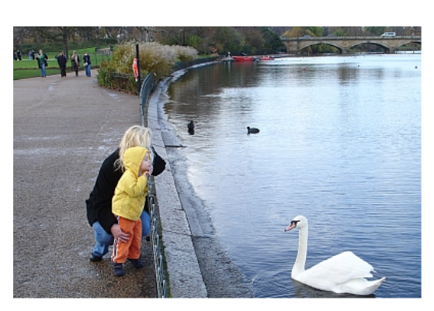
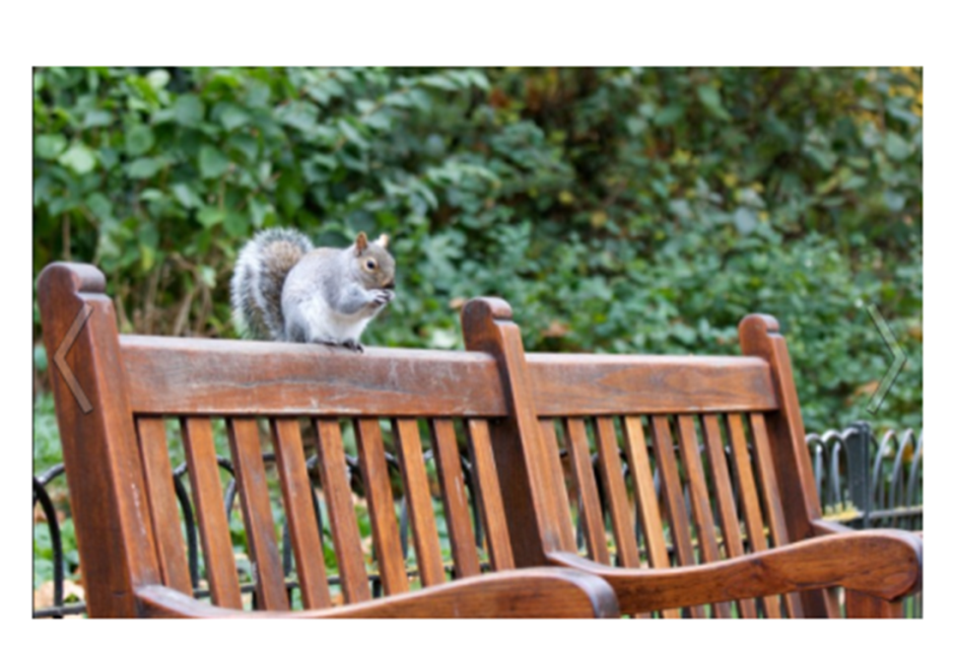
I want to see a white swan…
… and a nice squirrel.

Slide 14
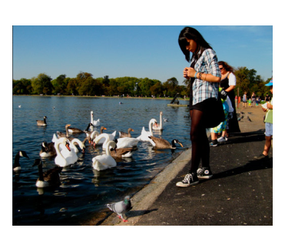
I want to feed swans, ducks and birds in the lake.

Slide 15
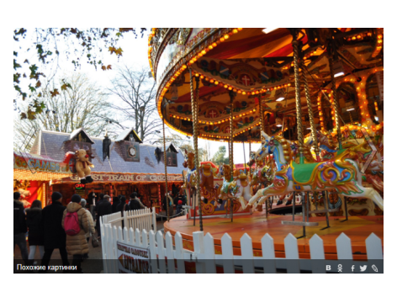
“Oh, what fun it is to ride…”

