Slide 1
Сибирцева Марина Андреевна,
учитель
английского языка
первой
квалификационной
категории
г. Находка

Slide 2
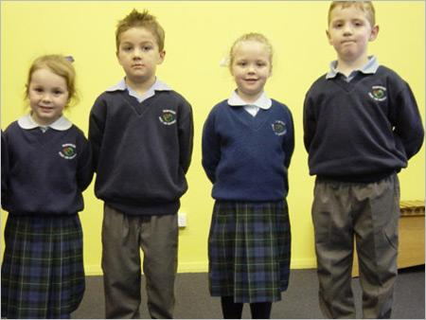
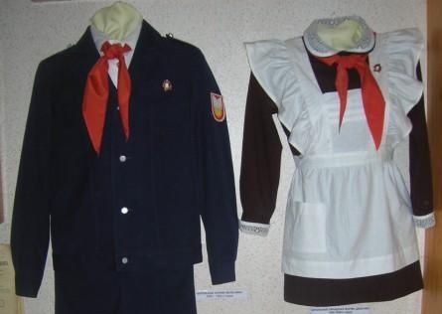
School uniform

Slide 3
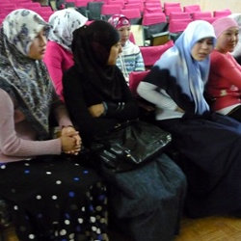
Scandal in the Stavropol Region
The director of the institution refused to let students to school wearing the hijab.

Slide 4
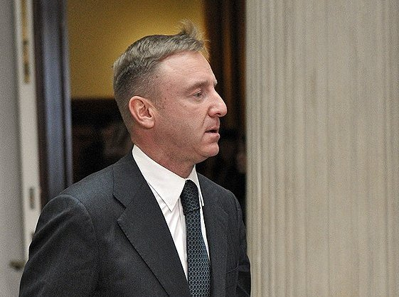
The minister of Education Dmitry Livanov
After that incident the minister of education Dmitry Livanov signed the law about dress cod in schools

Slide 5
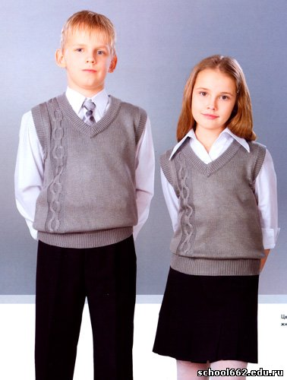
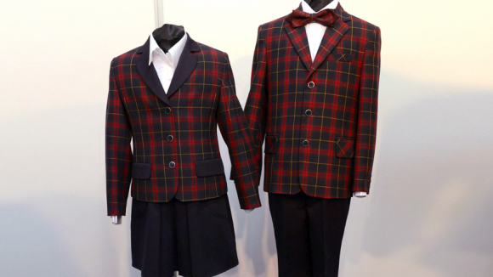
What is dress code?
Dress code- a standard of dress
established for a given environment,
for example, in a school or business,
or in a cultural group.

Slide 6
What is a uniform?
A uniform is a set of standard clothing worn by members of an organization while participating in that organization's activity. Modern uniforms are worn by armed forces and paramilitary organizations such as police, emergency services, security guards, in some workplaces and schools and by inmates in prisons.

Slide 7
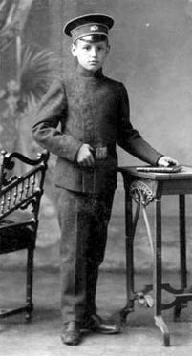
A school uniform in Russia
A school uniform came to Russia from England in 1834. The first uniforms were made for boys. Boys had special shirts,
trousers, black boots and a cap. Girls wore brown dresses and aprons.

Slide 8
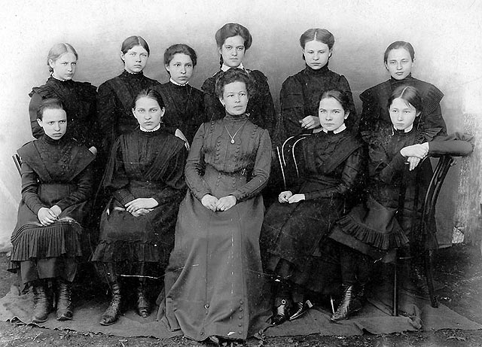
A school uniform in Russia
In 1896 this law
started to include
form for girls.

Slide 9
School uniform in the USSR
In Soviet schools uniform was common and compulsory for all pupils.

Slide 10
In Great Britain
Most British primary and secondary schools require pupils to wear uniforms. Boys wear a white shirt, long grey or black trousers ,jumper or sweater with the school logo on, school tie, black shoes.
Girls wear trousers or skirts as part of their uniform - typically black, grey, navy, or sometimes brown or maroon.

Slide 11
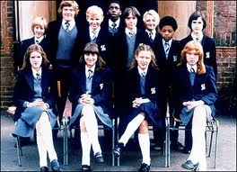
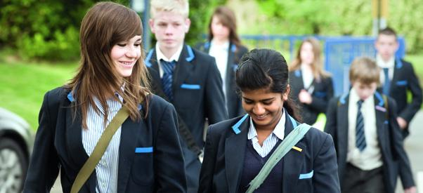
In the USA
Few state schools in the United States have formal school uniforms, but most have dress codes.

Slide 12
Pros and cons of the uniform
“Pros”
The school uniform makes children study at school more seriously
School uniform makes children more disciplined
It isn’t very expensive. Every family can buy it
School uniform removes social inequality because everybody wear the same clothes.
“Cons”
It prevents children to be individuality
Every day one and the same clothes are boring
By the end of the school year it becomes untidy and not pleasant to look at

Slide 13
Thank you for your attention!

