Slide 1
Welcome to the London Zoo!

Slide 2
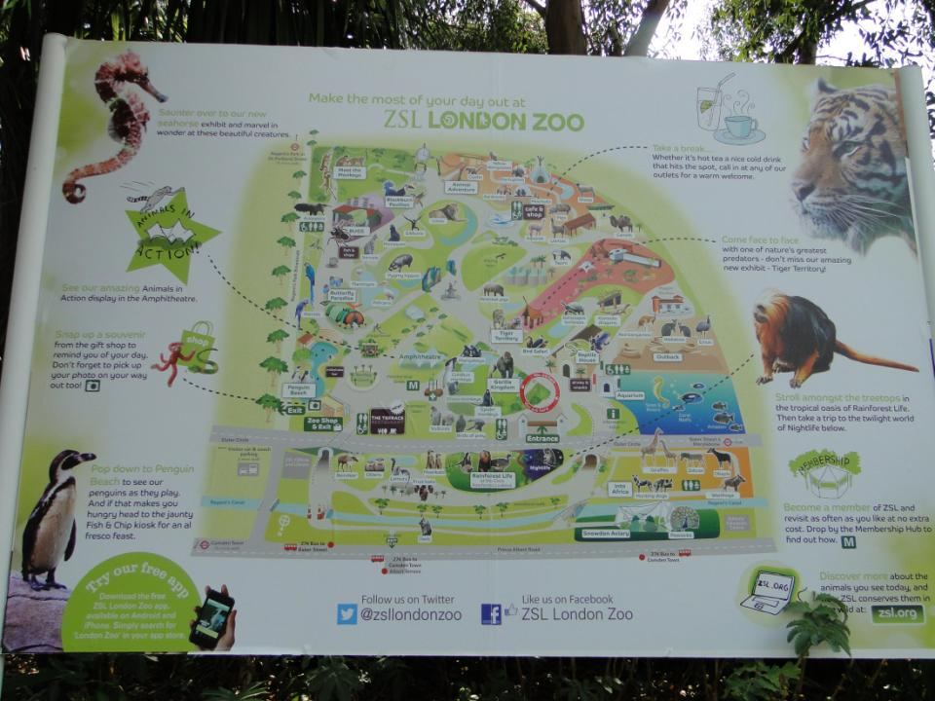

Slide 3
I want to see a …
I like … ,
because they are…
They can ...
They have got …

Slide 4
I want to see a monkey/tiger/crocodile Because it is funny/small/big/fluffy scary/nice/lazy/clever It has got a tail/a beak/wings/ big teeth It can run/hop/jump/climb a tree/ swim/fly/sing/bite/eat grass

Slide 5
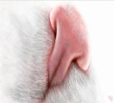
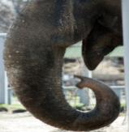
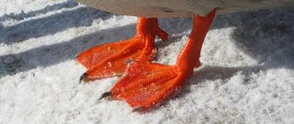
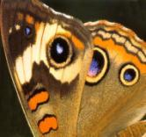
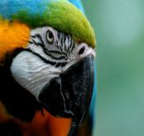
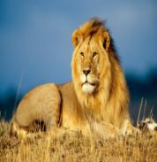
WHAT IS IT?
Choose a word for the picture

Slide 6
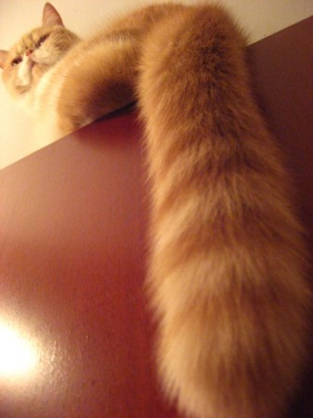
a head
a leg
a tail

Slide 7
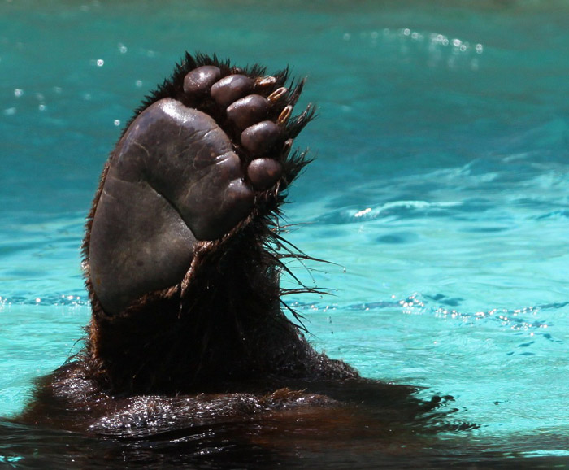
a head
a paw
a nose

Slide 8
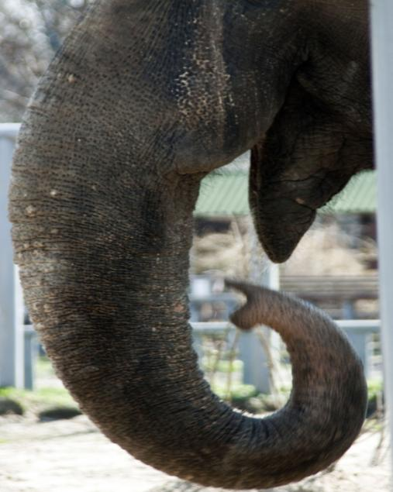
a trunk
a leg
a tail

Slide 9
a tail
a leg
a beak

Slide 10
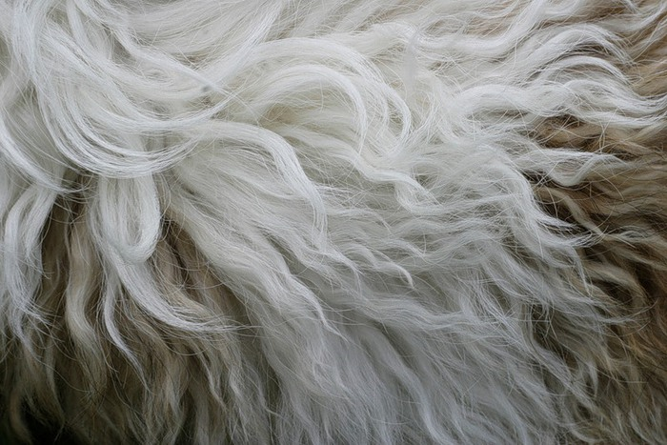
a nose
fur
an eye

Slide 11
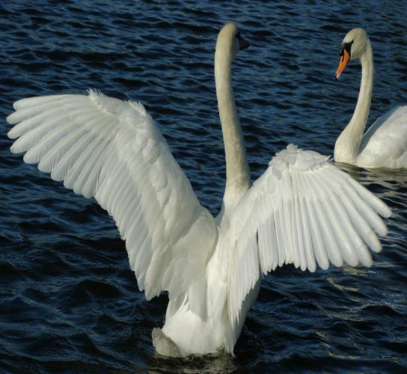
legs
fingers
wings

Slide 12
a tail
a beak
a trunk
fur
paws
wings

Slide 14
What can you see?
It can be a …
It must be a …

Slide 15
a long tail
fluffy fur
nice
funny
climb
a tree
eat bananas

Slide 16
What can you see?
It can be a …
It must be a …

Slide 17
long legs
a long neck
very tall
a long tail
short fur
eat grass

Slide 18
What can you see?
It can be a …
It must be a…

Slide 19
a crocodile

Slide 20
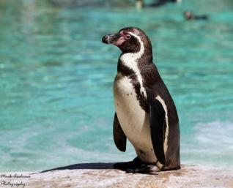
…I would like to tell you about myself.
I am not big or small. I am black and white. I haven’t got fur and I am not fluffy.
I have got a tail, but it is not long. It helps me to swim. I swim very well.
I have got two eyes, but I haven’t got a mouth. I have got a beak.
I can’t fly. What a pity! But I have got two wings.
I live with my friends here.
We like to go for a walk and
swim together...

Slide 21
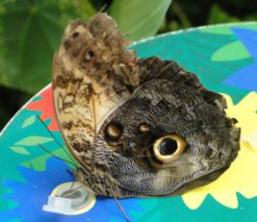
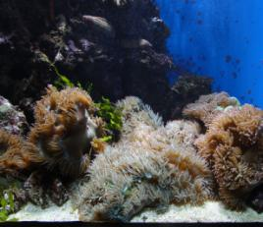
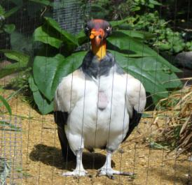
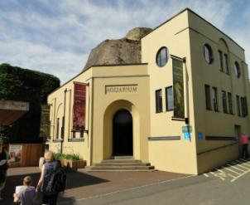
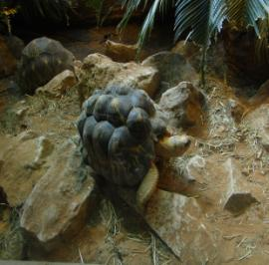
See you at the London Zoo!

