Slide 1
Countries, languages and capitals

Slide 2
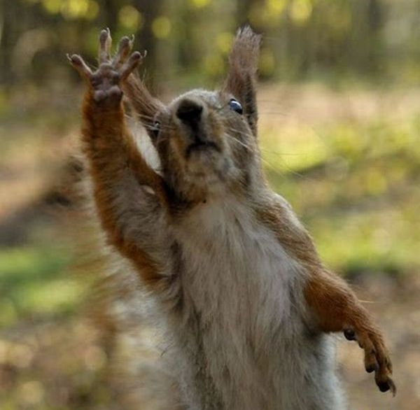
HI FIVE!

Slide 3
WARM UP
How many cans can a canner can,
If a canner can can cans?
A canner can can as many cans as a canner can
If a canner can can cans.

Slide 4
WARM UP
Can you imagine an imaginary menagerie manager
Imagining managing an imaginary menagerie?
I wish to wish the wish you wish to wish,
But if you wish the wish the witch wishes,
I won’t wish the wish you wish to wish.

Slide 5
ALL WRITE ROUND ROBIN
You can see on your desks sheets with the crossword.
Solve the crossword.
What country would you like to visit?
What country is our native?
Languages of what country do we study?

Slide 6
SIMULTANEOUS ROUND ROBIN
Take the sheets with crossword puzzle.
There are hidden the languages of the countries.
You must find them in the puzzle.

Slide 7
A/R GUIDE
Find out the countries, flags and capitals.
You have 3 minutes to do.

Slide 8
WARM UP
Let’s have a rest.
Listen to the music and do exercises after the song.

Slide 9
CONTINIOUS ROUND ROBIN
Listen to the song.
Take the sheets with the tasks.
Write down the missing words after listening to the song.

Slide 10
MODEL FRAYER
Country;
Capital;
Sight of the country;
Motto.

Slide 11
IT’S TIME TO SAY “GOOD BYE” GOODBYE MY CHILDREN, BYE!

