Slide 1
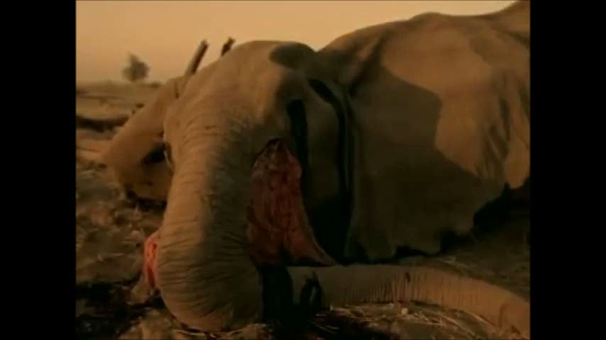
Видеофрагмент «Песня Земли»

Slide 2
Тема урока
What Can You Do to Save the Earth?

Slide 3
Problems of the Earth
- Dangerous diseases
- pollution
- dangerous technologies
- new local wars
- endangered animals
- lack of recycling
- people and their interrelations

Slide 4
More Problems
- Greenhouse gases
- pollution of oceans, seas and rivers
- cut down forests
- too much land used for farming

Slide 5
The Ways of Saving the Earth
- Save energy (walk, ride a bike)
- Plant trees, save water, take care of animals
- Recycle
- Give up bad habits
- Be polite
- Help people

Slide 6
Be an Example to Follow
- Be friendly
- Be polite to people
- Enter an ecological society
- Take part in clean-up days
- Go in for sport
- Don’t say dirty words
- Don’t drink alchohol

Slide 7
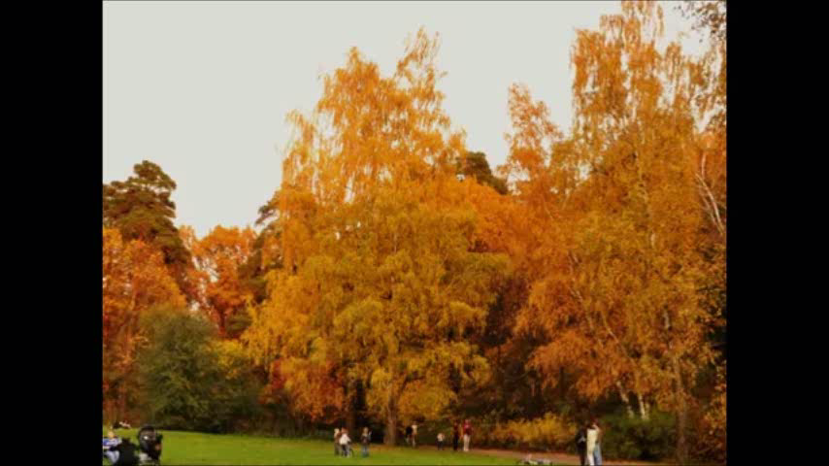
Video About Nature’s Beauty

Slide 8
Questions to Make a Report
- Is there a river in our village?
- How is it called?
- Do you usually swim in the river in summer?
- Does it need care?
- Is there little or much fish there?
- Can you see litter on the banks?

Slide 9
- Have you seen people washing cars on the river?
- What actions should be done to help the river?

Slide 10
Опоры для высказывания
- There is a ……………in our…………….
- It is…………………………………………….
- Usually I……………in summer.
- I think our river (doesn’t) ……….care.
- There is ………………….….fish there.
- I can see…………(often, sometimes, always).

Slide 11
Опоры для высказывания
- I ‘ve seen…………………….(several times, never, each time).
- To my mind we should…...........
- Let’s………………………………..........

Slide 12
Опоры для высказывания
- I think we should………………..
- Also our planet needs……………………………………
- Please, don’t……………………….
- People must…………………….….

Slide 13
Homework
Напишите статью о необходимости охраны реки Кинель, опираясь на упр. 4 на стр. 35 в рабочей тетради и материал, изученный на уроке.

Slide 14
Homework
Познакомьтесь с информацией на сайте www. ProjectEarth.net, зарегистрируйтесь и оставьте сообщение о необходимости охраны реки Кинель.
Cоздайте презентацию по теме «Save the Earth».

Slide 15
Источники для видеоклипов
Майкл Джексон «Песня Земли»
http://www.youtube.com/watch?v=XAi3VTSdTxU
Видеоклип о красоте земли
http://yandex.ru/video/search?text=%D1%81%D0%BF%D0%BE%D0%BA%D0%BE%D0%B9%D0%BD%D0%B0%D1%8F%20%D0%BC%D1%83%D0%B7%D1%8B%D0%BA%D0%B0%20%D0%B4%D0%BB%D1%8F%20%D0%B4%D1%83%D1%88%D0%B8&where=all&filmId=5_o2li0u8gE

Slide 16
Thank you for Your Time!

