Slide 1
ANIMALS
IN OUR LIFE

Slide 2
Name | What pet have you got? | Whose idea was it to have a pet in your house? | Do you take a good care of your pet?

Slide 3
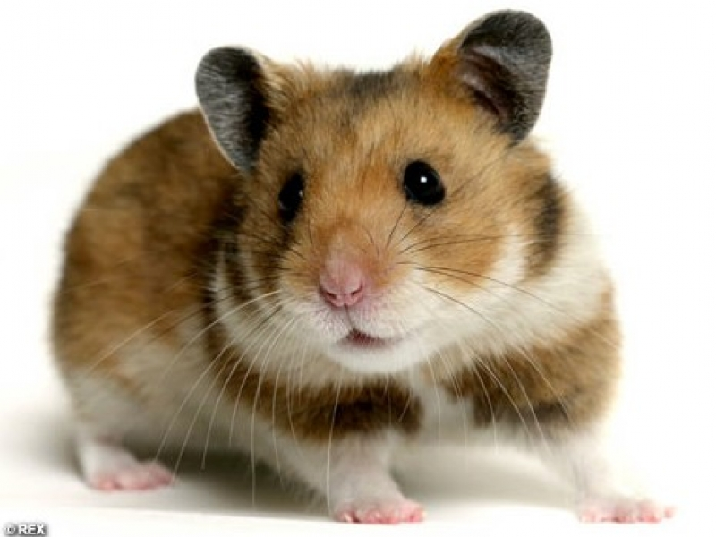

Slide 4
