Slide 1
How is bread made

Slide 2
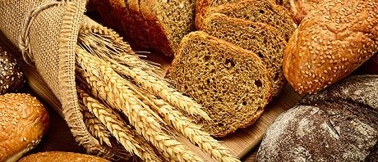
What kind of bread is eaten in your country?
What kind of bread do you eat?
When do you eat bread?

Slide 3
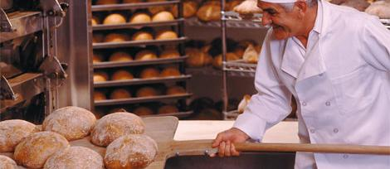
In many countries bread is made by a baker in his bakery.

Slide 4
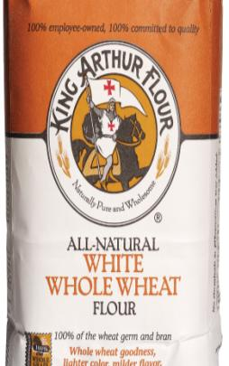
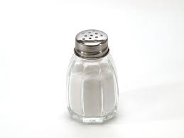
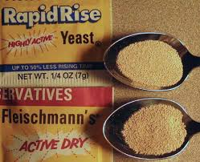
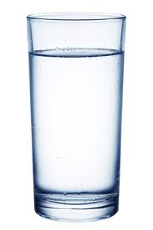
Bread is made from flour, salt, yeast and water.
Yeast is added if you want the bread to rise.

Slide 5
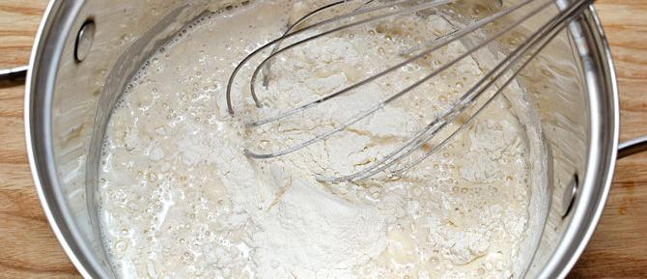
First the flour is mixed with the water, the salt and the yeast.
This mixture is called dough.

Slide 6
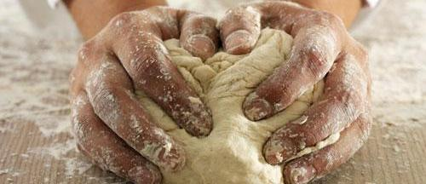
Then the baker kneads the dough.
He pushes and pulls it.

Slide 7
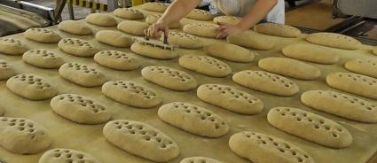
The dough is cut into loaves.

Slide 8
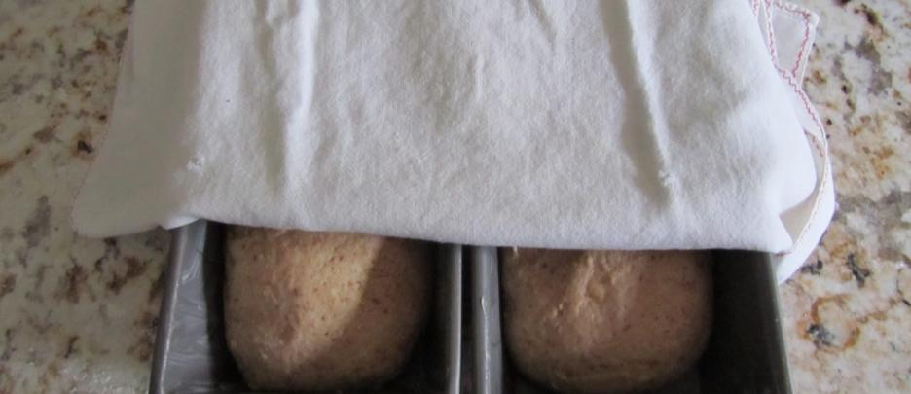
These are put in a warm place to rise.

Slide 9
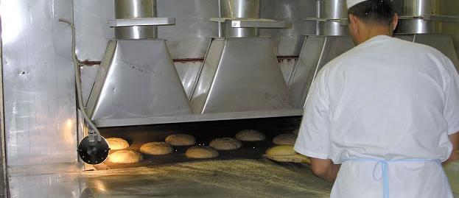
The loaves are baked in the oven.

Slide 10
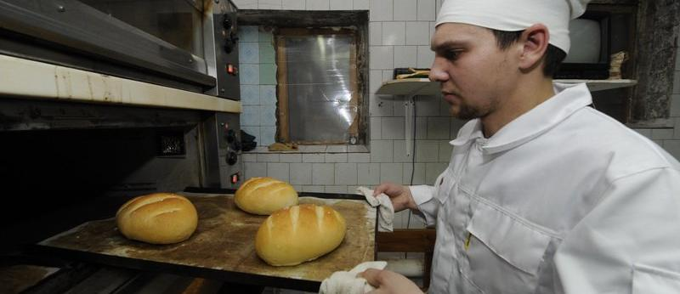
The baker takes the bread out.

Slide 11
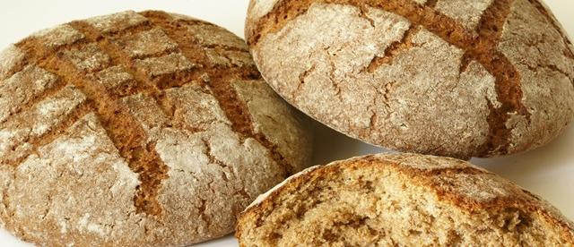
Mmm! It smells delicious!

