Slide 1
SUPERSTITIONS
AND OUR LIFE
Учитель английского языка
МБОУ «Кузьмичевская СОШ»
Городищенского муниципального района
Волгоградской области
Кирикмасова Анастасия Алексеевна
2013-2014 учебный год

Slide 2
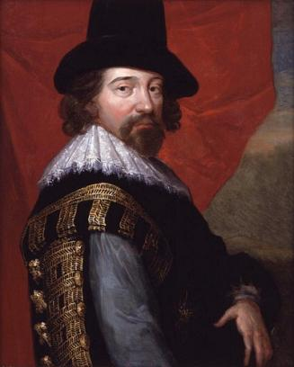
There is a superstition in avoiding superstitions.
Sir Francis Bacon

Slide 3
Match the words with their transcriptions
1. misfortune | a) ['kləuvər]
2. ladder | b) ['sɪzəz]
3. to avoid | c) ['fɪŋgəz]
4. mirror | d) ['hɔ:sʃu:]
5. to touch | e) [mɪs'fɔ:tʃən]
6. measure | f) [naɪf]
7. scissors | g) ['mɪrə]
8. umbrella | h) ['meʒə]
9. knife | i) [ʌmb'relə]
10. fingers | j) ['lӕdə]
11. horseshoe | k) [tʌtʃ]
12. clover | l) [ə'vɔɪd]

Slide 4
NEW WORDS
to touch wood, to wear a charm, to kill a spider, to break a mirror, to meet a black cat crossing you path, to meet a woman with an empty pail, to drop a knife, to drop a fork, to have Friday 13th, to have a horseshoe over the door, | to spill salt, to make a wish, to spit three times over your left shoulder, to walk under a ladder, to open an umbrella indoors, to put a coin in a shoe, to say “white rabbits, white rabbits, white rabbits” on the first day of the month, to catch falling leaves in Autumn

Slide 5
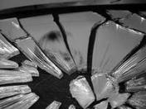
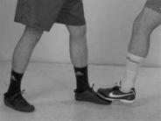
Russian superstitions
Before leaving for a long journey travelers, and all those who are seeing them off, must sit for a moment in silence before leaving the house. It is often conveniently written off as a time to sit and think of anything one may have forgotten.
Knocking on wood is practiced in Russia as in other countries. However Russians tend to add a symbolic three spits over one's left shoulder (or simply with the head turned to the left), and Russians will often knock three times as well.
Breaking a mirror is considered bad luck in Russia,
as is looking at one's reflection in a broken mirror,
but the effect is also more severe than 7 years of bad luck.
On examination day, it is bad luck to make your bed, wear anything new, or cut your fingernails.
If one person accidentally steps on another person's foot, it is common for the person who was stepped on to lightly step on the foot of the person who stepped first. It is said that they thus avoid a future conflict.
Birthday parties should be celebrated on or after one's birthday, not before.

Slide 6
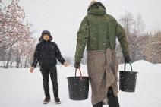
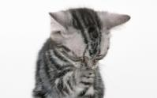
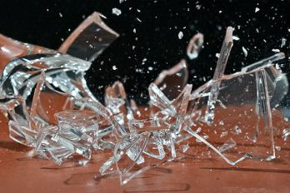
Russian superstitions
Returning home for forgotten things is a bad omen.
A woman with empty water buckets coming towards you is considered a bad omen.
Two or more people should never use one towel
at the same time to dry their hands or bodies,
or it is said to bring conflict.
Whistling in a house would bring misfortune to
that household.
If a black cat crosses your path, it's bad luck
If a cat is washing its face, expect guests soon.
If you spill salt, it's bad luck and is said to bring conflict, but no one will throw salt over their left shoulder.
If it's raining when you leave a place, it means
you'll return, and it is considered a generally
good omen.
Accidentally breaking a glass is
considered good luck.

Slide 7
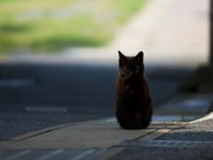
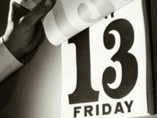
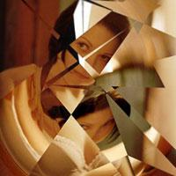
Do you know something about British superstitions?
1. Do you think that there is truth
behind superstitions?
2. Are there many superstitions in Britain?
3. What is the most widely-held superstition?
4. Is number 13 unlucky for people in Britain?
5. Why is it dangerous to break a mirror?
6. Why do British people touch wood?

Slide 8
Superstitions
Good luck
Bad luck
Black cats (in Russia), catching falling leaves in autumn,
breaking a mirror, a horseshoe over the door,
number 13, Friday 13th, a woman with empty bucket,
to whistle at home
black cats (in Britain), to see two magpies,
to go under a ladder

Slide 9
The most unreadable superstitions of the world
If you don't cover your bold head it will start raining. (Afghanistan)
If you shave your head on a Saturday, you will be in perpetual debt. (Africa)
You'll 'cut off' fortune if you use scissors on New Year's Day. (China)
You shouldn't wash your hair the day before an exam. (Russia)
If you go to the bathroom in the night with no clothes on, insects will fall on you. (Japan)

Slide 10
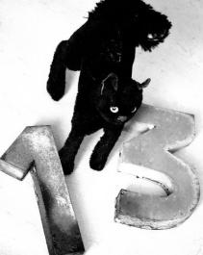
Are you superstitious?
Are you afraid of black cats?
Have you got a lucky number?
Do you believe in ghosts?
Do you often read a horoscope?
Do you believe it’s bad luck to break a mirror?
Do you believe in palmistry?
Do you believe it’s bad luck to open an umbrella in the house?
Is there a day of the week which is lucky or unlucky for you?
Have you ever made a wish on a New Year’s night?
Have you got a talisman or a lucky object?
Have you ever changed your plans because of a bad dream?
Do you believe that Friday 13th is the unluckiest day of all?

Slide 11
Your score
For every no: 0 For every yes: 2 For every doubtful answer: 1
Your scoring: Less than 4: You are not superstitious at all. That’s very unusual. Are you sure you answered all your questions honesty? Between 4 and 12: You are a practical person. You don’t believe in things other people do. But you probably wouldn’t be happy to sit for an important exam on Friday 13th. Between 12 and 24: For you, the superstitions of day may well be the fact of tomorrow. You probably believe in horoscopes and palmistry, ghosts and flying saucers.

Slide 12
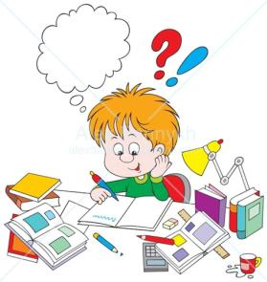
Ex. 32, p. 30 (SB)
Ex. 1, p. 17-18 (WB)

Slide 13
