Slide 1
Конспект урока по английскому языку по теме «Animals»
Урок разработан для 2-х классов по УМК «Spotlight»

Slide 2
 |  | d | _ | n | c | e
 | s | i | _ | g
 |  | f | _ | s | h
s | w | i | _
 |  | c | _ | n
 |  | f | _ | y
h | o | r | _ | e

Slide 3
 |  | d | A | n | c | e
 | s | i | _ | g
 |  | f | _ | s | h
s | w | i | _
 |  | c | _ | n
 |  | f | _ | y
h | o | r | _ | e

Slide 4
 |  | d | A | n | c | e
 | s | i | N | g
 |  | f | _ | s | h
s | w | i | _
 |  | c | _ | n
 |  | f | _ | y
h | o | r | _ | e

Slide 5
 |  | d | A | n | c | e
 | s | i | N | g
 |  | f | I | s | h
s | w | i | _
 |  | c | _ | n
 |  | f | _ | y
h | o | r | _ | e

Slide 6
 |  | d | A | n | c | e
 | s | i | N | g
 |  | f | I | s | h
s | w | i | M
 |  | c | _ | n
 |  | f | _ | y
h | o | r | _ | e

Slide 7
 |  | d | A | n | c | e
 | s | i | N | g
 |  | f | I | s | h
s | w | i | M
 |  | c | A | n
 |  | f | _ | y
h | o | r | _ | e

Slide 8
 |  | d | A | n | c | e
 | s | i | N | g
 |  | f | I | s | h
s | w | i | M
 |  | c | A | n
 |  | f | L | y
h | o | r | _ | e

Slide 9
 |  | d | A | n | c | e
 | s | i | N | g
 |  | f | I | s | h
s | w | i | M
 |  | c | A | n
 |  | f | L | y
h | o | r | S | e

Slide 10
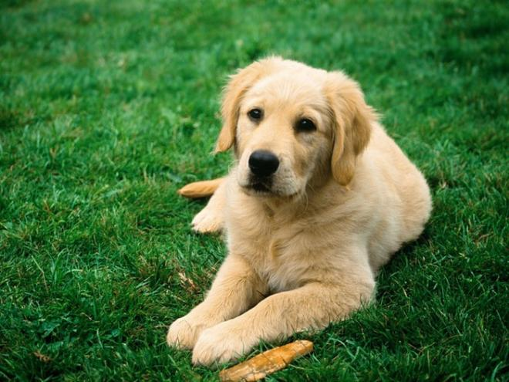
It is a dog.

Slide 11
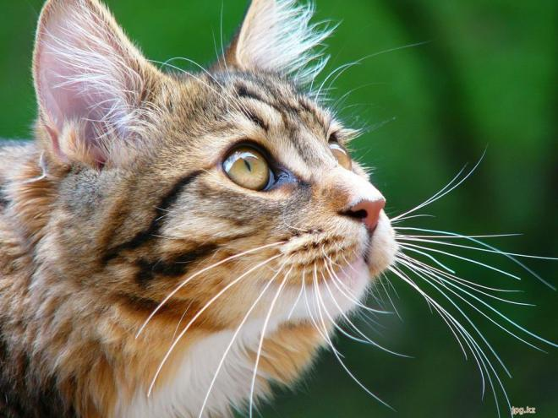
It is a cat.

Slide 12
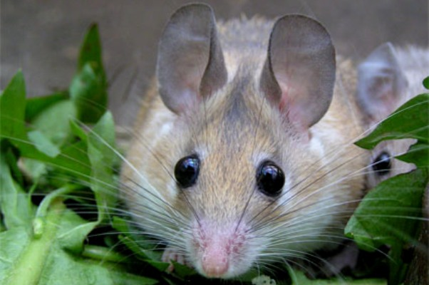
It is a mouse.

Slide 13
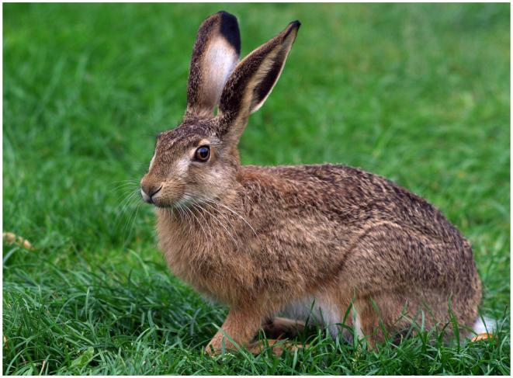
It is a hare.

Slide 14
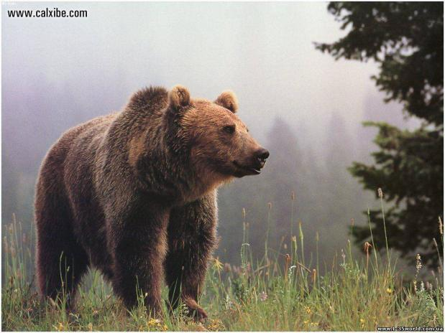
It is a bare.

Slide 15
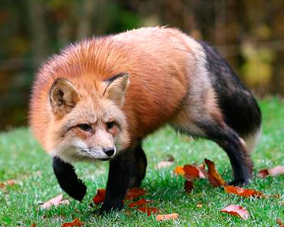
It is a fox.

Slide 16
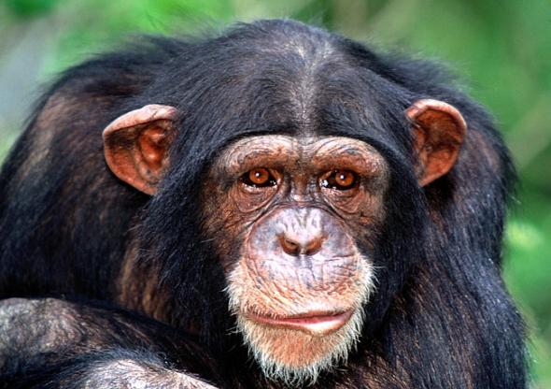
It is a monkey/a chimp.

Slide 17
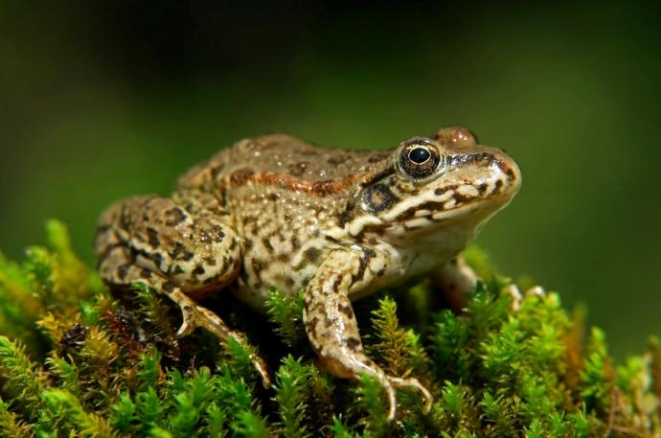
It is a frog.

Slide 18
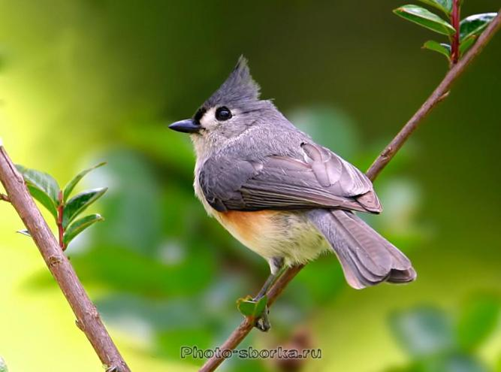
It is a bird.

Slide 19
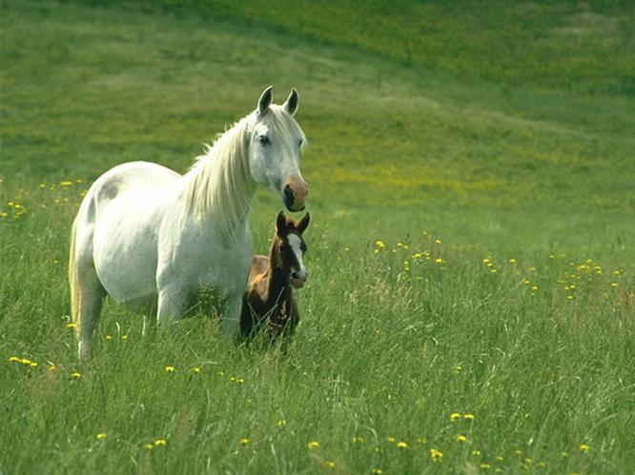
It is a horse.

Slide 20
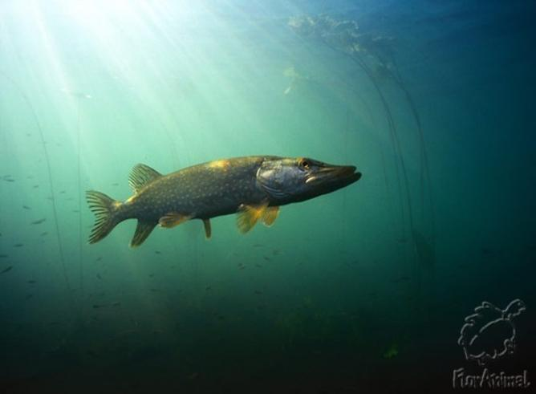
It is a fish.

Slide 21
e.g. A frog can jump.
1) Frog | a) Sing
2) Chimp | b) Swim
3) Fish | c) Jump
4) Bird | d) Run
5) Horse | e) Dance

