Slide 1
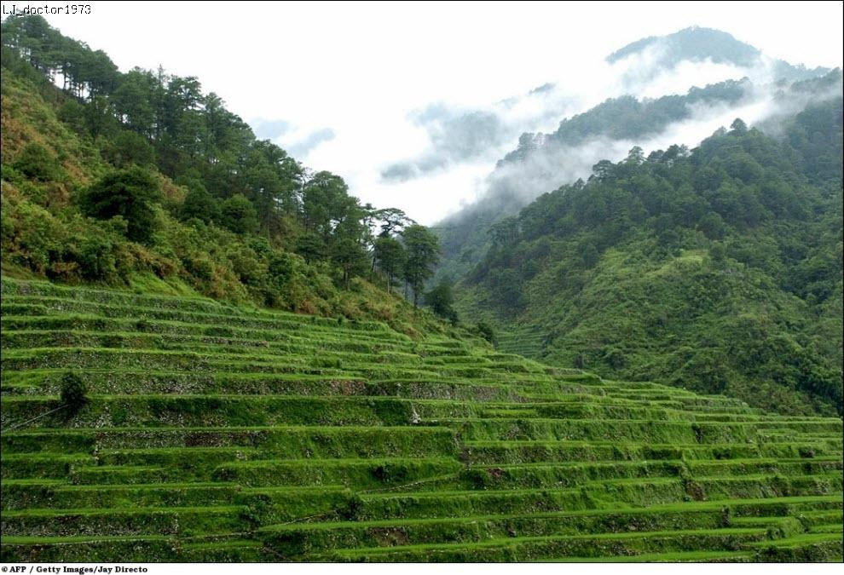

Slide 2
A nation that destroys its soil destroys
itself. Forests are the lungs of our lands,
purifying the air and giving fresh strength
to our people.
Franklin D Roosevelt, American president

Slide 3
Lesson vocabulary
Nouns Verbs
An environment 9. To pollute
Pollution 10.To cause
Destruction 11. To dump
A shortage 12.To poison
Waste 13. To survive
Poison 14. To save
A weapon 15. To solve
The greenhouse effect 16. To protect

Slide 4
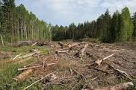

Slide 5
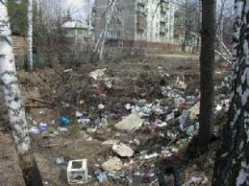

Slide 6
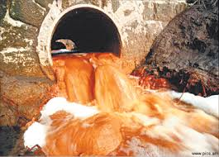

Slide 7
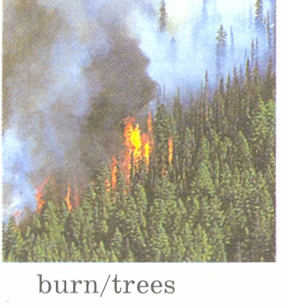

Slide 8
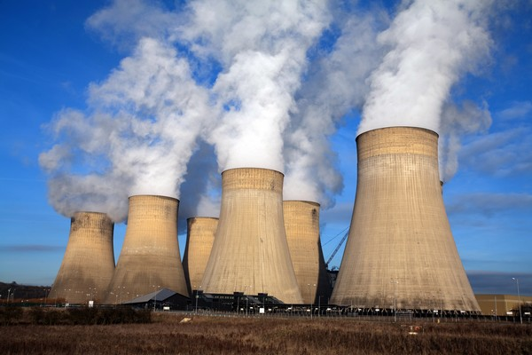

Slide 9
1.Something that kills people or animals if it is swallowed.
2. A place where rubbish is left.
3. Something that is used to kill or hurt people in a fight or a war.
4. Making water, air, atmosphere dirty and dangerous for people and animals to live in.
5. A situation where there is not enough of something.
6. Material which was used and is no longer wanted.
7. This word means simply what is around us.
8. The thing which we breath in.
9. The thing which we breath out.
10. A natural process that warms the Earth's surface.

Slide 10
clean water / protect forests /
take care of animals and birds/ ask our government to make laws to protect Nature / grow trees, flowers/
clean the place we live / use alternative sources of energy if it is possible/ built more recycling plants to solve the problem of litter / walk or use a bicycle instead of going by car/ develop international cooperation to solve ecological problems together.

Slide 11
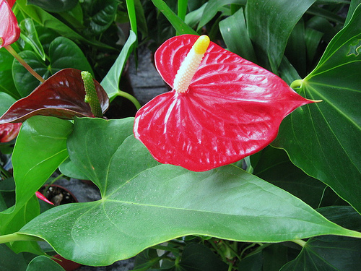

Slide 12
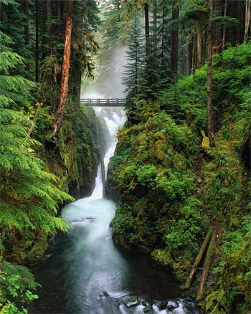

Slide 13
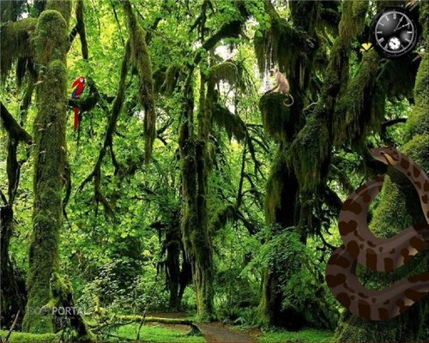

Slide 14
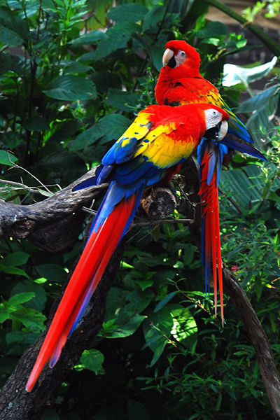

Slide 15
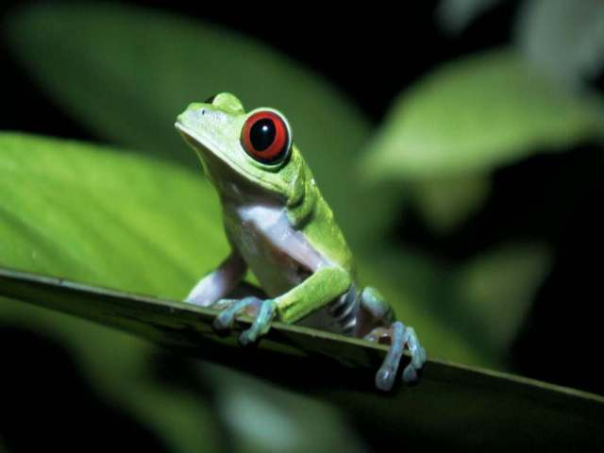

Slide 16
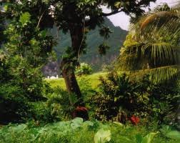

Slide 17
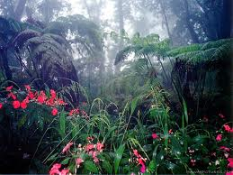

Slide 18
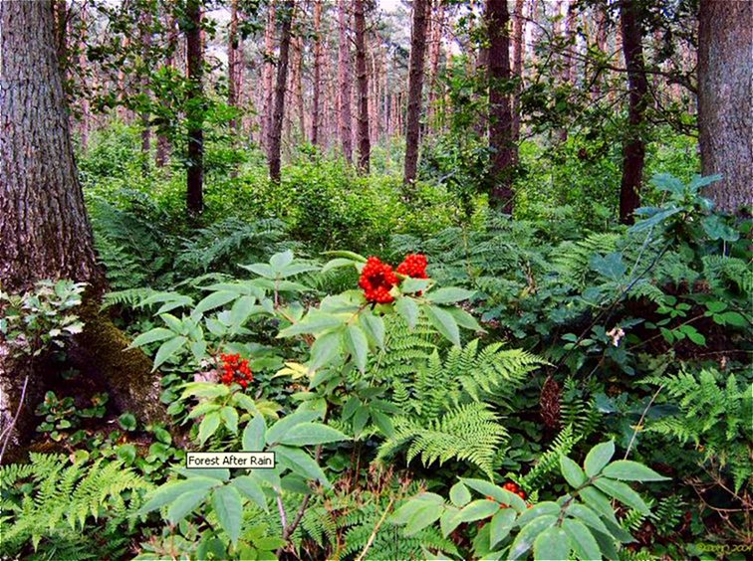

Slide 19
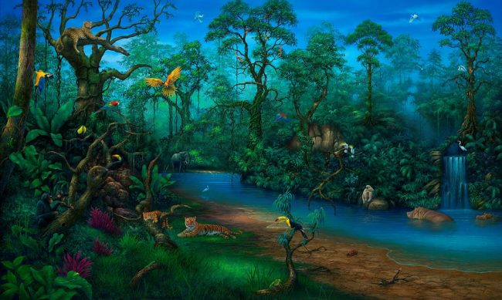

Slide 20
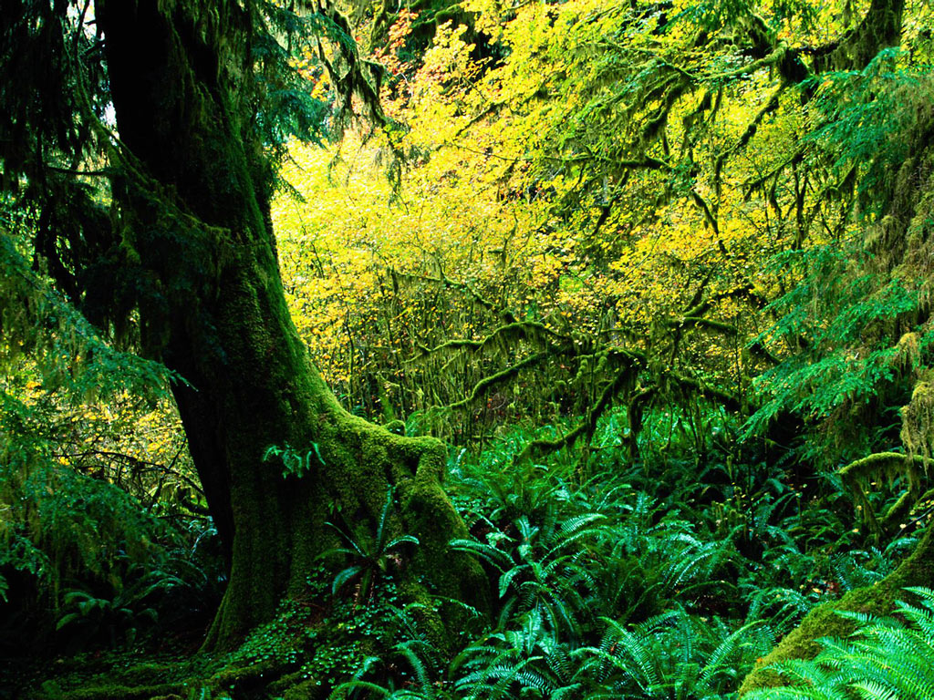

Slide 21
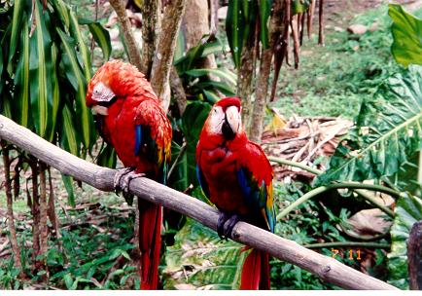

Slide 22
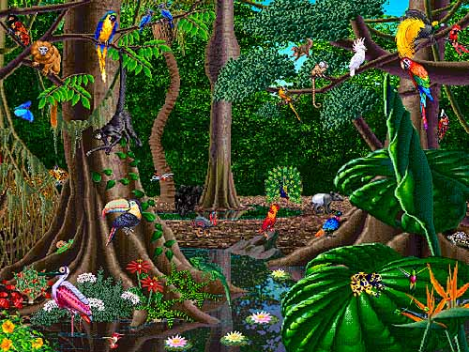

Slide 23
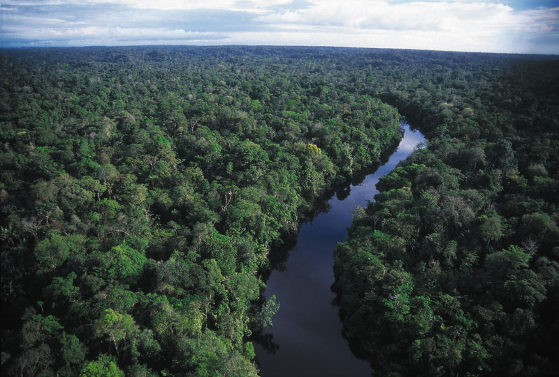

Slide 24
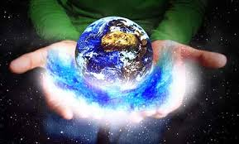
SAVE THE WORLD!

