Slide 1
Can

Slide 2
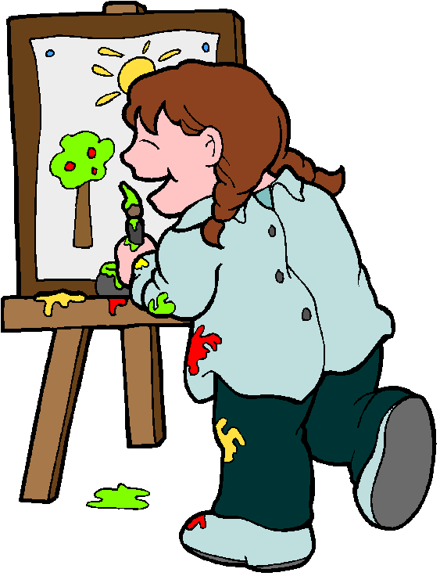
She can paint.

Slide 3
She can jump.

Slide 4
She can skip.

Slide 5
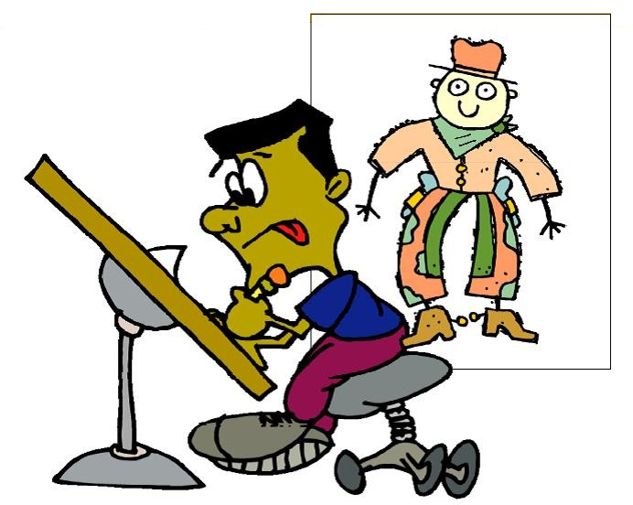
He can draw.

Slide 6
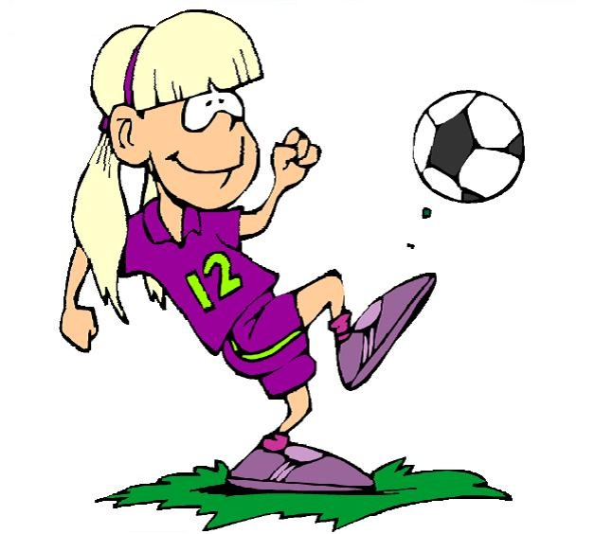
She can play football.

Slide 7
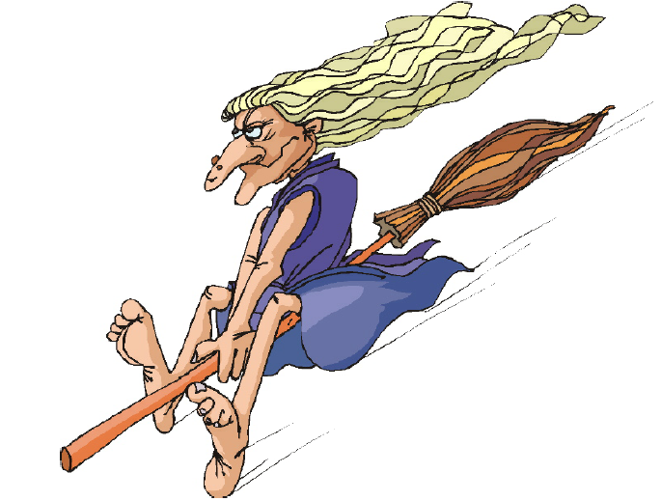
She can fly.

Slide 8
He can read.

Slide 9
She can dance.

Slide 10
He can skate.

Slide 11
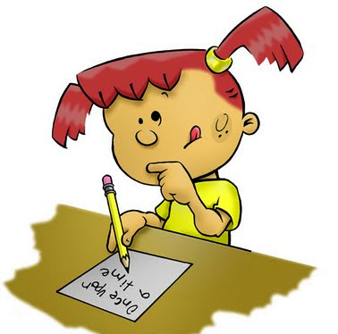
She can write.

Slide 12
She can play basketball.

Slide 13
He can play badminton.

Slide 14
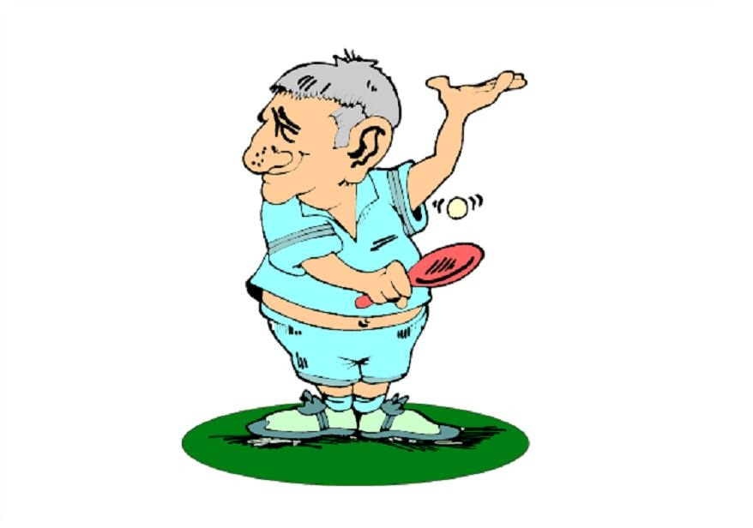
He can play table tennis.

Slide 15
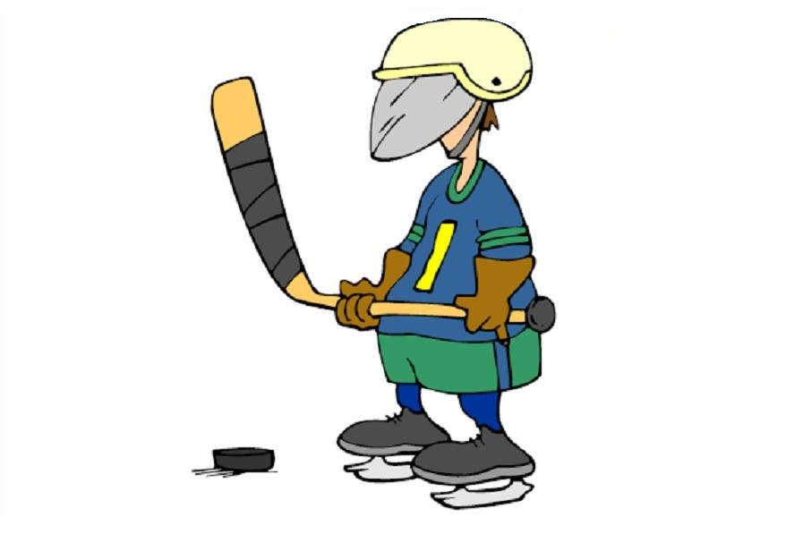
He can play hockey.

Slide 16
She can sing.

Slide 17
He can speak English.

Slide 18
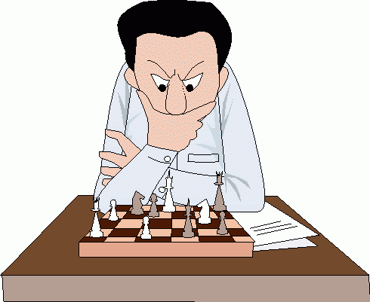
He can play chess.

Slide 19
He can sit.

