Slide 1
theme: Describing people – Appearance.
October, 23
lesson 12

Slide 2
Цель занятия:
Повтор изученного лексического и грамматического материала;
Изучение новой лексики: Describing people – appearance (Описание людей – внешность);
Закрепление нового лексического материала.

Slide 4
ex. 13.3.3 (p. 184) – the text "Jane's letter"
Explanations for the growth of violence:
1) the possibility to buy any kind of weapons at gun shops everywhere in the US;
2) the growth of using drugs;
3) the propaganda of violence by mass media and especially television and films;

Slide 5
ex. 13.3.4 (p. 184) – grammar exercise
1) The student is being examined. Don’t enter the room.
is
being
V-ed
Present Continuous, Passive
Студента экзаменуют.
Не входите в комнату.

Slide 6
2) The students are examined twice a year.
are
V-ed
Present Indefinite, Passive
Студентов экзаменуют дважды в год.

Slide 7
3) The paper was published yesterday.
was
V-ed
Past Indefinite, Passive
Газета была издана вчера.

Slide 8
4) The paper has been published already.
has
been
V-ed
Present Perfect, Passive
Газета уже издана.

Slide 9
5) The paper had been published by 7 o’clock yesterday.
had
been
V-ed
Past Perfect, Passive
Газету издали вчера к 7 часам.

Slide 10
6) The paper was being published at this time yesterday.
was
being
V-ed
Past Continuous, Passive
Газету издавали в это время вчера.

Slide 11
7) The letter will be sent tomorrow.
will
be
V3
Future Indefinite, Passive
Письмо будет отправлено завтра.

Slide 12
8) The letter will have been sent tomorrow by 7 o’clock.
will
have
been
V3
Future Perfect, Passive
Письмо отправят завтра к 7 часам.

Slide 13
 | Indefinite | Continuous | Perfect
Present | 2 | 1 | 4
Past | 3 | 6 | 5
Future | 7 |  | 8

Slide 14
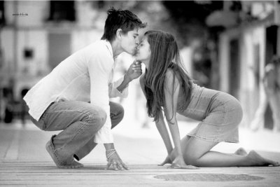
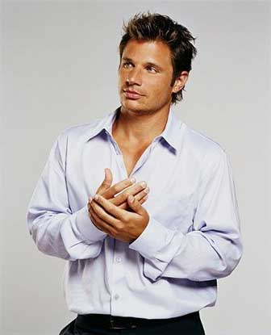
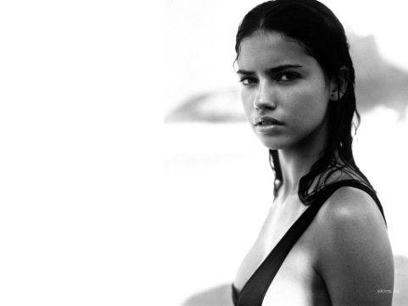
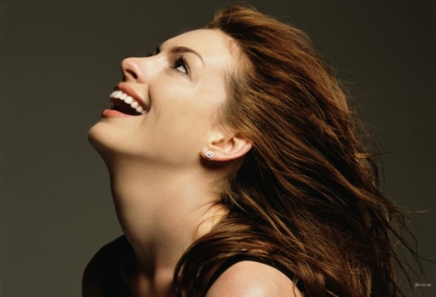
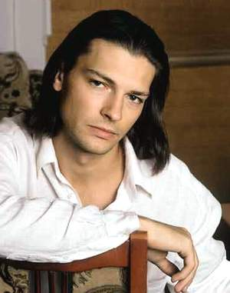
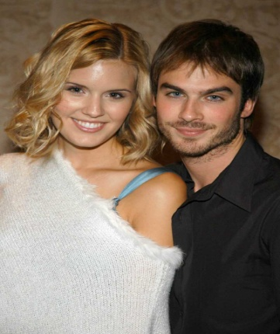
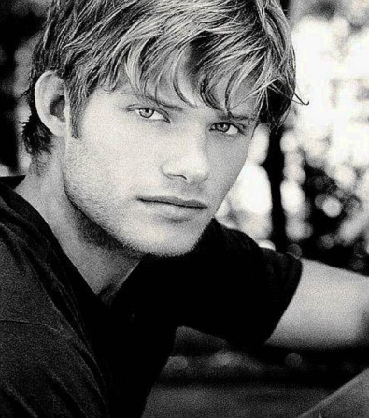
Describing people – appearance
We are different in the this world

Slide 15
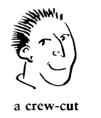
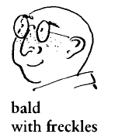
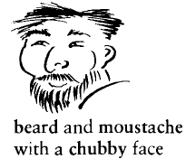
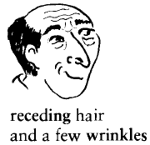
Hair, face, skin, complexion:

Slide 16
Hair, face, complexion:
straight – прямой
wavy – волнистый
curly – кудрявый
bald – лысый
receding (hair) – выпадающие (волосы)
beard – борода
moustache – усы
thin – faced – с худым лицом
round – faced – круглолицый
chubby - faced – полнощекий, скуластый
freckles – веснушки
wrinkles – морщины
blond – блондин (ка)
fair – белокурый
auburn – темно-рыжий
ginger-haired – рыжеволосый (медный)

Slide 17
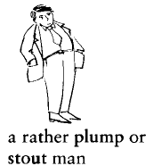
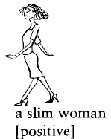
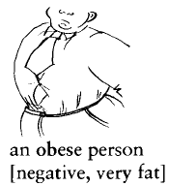
Height and build

Slide 18
Height and build
plump – полный
stout – дородный, тучный
fat - толстый
slim – стройный
obese – страдающий ожирением
a bit overweight – немного полный
stocky – коренастый
well – built – хорошо сложенный
anorexic – анорексик, страдающий отсутствием
аппетита

Slide 19
General appearance:
smart – изящный
elegant – элегантный
well – dressed – хорошо одетый
scruffy – неряшливый
untidy – looking – неопрятно выглядящий
good – looking – привлекательный
unattractive – непривлекательный
! beautiful (woman) – красивая (женщина)
! handsome (man) – красивый (мужчина)

Slide 20
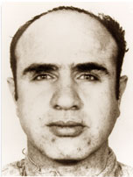

Slide 21
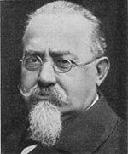

Slide 22
Wanted! Missing!
He is the best-known of all American gangsters. His home ground was Chicago. He seized his chance when prohibition was declared in 1920, which made the manufacture and sale of alcohol illegal in America.
A fierce and vicious man, he was responsible for many gangland killings, including the 1929 St. Valentine’s Day Massacre, in which seven rival “bootleggers” (men selling illicit liquor) were trapped by gunmen dressed as police and machine-gunned to death.
He was imprisoned in 1931 on income tax charges, became a model prisoner and was released in 1939.

Slide 23
An Italian, is regarded as the father of the scientific study of criminals, or criminology.
In an enormous book called “The Criminal”, he set out the idea that there is a definite criminal type, who can be recognized by his or her appearance. Some of what he said is difficult to believe. For example, he said that left-handed persons have a criminal instinct. Among the things he considered important were the shape of the head, colour of the hair, the eyes, the curve of the chin and forehead and if the ears stick out.
His ideas were very new at the time and, although not altogether correct, caused a lot of interest and made other people look into the problem of crime in a more scientific way.

Slide 24
Задание для самостоятельной работы во внеурочное время:
Learn by heart new words : “Describing people – Appearance”
Describe one of your groupmates for recognizing

Slide 25
Good Luck!

