Slide 2
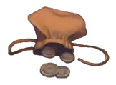

Slide 13
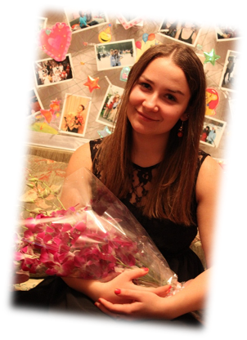
Careographers:
Ksenia Belina
Ekaterina Karpuhina

Slide 14
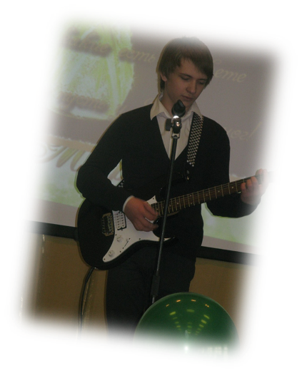
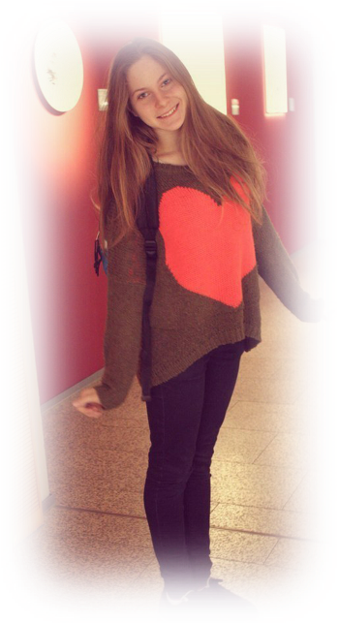
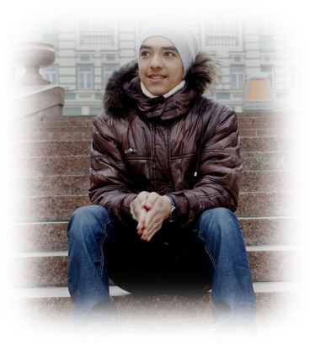
At cast:
Della - Alena Sulimenko
Jim – Dmitry Shulgin
Shop assistant 1 - Sasha Kosterina
Shop assistant 2 - Nikita Arumugam

