Slide 1
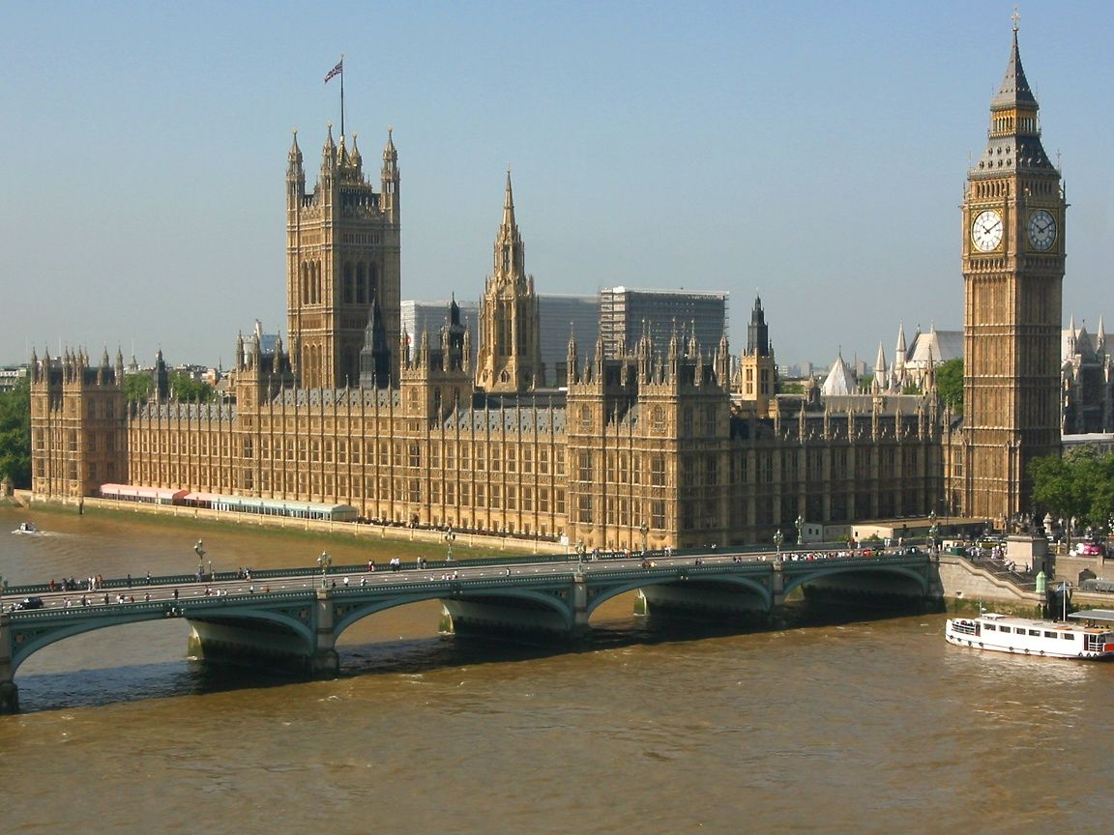

Slide 2
The Houses of Parliament

Slide 3
The Magna Carta
The Magna Carta was an agreement between the King and his barons. It limited the King’s power.

Slide 5
Here are some mistakes that some people make about the British state and its Parliament. Correct these mistakes using the expressions of disagreeing and generalizing.
e.g. Many people think, everybody says that, but in fact, but actually, in reality, but don’t forget.
1. The Queen chooses the Prime Minister.
2. There is a general election when the Queen decides.
3. Before the bill becomes a law the Queen has to say “The Queen wishes it.” The Queen uses English as a part of tradition.
4. The members of the House of Lords and the House of Commons are called MPs.
5. The Prime Minister is the head of state.
6. Members of the House of Lords form the British government.

Slide 6
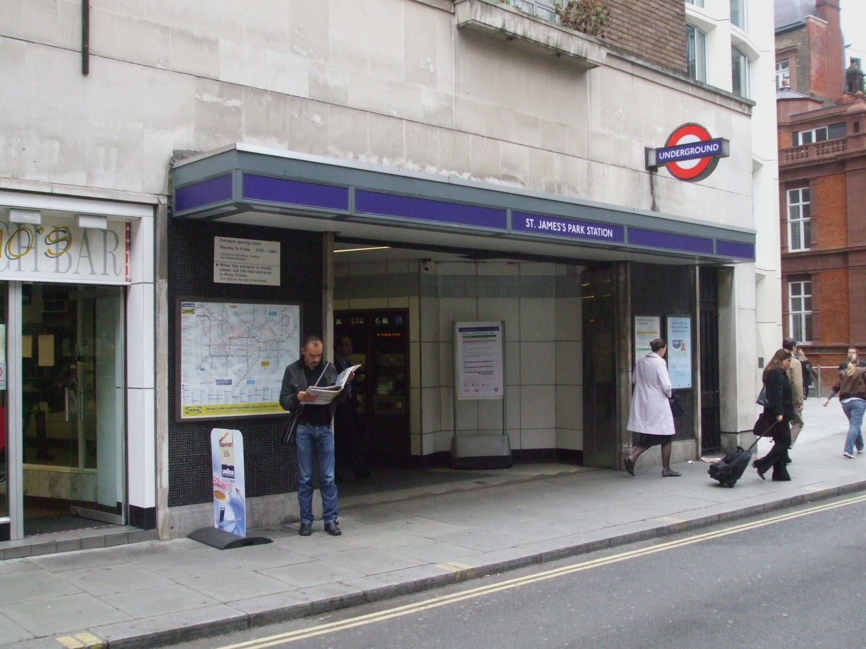

Slide 7
The Royal Gallery

Slide 8
The Queen’s Robing Room

Slide 9
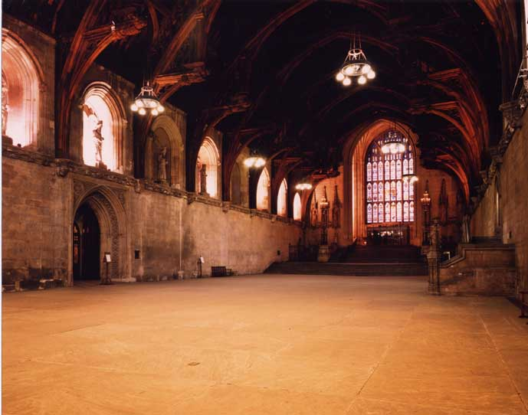
Westminster Hall

Slide 10
The House of Lords

Slide 11
The famous Woolsack

Slide 12
The archway with two statues of Sir Winston Churchill and David Lloyd George

Slide 13
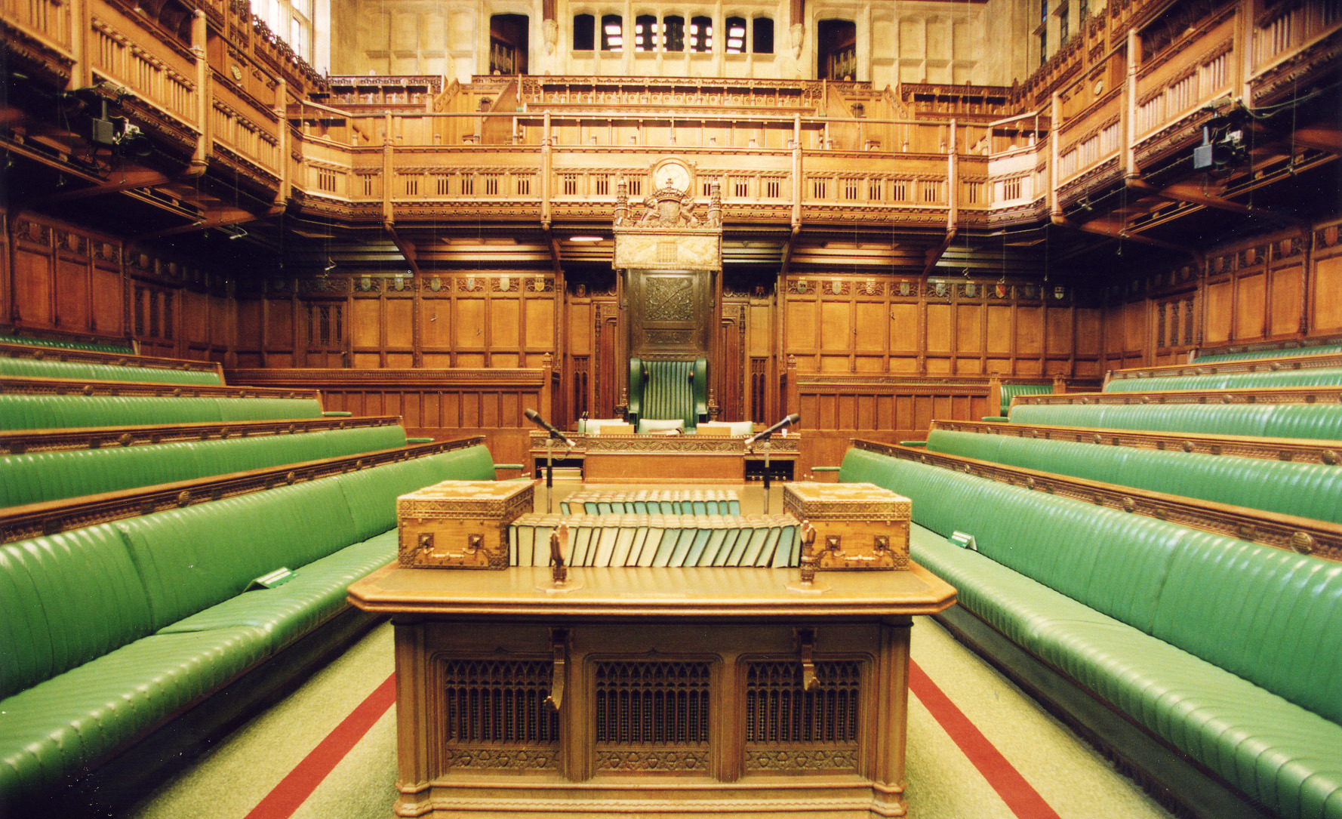
The Chamber of the House of Commons

Slide 14
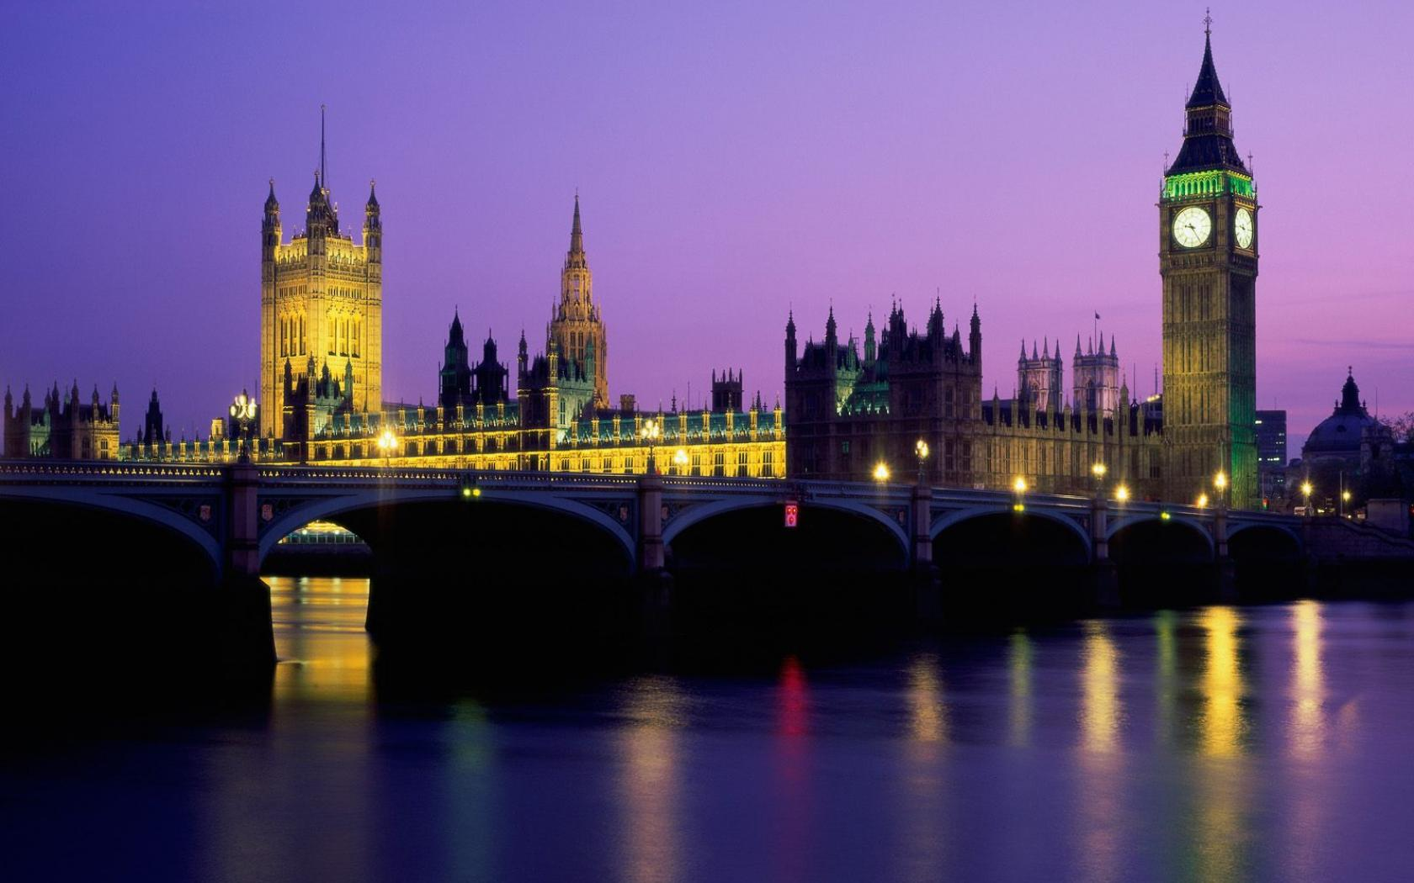

Slide 15
What have we done today?
Have/has +Ved/3
- to talk about the British Parliament
- to listen to the text about Big Ben
- to do the quiz
to visit the Houses of Parliament

