Slide 1
BOOKWORMS
People who read a lot of books

Slide 2
Why do people read book?
A book holds a house of gold.
Chinese Proverb

Slide 3
What genres do you know?
Legend
Fairy tale
Myth
Humorous story
History
Biography
Poem
Comedy
Adventure
Suspense story
Mystery
Drama
Science fiction
Novel

Slide 4
QUIZ! Ex.1, p16. Work in pairs. You have 5 minutes.
B
C
A
A
C
B
Mistakes:
0 Excellent!!!
1 Very good!
2 Not bad!
3-4 What’s a pity!

Slide 5
Listening for gist What famous authors and characters is it about?

Slide 6
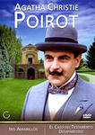
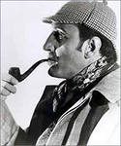
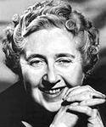
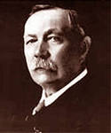
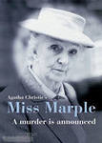
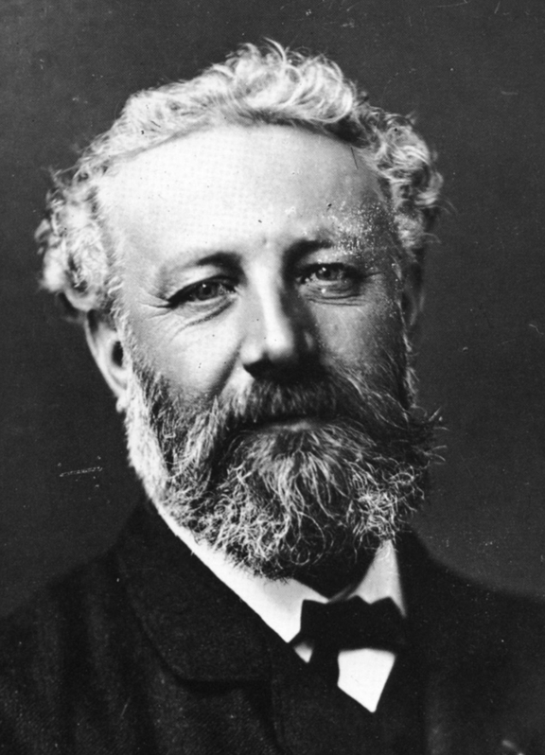
Famous authors and their characters

Slide 7
Reading for specific information
Ex.2, p.16 Work in pairs. You have 5 minutes.

Slide 8
Famous authors and their characters

Slide 9
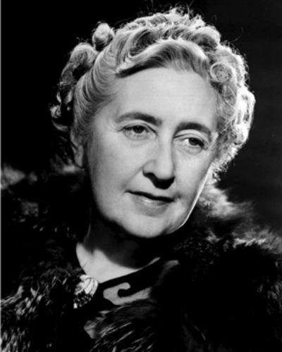
The famous author
Agatha Christie
born: 15.09.1890
Devon, England
died: 12.01.1976
famous for 60 crime novels
characters: Ms. Marple, Hercule Poirot
nickname: the ‘Queen of Crime’
9

Slide 10
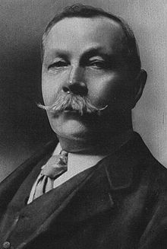
The famous author
Sir Arthur Conan Doyle
born: 22.05.1859
Edinburgh, Scotland
died: 07.07.1930
studied medicine at University of Edinburgh
famous for his crime fiction stories
characters: Sherlock Holmes, Dr. Watson
10

Slide 11
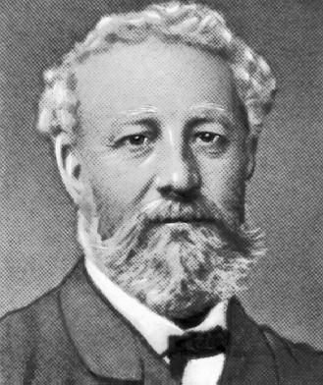
The famous author
Jules Verne
born: 08.02.1828
Nantes, France
died: 24.03.1905
loved the sea, had the great imagination,
famous for his 55 science fiction and adventure stories
character: Captain Nemo
11

Slide 12
Answer the questions:
Who solves crimes with a partner?
Who always wants to be neat and tidy?
Who doesn’t look like a detective?
Who travels in a submarine?
Who was called the ‘Queen of Crime’?
Who wrote the adventure novels?
12

Slide 13
Find the synonyms from the text
well known
unusual
amazing
clever
ordinary
loyal

Slide 14
Check the answers
well known - famous
unusual - strange
amazing - extraordinary
clever - intelligent
ordinary - typical
loyal - faithful
Use the adjectives to describe the
characters.

Slide 15
Write an article for your school newspaper about your favourite author
Write about your favourite author:
where he/she was born
what he/she did before writing
what famous character(s) he/she wrote about
what the famous character(s) are like
Your homework: Ex. 9, p. 17

Slide 16
Интернет-ресурсы:
www.prosv.ru/umk/spotlight
www.agendaweb.org/listening/audiobooks.html
http://en.wikipedia.org/wiki/Agatha_Christie
http://en.wikipedia.org/wiki/Arthur_Conan_Doyle
http://ru.wikipedia.org/wiki/Jules_Verne
http://office.microsoft.com/ru-ru/images/

