Slide 1
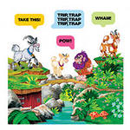
THE STORY OF THE THREE GOATS

Slide 2
Речевая разминка
I’ve got a goat Such clever tricks
His name is Jack My goat can do
His head is white. I love my goat
His nose is black. He loves me too!
I take him out
Every day.
Such fun we have!
We run and play.

Slide 3
New words
tip-toe – идти на цыпочках
horn – рог
hit – ударил
fell – упал
stick - палка

Slide 4
Complete the sentences
Big Goat looked at his two brothers …
The three Goats took the long stick …
He had …
Big Goat went to the bridge …
Troll got …
We can help you …
Big Goat started …

Slide 5
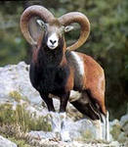
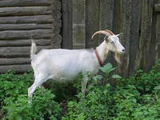
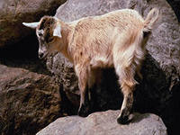
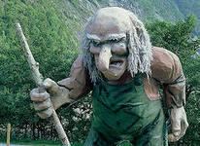

Slide 6
Who said the following
It looks very good. We can’t eat it. He is eating the long green grass! Can you see the bridge? We can help you, Troll, if you let us cross your bridge every day. Who is crossing my bridge? Please let me cross your bridge. Thank you very much. He can’t stop me. Look at our little brother. | Big Goat Little Goat Middle Goat Troll

Slide 7
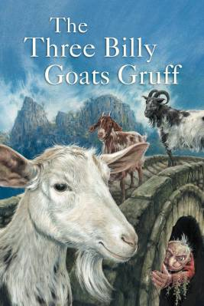

Slide 8
Thank you for attention

