Slide 1
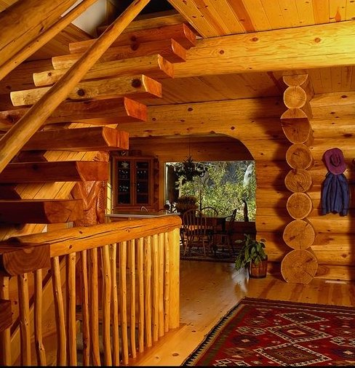
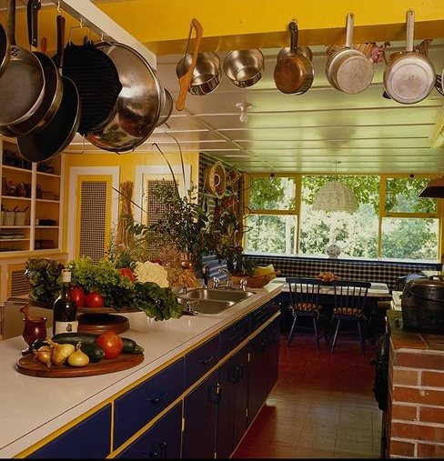
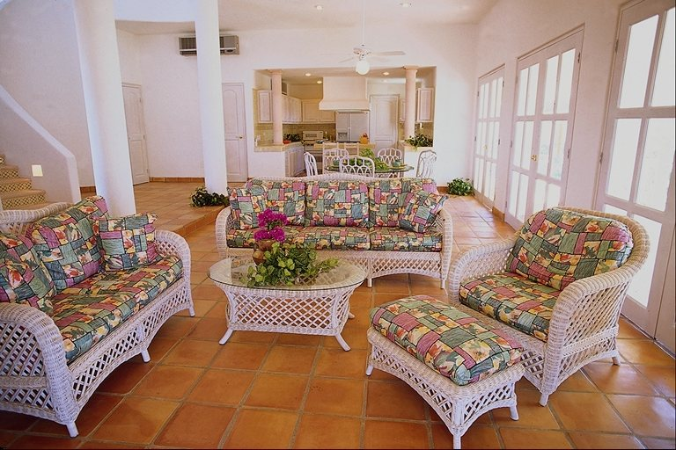
M y h o m e
i s m y c a s t l e

Slide 2
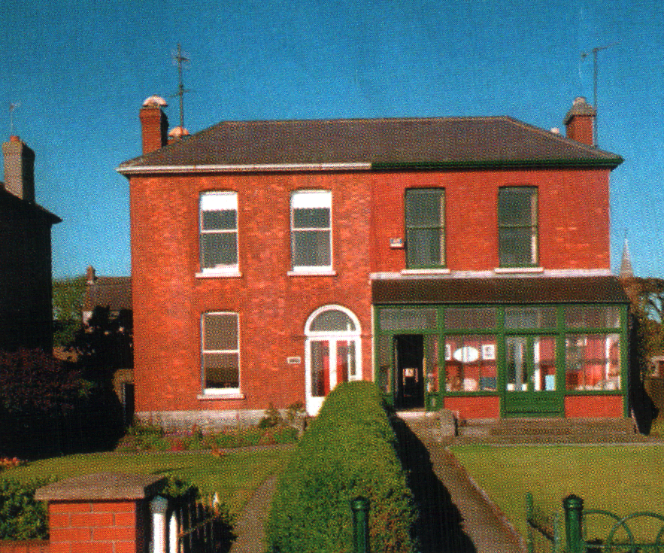
Semi-detached house

Slide 3
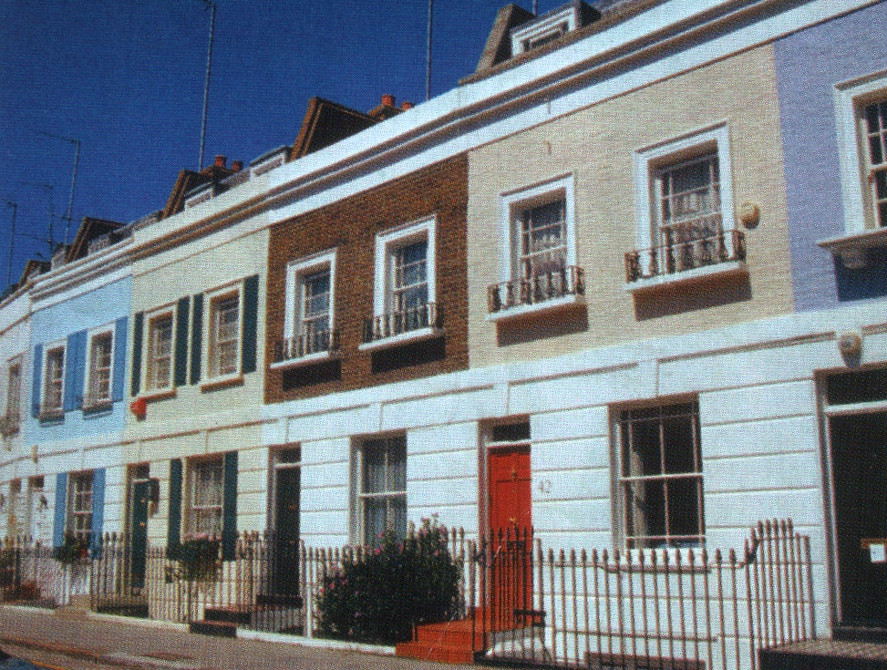
Terraced house

Slide 4
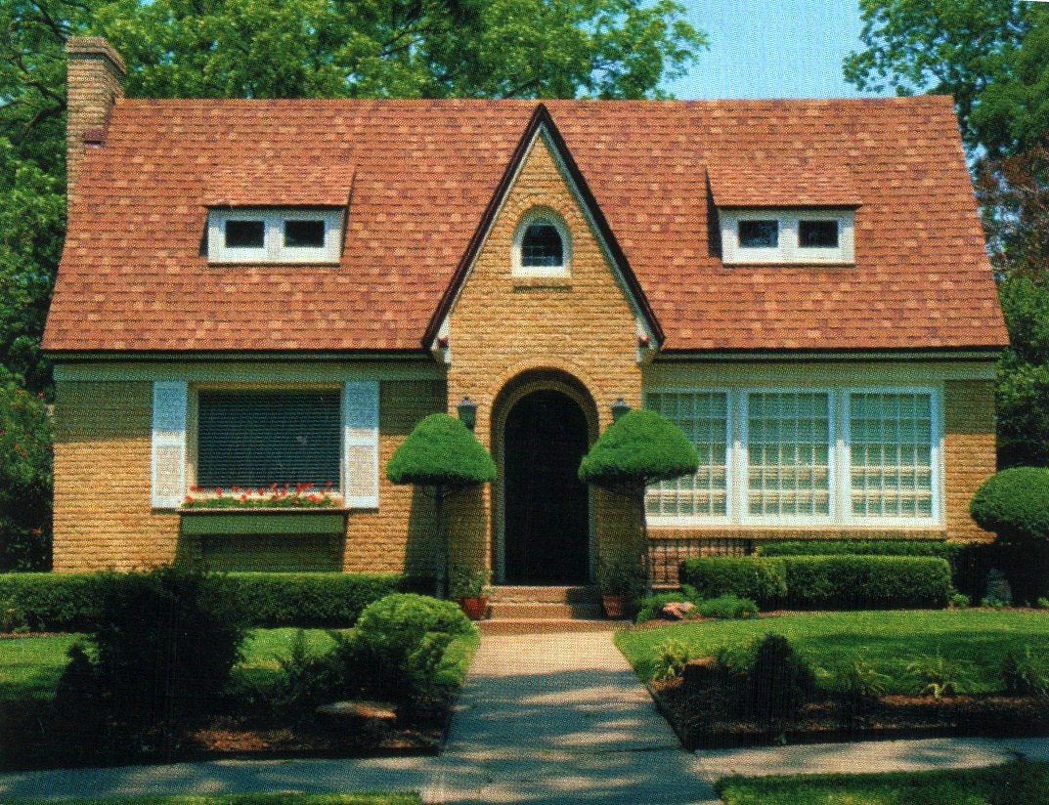
Detached house

Slide 5
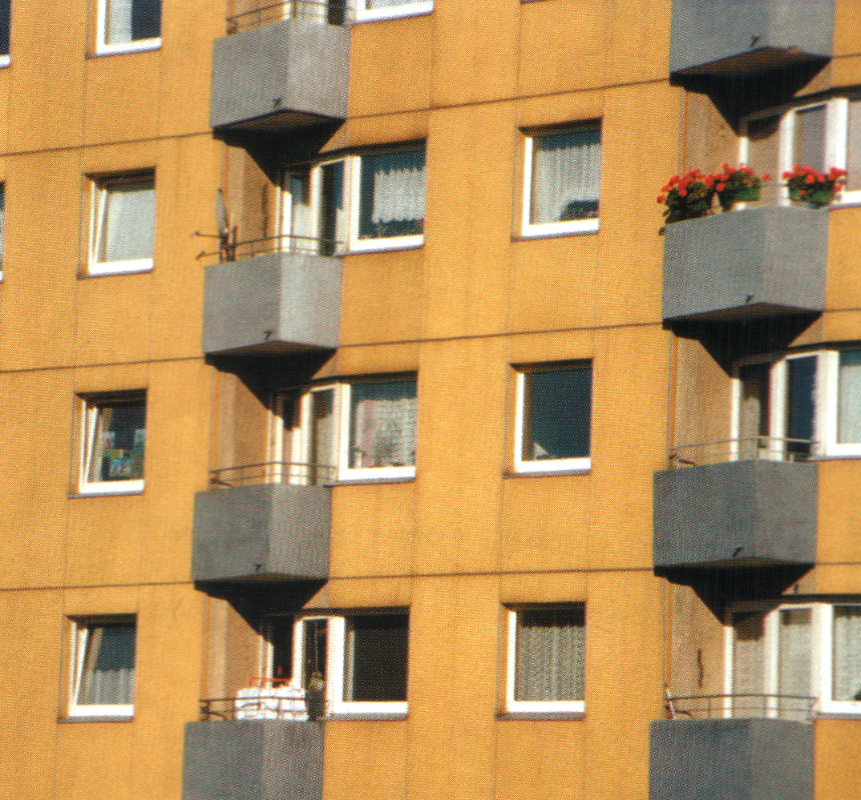
Flats

Slide 6
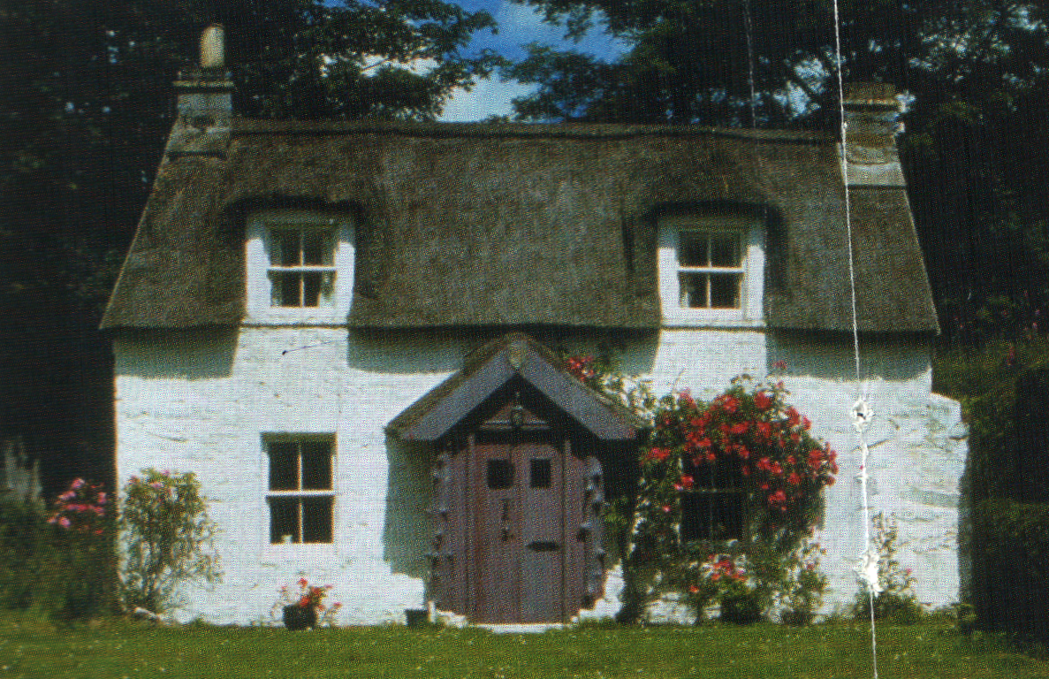
Cottage

Slide 7
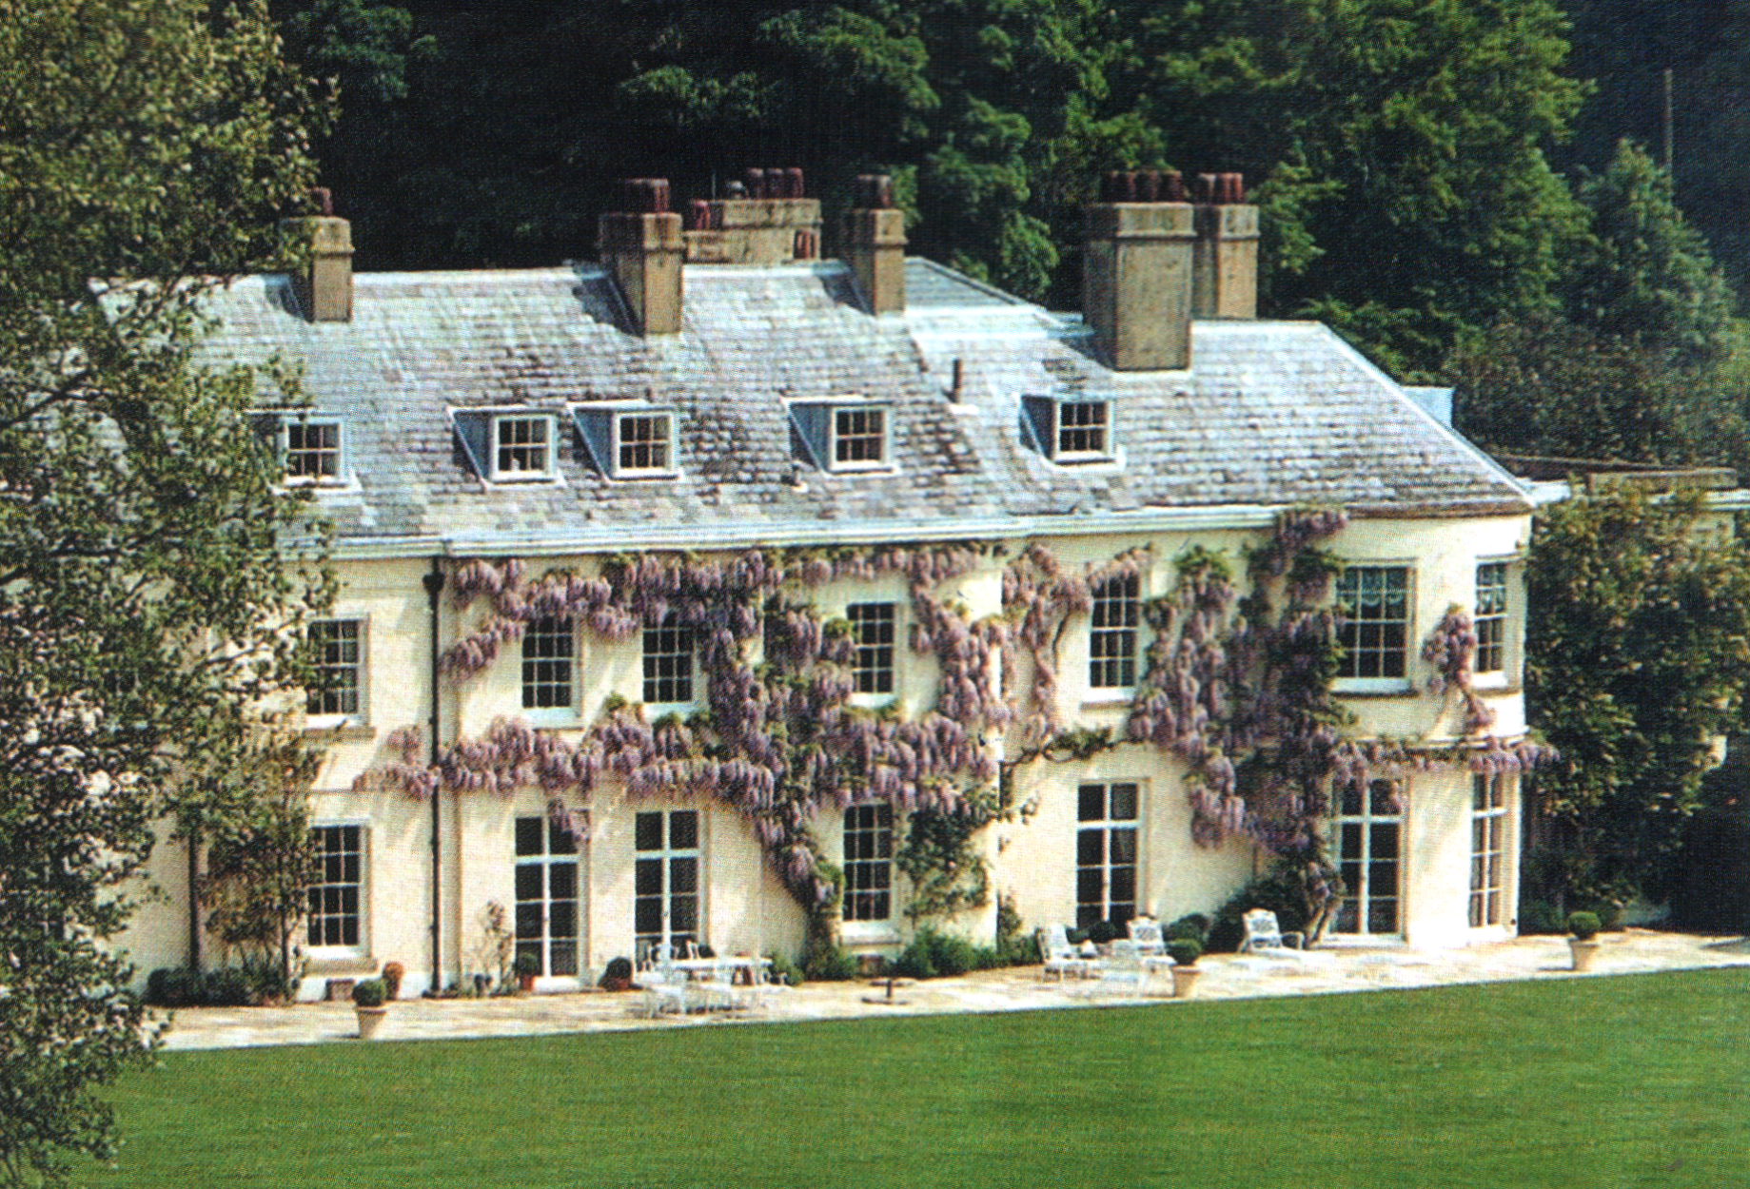
Madonna’s house

Slide 8
A detached [dı’tæt∫t] house A semi-detached [,semıdı’tæt∫t] house A flat A cottage [‘kotıdз] A terraced [‘terәst ] house | Big - Small Old - Modern Light - Dark Nice Beautiful Comfortable Wood Brick Concrete | A green lawn A garden with trees and flowers Neighbour [‘neıbә]
I’d like to live in the … because … It is … It has … It is made of …

Slide 9
What kinds of houses are there in Britain else?
Have British got gardens near their houses?
Do they love pets?

Slide 10
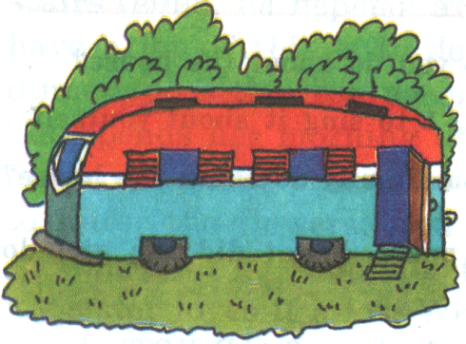
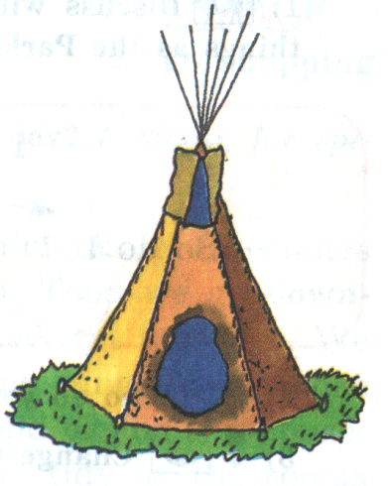
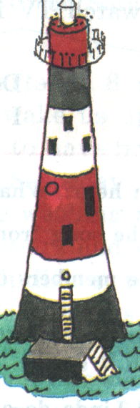
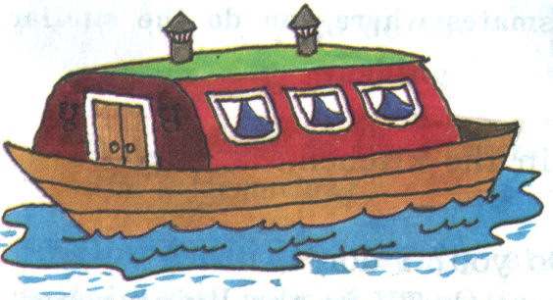
A bungalow [‘b۸ŋg әlәυ]
A mansion [‘mæn∫n]
A castle [‘k۸sl]
A caravan [,kærә’væn]
A teepee [‘ti:pi:]
A lighthouse [‘laıthaus]
A (house)boat [‘bәυt]

Slide 11
GOOD JOB!
Choose a smile for your own according to your work at the lesson.
Be objective!
I did all my best! Excellent!
I tried as much as I could.
Rather good!
I should learn English better!
Not very well…

